Slide 1
Gastrointestinal I laboratory
MHD II
1/5/2018

Slide 2
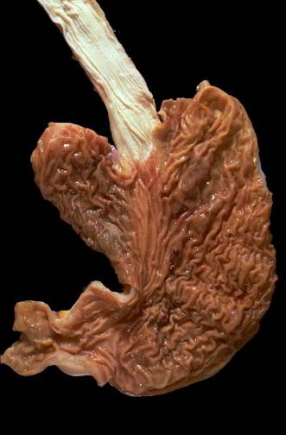
Case 1
Identify and describe the gross findings of the following anatomic regions:
Esophagus
Gastroesphageal junction
Gastric cardia
Gastric fundus
Gastric body
Gasrtic Antrum
Pylorus

Slide 3
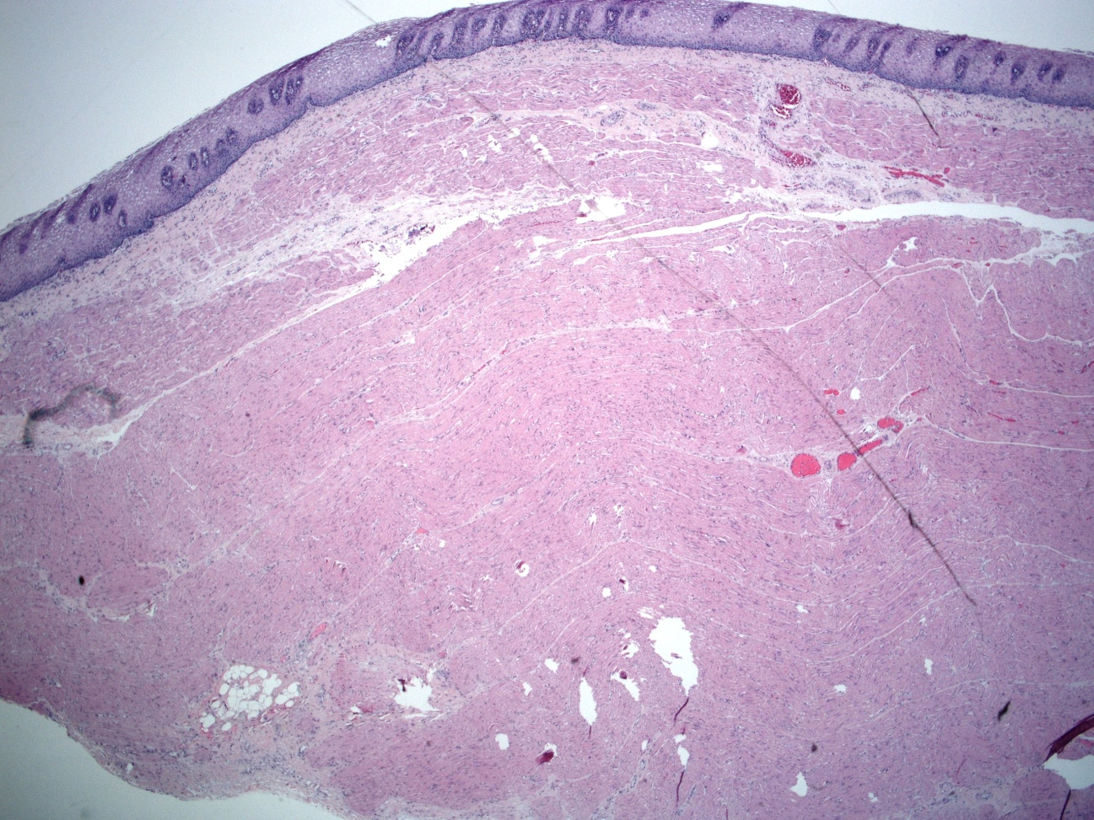
Case 1
Name the organ. Name the layers A-D
A
B
C
D

Slide 4
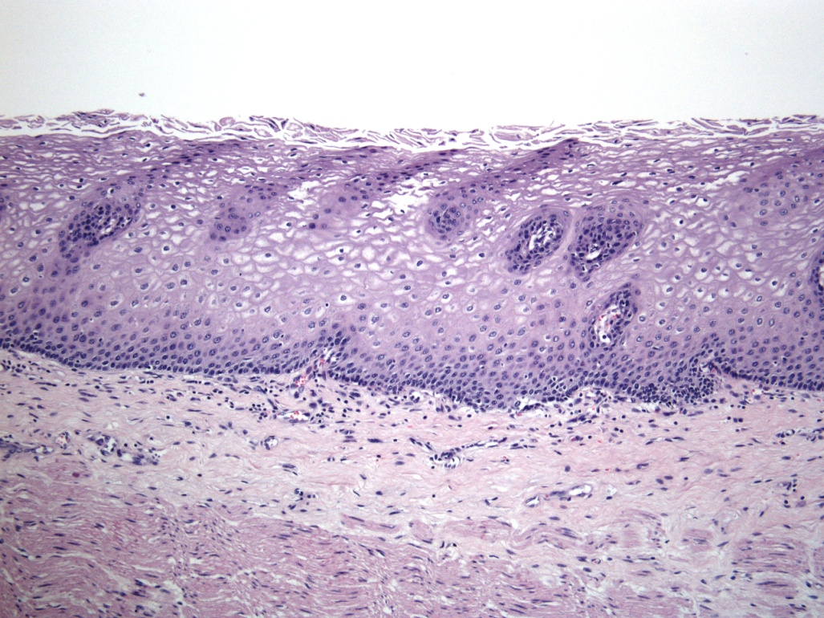
What do F, G and H designate?
Case 1
High power of layer “A” from previous slide
F
G
H

Slide 5
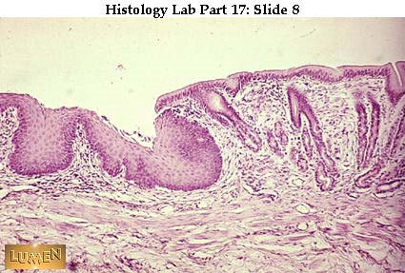
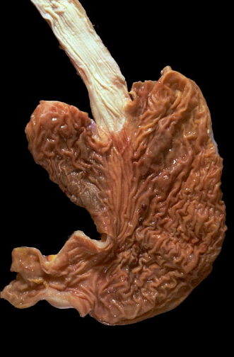
Correlate the histology with the gross image. Describe the mucosa
Case 1

Slide 6
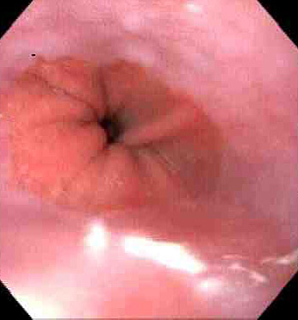
Case 1
Describe the findings seen in this endoscopic photo of the G-E
junction and correlate to the normal histology.
Image Source – Utah Web Path –
The Internet Pathology Laboratory for Medical Education

Slide 7
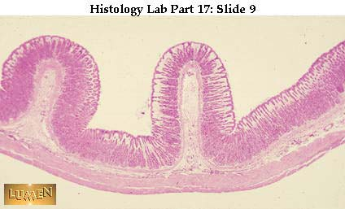
Name the organ. Describe the low power findings. Identify the mucosa, muscularis mucosa, submucosa, muscularis externa and serosa
Case 2

Slide 8
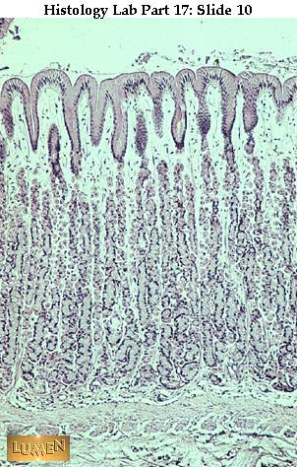
Case 2
Gastric Fundus
Identify the surface mucous cells,
gastric pits and fundic glands.
What is the function of the surface
mucous cells?

Slide 9
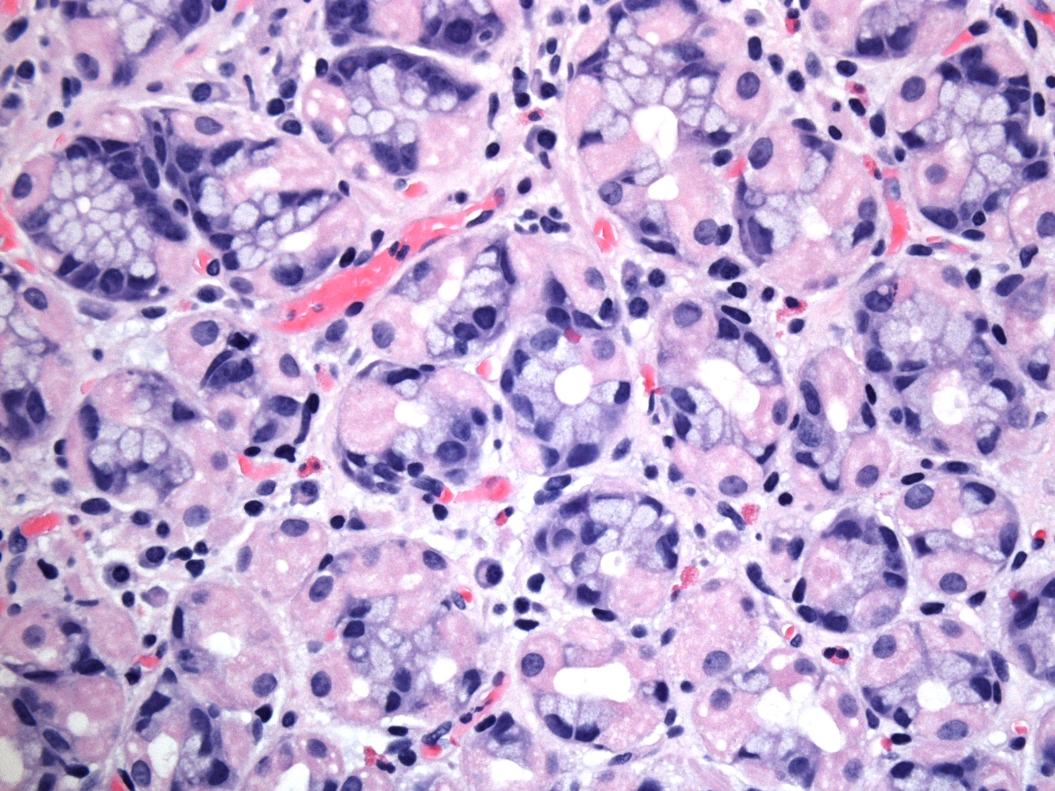
Case 2
Identify and describe the function of the cells represented by A and B.
A
B

Slide 10
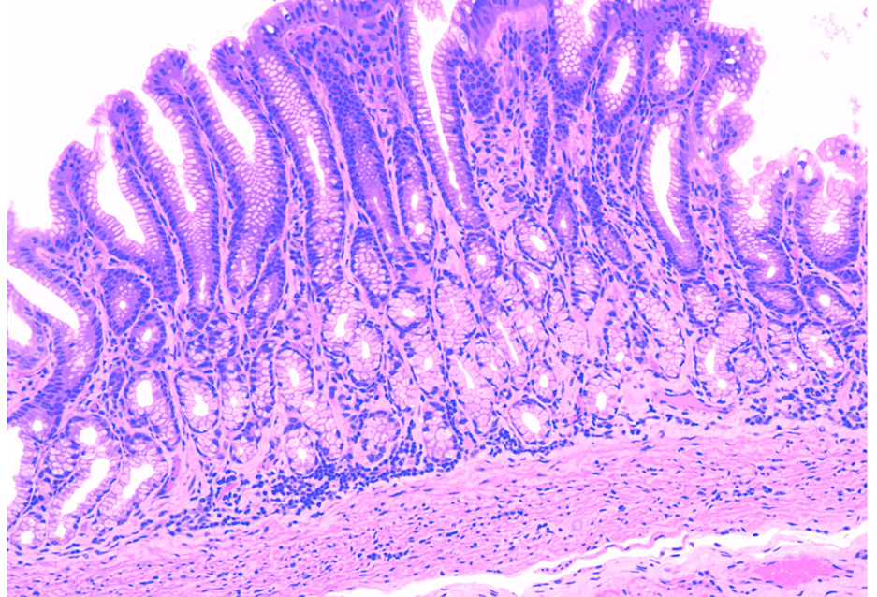
Case 2
Gastric Pylorus
Identify the gastric pits and the pyloric glands.
What cell type is predominant in the Pyloric glands? What is its function?

Slide 11
Case 3
HISTORY:
A 65 year-old man has a burning pain which begins in his epigastrium and travels up into his chest. The pain seems worse post-prandially or in a supine position. He says he frequently has a “sour” taste in his mouth and feels better after taking an antacid. He has had these symptoms for several years.
PHYSICAL EXAMINATION:
Vital signs: BP 130/90, HR 90/min, RR 18/min, T 98°F
The patient is obese. He uses his hand to indicate the area of burning pain in his upper abdomen extending into his chest.
The abdomen is soft and non-tender with no palpable masses or organomegaly.
Rectal exam is done: stool is brown and occult blood negative.

Slide 12
Case 3
Develop a differential diagnosis for this patient’s problem. Which diagnosis do you favor?
Are there recommendations for drug therapy and/or non-drug therapy you would relay to the patient?
What are potential complications of this disease process?

Slide 13
Case 3
The patient’s symptoms initially improve with your recommendations.
After several years his symptoms recur. His physician recommends upper endoscopy (esophagoduodenoscopy – EGD).

Slide 14
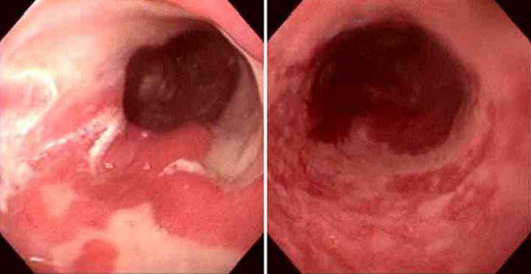
Describe the endoscopic findings and contrast to the normal esophagus.
Case 3
normal
Image Source – Utah Web Path - The Internet Pathology Laboratory for Medical Education

Slide 15
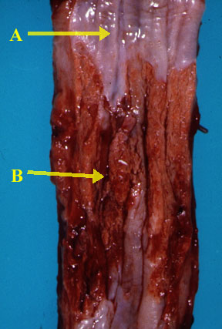
Case 3
Describe the gross exam findings from an autopsy performed on a patient with the same disease. What do “A” and “B” indicate?

Slide 16
Case 3
Describe the histologic findings. What cell type is depicted by the arrows?
normal

Slide 17
Case 3
Correlate the gross findings with the histologic changes.
What is your diagnosis?

Slide 18
Case 3
What complication(s) can occur as a result of this disease process?

Slide 19
Case 4
CHIEF CONCERN: “Food sticks in my throat when I swallow.”
HISTORY:
A 72 year-old man has developed dysphagia which gradually progressed from solids to soft foods then to liquids. He has fatigue and a 20 lb weight loss over 6 months.
He has a 30 pack year smoking history and a history of heavy alcohol use but stopped both 10 years ago.
PHYSICAL EXAMINATION:
BP 140/80, HR 85/min, RR 19/min, T 98°F
Patient is alert, extremely thin. He has enlarged, firm, fixed cervical lymph nodes. The remainder of the physical examination is unremarkable.

Slide 20
Case 4
Develop a problem list
Formulate a differential diagnosis for this set of problems

Slide 21
Case 4
EGD is recommended but the patient is hesitant to undergo it. A barium swallow is performed.

Slide 22
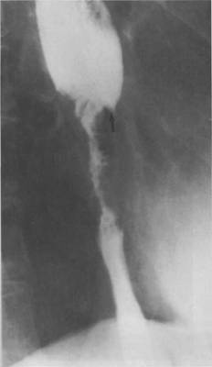
Case 4
What is a barium swallow?
What are the findings of the patient’s study?

Slide 23
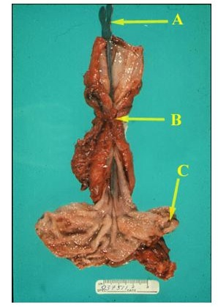
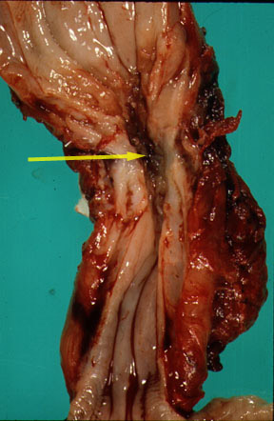
Case 4
Specimen A. Describe the gross findings . Correlate the findings with the barium swallow.
Probe

Slide 24
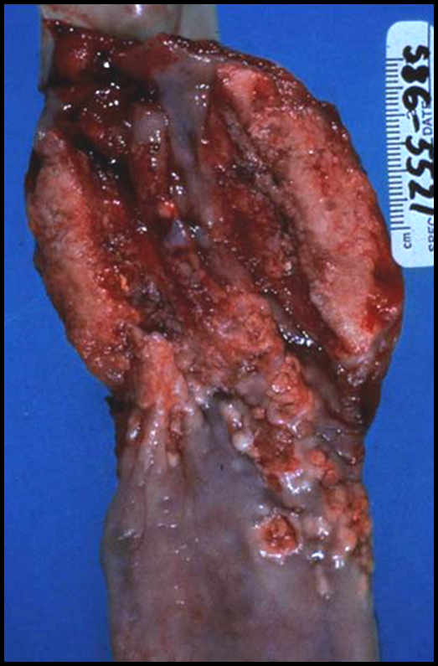
Specimen B. Describe the gross findings. Correlate the findings with the barium swallow.

Slide 25
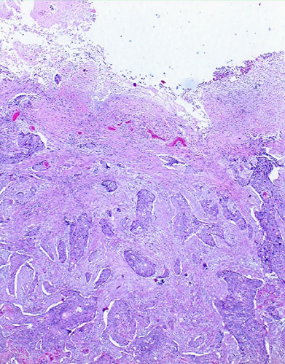
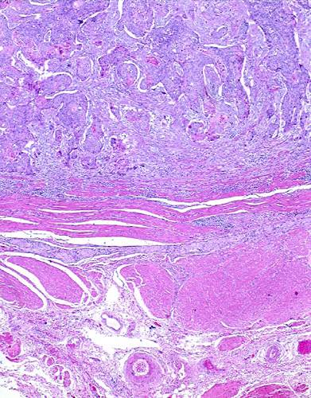
Describe the histologic findings.
Case 4
Low power
Low power

Slide 26
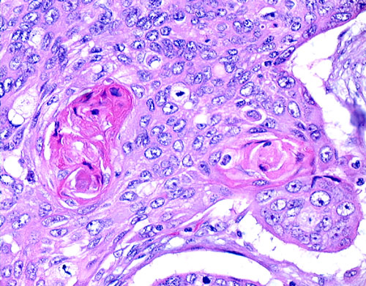
Case 4
High power

Slide 27
Case 4
What is your diagnosis?
Correlate the clinical findings with the pathology.

Slide 28
Case 4
What are risk factors for the development of this disease process?

Slide 29
Case 4
Compare the epidemiology of squamous cell carcinoma vs adenocarcinoma of the esophagus.
Compare where in the esophagus squamous cell carcinomas vs adenocarcinomas arise.

Slide 30
Case 5
CHIEF COMPLAINT: “I’ve been having pains in my stomach.”
HISTORY: A 47 year-old male truck driver presents with epigastric pain. The pain seems to worsen when he eats. He strained his back lifting a load into his truck several months ago and has been taking ibuprofen 400-600mg two to three times daily since. He notes that he is extremely tired lately and has noticed intermittent passage of black tarry stool.
His social history is significant for a 20-pack year smoking habit.
PHYSICAL EXAMINATION:
BP 145/90, HR 80/min, lying down
BP 149/88, HR 89/min, standing up
RR 18/min, T 98°F
Alert and oriented man
The abdomen is soft with mild epigastric tenderness. No palpable masses or organomegaly are noted. Rectal exam shows black stool which is hemoccult positive

Slide 31
Case 5
Develop a problem list
Develop a differential diagnosis. Is there a diagnosis that you favor?

Slide 32
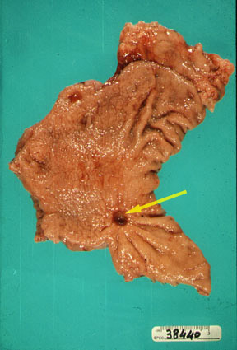
Describe the gross findings.
Case 5

Slide 33
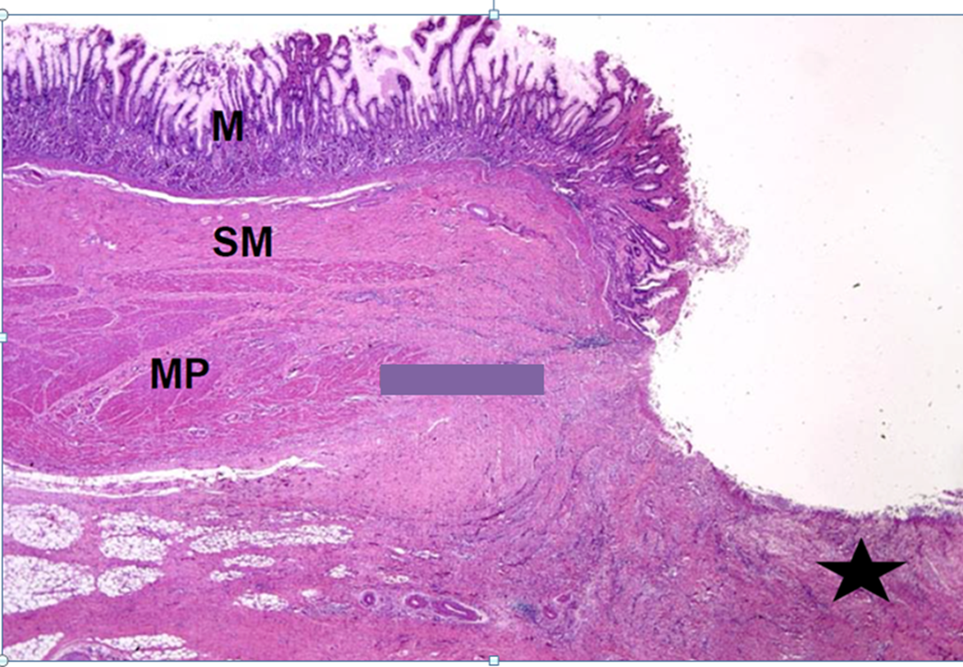
Case 5
Describe the low power histologic findings.

Slide 34
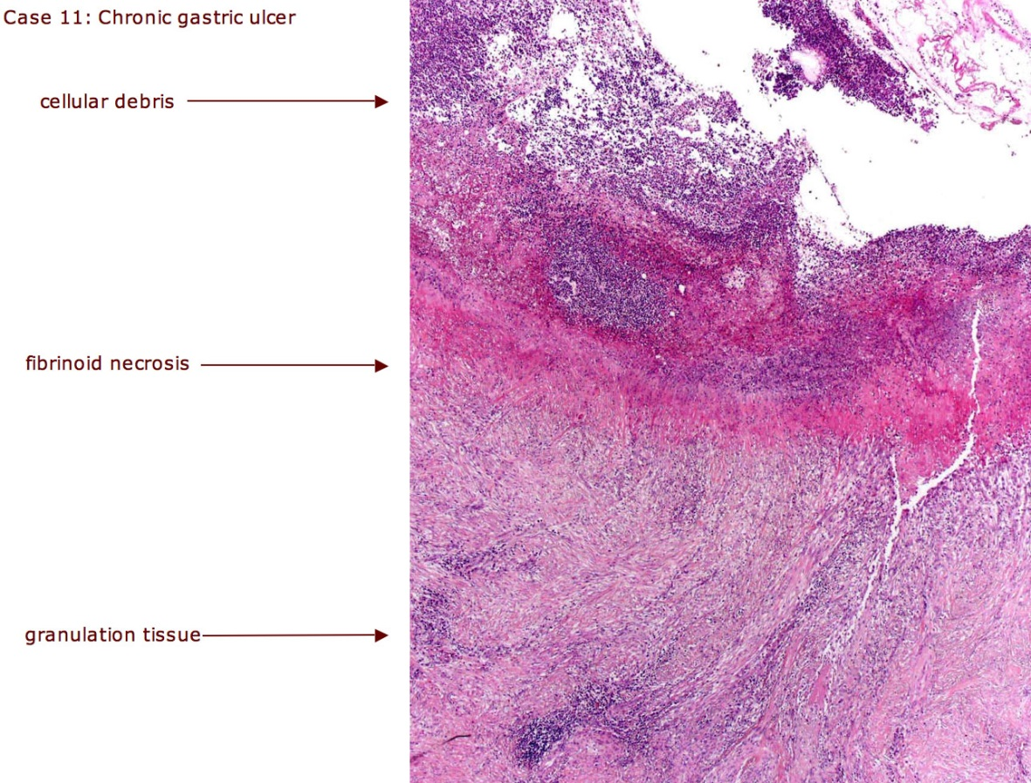
Case 5
20x

Slide 35
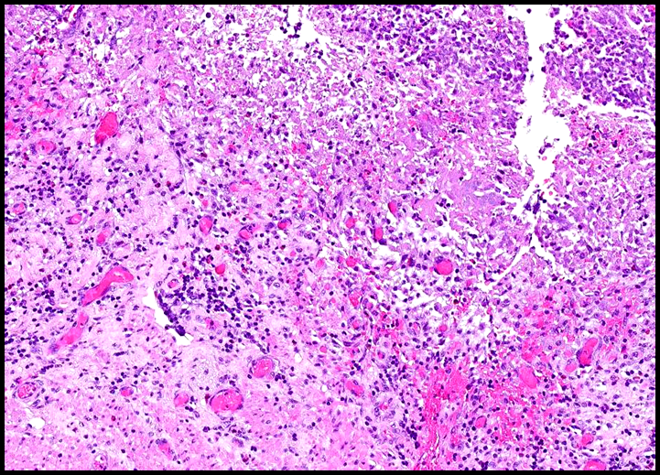
Case 5
40x

Slide 36
Case 5
What is your diagnosis?
What are associated risk factors in general and in this patient?

Slide 37
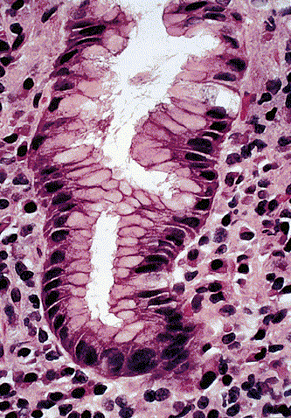
Describe the histologic findings from this high power photo.
Case 5

Slide 38
Case 5
What are potential complications related to the disease process depicted in this case?

Slide 39
Describe the gross findings.
Case 5

Slide 40
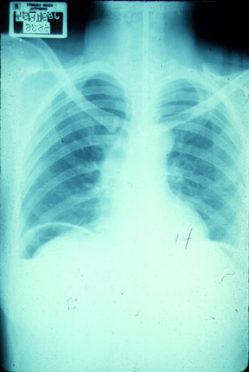
Case 5
Correlate
the previous gross
image with the upright
chest X-ray.

