Slide 1
Hematopathology I laboratory:
Red blood cell disorders / Anemia
MHD I
12/4/2017

Slide 2
Case 1
A CBC is ordered on a 32-year old healthy man as part of a life-insurance policy evaluation.

Slide 3
Case 1
What type of “test tube” is used to submit a blood sample for CBC analysis?

Slide 4
CBC w/ DIFF
WBC 7.3 [4.0-10.0] k/ul
RBC 4.39 [3.60-5.50] m/ul
Hgb 15.1 [12.0-16.0] gm/dl
Hct 45.3 [34.0-51.0] %
MCV 92 [85-95] fl
MCH 29.3 [28.0-32.0] pg
MCHC 43.3 [32.0-36.0] gm/dl
RDW 11.5 [11.0-15.0] %
Plt Count 305 [150-400] k/ul
Diff Type Automated
Gran 62 [45-70] %
Gran# 4.5 [2.0-7.0] k/mm3
Lymph 34 [20-45]
Lymph # 2.4 [1.0-4.0] k/mm3
Mono 1 [0-10] %
Mono# 0.7 [0.0-1.0] k/mm3
Eo 3 [0-7] %
Eo# 0.2 [0.0-0.7] k/mm3
Baso 0 [0-2] %
Baso# 0.0 [0.0-0.2] k/mm3

Slide 5
Case 1
Define “automated differential” and summarize how it is performed.
Define “manual differential” and summarize how it is performed.

Slide 6

Case 1
Describe how a peripheral blood smear slide is made.

Slide 7
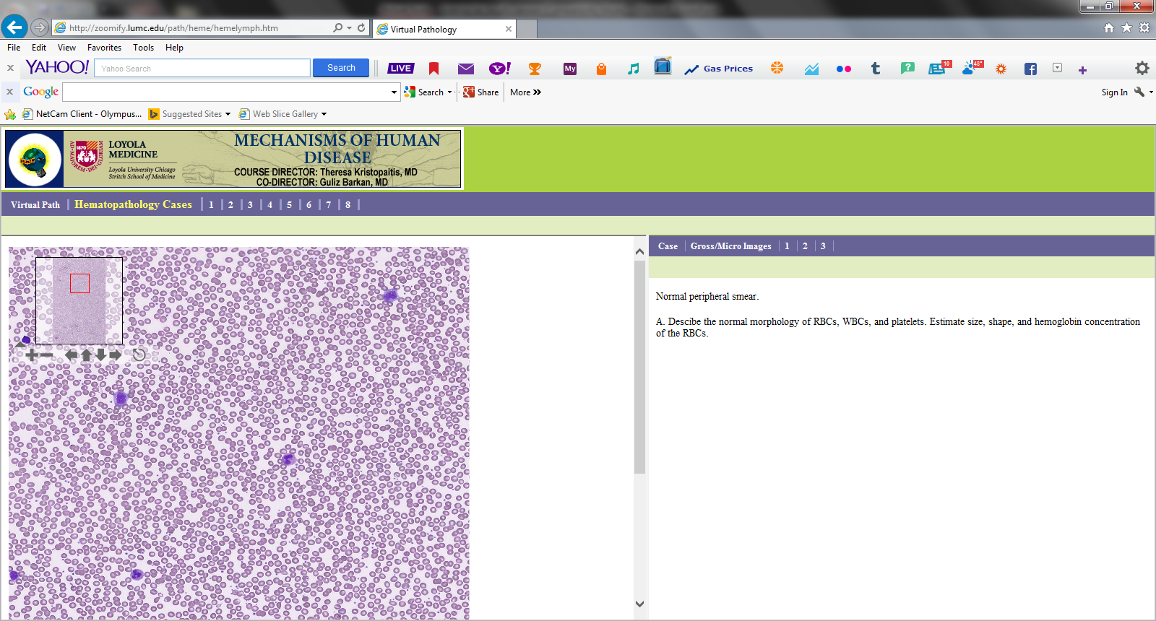
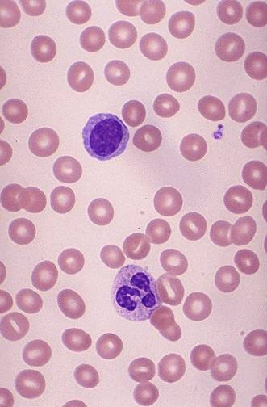
Case 1
Evaluate and describe the normal peripheral blood smear below. Identify and describe the red blood cells, white blood cells and platelets.
Low Power H&E
High Power H&E

Slide 8
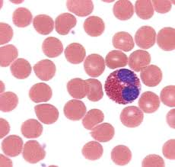
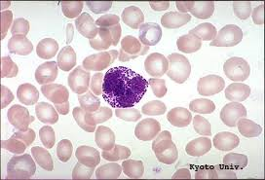
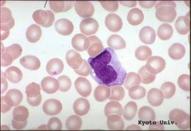
Case 1 – Name the type of leukocytes in the images below

Slide 9
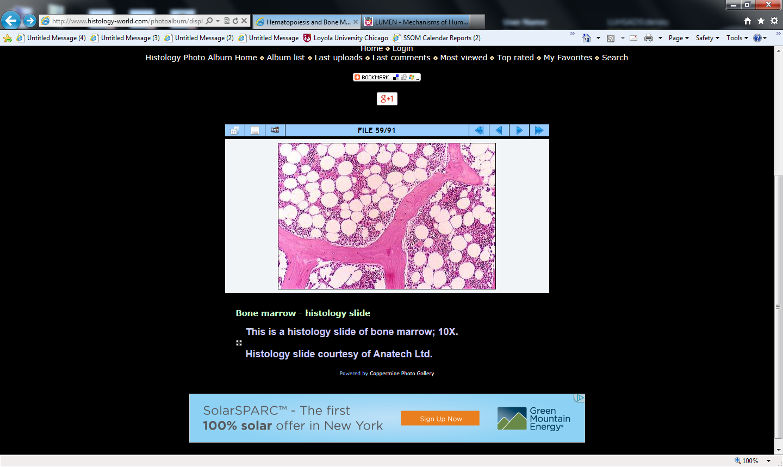
Case 1
Normal Bone Marrow Biopsy (Low power). Summarize the findings and labels

Slide 10
Case 2
A 45-year old woman from Washington presents to a physician because she is feeling “off” and very tired. On review of systems she reports having an unintentional 10# weight loss over the last several months and looser stools. She has been a sushi enthusiast for years.
Vitals: T 97.6 F, Pulse 90, RR 16 , BP 130/80
Physical exam reveals a thin woman. HEENT - pale conjunctiva. She has mild diffuse tenderness to palpation of the abdomen without masses or organomegaly. There is mild decreased vibration sense of the feet bilaterally.
CBC
RBC 3.1 m/ul
Hemoglobin 9.1 g/dl
Hematocrit 27.3%
MCV 110 fl
Platelet 130 k/ul
Reticulocyte index 1.2%

Slide 11
Case 2
Interpret the CBC.
What is the differential diagnosis for these
findings?

Slide 12
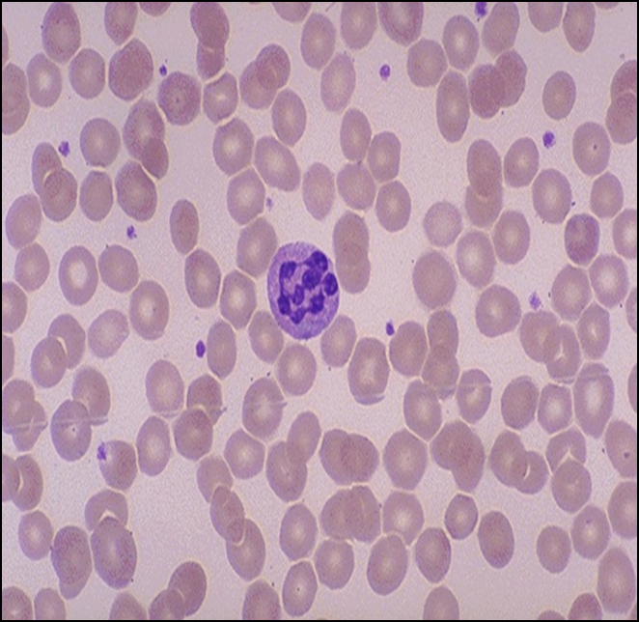
Case 2
Interpret the peripheral blood smear.
normal

Slide 13
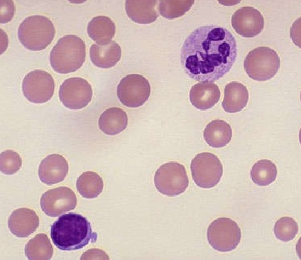
Case 2 – Comment on the RBC size
normal

Slide 14
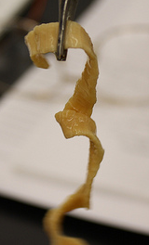
Case 2
Two days later the patient arrives to the physician’s office frantic because she passed the following (which measured 75-cm in length)

Slide 15
Case 2
What is your diagnosis?
Correlate the clinical with the pathologic findings.

Slide 16
Case 3
A 49-year old woman with perimenopausal menometrorrhagia is being evaluated by her gynecologist. She has generalized fatigue.
CBC:
WBC 8500/uL
Hgb 7.8 g/dL
Hct 23.5%
RDW 22.1
MCV 73 fL
Platelet count 290,000/uL
Reticulocyte index 1.1%

Slide 17
Case 3
Interpret the CBC
Develop a differential diagnosis for the findings.

Slide 18
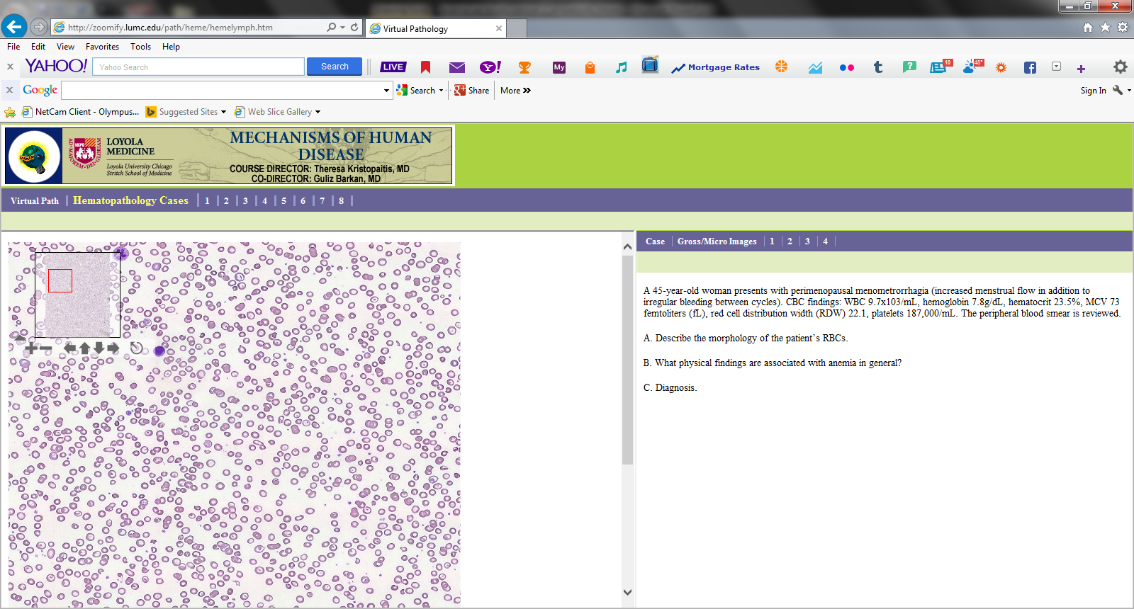
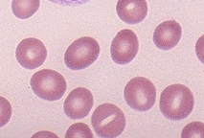
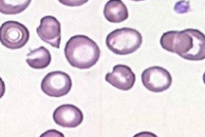
Case 3
Compare and contrast the low and high power peripheral blood smears from a healthy patient in A and our patient in B.
A
B

Slide 19
Case 3
Interpret the studies.
Iron 12 mcg/dl
TIBC 499mcg/dl
Ferritin 5ng/ml

Slide 20
Case 3
What is your final diagnosis?
Correlate the pathologic findings with the clinical findings.

Slide 21
Case 4
A 22-year-old African-American man presents with severe pain in several joints and diffuse abdominal pain. He states he is active physically and participates in different sports several times a week. He has had no fevers or chills. Review of systems is negative for any symptoms of infection.
CBC:
WBC 13.2x10³/uL
Hemoglobin 7.9g/dL
Hematocrit 22.8%
MCV 91.4 femtoliters (fL)
RDW 24.1
Platelets 481,000/uL

Slide 22
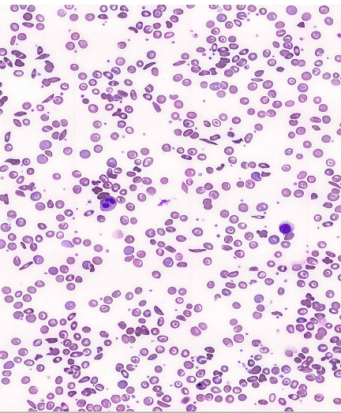
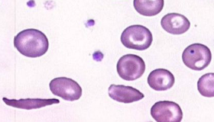
Case 4
Compare and contrast the low and high power peripheral blood smears from a healthy patient in A and our patient in B.
A
B

Slide 23
Case 4
Describe and explain the morphology of the RBCs
What is your diagnosis?
Define “poikilocytosis” and how it is demonstrated on the smear.

Slide 24
Case 4
Correlate the clinical findings with the disease process.

Slide 25
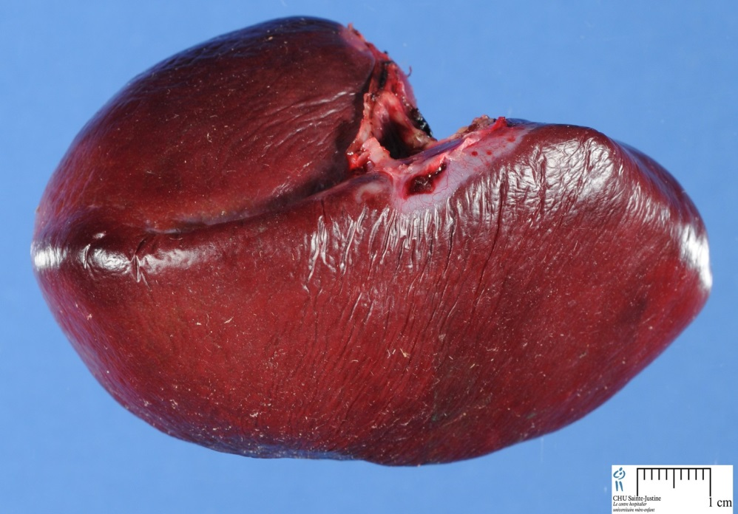
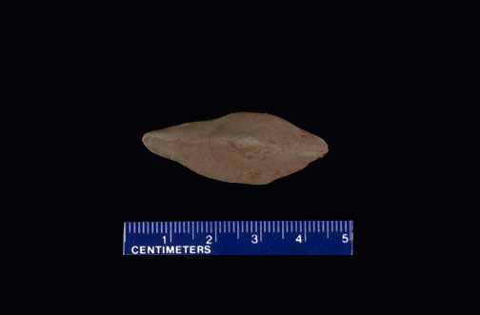
Case 4
Normal organ in A. Our patient’s organ in B. Compare and contrast the gross morphologic findings. What is the pathogenesis?
B
A

Slide 26
Case 4
Patients with this disease process are at risk for infections with what types of micro-organisms?

Slide 27
Case 5
A 5-year old presents to the ED with fever and bloody diarrhea. He has recently been at a picnic, where they served rare hamburgers.
Vitals: T 102.1 F, pulse 150, BP 90/42, RR 40 Physical exam reveals a fatigued child with pallor, abdominal tenderness, and petechiae.
The CBC demonstrates RBC, hemoglobin and hematocrit <5th percentile for age; platelets 50,000.
Creatinine is 2.6mg/ml

Slide 28
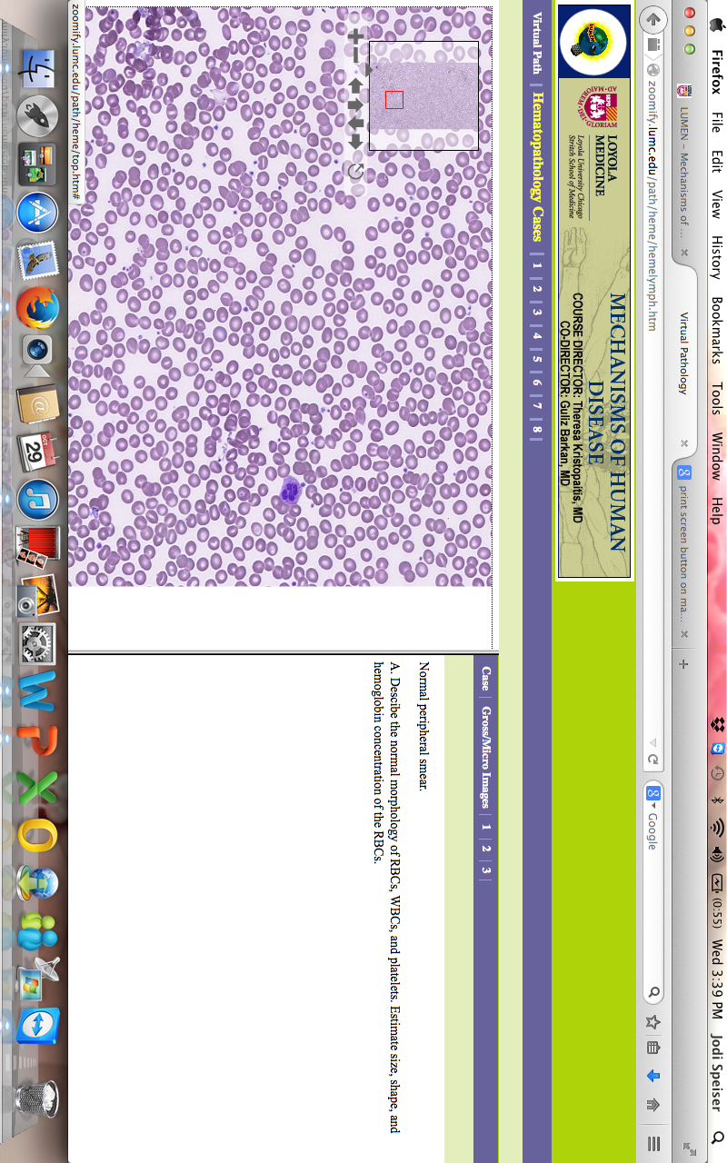
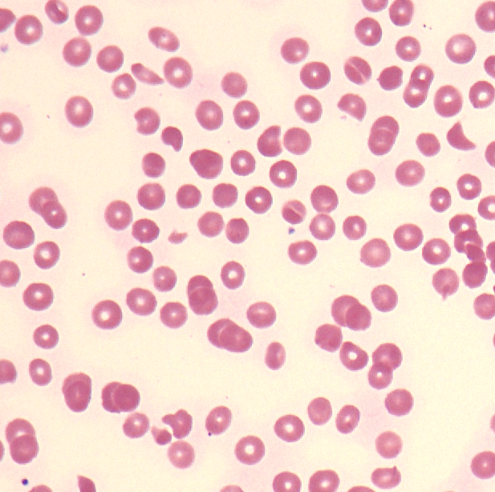
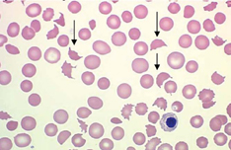
Case 5
Compare and contrast the low and high power peripheral blood smears from a healthy patient in A and our patient in B.
A
B

Slide 29
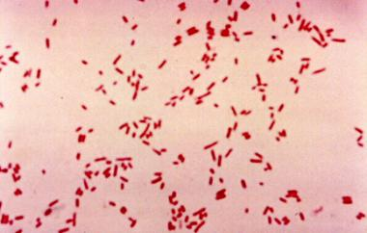
Case 5
Describe the organisms seen on gram stain from patient’s stool culture.

Slide 30
Case 5
What is your diagnosis?
Correlate the clinical and histologic findings.

Slide 31
Case 6
A 5-year old child, who lives in an old home in Chicago, presents to an urgent care clinic with irritability, poor appetite, weight loss, abdominal pain and reduced attention span.
Vital signs: T 98.6 F, BP 110/79, RR 50, Pulse 150.
Physical exam demonstrates an irritable, thin child with mild diffuse abdominal pain to palpation

Slide 32
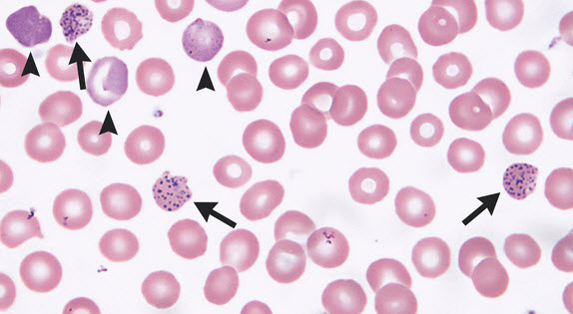
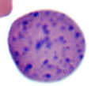
Case 6 – Peripheral Blood Smear
Describe the pathologic changes seen below.

Slide 33
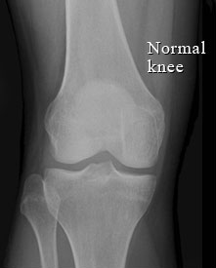
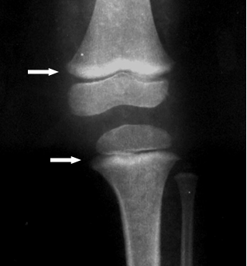
Case 6 - Radiology
Compare and contrast the knee X-rays from a healthy patient in A and our patient in B.
.
A
B

Slide 34
Case 6
What is your diagnosis?
Correlate the clinical with the pathologic findings.

