Slide 1
Pulmonary Pathology I
MHD I Laboratory
11/16/17

Slide 2
Case 1 Describe the gross findings. What is the normal weight of an adult lung?
Normal, fresh specimen

Slide 3
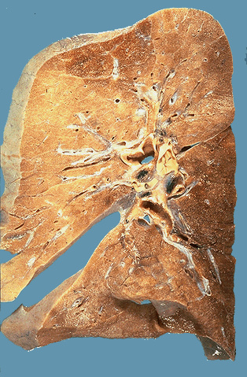
Case 1 Describe the gross findings
Normal, Cut surface, Formalin Fixed Specimen

Slide 4
Case 1 Name the structure. Identify the labels.

Slide 5
Case 1 Identify the labels

Slide 6
Case 1 Describe the histology on low power

Slide 7
Case 1 Describe the histologic findings. Name A-E
C
E
A
D
B

Slide 8
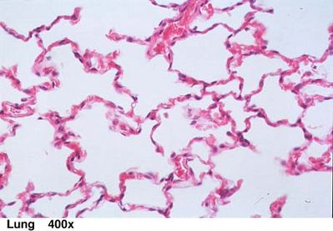
Case 1 Describe the histologic findings

Slide 9
Case 2 Case History
A 67-year-old man presents with dyspnea. He also complains of cough, which is worse in the mornings, off and on for several years. There is no history of fever or purulent sputum or cyanosis. He smokes two packs of cigarettes/day for the last 50 years.
On exam there is hyper-resonance of the chest by percussion and prolonged expiratory phase on auscultation.

Slide 10
Case 2 Describe the gross findings. Comment on “A”.
A

Slide 11
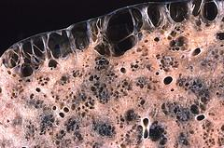
Case 2 Describe the primary abnormality

Slide 12
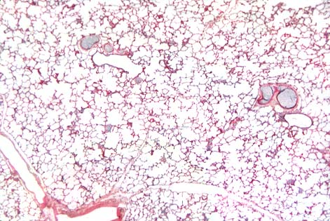
Case 2 Describe the low power findings on B. Compare with the normal lung in A.
A
Low Power H&E
B
Low Power H&E

Slide 13
Case 2 Describe the high power findings
High Power H&E

Slide 14
Case 2 Describe the histologic findings. Correlate with the gross specimen (note – this section was taken near the pleural surface)

Slide 15
Case 2
What is your diagnosis?
What is the most common etiology of this disease process? What are other potential etiologies?

Slide 16
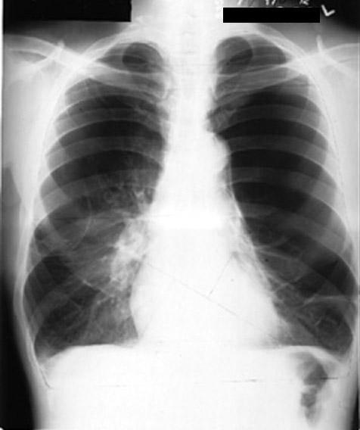
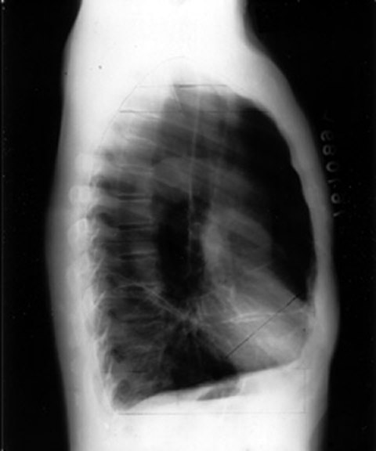
Case 2 Correlate the morphologic findings with the classic radiographic findings.

Slide 17
Case 2
Proceed to Slides 26 and 27 and be prepared to discuss the characteristics for “Case 2”

Slide 18
Case 3 History
A 58 year-old man has had 2 ½ years of progressive dyspnea. He is now short of breath with minimal exertion. He denies fever, chest pain or hemoptysis. He has never smoked cigarettes.
On physical exam he is hypoxemic. On chest auscultation there are fine, diffuse, end-inspiratory crackles (sound like Velcro).
Chest X-ray shows bilateral interstitial infiltrates with a peripheral distribution.

Slide 19
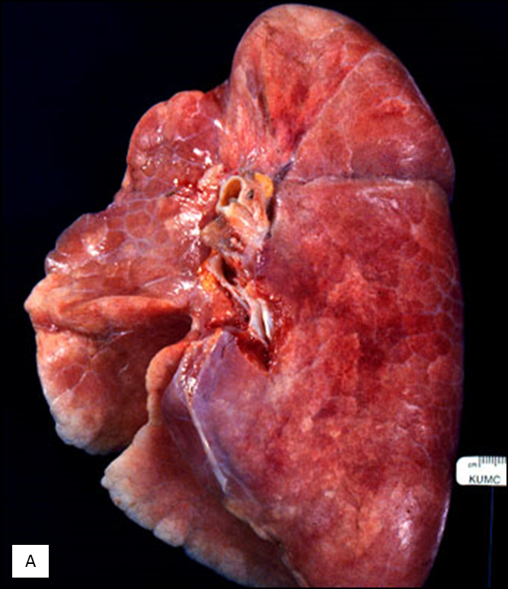
Case 3 Describe the gross findings in B. Compare to normal lung in A.
B

Slide 20
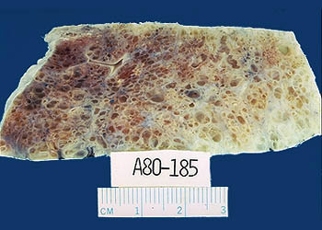
Case 3 Describe the key finding depicted in the images.

Slide 21
Case 3 Describe the low power findings in B. Compare to normal lung in A.
A
B

Slide 22
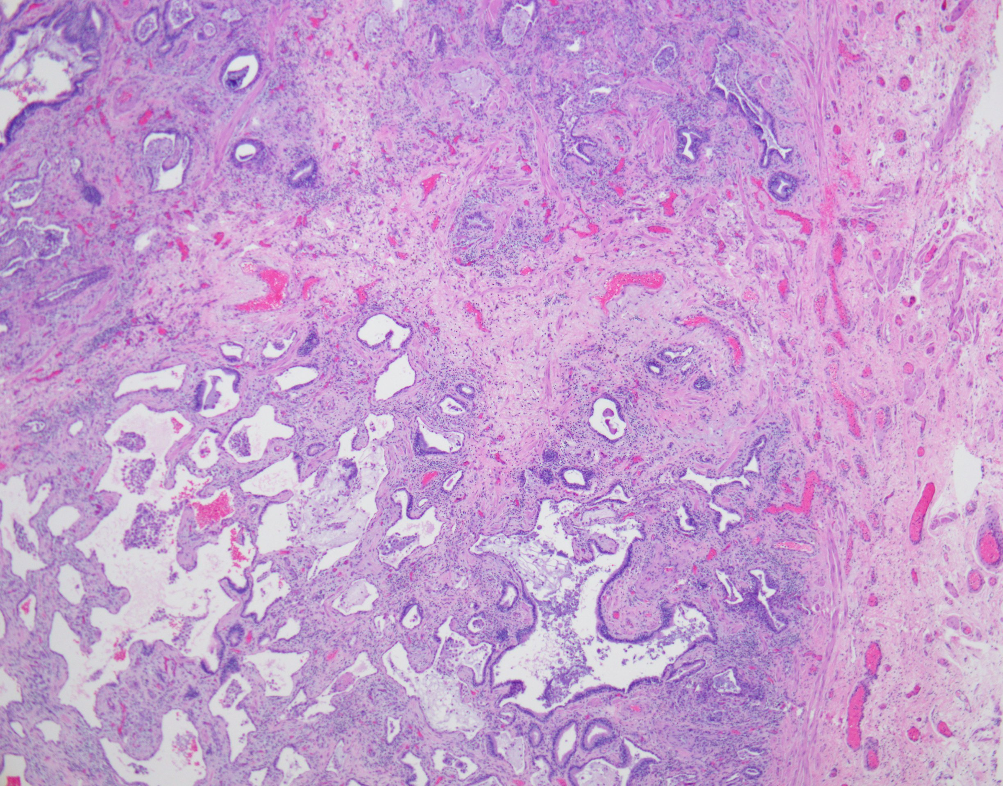
Case 3 – Describe the findings on 20X

Slide 23
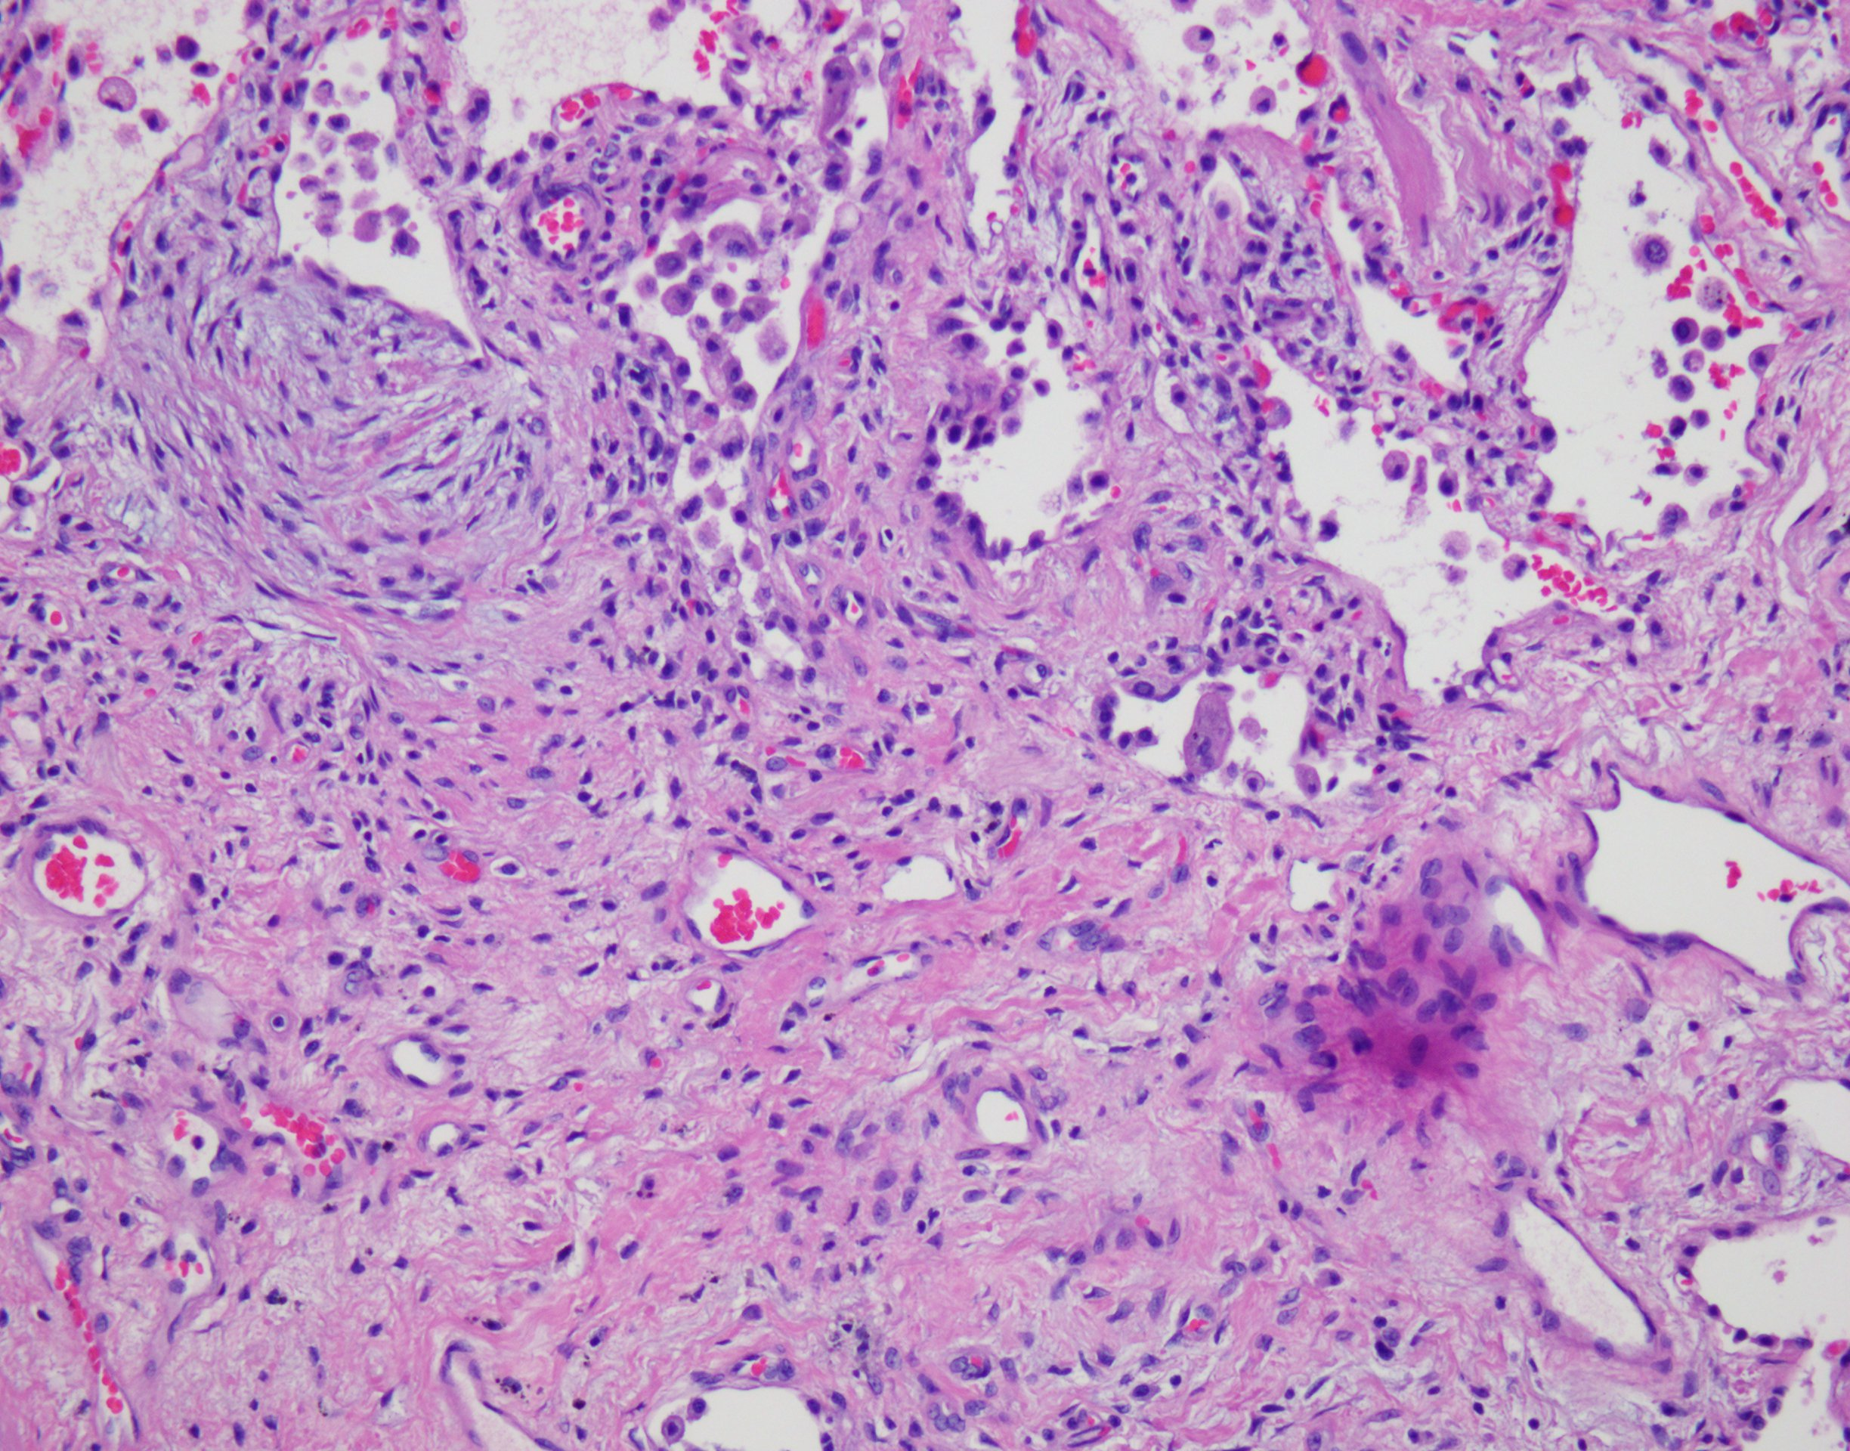
Case 3 – Describe the high power findings. Be sure to analyze the focus in the box

Slide 24
Case 3 Describe the high power findings

Slide 25
Case 3
Correlate the gross/radiographic images with the histology.
What is your diagnosis? Are there other disease process in the differential?

Slide 26
Case 2 and 3 Comparison
Characteristic | Case 2 | Case 3
Diagnosis
Pathogenesis
PFTs
Physical exam
Gross morphology
Histology
Case 2 characteristics will be summarized by Case 2 presenters

Slide 27
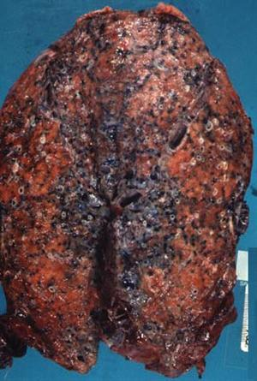
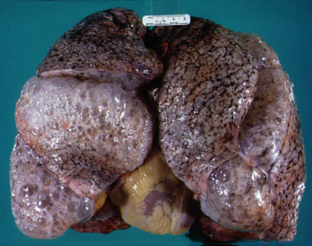
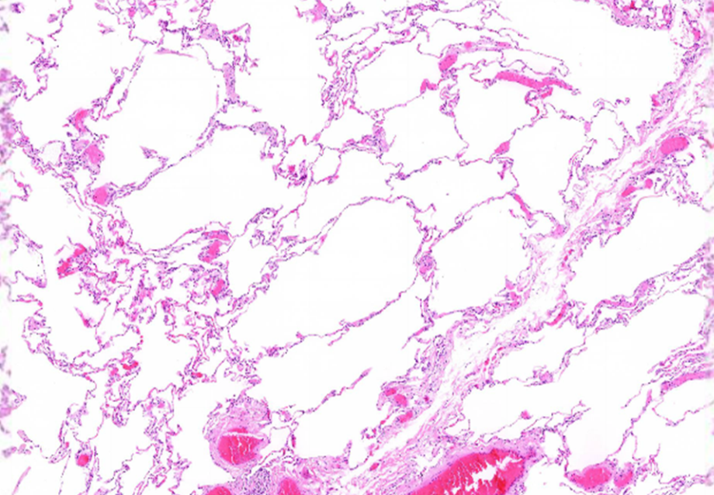
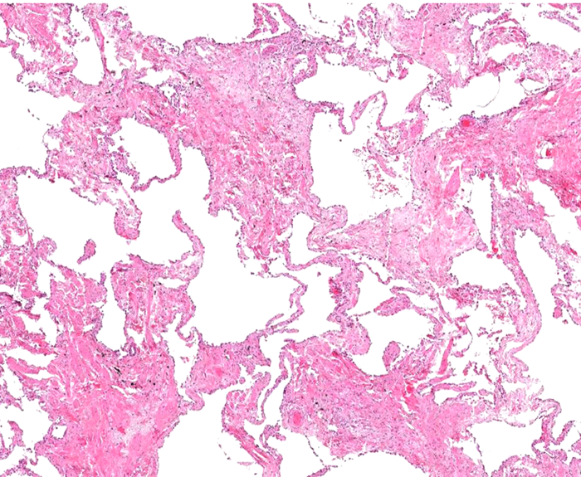
Case 2 & 3 Comparison Summarize/Contrast the morphologic changes (and see chart on next slide)
2
3

Slide 28
Case 4 History
A 44-year-old woman undergoing chemotherapy for metastatic ovarian cancer is admitted to the hospital with sepsis secondary to a urinary tract infection. Over the next 2 days she develops progressive dyspnea. She becomes hypoxic and cyanotic and requires increasing oxygen concentration.

Slide 29
Case 4 Interpret the chest x-ray. What disease processes could this represent?

Slide 30
Case 4 Describe the gross findings in B. Compare to the normal lung in A.
B
Lung weights: Left: 840gm, Right: 900gm

Slide 31
Case 4 Describe the low power findings in B. Contrast with normal in A
A
B

Slide 32
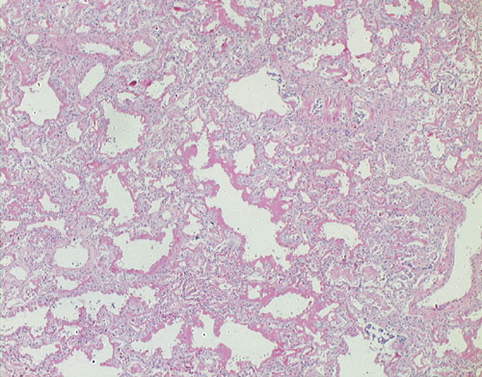
Case 4 Describe the findings on 20x

Slide 33
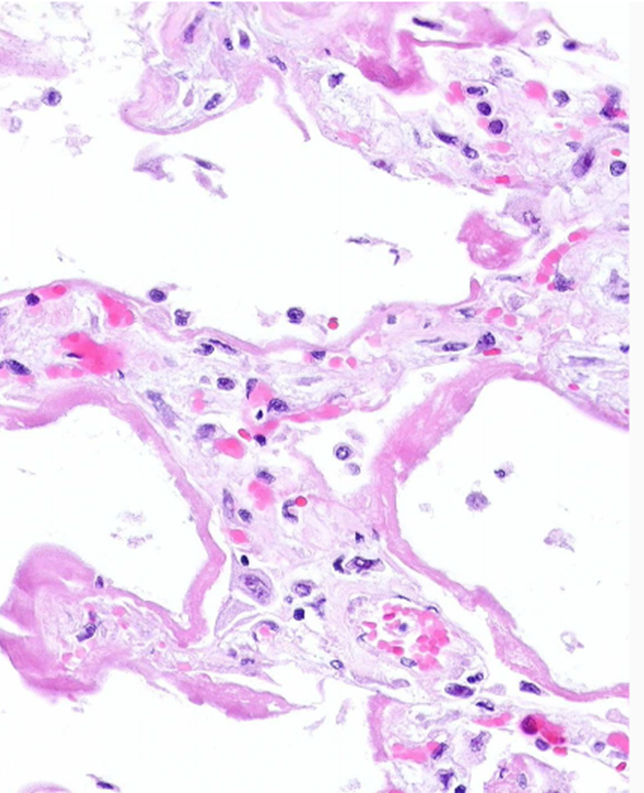
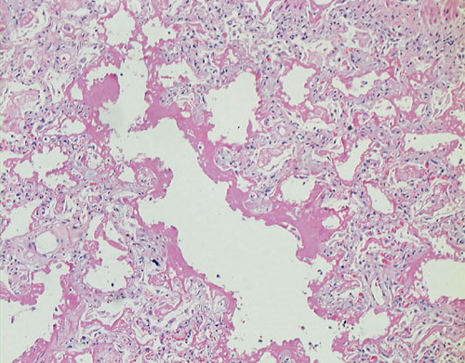
Case 4 Describe the high power findings

Slide 34
Case 4
What is your diagnosis?
Correlate the clinical and morphologic findings.

Slide 35
Case 4
List the most common etiologies of this condition.
Be prepared to compare/contrast the pathogenesis of this disease process with that of Case 5 after it is presented.

Slide 36
Case 5 Case History
A newborn develops respiratory insufficiency. He was born at 25 weeks gestation and weighed 500 gm at birth. The mother had fever for 3 days before delivery and the amniotic fluid was purulent. Surfactant and antibiotics were administered. The baby’s condition deteriorated rapidly and he died 8 hours later.

Slide 37
Case 5 – Interpret the x-ray focusing on the lung findings.

Slide 38
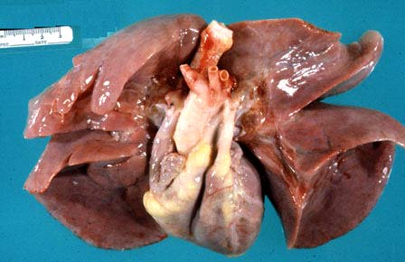
Case 5 Describe the gross findings in B. Compare to the normal lung in A.
A
B
Lung weights combined: 30gm,
Normal combined lung weight for 25 weeks gestational age: 19gm

Slide 39
Case 5 Describe the lower power findings in B. Contrast with normal fetal lung in A (note a developing fetal lung has histologic differences compared to a fully developed lung)
A
B

Slide 40
Case 5. Describe the high power findings in B. Compare with normal in A
A
B

Slide 41
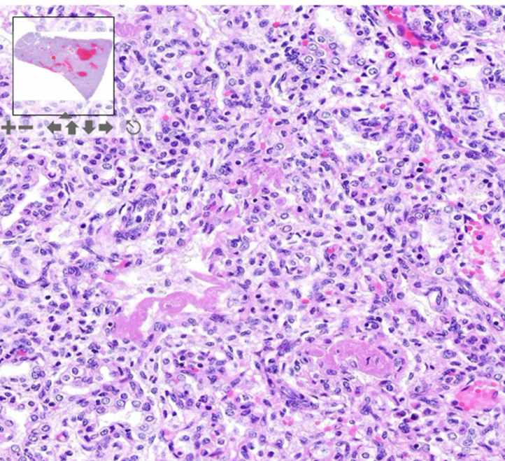
Case 5
Based on the clinical and morphologic findings, what is your diagnosis?
What are the “structures” highlighted by the arrows composed of?

Slide 42
Case 5
Correlate the clinical findings with the pathology.
Compare/contrast the pathogenesis of this disease process with that of Case 4 (Case 4 student presenters are prepared to discuss with you).

Slide 43
Case 5 – Alternate scenario
This newborn ultimately survives this disease process. During his course of care he receives high concentrations of ventilator-administered oxygen for prolonged periods.
Describe the two most common associated complications he may develop.

Slide 44
Case 6 History
A 33-year old woman is involved in a motor vehicle accident. She sustained minor chest and head trauma. The patient is healthy, works as a school-teacher, and has never smoked. She takes no prescription or over the counter medications. Physical exam is notable for a frontal head hematoma and is otherwise unremarkable.
In the ED a head CT and chest-ray were performed.

Slide 45
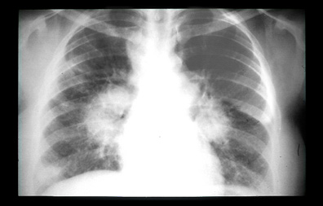
Case 6 What is the primary abnormality on this radiograph?

Slide 46
Case 6
The patient was lost to follow-up. She presented several years later with dyspnea.

Slide 47
Case 6 Describe the low power findings in B. Where is the abnormality compared to normal lung in A.
A
B

Slide 48
Case 6 Describe the findings on 20x

Slide 49
Case 6 Describe the high power findings

Slide 50
Case 6
Are there any “special stains” that should be performed on the biopsied tissue before rendering a diagnosis?

Slide 51
Case 6
The stains ordered are negative. What is the most likely diagnosis?
If the disease progresses to an advanced stage, histopathologic changes will resemble the findings from which case presented today?

Slide 52
Case 6 Describe other potential clinical manifestations of this disease process (be sure to comment on A, B, C, D, F, K and L)
Iannuzzi MC et al. N Engl J Med 2007;357:2153-2165

