Slide 1
MHD I Histology Lab
Histology Boot Camp

Slide 2
Objectives
Recognize the most common stain used in pathology (H&E) and describe the characteristic staining pattern
Summarize the concept of “power” when microscopically visualizing histologic sections
Define “special stains” and give examples of use
Identify the following basic cellular components histologically:
Nucleus – Nucleolus – Cytoplasm - Cell borders
Identify basic tissue types histologically
epithelial tissue, connective tissue, adipose tissue, blood vessels, muscle tissue, nervous tissue, inflammatory cells

Slide 3
2 Volunteers, please

Slide 4
Describe what you see

Slide 5
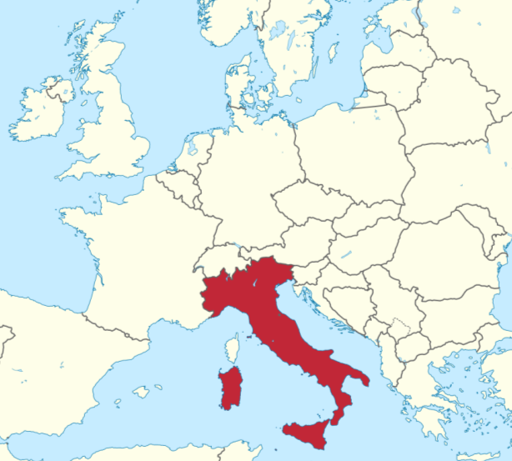
Describe what you see

Slide 6
Desribe what you see

Slide 7
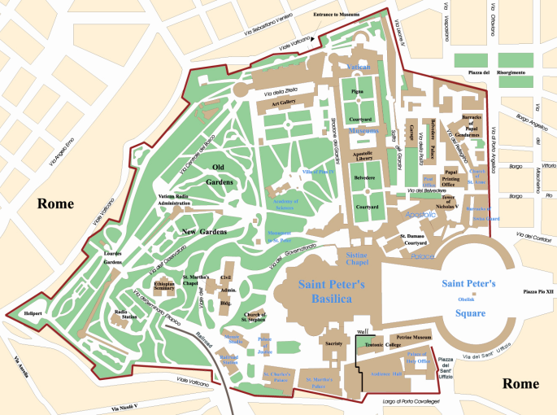
Describe what you see

Slide 8
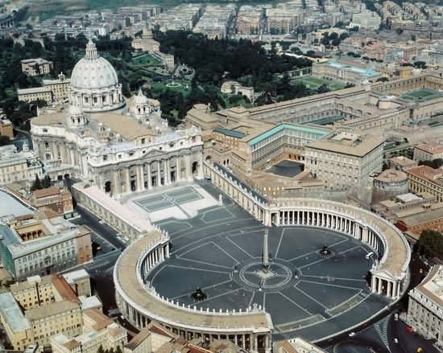
Describe what you see

Slide 9
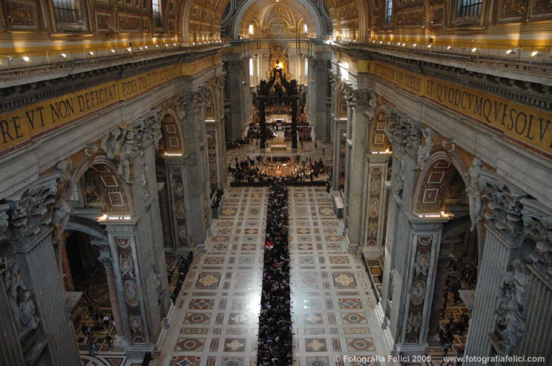
Describe what you see

Slide 10
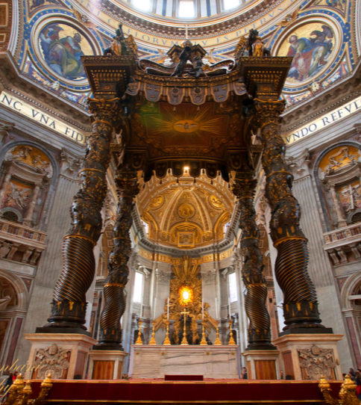
Describe what you see

Slide 11
What did we just do?
Zoomed into a specific part of St. Peter’s Basilica starting from a map of the world

Slide 12
What knowledge/skills were needed to do what you just did?
Geography
Map reading
Italy
Architecture
Church architecture
Thank you, Volunteers

Slide 13
2 new Volunteers, please

Slide 14
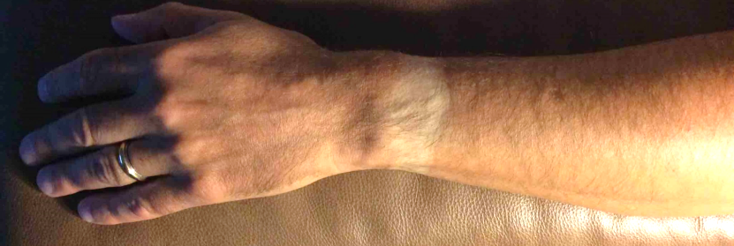
Describe what you see

Slide 15
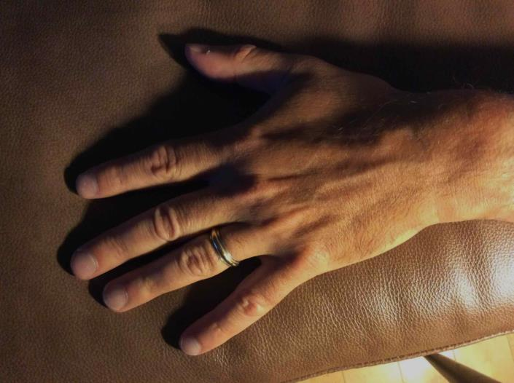
Describe what you see

Slide 16
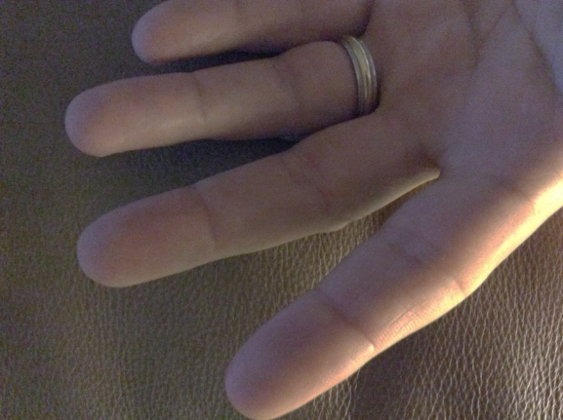
Describe what you see

Slide 17
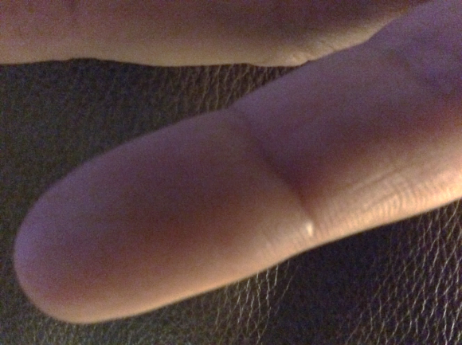
Describe what you see

Slide 18
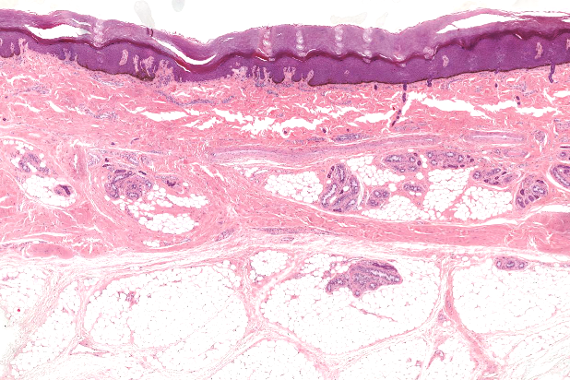
Describe what you see

Slide 19
What did we just do?
“Zoomed into” a histologic image of the palm from an image of an arm

Slide 20
What knowledge/skills were needed to do what you just did?
Human anatomy
Surface anatomy
Parts of the arm, hand, fingers
Distinguish palmar surface of hand
Distinguish gross anatomy from histology
Recognize and name basic tissue types histologically
Recognize and name microscopic anatomy of the skin
Thank you, volunteers

Slide 21
HISTOLOGY
It is not all new to you…

Slide 22
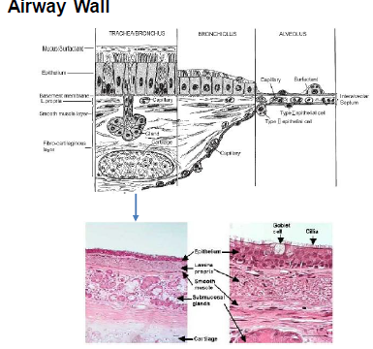
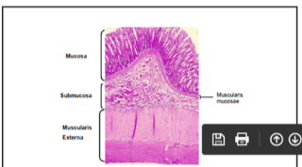
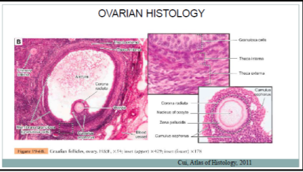
Slides from FHB

Slide 23
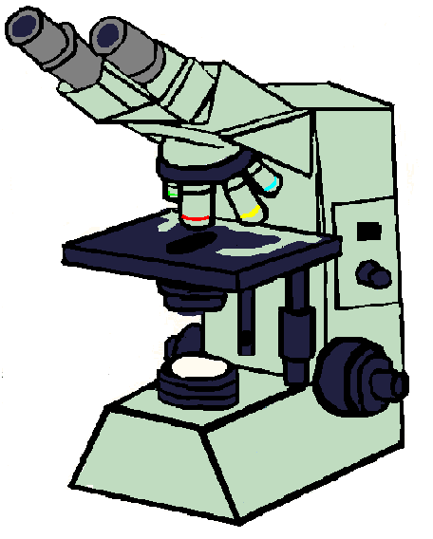
How do we visualize microscopic anatomy (histology) and pathology (histopathology)?
Traditional Microscope
Digitally scanned slides
SSOM “Zoomify” = Digitally scanned slides
Viewable via a “virtual microscope”
Simulates traditional microscope

Slide 24
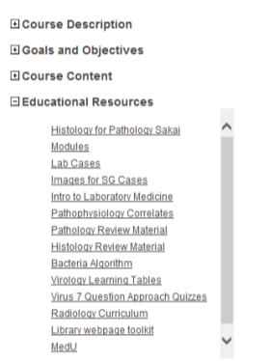
Zoomify Digital Histology Slides on LUMEN

Slide 25
During MHD Labs
We will be displaying histology and histopathology slides on different powers largely via static images
Zoomify Histology Slides are included in the “Histology for Pathology” modules on Sakai for your review

Slide 26
Objective
Recognize the most common stain used in pathology (H&E) and describe the characteristic staining pattern

Slide 27
Hematoxylin and Eosin (H&E stain)
Hematoxylin
A basic dye
Stains structures containing nucleic acids blue
Eosin
An acidic dye
Stains structures containing protein (e.g cytoplasm) pink

Slide 28
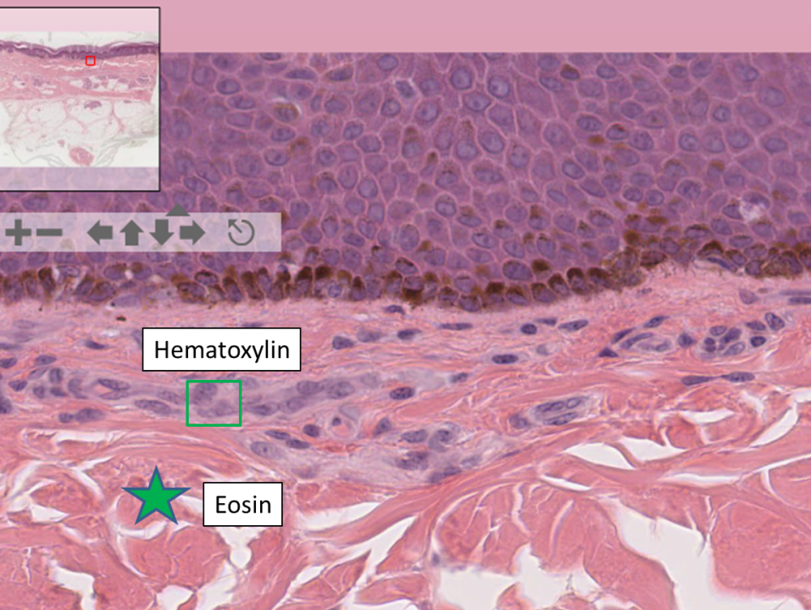

Slide 29
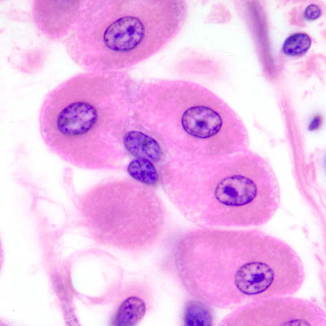
Blue nuclei (Nucleic Acids)
Pink cytoplasm
(proteins)

Slide 30
Objective
Define “special stains” and give examples of when they are used

Slide 31
“Special Stains”
Staining techniques used to:
demonstrate specific cellular components
structures and/or substances
Identify micro-organisms
Aid pathologists in the diagnosis of disease

Slide 33
Objective
Summarize the concept of “power” when microscopically visualizing histologic sections

Slide 34
What is “power”?
Many objectives from 2x – 100x
Low power – 2x-10x – to see overall structure of tissue
High Power – 20x-100x – examine smaller structures / cellular level

Slide 35
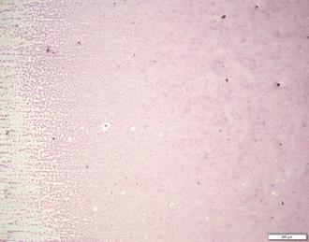
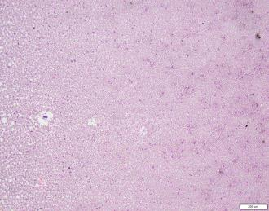
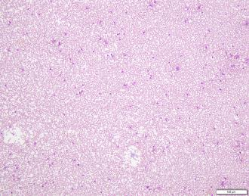
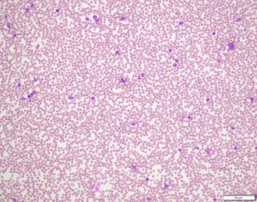
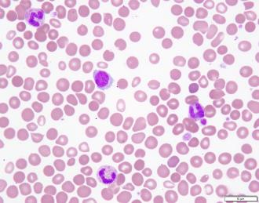
2X
4X
10X
20X
100X

Slide 36
http://zoomify.lumc.edu/histonew/skin/skin_main.htm .
Thick skin palm
Review slide from low power to high power

Slide 37
Objective
Identify basic cellular components histologically:
nucleus
nucleolus
cytoplasm
cell borders

Slide 39
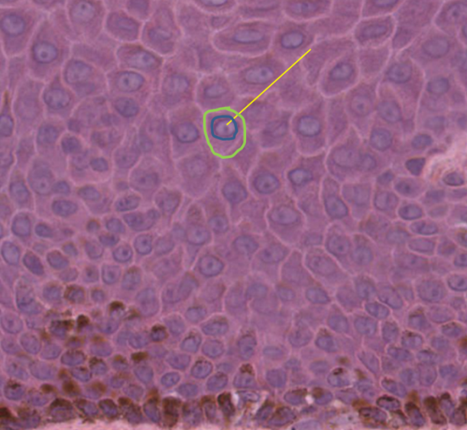
Identify basic cellular components histologically: Nucleus, nucleolus, cytoplasm, cell borders
Low power 10x
High power 40x

Slide 40
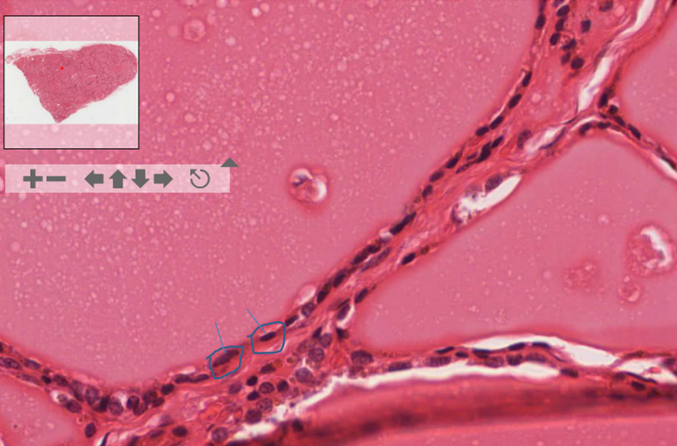
Thyroid Gland: Identify cells, nuclei, cytoplasm

Slide 41
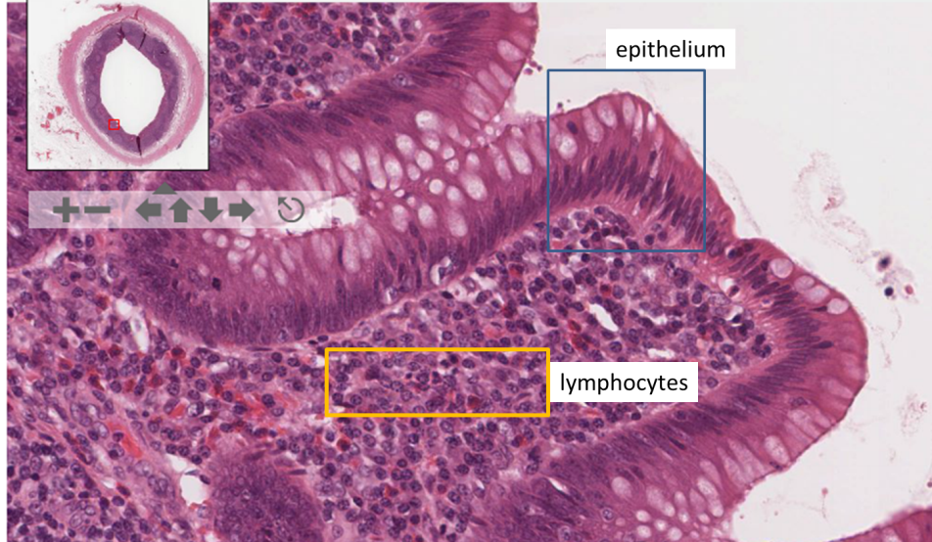
Appendix: Identify cells, nuclei, nucleoli, cytoplasm

Slide 42
Objective Identify basic tissue types histologically
Epithelium
Adipose tissue
Adipose tissue
Blood vessels
Muscle
Inflammatory cells
Nervous tissue

Slide 43
Epithelium
Tissue which covers nearly all body surfaces
Functions:
Protects (skin, esophagus)
Absorbs (GI tract, kidney)
Transports (ciliated cells of trachea)
Secretes (glands)
Gas exchange (lung)
Lubricates (pleural cavity)

Slide 44
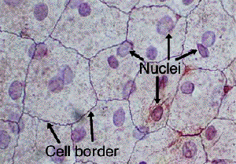
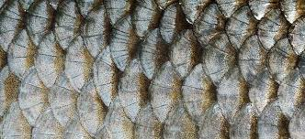
Peritoneum: Simple Squamous (scale-like)
40x

Slide 45
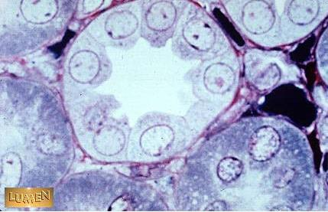
Kidney Tubule: Simple Cuboidal
10x
PAS stain – 40x
What is the PAS stain outlining
on this section?
Basement Membrane

Slide 46
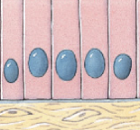
Appendix: Simple Columnar

Slide 47
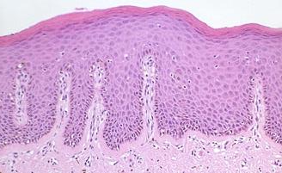
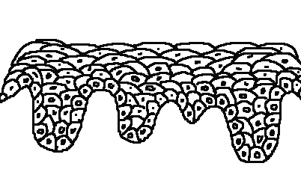
Skin – Epidermis: Stratified Squamous
Cells originate from a layer of cells along a basal lamina and form a multilayered structure.
Cells toward the surface have smaller nuclei and greater amounts of cytoplasm with keratin.

Slide 48
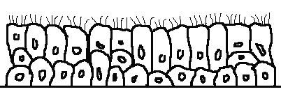
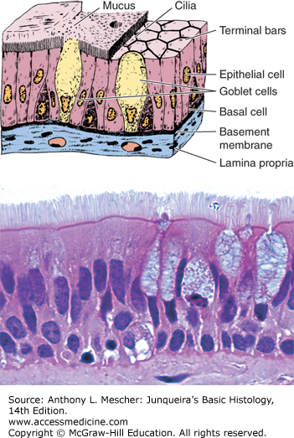
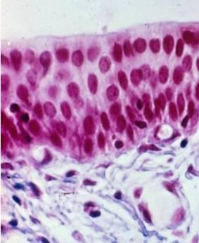
Respiratory Tract: Nasopharynx
not all the cells along the basal lamina reach the luminal surface, but all contact basal lamina

Slide 49
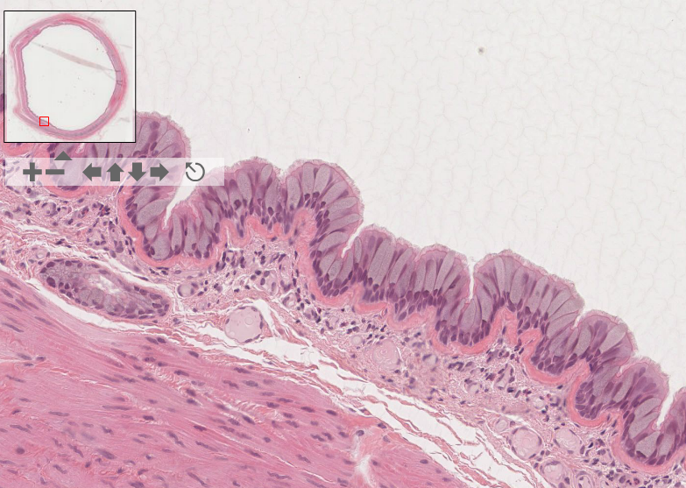
Self-Assessment: Type of Epithelium?
Columnar

Slide 50
Objective
Identify basic tissue types histologically:
epithelial tissue
connective tissue
adipose tissue
blood vessels
muscle tissue
nervous tissue
inflammatory cells

Slide 51
Connective Tissue
Provides structural support
Binds cells and tissues together
Provides metabolic support
Types
Dense connective tissue, loose connective tissue
Fibers (mostly collagen)
“Fibroblast” = nuclei
Adipose Tissue
Primary site of fat storage
Elastic tissue, reticular tissue

Slide 52
Dense connective tissue?
?
skin

Slide 53
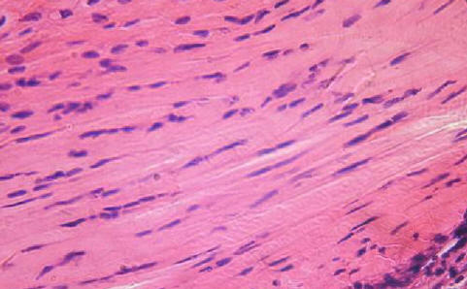
Identify fibroblasts and collagen fibers

Slide 54
Adipose Tissue
Skin

Slide 55
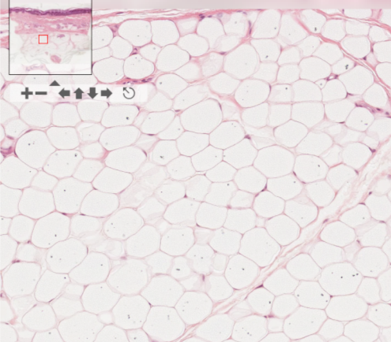
Cells = Adipocytes
-Thin cell membrane
-Surrounds cytoplasmic lipid
(cytoplasm appears clear because
processing removes the actual lipids)
-Cell nucleus is pushed to the side
by cytoplasmic lipid

Slide 56
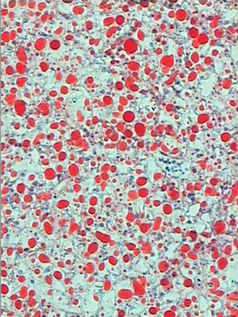
“Special Stain” Example
Oil Red O
Fat soluble dye
Stain lipids, triglycerides and some lipoproteins
Requires special processing of tissue sections

Slide 57
Objective
Identify basic tissue types histologically:
epithelial tissue
connective tissue
adipose tissue
blood vessels
muscle tissue
nervous tissue
inflammatory cells

Slide 58
Blood Vessels
Arterial
Arteries, arterioles, capillaries
Veins
Lymphatics
All lined by endothelium and have a smooth muscle layer of various thickness

Slide 59
Artery
Lumen
Smooth Muscle
Vein
What is this
Tissue?
SM

Slide 60
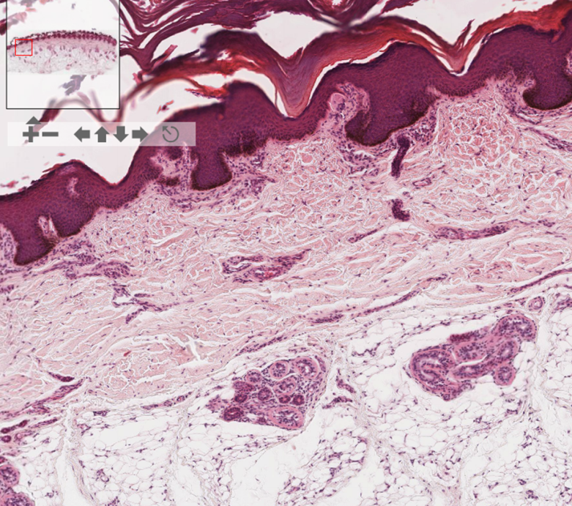

Slide 61
40x
Endothelial Cell
?
?

Slide 62
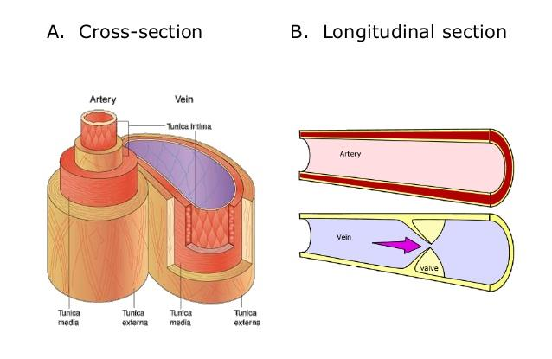

Slide 63
Objective
Identify basic tissue types histologically:
epithelial tissue
connective tissue
adipose tissue
blood vessels
muscle tissue
nervous tissue
inflammatory cells

Slide 64
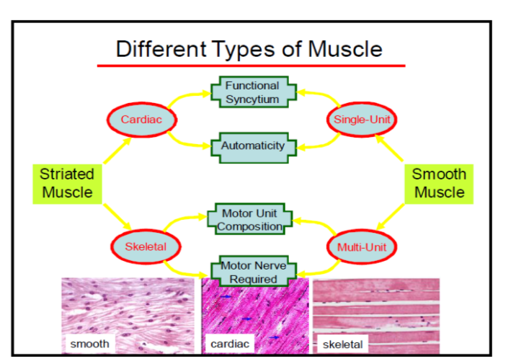
Muscle
From your FHB Lecture – Muscle 1 – L3

Slide 65
Tongue: a) What tissue type is covering the surface of the tongue? b) Where is the muscle?
Epithelium - Tissue which covers nearly all body surfaces

Slide 66
What kind of epithelium covers the surface of the tongue?
Stratified
Squamous

Slide 67
Muscle – point out cross sections and longitudinal sections
CT
Muscle

Slide 68
Skeletal muscle
Longitudinal section
Cross section
F
F
F = muscle fibers
Where are the
Nuclei?
F

Slide 69
Identify nuclei, fibers, cross-striations
60x

Slide 70
Skin
Identify epithelium, dense connective tissue, adipose tissue

Slide 71
Objective
Identify basic tissue types histologically:
epithelial tissue
connective tissue
adipose tissue
blood vessels
muscle tissue
nervous tissue
inflammatory cells

Slide 72
40x
Identify
Dense connective tissue
Blood vessels
Nerve bundle is highlighted by
the arrow
What are these cells?

Slide 73
Nerve bundle: Cross section

Slide 74
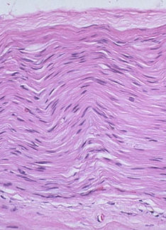
Nervous Tissue
Nerve Fiber
Schwann Cell Nuclei
Fascicle
Perinuerium
Cross Section
Longitudinal Section

Slide 75
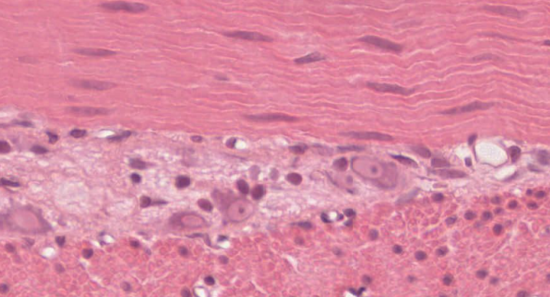
Ganglion Cells
Nerve cell bodies that are part of the sympathetic and parasympathetic nervous system
Identify the
Nucleus
Nucleolus
Cytoplasm
of the ganglion cells

Slide 76
Inflammatory Cells in tissue
Sometimes lymphocytes and plasma cells can be part of “normal” histology of an organ
Appendix
Ileum
Neutrophils
Eosinophils
Lymphocytes
Plasma cells
Macrophages

Slide 77
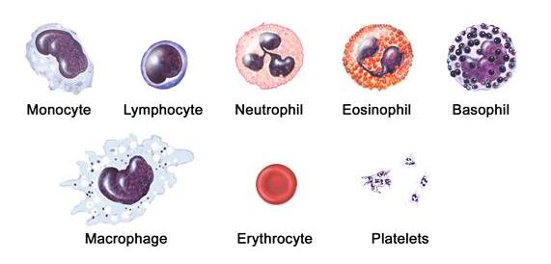
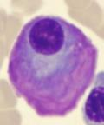
Plasma Cell

Slide 78
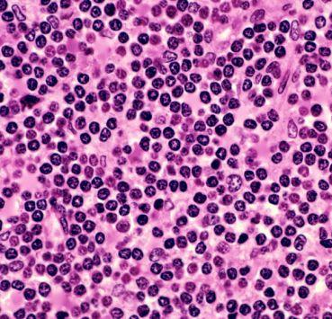
Normal Appendix – what cells are the arrows highlighting on low power and the predominant cell type on high power?
lymphocytes

Slide 79
What cells are highlighted in the image?

Slide 80
“Final Exam”
Ileum
Identify:
Epithelium – name the type
Smooth muscle
Loose Connective tissue
Dense Connective tissue
Adipose tissue
Blood vessels
Inflammatory cells
View on your own computer.
Pair up or do so in small groups.
We will ask for 2 volunteers to review
the slides with us.
http://zoomify.lumc.edu/histonew/gioverview/overview_main.htm
Ileum #131

Slide 81
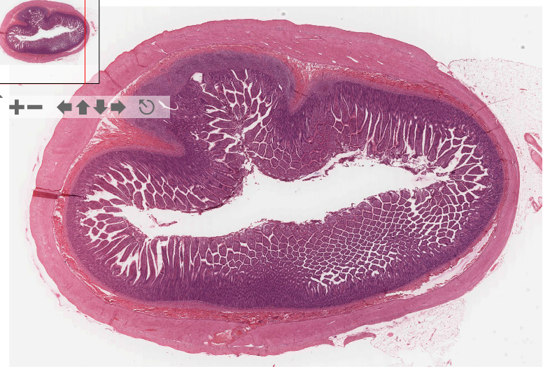

Slide 82
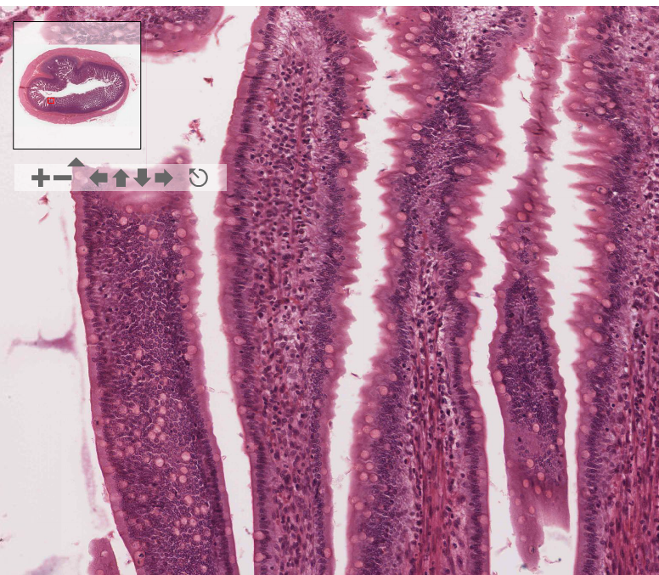

Slide 83
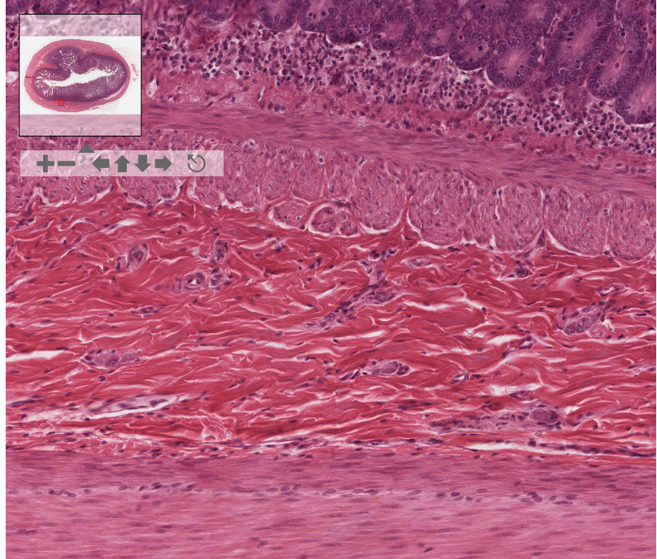

Slide 84
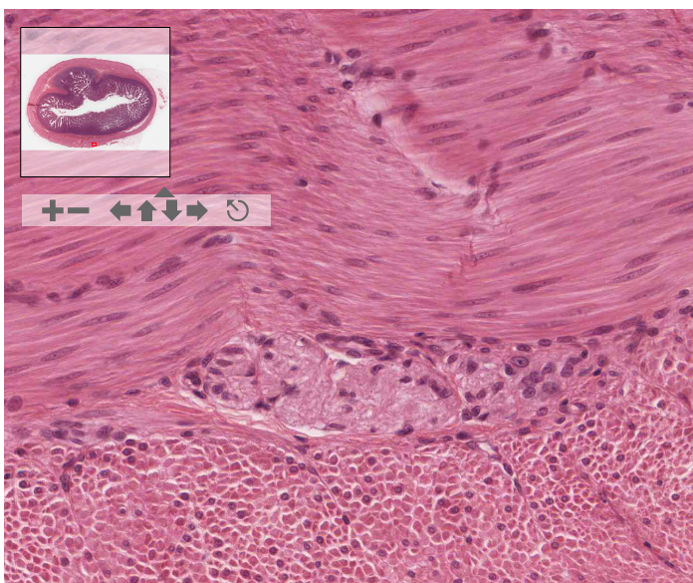

Slide 87
Final Questions?

