Slide 1
MHD I Histology Lab (aka Histology Boot-Camp)
August 3, 2017

Slide 2
Objectives
Recognize the most common stain used in pathology (H&E) and explain the characteristic staining pattern.
Summarize the concept of “power” when visualizing histologic sections under a microscope.
Define “special stains” and give examples of when they would be used.
Identify basic cellular components histologically:
nucleus
nucleolus
cytoplasm
cell borders
Identify basic tissue types histologically:
epithelial tissue
connective tissue
adipose tissue
blood vessels
muscle tissue
nervous tissue
inflammatory cells

Slide 3
Warm-up
2 volunteers, please

Slide 4
Describe what you see

Slide 5
Describe what you see

Slide 6
Desribe what you see

Slide 7
Describe what you see

Slide 8
Describe what you see

Slide 9
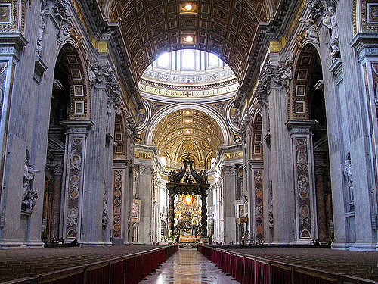
Describe what you see

Slide 10
Describe what you see

Slide 11
What did we just do?

Slide 12
What knowledge/skills were needed to do what you just did?

Slide 13
2 new Volunteers, please

Slide 14
Describe what you see

Slide 15
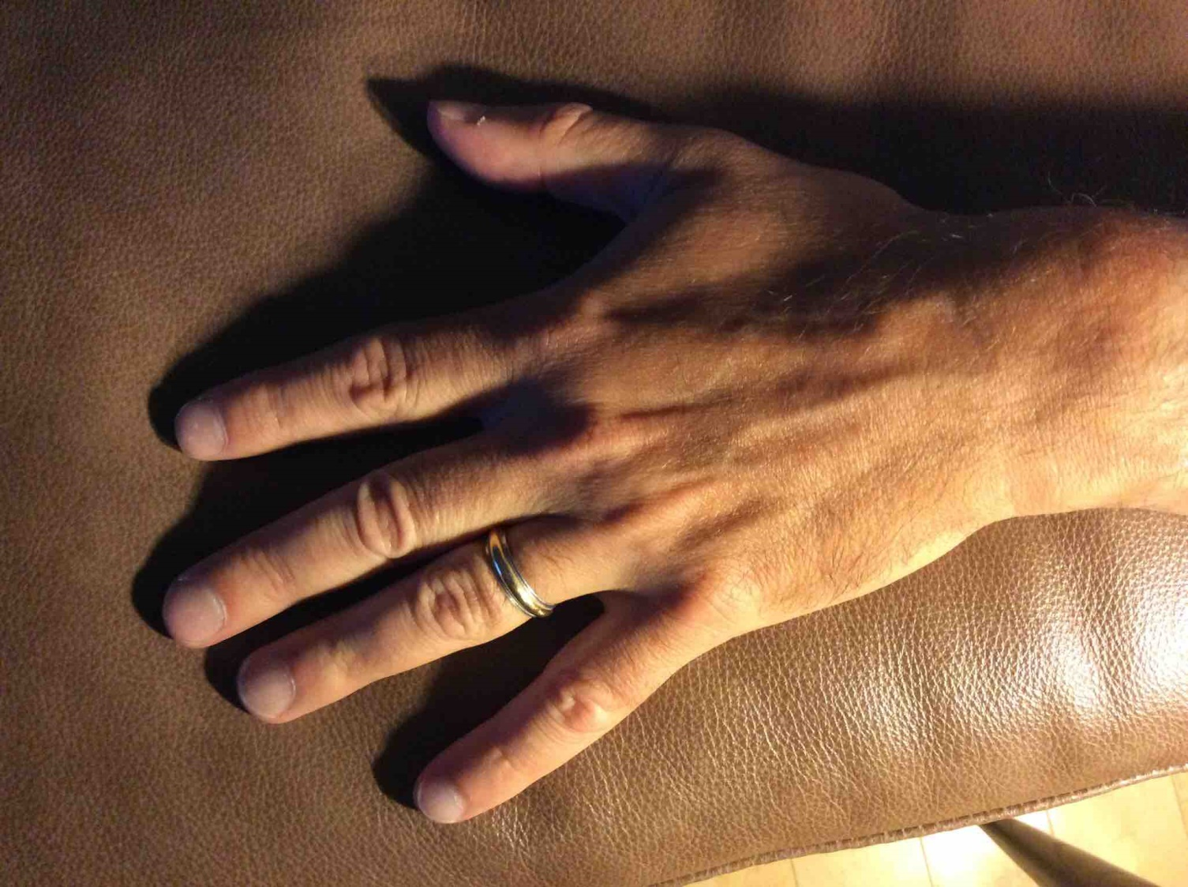
Describe what you see

Slide 16
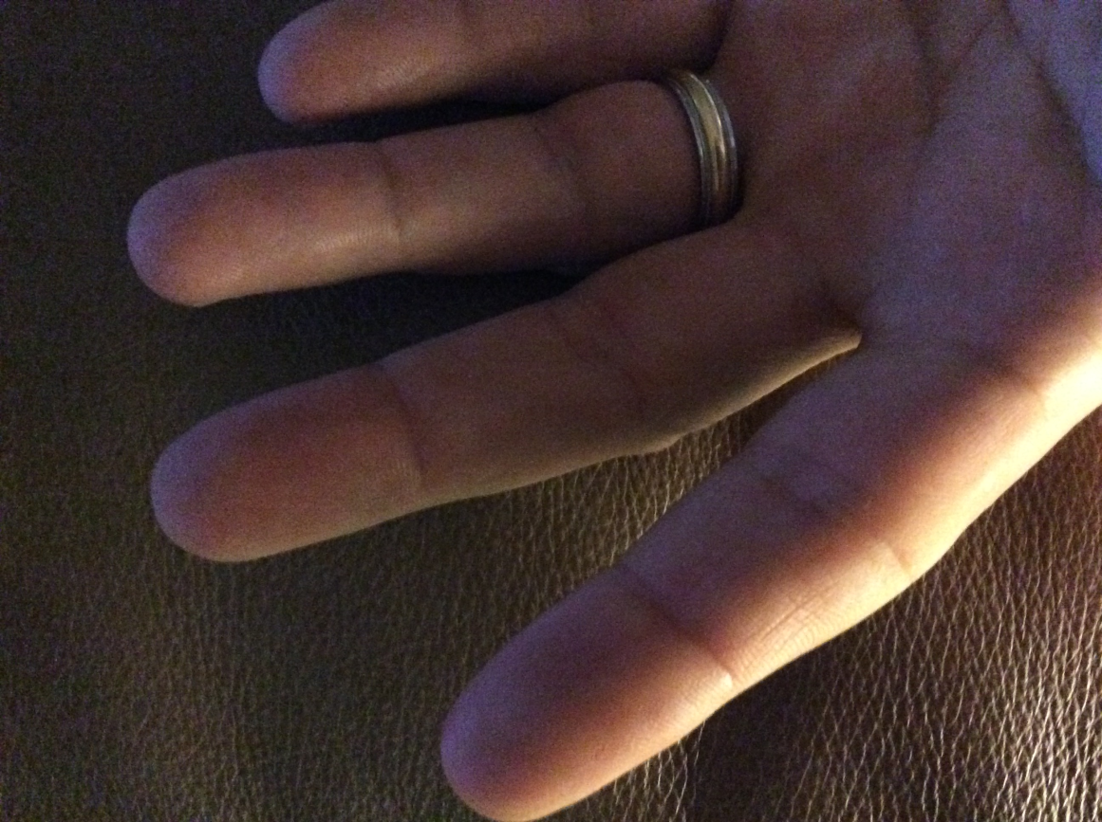
Describe what you see

Slide 17
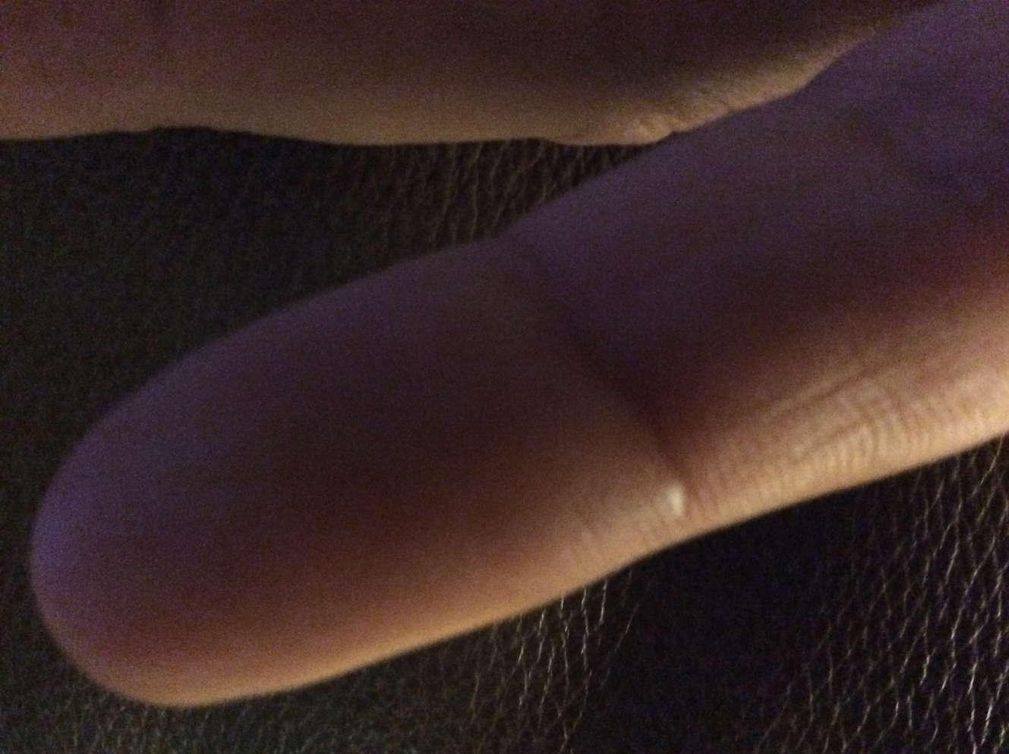
Describe what you see

Slide 18
Describe what you see

Slide 19
What did we just do?

Slide 20
What knowledge/skills were needed to do what you just did?

Slide 21
HISTOLOGY
It is not all new to you

Slide 22
Slides from FHB

Slide 23
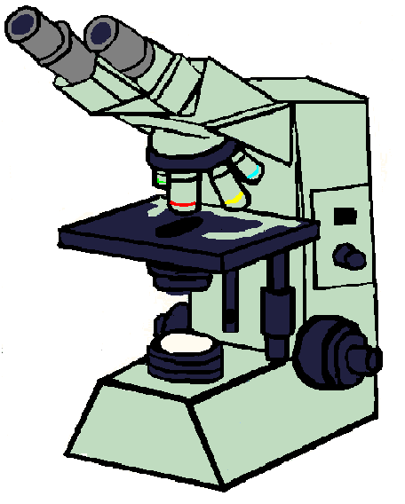
How do we visualize microscopic anatomy (histology) and pathology (histopathology)?
Traditional Microscope
Digitally scanned slides
SSOM “Zoomify” = Digitally scanned slides
Viewable via a “virtual microscope”
Simulates traditional microscope

Slide 24
Full set of Zoomify digital histology slides available on LUMEN

Slide 25
During the MHD labs themselves we will be displaying histology and histopathology slides on different powers largely via static images
Zoomify Histology Slides are included in the “Histology for Pathology” modules on Sakai for your review

Slide 26
Objective
Recognize the most common stain used in pathology (H&E) and explain the characteristic staining pattern.

Slide 27
Hematoxylin and Eosin (H&E stain)
Hematoxylin
A basic dye
Stains structures containing acids (e.g. nuclei) blue
Eosin
An acidic dye
Stains structures containing protein (e.g cytoplasm) pink

Slide 29
Objective
Define “special stains” and give examples of when they would be used.

Slide 30
“Special Stains”
Staining techniques used to
demonstrate specific cellular components (structures and substances)
identify micro-organisms
aid pathologists in the evaluation of disease states

Slide 32
Objective
Summarize the concept of “power” when visualizing histologic sections under a microscope.

Slide 33
What is “power”?
Many objectives from 2x – 100x
Low power – 2x-10x – to see overall structure of tissue
High Power – 20x-100x – examine smaller structures / cellular level

Slide 34
http://zoomify.lumc.edu/histonew/skin/skin_main.htm .
Thick skin palm
Review slide from low power to high power

Slide 35
Objective
Identify basic cellular components histologically:
nucleus
nucleolus
cytoplasm
cell borders

Slide 37
Identify basic cellular components histologically: Nucleus, nucleolus, cytoplasm, cell borders
Low power 10x
High power 40x

Slide 38
Thyroid Gland Identify cells, nuclei, cytoplasm

Slide 39
Organ: Appendix Identify cells, nuclei, nucleoli, cytoplasm
epithelium
lymphocytes

Slide 40
Objective: Identify basic tissue types histologically
Epithelium
Adipose tissue
Adipose tissue
Blood vessels
Muscle
Inflammatory cells
Nervous tissue

Slide 41
Epithelium
Tissue which covers nearly all body surfaces
Functions:
Protects (skin, esophagus)
Absorbs (GI tract, kidney)
Transports (ciliated cells of trachea)
Secretes (glands)
Gas exchange (lung)
Lubricates (pleural cavity)

Slide 43
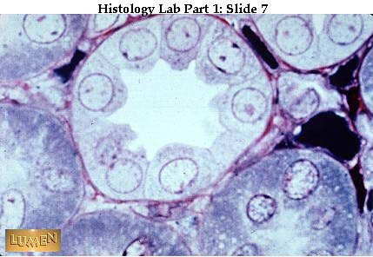
Kidney Tubule: Simple Cuboidal
10x
What is the PAS stain outlining
on this section?
PAS stain – 40x

Slide 44
Appendix: Simple Columnar

Slide 45
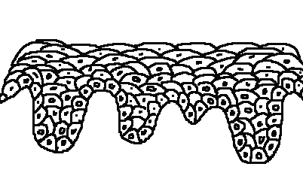
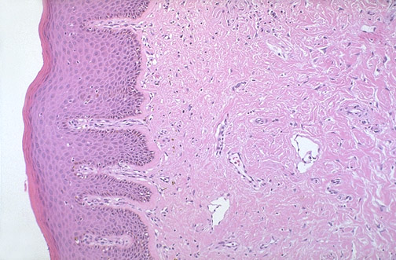
Skin – Epidermis Stratified Squamous
Cells originate from a layer of cells along a basal lamina and form a multilayered structure.
Cells toward the surface have smaller nuclei and greater amounts of cytoplasm with keratin.

Slide 46
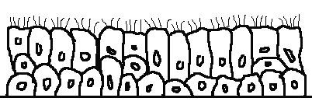
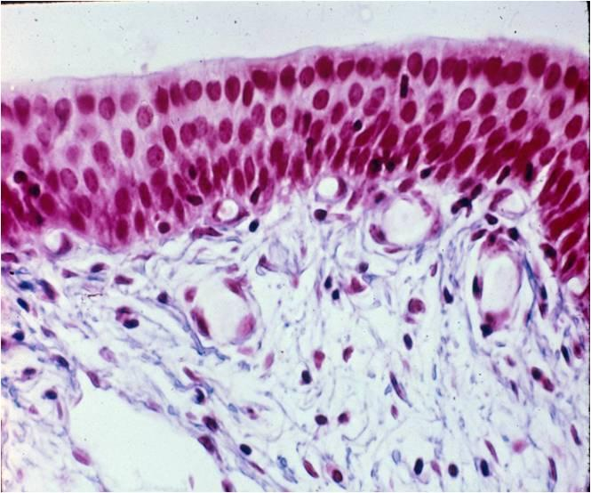
Respiratory Tract: Nasopharynx
not all the cells along the basal lamina reach the lumenal surface, though all contact the basal lamina.

Slide 47
Self-Assessment: Type of Epithelium?

Slide 48
Objective
Identify basic tissue types histologically:
epithelial tissue
connective tissue
adipose tissue
blood vessels
muscle tissue
nervous tissue
inflammatory cells

Slide 49
Connective Tissue
Provides structural support
Binds cells and tissues together
Provides metabolic support
Types
Dense connective tissue, loose connective tissue
Fibers (mostly collagen)
“Fibroblast” = nuclei
Adipose Tissue
Primary site of fat storage
Elastic tissue, reticular tissue

Slide 50
Dense connective tissue?
skin
?

Slide 51
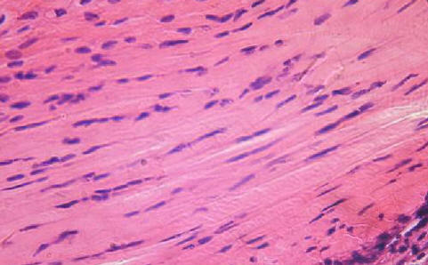
Identify fibroblasts Identify the collagen fibers

Slide 52
Adipose Tissue
Skin

Slide 53
Cells = Adipocytes
-Thin cell membrane
-Surrounds cytoplasmic lipid
(cytoplasm appears clear because
processing removes the actual lipids)
-Cell nucleus is pushed to the side
by cytoplasmic lipid

Slide 54
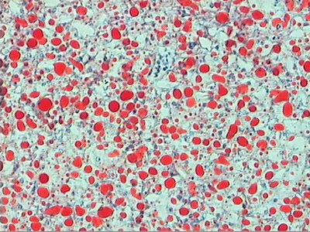
“Special Stain” Example
Oil Red O
Fat soluble dye which can stain lipids, triglycerides and some lipoproteins
Requires special processing of tissue sections

Slide 55
Objective
Identify basic tissue types histologically:
epithelial tissue
connective tissue
adipose tissue
blood vessels
muscle tissue
nervous tissue
inflammatory cells

Slide 56
Blood Vessels
Arterial
Arteries, arterioles, capillaries
Veins
Lymphatics
All lined by endothelium and have a smooth muscle layer of various thickness

Slide 57
Artery
Lumen
Smooth Muscle
Vein
SM
What is this
Tissue?

Slide 58
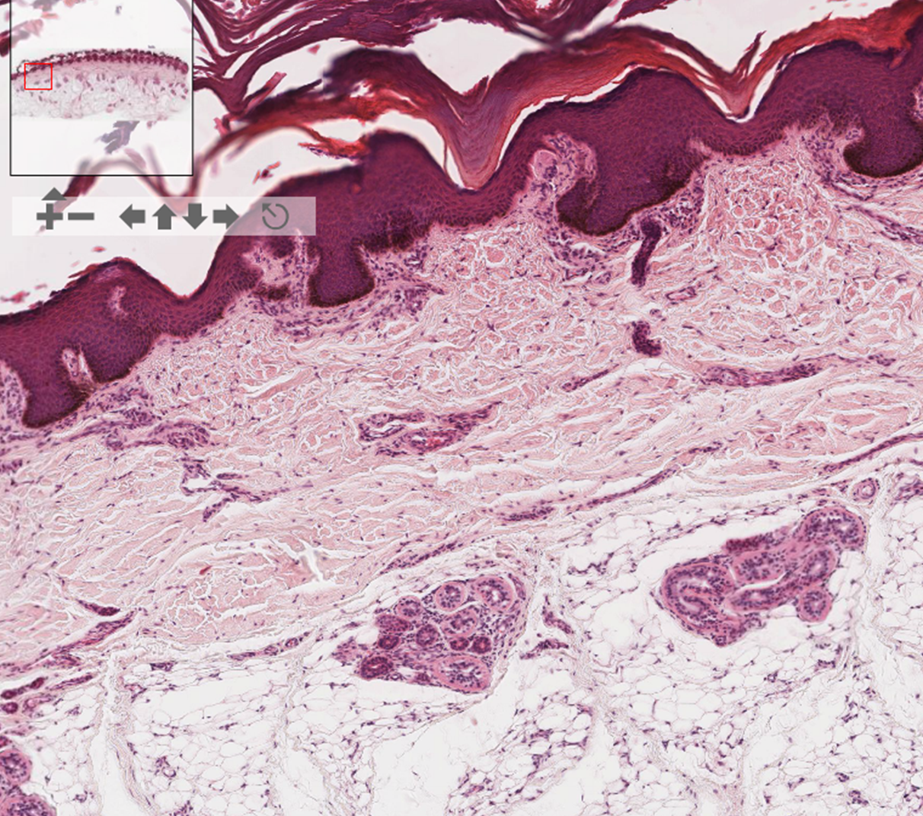

Slide 59
40x
Endothelial Cell
?
?

Slide 61
Objective
Identify basic tissue types histologically:
epithelial tissue
connective tissue
adipose tissue
blood vessels
muscle tissue
nervous tissue
inflammatory cells

Slide 62
Muscle
From your FHB Lecture – Muscle 1 – L3

Slide 63
Tongue: a) What tissue type is covering the surface of the tongue? b) Where is the muscle?

Slide 64
What kind of epithelium covers the surface of the tongue?

Slide 65
Muscle – point out cross sections and longitudinal sections
CT
Muscle

Slide 66
Skeletal muscle

Slide 67
Identify nuclei, fibers, cross-striations
60x

Slide 68
Skin
On low power, identify
Epithelium
Dense connective tissue
Adipose tissue

Slide 69
Objective
Identify basic tissue types histologically:
epithelial tissue
connective tissue
adipose tissue
blood vessels
muscle tissue
nervous tissue
inflammatory cells

Slide 70
40x
Identify
Dense connective tissue
Blood vessels
Nerve bundle is highlighted by
the arrow
What are these cells?

Slide 71
Nerve bundle: Cross section

Slide 72
Nervous Tissue
Nerve Fiber
Schwann Cell Nuclei
Fascicle
Perinuerium
Cross Section
Longitudinal Section

Slide 73
Ganglion Cells
Nerve cell bodies that are part of the sympathetic and parasympathetic nervous system
Identify the
Nucleus
Nucleolus
Cytoplasm
of the ganglion cells

Slide 74
Inflammatory Cells in tissue
Neutrophils
Eosinophils
Lymphocytes
Plasma cells
Macrophages
Sometimes lymphocytes and plasma cells can be part of “normal” histology of an organ
Appendix
Ileum

Slide 76
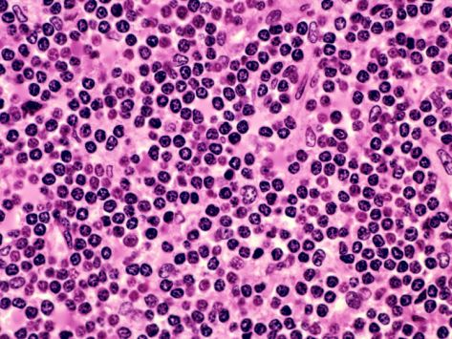
Normal Appendix – what cells are the arrows highlighting on low power and the predominant cell type on high power?

Slide 77
What cell types are highlighted in the image?

Slide 78
“Final Exam”
View on your own computer.
Pair up or do so in small groups.
We will ask for 2 volunteers to review
the slides with us.
Ileum
Identify:
Epithelium – name the type
Smooth muscle
Loose Connective tissue
Dense Connective tissue
Adipose tissue
Blood vessels
Inflammatory cells
http://zoomify.lumc.edu/histonew/gioverview/overview_main.htm
Ileum #131

Slide 85
Final Questions?

