Slide 1
Neuropathology lab II
MHD II
2/9/2018

Slide 2
Case 1
CHIEF COMPLAINT: Inability to move right arm and leg
HISTORY: A 68 year-old man is brought to the emergency department by paramedics who were called by the patient's daughter. The patient was playing with his grandchildren in the backyard when he suddenly stumbled and collapsed to the ground. The children called their mother who found the patient lying on his back, awake but unable to move his right arm and leg. In response to questions, he mumbled with slurred speech and answered incoherently.

Slide 3
Case 1
The patient has diabetes mellitus, type 2. He has been treated for hypertension with hydrochlorothiazide and enalapril. His has hyperlipidemia but has not tolerated statin therapy due to myalgias.
The patient has a 40-pack-year history of smoking.
Six months ago, the patient had a transient episode of (R) arm and leg weakness from which he recovered completely.

Slide 4
Case 1
PE: The patient is drowsy but arousable. He seems unable to comprehend most commands but he does not appear to be in acute distress. Vital signs: blood pressure 164/90 mmHg, apical heart rate 66/minute and regular, respiratory rate 20/minute, temperature 99°F.
Examination of the head and neck: The right corner of his mouth droops. He is unable to puff up the right cheek. The left pupil is dilated and reacts sluggishly to light and accommodation. Although he reacts appropriately to visual threats from the left side, he does not do so from the right side. The right pupil is 4mm in diameter and reacts to light appropriately.
The retinae show arteriolar narrowing but no flame hemorrhages or papilledema.
Examination of the chest reveals an increased A‑P diameter. Percussion reveals generalized, increased tympany. The breath sounds are soft.
On auscultation of the heart there is a grade II early systolic murmur heard best in the right second intercostal space.
The abdomen is soft and non‑tender. There are no palpable masses. The bowel sounds are normal.

Slide 5
The neurologic examination reveals the following findings: Refer to the head and neck for cranial nerve findings. Examination of the sensory system reveals an absence of pin‑prick sensation of the right side of the body.
Upon command the patient is unable to move his right arm and leg. He is barely able to wiggle the toes of his right foot. The deep tendon reflexes are hyperreactive on the right side. The right plantar response is extensor (positive Babinski).
The sensory and motor systems of the left side of the body are normal.

Slide 6
Case 1
Localize the lesion based on the clinical data.
Develop a differential diagnosis for the etiology of the findings.

Slide 7
Case 1
Discuss the significance of the following physical findings and clinical history:
-dilated left pupil with sluggish reaction
-right extensor plantar response
-previous attack of weakness of the right leg and arm

Slide 8
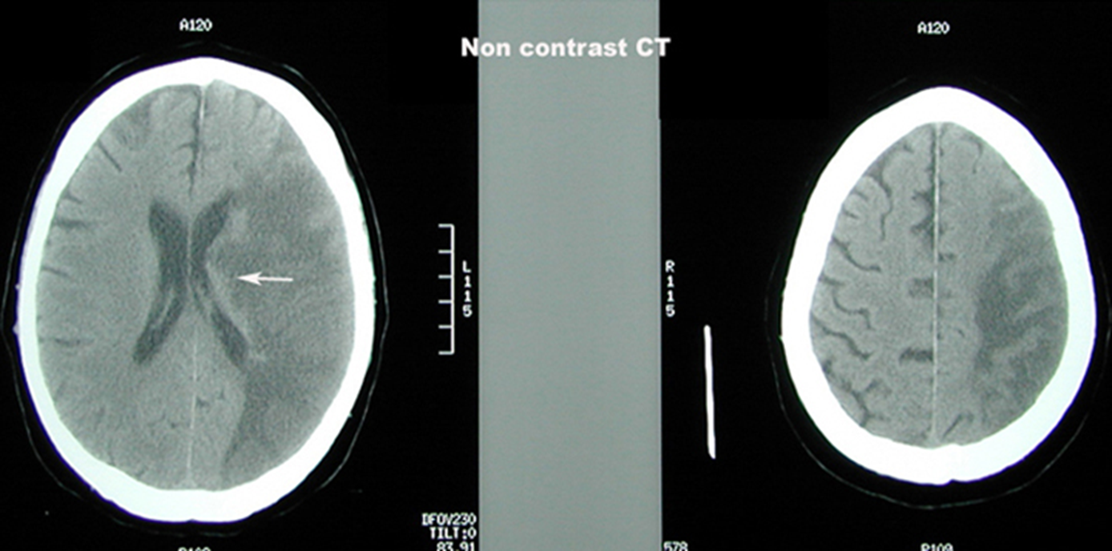
Describe the findings
Case 1
L

Slide 9
Case 1
Considering the imaging findings and onset of the patient’s symptoms, what treatment should be considered?

Slide 10
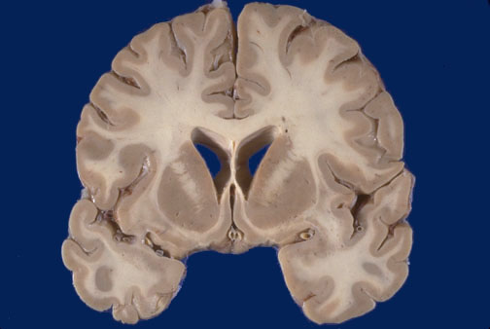
Case 1 – Describe the gross findings.
normal

Slide 11
Describe the 20x histologic findings, in particular identify and describe the appearance of the neurons.
Case 1
normal

Slide 12
Case 1 Contrast the neurons with the normal neuron
Normal

Slide 13
Case 1
The patient’s daughter wants to understand why this happened to her father. How would you explain the pathogenesis to her?

Slide 14
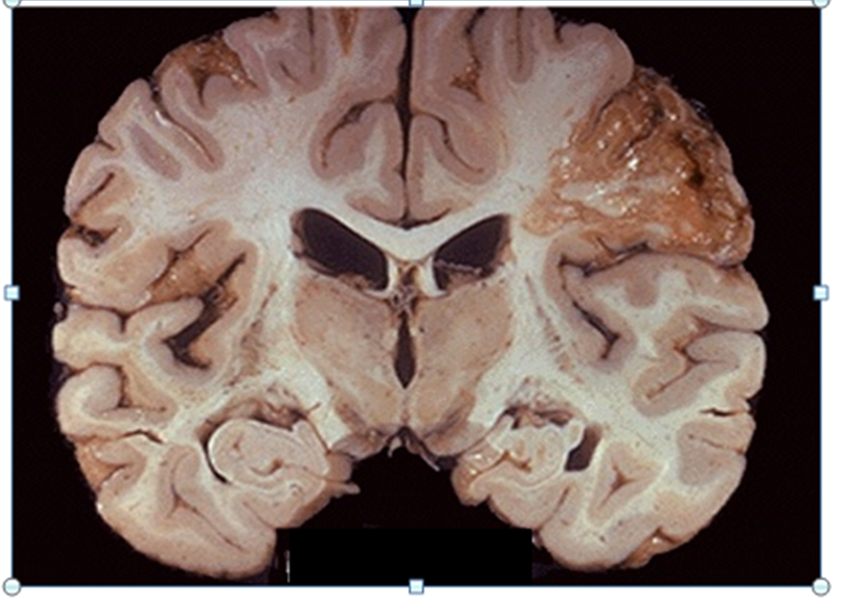
Case 1
Different patient after the same pathologic process. Time has
passed. Describe the gross findings.

Slide 15
Case 1: Describe the low power histologic findings.

Slide 16
Case 1: Describe the high power findings. What is the predominant cell type? Approximately how many days after the patient’s initial presentation will one see these cells?

Slide 17
Case 1 – months later.
Describe the gross findings- where is the
primary pathologic abnormality?

Slide 18
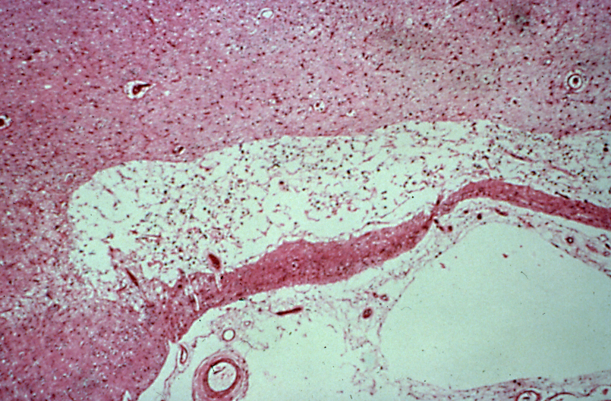
Case 1
Section correlates with the primary gross abnormality. Describe the
histologic findings

Slide 19
Case 2
The patient is a 64-year-old man who developed a headache 10 days prior to being seen in the office. He describes the headache as being mild and in the front of his head initially. The headache became more intense and generalized during the past week. He cannot relieve the pain.
His wife and son say that the patient has been confused at times and increasingly irritable this past week. They became alarmed several days ago when the patient developed weakness of his left arm and leg. He seems to be "dragging his left foot" and is clumsy. The patient angrily denies that there is any problem other than his headache.
Although he complains of some nausea he has not vomited. He has not felt dizzy or fainted. He has had no chills/fever. He denies having a stiff neck.
The patient is being treated for mild hypertension.

Slide 20
Case 2
PE: The patient is awake, alert, and in no apparent distress. He speaks coherently and is oriented to person, place and time. Vital signs are as follows: BP 152/86, apical heart rate 74/minute and regular, respiratory rate 16/minute, temperature 98.8°F.
Examination of the head and neck reveals normal symmetry and contour. The neck muscles are not spastic. The temporal arteries are not painful or palpable. The pupils are 3mm in diameter, round, equal and react to light and accommodation normally. The extra ocular muscles all function normally. Funduscopic exam shows mild blurring of the optic disks.
The lungs are clear to percussion and auscultation.
The cardiac sounds are soft but normal. Murmurs and extra sounds are not heard.
The abdomen is not-distended, non‑tender and without palpable masses. Rectal exam is normal.
The neurologic examination: Cranial nerves II through XII are intact. Examination of the motor system reveals grade 3/5 left sided muscle strength and grade 5/5 right-sided muscle strength. Fine movement of the left hand, but not the right is impaired. Examination of the sensory system is normal bilaterally. The deep tendon reflexes are 3 + on the left side and 2 + on the right side. The Babinski sign is positive on the left side.

Slide 21
Case 2
Summarize the main clinical problem
Develop a differential diagnosis.

Slide 22
Correlate the findings on imaging with the gross pathology
Case 2

Slide 23
Case 2 Describe the low power histologic findings. Is there any “normal” brain in this image?

Slide 24
Case 2 Describe the high power histologic findings.

Slide 25
Case 2
What is your diagnosis?
What is the approach to treatment and prognosis?

Slide 26
Describe the gross pathology. (specimen from another patient with same disease process)
Case 2

Slide 27
Case 3
A 34 year-old man is presents for evaluation of progressive bilateral hearing loss. At times he also senses ringing in his ears.
Past medical history is significant for having tonic-clonic seizures, treated with phenytoin for a year.
On review of systems he notes that over the past several months he has felt intermittently unsteady on his feet.

Slide 28
Case 3
PE: The patient is alert and oriented, with normal cognitive function.
He has bilateral hearing loss and diminished visual acuity.
Few scattered skin lesions that resemble skin tags are present.
Audiometric evaluation reveals bilateral sensorineural hearing loss, more severe on the right.

Slide 29
Case 3
Summarize the patient’s problems.
Develop a differential diagnosis.

Slide 30
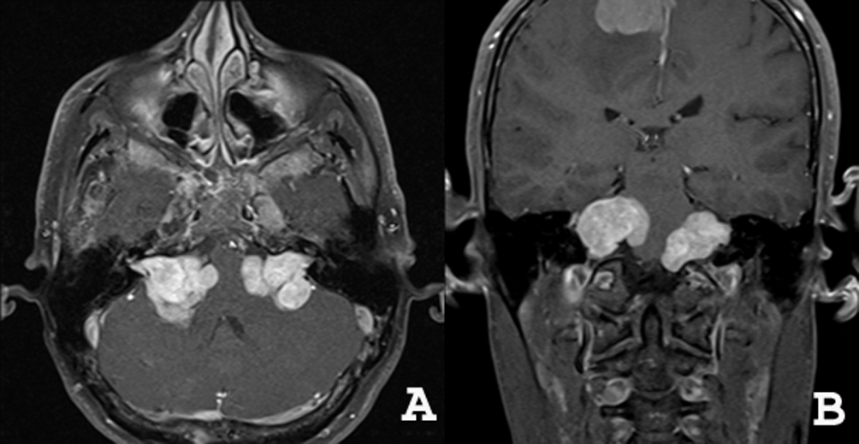
Case 3 Describe imaging findings

Slide 31
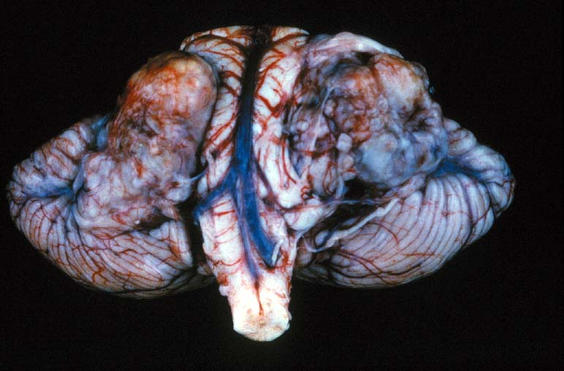
Case 3 Describe the corresponding gross findings

Slide 32
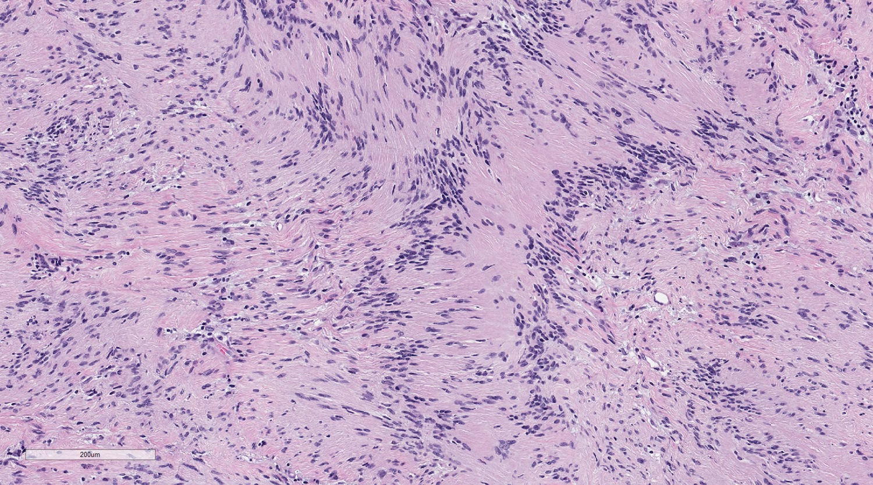
Case 3 – Describe the representative histologic findings
Both these images are take from different sites of the same tumor

Slide 33
Case 3
What is your diagnosis?

Slide 34
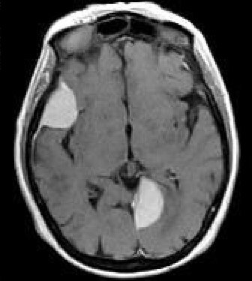
Case 3 Describe additional imaging findings

Slide 35
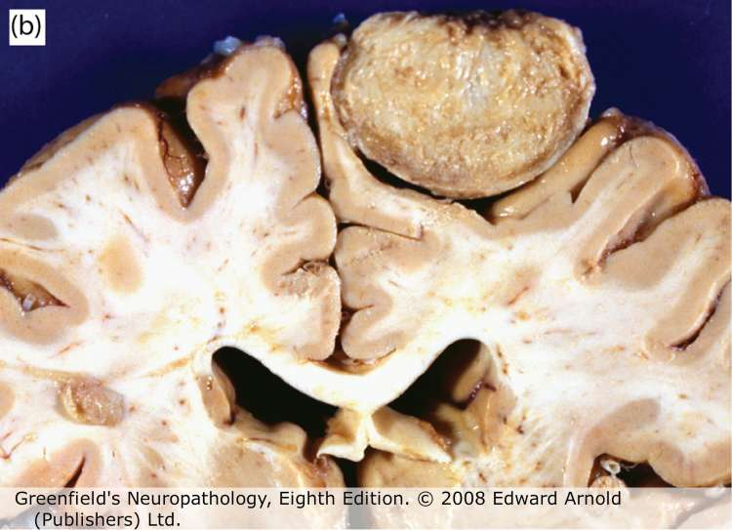
Case 3 Describe representative corresponding gross findings

Slide 36
Case 3 Describe the histologic findings.

Slide 37
Case 3
What is your diagnosis?

Slide 38
Case 3
Is there a condition that may explain the co-existence of these neoplasms?
What additional clinical history would you obtain to confirm your suspicion? What laboratory test(s)?
Are there other lesions this patient is at risk of developing?

Slide 39
Case 4
A 62 year old man presents with 4-5 years of memory problems. His initial symptoms included forgetting things, such as where he placed his car keys. His daughter also recalls incidents such as him asking for ketchup for spaghetti instead of Parmesian cheese. Memory problems impaired his ability to work effectively resulting in early retirement 1 year ago. Recently he lost his way home from the local grocery store at which he shopped for many years.

Slide 40
Case 4
Some days he has gotten dressed putting his shirt on backwards. He has paid less attention to his hygiene, not wanting to shave or brush his teeth for several days.
His wife has slowly taken over paying their bills since finding overdue notices and checks written out for wrong amounts.
He has always been known as a kind and giving man but of late his family has found him to be more irritable and even self-centered.

Slide 41
Case 4
Summarize the patient’s symptoms.
What pathophysiological process is suggested by the time course of his symptoms?

Slide 42
Case 4
What additional information would you obtain from his history?

Slide 43
Case 4
Physical Exam:
BP 141/80, P 52, Wt 172#. Ht. 69 in.
General appearance showed psychomotor restlessness.
He displayed some difficulty with balance getting up from a chair.
His Mini-Mental Status Score was 18/30
Describe the components of the Folstein Mini-Mental Status Exam.

Slide 44
Case 4
Neurological exam
Cranial nerves: decreased hearing
Motor exam: bilateral upper and lower extremity strength is 5-/5
Sensory Exam: primary and cortical sensation intact
Reflexes: deep tendon reflexes are slightly brisk

Slide 45
Case 4
The following tests were ordered. Why?
Vitamin B12 – 479 pg/ml (211-911 pg/ml)
TSH – 0.64 uIU/ml (0.35-4 uIU/ml)
RPR – Nonreactive

Slide 46
Case 4
The patient’s daughter states that she read an article about “APOE4 genotyping”. What role, if any, would it have in the evaluation of this patient?

Slide 47
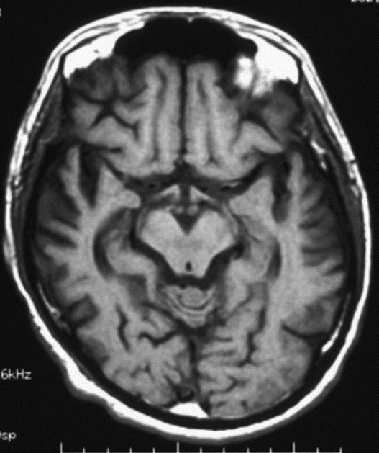
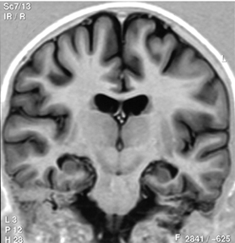
MRI
Case 4 - MRI
Interpret the findings of both images from this patient.

Slide 48
Case 4
What is your diagnostic impression based on the given data?

Slide 49
Case 4: Follow-up
The patient continued to decline cognitively and functionally over next 5 years. His ambulation decreased and he became bedbound. He was hospitalized twice for aspiration pneumonia. He developed a large sacral decubitus ulcer. He lost his ability to verbally communicate.
His family agreed that the goals of care were comfort and quality of life.
He was enrolled in a home hospice program and died 5 months later.

Slide 50
Case 4
Why did the patient develop aspiration pneumonia?
What is a sacral decubitus ulcer? Why did it develop?

Slide 51
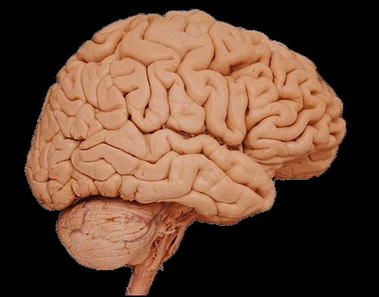
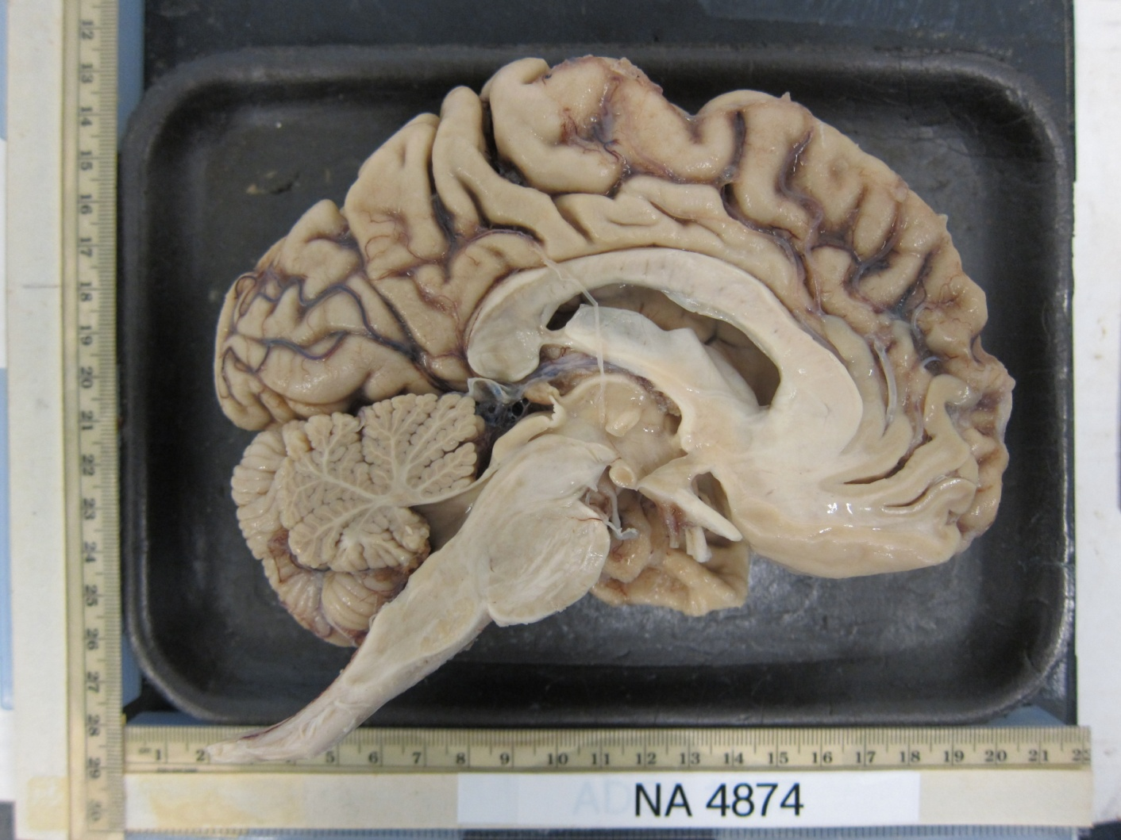
Case 4
Describe the gross
findings
Normal brain
BRAIN WEIGHT (FRESH):
900 GRAMS
Notes:
.

Slide 52
Case 4 – Describe the gross findings
PATIENT
NORMAL

Slide 53
Case 4 – Describe the low power findings
NORMAL
PATIENT

Slide 54
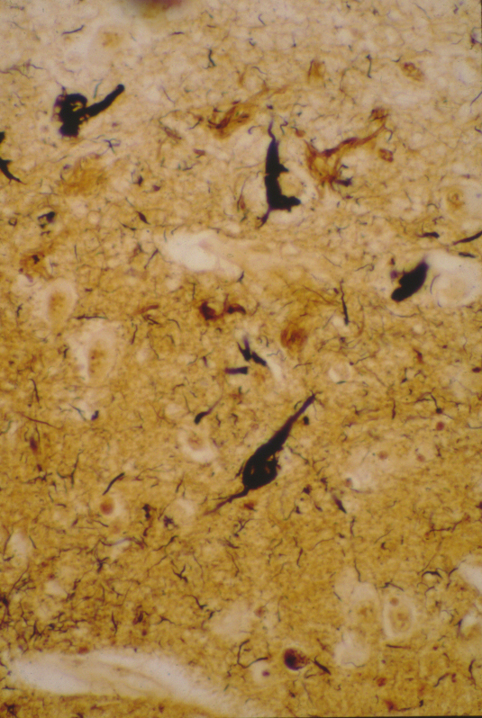
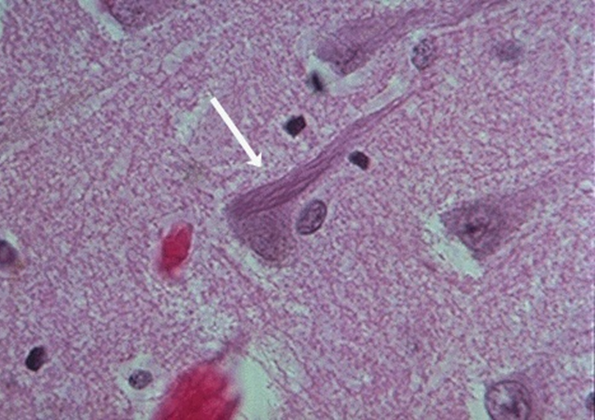
Case 4
What is indicated by the arrow? What is it composed of? What is its significance?
H&E
Silver Stain

Slide 55
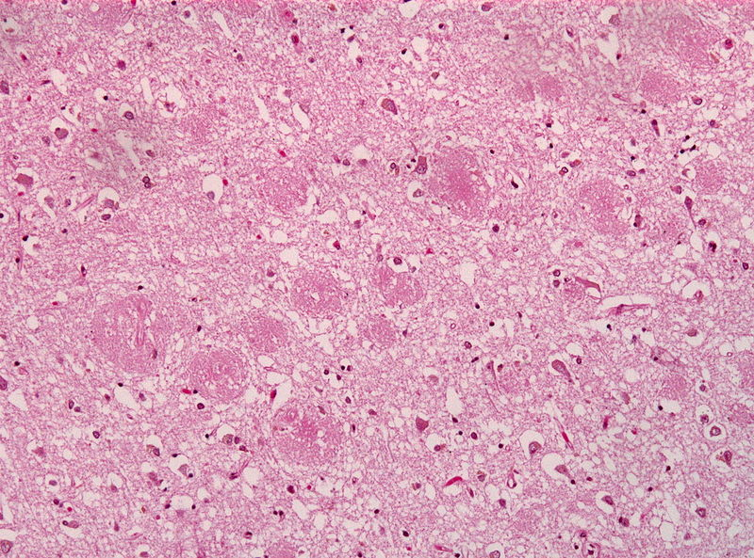
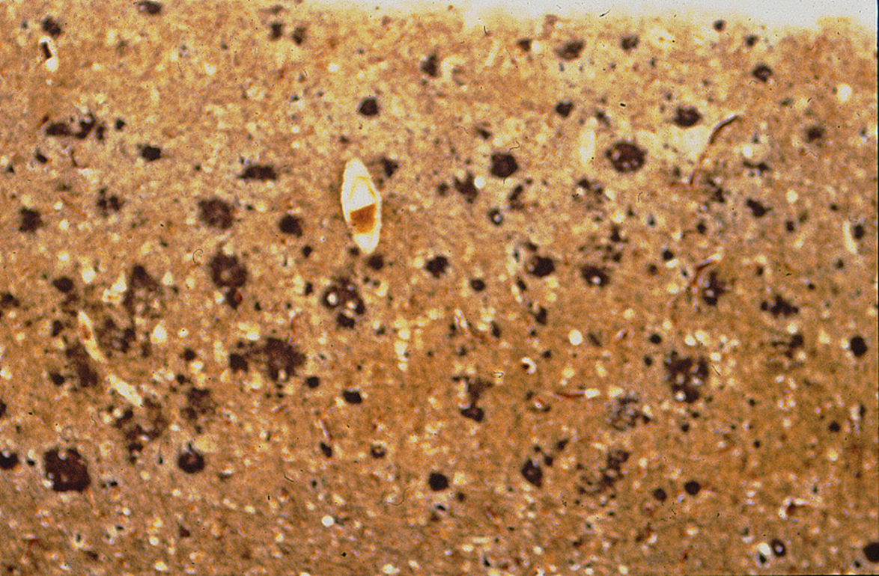
Case 4
What is indicated by the arrow? What is it composed of? What is its significance?
Silver stain

Slide 56
Case 4
Describe the blood vessels. What substance is most likely deposited in their walls?
Notes:
.

Slide 57
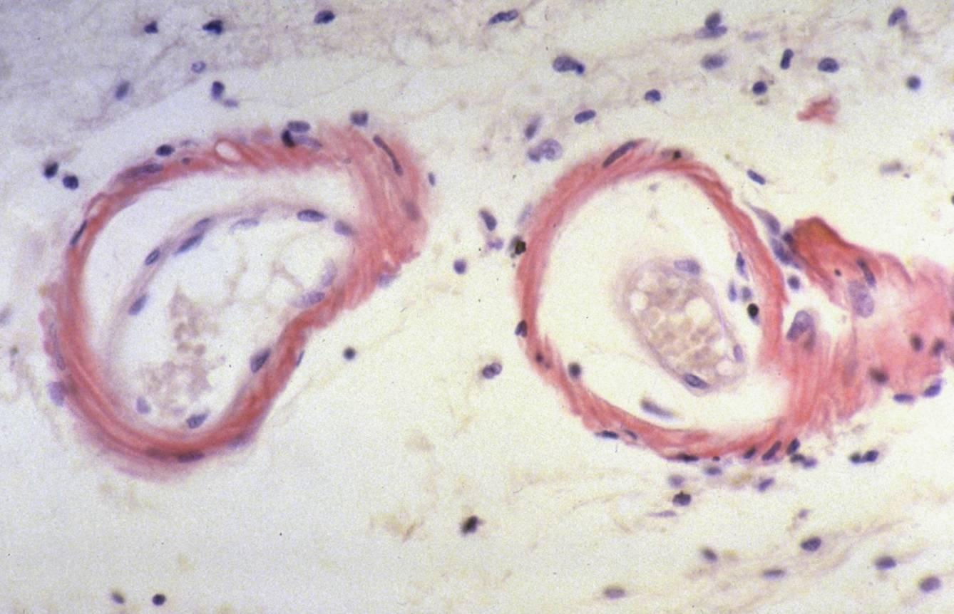
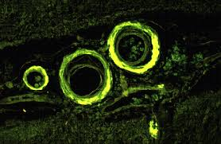
Case 4. What stain is represented in slide A? What does slide B represent?
B
A

Slide 58
Case 4
The blood vessel findings may predispose patients to what potential complication (even if the patient does not have the disease process depicted in this case)?

