Slide 4
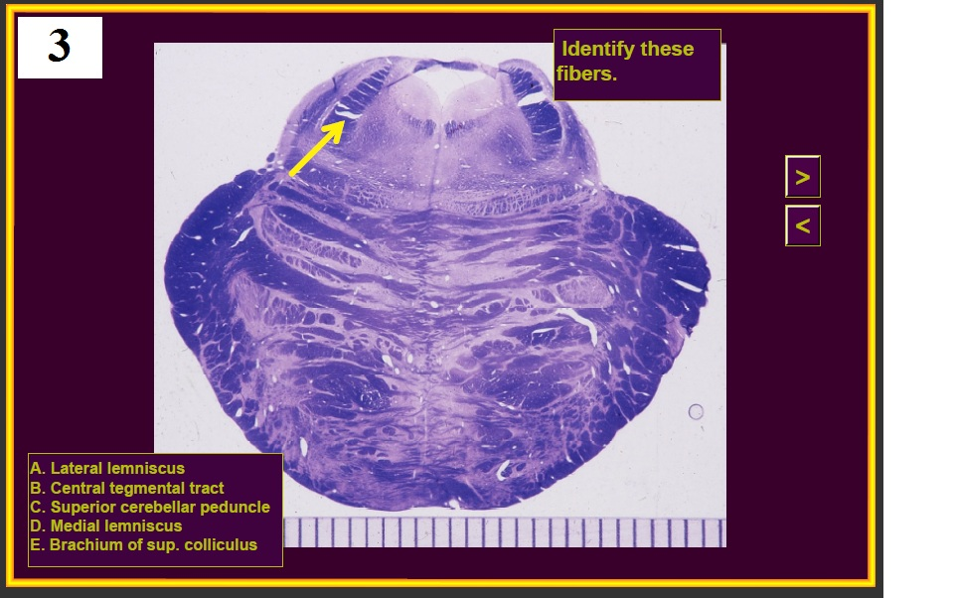

Slide 6
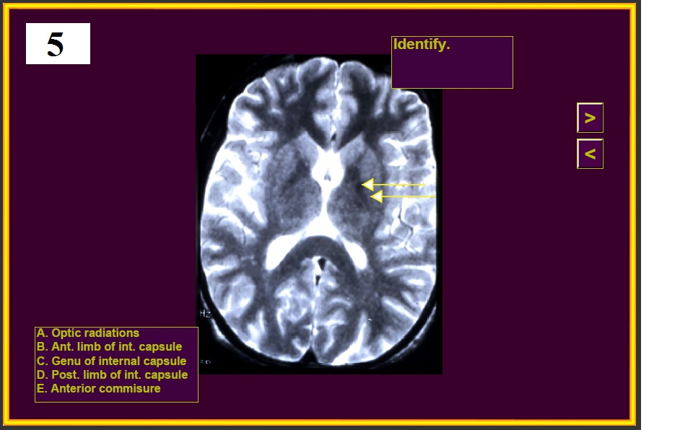

Slide 14
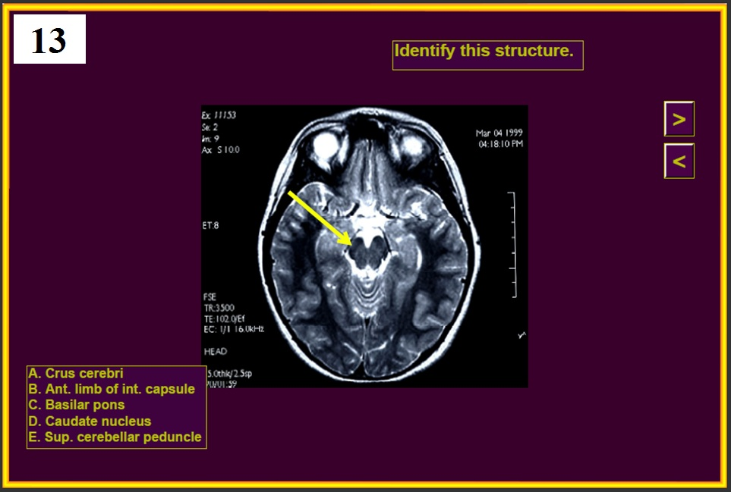

Slide 15
14

Slide 16
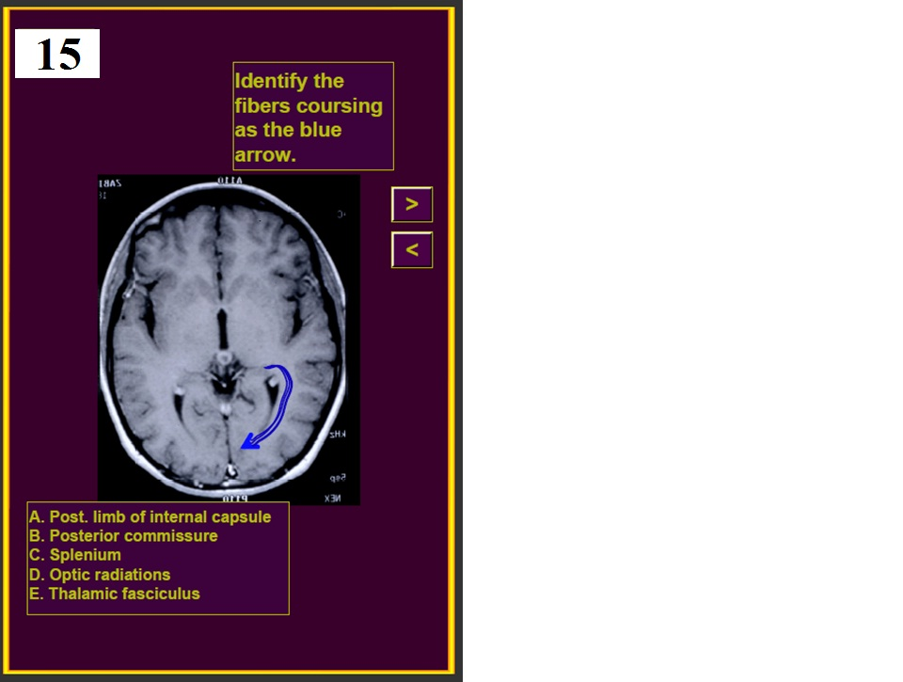
Identify the fibers coursing at the blue arrow.

Slide 19
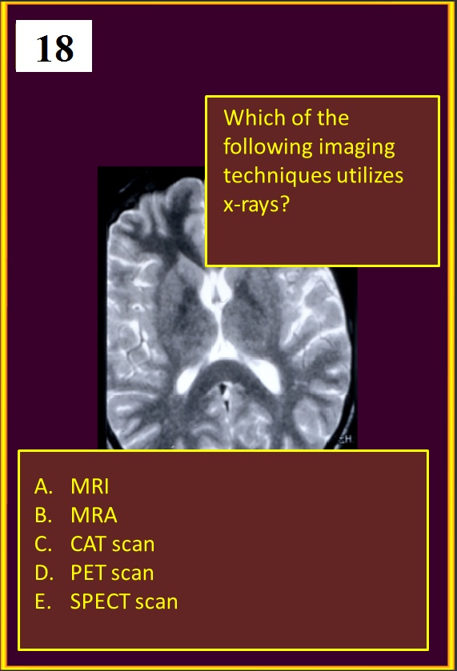

Slide 21
20.
A teacher has had 2 weeks of back pain radiating down his posterior left leg. Which scan is the best for demonstrating a herniated disc?
MRA
CAT scan
PET scan
T1 MRI
T2 MRI

Slide 22
END OF QUIZ #3

Slide 36
14

Slide 37
Identify the fibers coursing at the blue arrow.

Slide 42
20.
A teacher has had 2 weeks of back pain radiating down his posterior left leg. Which scan is the best for demonstrating a herniated disc?
MRA
CAT scan
PET scan
T1 MRI
T2 MRI

