Slide 1
Neuroanatomy Brainstem Slides
Self Assessment
Use as a study guide, or you can click on any outlined structure in presentation mode to see its name.
Robert J. Frysztak, Ph.D.

Slide 2
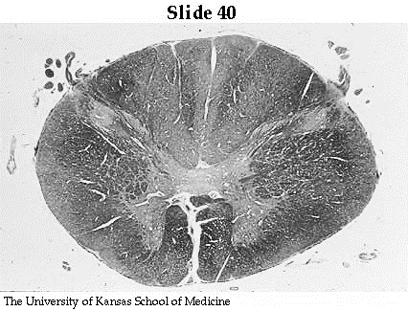
C1 Spinal Cord (Slide 40)
Fasiculus Gracilus
Fasiculus Cunneatus
Spinal Trigeminal Tract
Spinal Trigeminal Nucleus
RubroSpinal Tract
Medial Longitudinal Fasciculus
Dorsal SpinoCerebellar Tract
A
TectoSpinal Tract
Ventral SpinoCerebellar Tract
Reticulospinal & Vestibulospinal Tracts
SpinoThalamic Tract
The University of Kansas School of Medicine
CorticoSpinal Tract

Slide 3
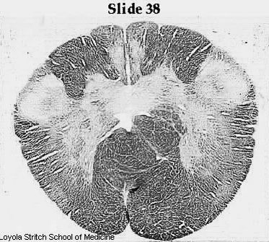
Medulla – Pyramidal Decussation (Slide 40)
Fasiculus Gracilus
NG
Fasiculus Cunneatus
Solitary Nucleus
Nucleus Gracilus
NC
Nucleus Cunneatus
Spinal Trigeminal Tract
Spinal Trigeminal Nucleus
RubroSpinal Tract
Dorsal SpinoCerebellar Tract
Medial Longitudinal Fasciculus
Ventral SpinoCerebellar Tract
TectoSpinal Tract
SpinoThalamic Tract
Reticulospinal & Vestibulospinal Tracts
Loyola University Stritch School of Medicine
Pyramidal Tract (CST)

Slide 4
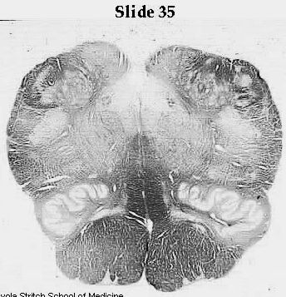
Medulla – Sensory Decussation (Slide 35)
Spinal Trigeminal Tract
Fasiculus Gracilus
Spinal Trigeminal Nucleus
Fasiculus Cunneatus
NG
Solitary Tract & Nucleus
Lateral Cuneate Nucleus
NC
10
Dorsal Motor Nucleus of Vagus
Nucleus Gracilus
Nucleus Cunneatus
12
Hypoglossal Nucleus
RubroSpinal Tract
Dorsal SpinoCerebellar Tract
Medial Longitudinal Fasciculus
Ventral SpinoCerebellar Tract
TectoSpinal Tract
SpinoThalamic Tract
Medial Lemniscus
Reticulospinal & Vestibulospinal Tracts
12
Principle Olive
Loyola University Stritch School of Medicine
Pyramidal Tract

Slide 5
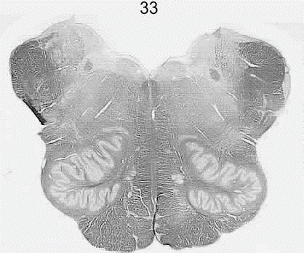
Medulla – Vagal Nuclei (Slide 33)
Lateral Cuneate Nucleus
Hypoglossal Nucleus
Spinal Trigeminal Nucleus
Spinal Trigeminal Tract
Solitary Tract & Nucleus
Dorsal Motor Nucleus of Vagus
Inferior Cerebellar Peduncle
Nucleus Ambiguus
RubroSpinal Tract
10
Dorsal SpinoCerebellar Tract
Ventral SpinoCerebellar Tract
Medial Longitudinal Fasciculus
SpinoThalamic Tract
TectoSpinal Tract
Medial Lemniscus
12
Principle Olive
Reticulospinal & Vestibulospinal Tracts
Medial Vestibular Nucleus
Loyola University Stritch School of Medicine
Inferior Vestibular Nucleus
Pyramidal Tract
Lateral Vestibular Nucleus

Slide 6
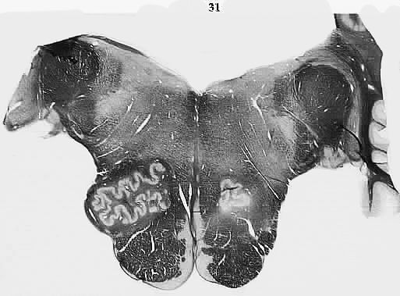
Medulla – Glossopharyngeal Nerve (Slide 31)
Medial Vestibular Nucleus
Inferior Salivatory Nucleus
Solitary Tract & Nucleus
Nucleus Ambiguus
Inferior Vestibular Nucleus
Dorsal Cochlear Nucleus
Spinal Trigeminal Nucleus
Inferior Cerebellar Peduncle
Spinal Trigeminal Tract
Ventral Cochlear Nucleus
Dorsal SpinoCerebellar Tract
RubroSpinal Tract
Ventral SpinoCerebellar Tract
9
MLF
SpinoThalamic Tract
TectoSpinal Tract
Medial Lemniscus
Principle Olive
Facial Motor Nucleus
Pyramidal Tract
Loyola University Stritch School of Medicine

Slide 7
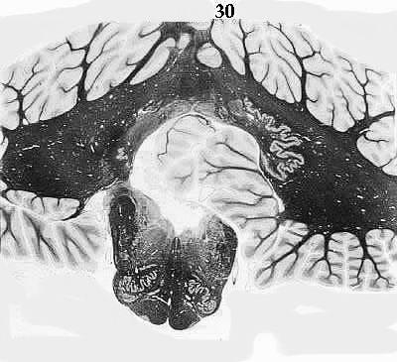
Medulla – Pontomedullary Junction (Slide 30)
Fastigial
nucleus
Cerebellar Cortex
Globose
nucleus
Emboliform
nucleus
Dentate
nucleus
Inferior Cerebellar Peduncle
Dorsal Cochlear Nucleus
MLF
TectoSpinal Tract
Principle Olive
Medial Lemniscus
Pyramidal Tract
Loyola University Stritch School of Medicine

Slide 8
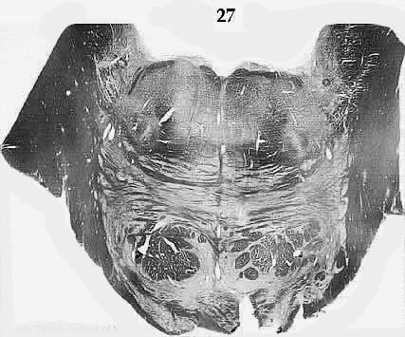
Abducens Nucleus
Pons – Genu of Facial Nerve (Slide 27)
Mesencephalic Tract & Nucleus
Spinal Trigeminal Tract
Facial colliculus
Spinal Trigeminal Nucleus
MLF
TectoSpinal Tract
Dorsal SpinoCerebellar Tract
Medial Lemniscus
Facial Motor Nucleus
Trapezoid Body & Nucleus
(from cochlear nuclei)
SpinoThalamic Tract
Middle Cerebellar Peduncle
Lateral Lemniscus
(from superior olivary nucleus)
7
Superior Olivary Nucleus
(from cochlear nuclei)
Pontine Gray
Pyramidal Tract
6
Loyola University Stritch School of Medicine

Slide 9
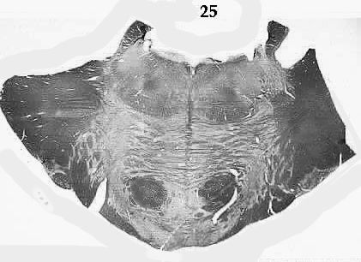
Pons – Trigeminal Nerve (Slide 25)
Superior Cerebellar Peduncle
MLF
Mesencephalic Tract & Nucleus
Ventral SpinoCerebellar Tract
TectoSpinal Tract
Middle Cerebellar Peduncle
Principal (Chief) Sensory Nucleus
Trigeminal Motor Nucleus
Lateral Lemniscus
(from superior olivary nucleus)
SpinoThalamic Tract
Medial Lemniscus
Pyramidal Tract
Pontine Gray
5
Loyola University Stritch School of Medicine

Slide 10
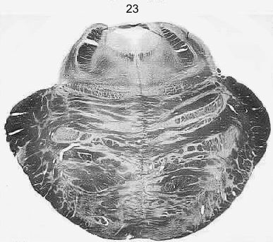
Pons – Trochlear Nerve Fibers (Slide 23)
Trochlear Nerve Fibers (crossing)
4th Ventricle (Aqueduct of Sylvius)
Superior Cerebellar Peduncle
Periaqueductal Gray
MLF
Lateral Lemniscus
(from superior olivary nucleus)
Mesencephalic Tract
SpinoThalamic Tract
Locus Ceruleus
Medial Lemniscus
TectoSpinal Tract
Raphe Nuclei
Middle Cerebellar Peduncle
Pyramidal Tract
Pontine Gray
Loyola University Stritch School of Medicine

Slide 11
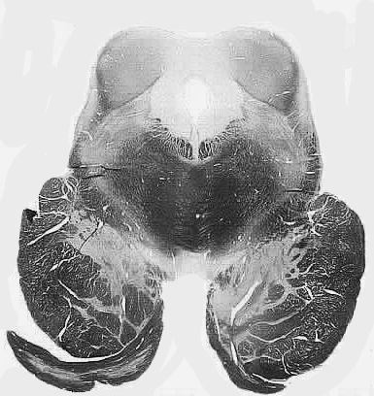
Midbrain – Inferior Colliculus (Slide 20)
Trochlear Nucleus
Inferior Colliculus
Aqueduct of Sylvius
Lateral Lemniscus
(Auditory Information)
Periaqueductal Gray
MLF
SpinoThalamic Tract
Medial Lemniscus
Superior Cerebellar Peduncle Decussation
Substantia Nigra
Crus Cerebri
Corticospinal Tract
Loyola University Stritch School of Medicine

Slide 12
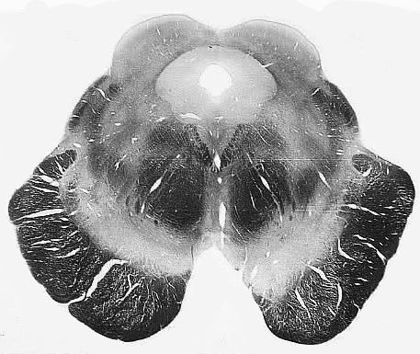
Midbrain – Superior Colliculus (Slide 18)
Superior Colliculus
Periaqueductal Gray
Edinger-Westphal Nucleus (III)
Aqueduct of Sylvius
MLF
Oculomotor Nucleus
SpinoThalamic Tract
Medial Lemniscus
Substantia Nigra
Superior Cerebellar Peduncle
Crus Cerebri
Corticospinal Tract
*
Cerebral Peduncle
( Interpeduncular fossa)
3
*
Loyola University Stritch School of Medicine

Slide 13
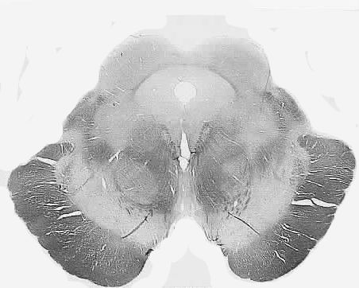
Midbrain – Superior Colliculus (Slide 16)
Superior Colliculus
Periaqueductal Gray
Aqueduct of Sylvius
SpinoThalamic Tract
Oculomotor Nucleus
Medial Lemniscus
CerebelloThalamic Fibers
(remnants of SCP)
MLF
Substantia Nigra
Red Nucleus
Crus Cerebri
Corticospinal Tract
*
Cerebral Peduncle
( Interpeduncular fossa)
3
*
Loyola University Stritch School of Medicine

