Slide 1

ANEMIAS
Jorgena Kosti-Schwartz, DO

Slide 2
WORK UP
RC
LDH, Tbili, Hapto
Coombs
B12/folate/copper/TSH
Ferritin/Iron sat/TIBC ➔ Soluble transferrin receptor
Peripheral smear
Bone Marrow Biopsy / SPEP/IE/FLC/Ig
Epo level

Slide 3
RC
Normal/Decreased
Increased
MCV
Hemolysis
Blood Loss
Microcytic
Normocytic
Macrocytic
Intrinsic
Extrinsic
IDA
Thalassemia
ACD (late)
Sideroblastic
TEC
ACD (early)
Renal, Thyroid
BM Invasion
B12, Folate
Medications/ Substances
BM Aplasia
Membrane
Hemoglobinopathy
Enzyme
Immune
Non-Immune
Notes:
Transient erythroblastopenia of childhood

Slide 4
RC
Normal/Decreased
Increased
MCV
Hemolysis
Blood Loss
Microcytic
Normocytic
Macrocytic
Intrinsic
Extrinsic
IDA
Thalassemia
ACD (late)
Sideroblastic
TEC
ACD (early)
Renal, Thyroid
BM Invasion
B12, Folate
Medications/ Substances
BM Aplasia
Membrane
Hemoglobinopathy
Enzyme
Immune
Non-Immune

Slide 5
RBC Membrane Disorders
  Presentation: Persistent mild – moderate Anemia, +/- acute hemolysis, inherited
  Clinical findings: Scleral icterus, jaundice, splenomegaly, pigmented gallstones
  Lab findings: MCV variable, often normal (HS), elevated RC, elevated LDH, elevated tbili, low Hapto
Notes:
Peripheral smear

Slide 6
Spherocytosis…
Hereditary Spherocytosis
WAHA
Cold agglutinin disease
Extensive thermal burns
Scorpion Venom

Slide 7
Hereditary Spherocytosis
Age: variable (hydrops fetalis)
AD – 75%; AR – 25%
Most common inherited Hemolytic Anemia in Northern European Ancestry, 1 in 2000
Mechanism: Vertical associations of proteins that link the cytoskeleton to the lipid bilayer
  Mutations: Ankyrin (ANK1), Band 3 (SLC4A1), Spectrin (SPTB, SPTA), Protein 4.2
  Spherocytes prone to Extravascular hemolysis/phagocytosis by splenic macrophages

Slide 8
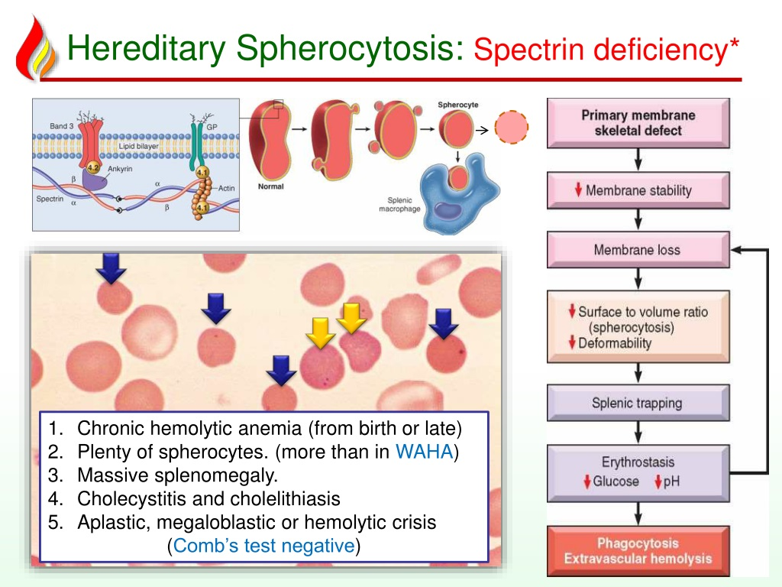
Notes:
Splenic interendothelial fenestrations

Slide 9
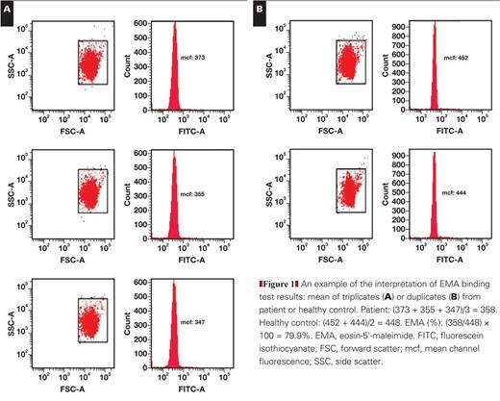
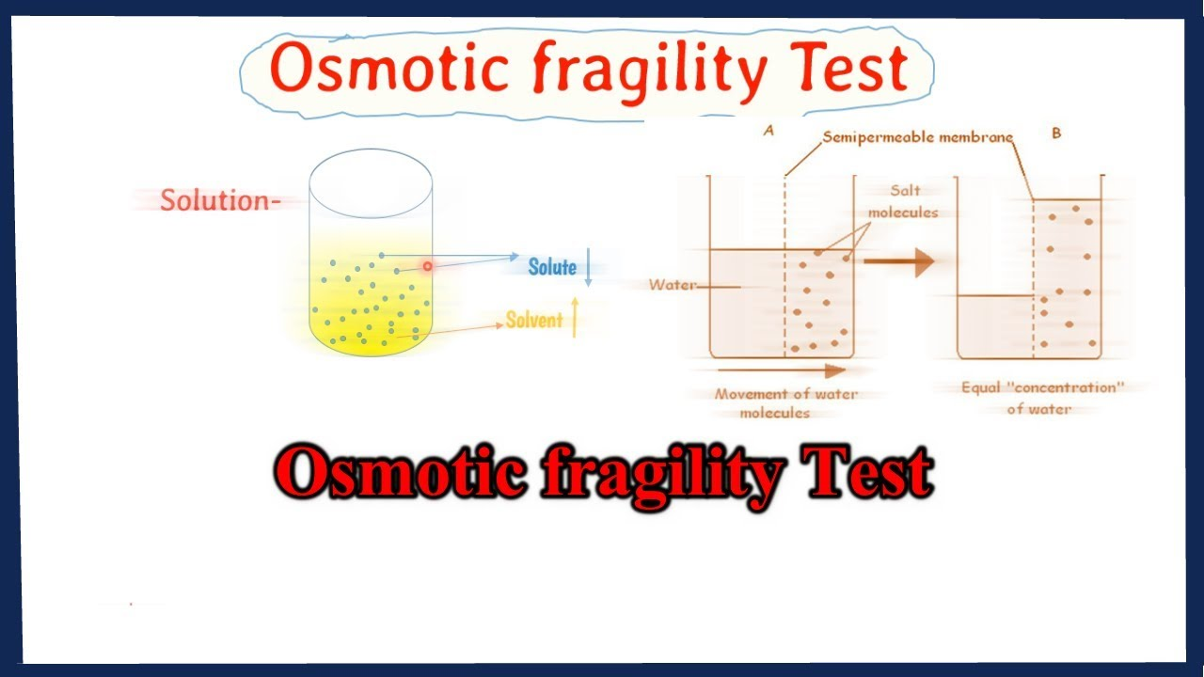
Diagnosis
Notes:
eosin-5′-maleimide (EMA) binding test is a flow cytometric test. EMA is a fluorescent dye that binds to plasma membrane proteins of red blood cells (RBCs), mainly to band 3 protein. The mean fluorescence of EMA-stained RBCs in HS patients is lower when compared with control RBCs. Can also be low in other conditions.

Slide 10
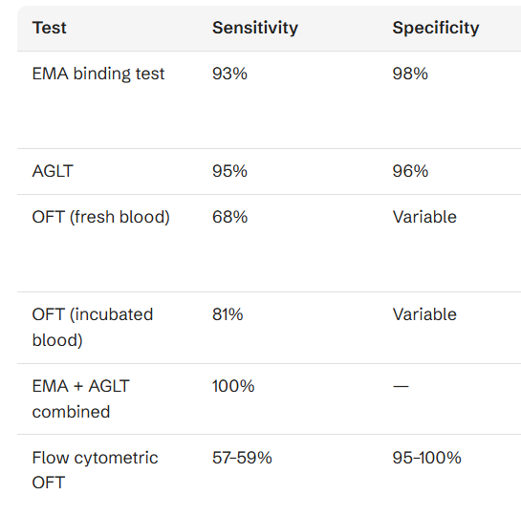
TESTING METHODS
Genetic sequencing*

Slide 11
Complications
Cholelithiasis
Leg ulcers/chronic dermatitis
Aplastic crisis/Parvo B19
Megaloblastic Crisis/Folate demand
Thrombosis – s/p splenectomy

Slide 12
Treatment
Supportive
  RBC transfusions for severe anemia or aplastic crisis
Splenectomy/Cholecystectomy
5- 9 y.o
  Accessory Spleen in 15 – 40%
Notes:
Train, mild, moderate, severe
Splenectomy: TD, leg ulcers, growth failure, EMH tumors, increases risk of gallstones

Slide 13
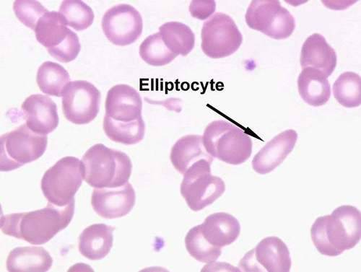

Slide 14
Elliptocytosis/Ovalocytosis
Southeast Asian, West African, Mediterranean
  Mostly AD inheritance
  Clinical severity – Mild, minimal hemolysis
Horizontal associations that link membrane cytoskeleton to the lipid layer
  Spectrin, Protein 4.1, Glycophorin
Smear for diagnosis
Notes:
Defect in horizontal linkage of cytoskeleton with lipid bilayer

Slide 15
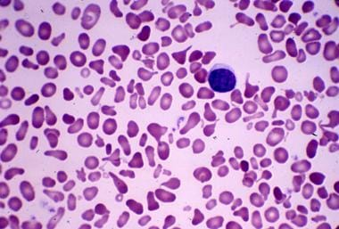
Find what’s on the smear…

Slide 16
Hereditary Pyropoikilocytosis
Variable Hemolysis – worse in childhood
Bizarre Shapes RBCs
Typically Microcytic
Same as Hereditary Elliptocytosis – Spectrin mutation
- Homozygous & Compound Heterozygous
Splenectomy
Notes:
Subtype o HE; Horizontal and vertical

Slide 17
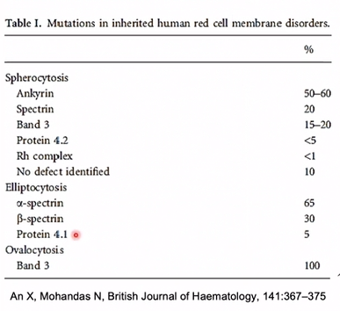

Slide 18
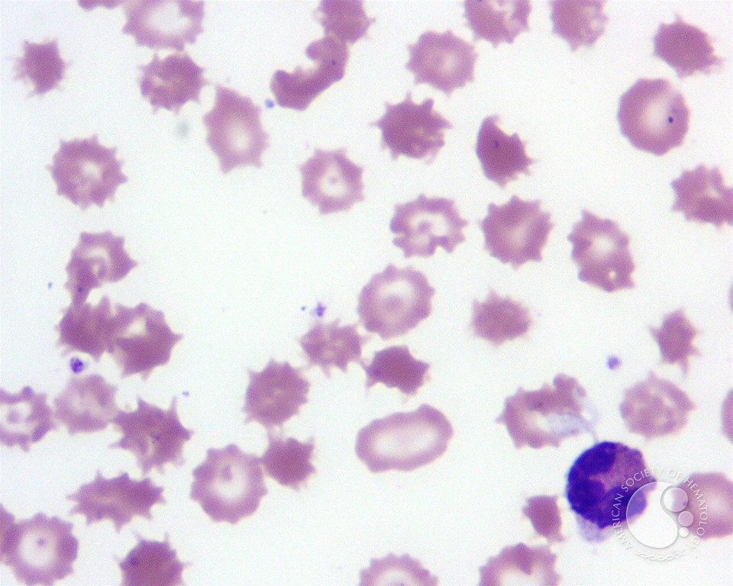
Spur Cell Hemolytic Anemia
LIVER DISEASE
Notes:
Severe Liver Disease where abnormal lipoproteins and excess cholesterol produced in liver acquired by RBCs → increase in cellular surface area. After spleen RBC acquire projections

Slide 19
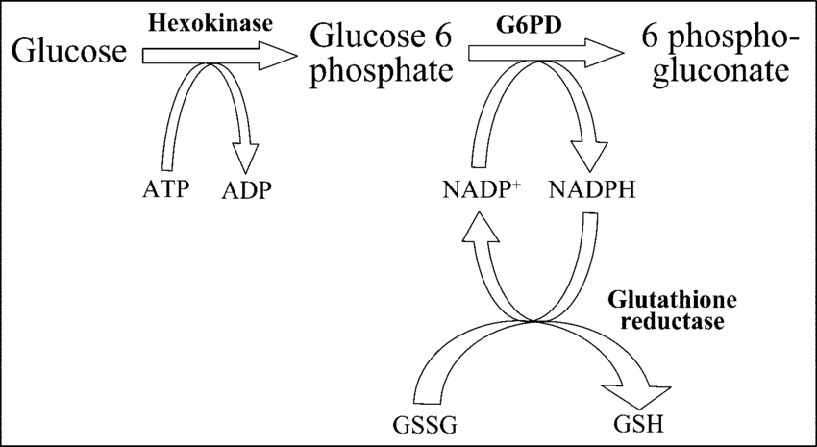
RBC Enzyme disorders
G6PD Deficiency
Pyruvate Kinase Deficiency
Pyrimidine 5 nucleotidase Deficiency (AR)
Glucose phosphate isomerase Deficiency (AR, rare)
Notes:
Antioxidant pathway to protect RBC proteins and Hgb from oxidation
G6PD catalyzes 1st step in hexose monophosphate pathway and in process reduces NADP to NADPH to maintain glutathione in the reduced state (major antioxidant) → precipitation of damaged proteins → binding of proteins to cytoskeleton distorts RBC, reduces life span.

Slide 20
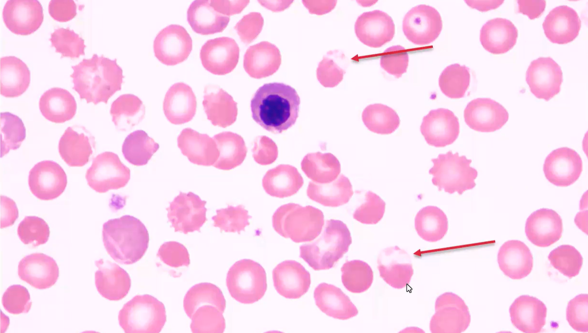
G6PD – X linked
Acute hemolytic events
Mild hemolysis at baseline
Mediterranean, Middle East, African, SE Asian
Exposure to medication/food or infection
Diagnosis: Blister/Bite cells on smear at time of hemolytic event
G6PD level: Do not draw during event (RC higher G6PD level)
Notes:
Heinz bodies: oxidized denatured Hgb insoluble complexes that attach to membrane
Oxidized Hgb also goes cross lining → puddling of Hgb in the cytoplasm forming bite cells – characteristic
Blister: vacuoles in the membrane

Slide 21
G6PD Variants – WHO
Class I (< 10% activity); chronic hemolytic anemia
Class II (Mediterranean; < 10% activity); episodic/severe hemolysis w/ triggers
Class III (African; A- variant); Only older RBCs effected; milder form
Class IV (> 60% activity, A+ variant); minimal hemolysis
Notes:
Only class I has ongoing chronic hemolytic anemia
Events are precipitated by drugs, infections foods etc

Slide 22
G6PD - Management
AVOID:
Antimalarials
Aspirin
Nitrofurantoin
NSAIDs
Quinine
Quinidine
Sulfa Drugs
Supportive
  Transfusion as needed, during hemolysis events
  Avoidance of triggers
Notes:
Hemolysis is intravascular and extravascular

Slide 23
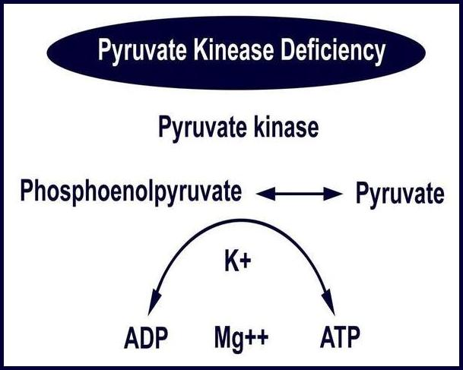
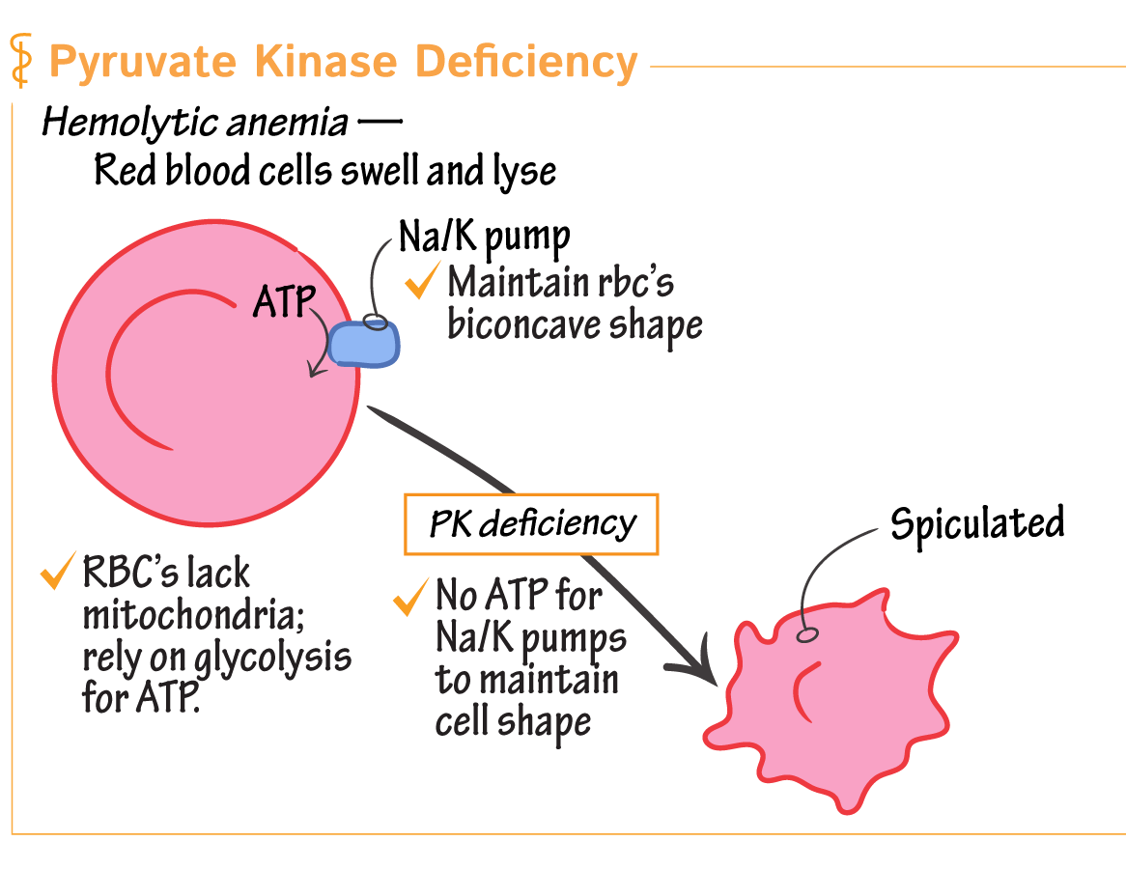
Pyruvate Kinase Deficiency
Moderate chronic HA & acute worsening hemolysis
AR; PKLR gene; Amish population
Diagnosis: Enzyme activity; Sequencing
Presentation: Extravascular Hemolysis - Variable
Notes:
PKLR → Liver Red cell isoform of the protein
Block in Glycolytic pathway; Mechanism not fully known

Slide 24
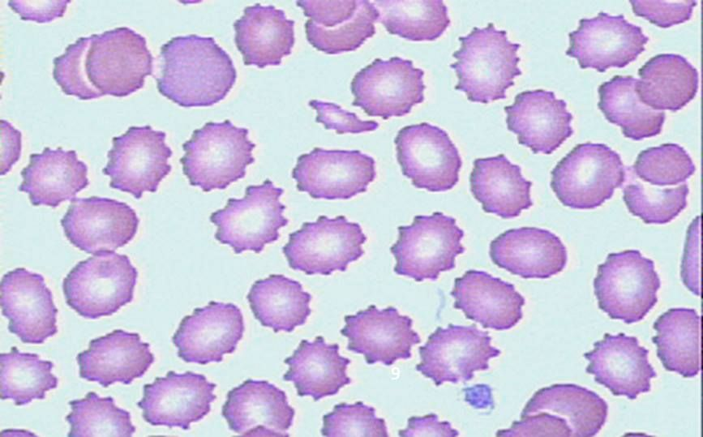
Pyruvate Kinase Deficiency
Management: Supportive; Transfusions variable
Mitapivat*
Splenectomy – severe anemia : 1- 2 g bump in Hgb
Folate → post splenectomy
HSCT
Notes:
Echinocytes

Slide 25
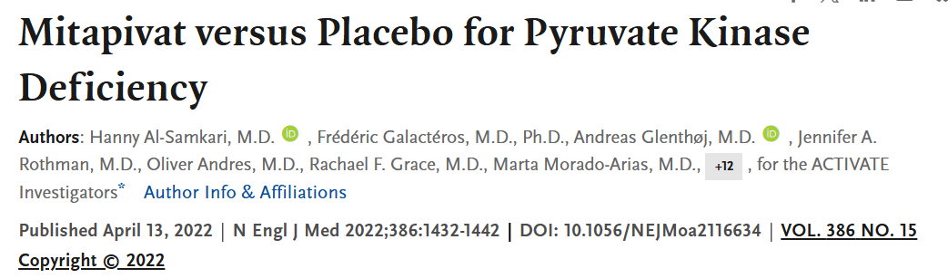
Notes:
first-in-class, oral, small-molecule allosteric activator of red cell pyruvate kinase. It binds to the PK tetramer and increases enzymatic activity, restoring ATP production in RBCs and thereby reducing hemolysis and improving red cell survival.

Slide 26
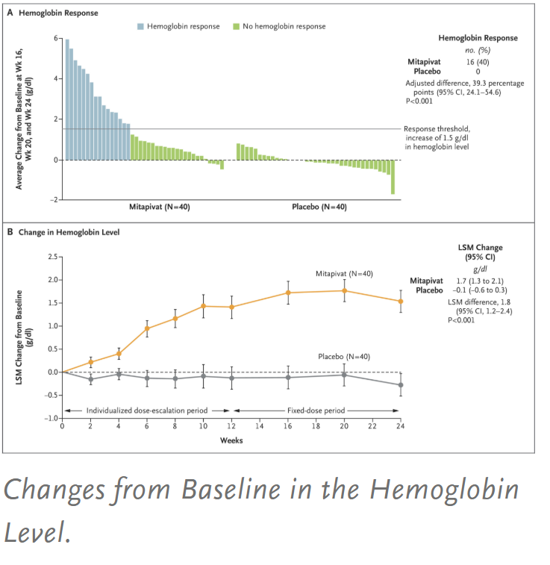
MITAPIVAT
Al-Samkari et al. NEJM. 2022.

Slide 27
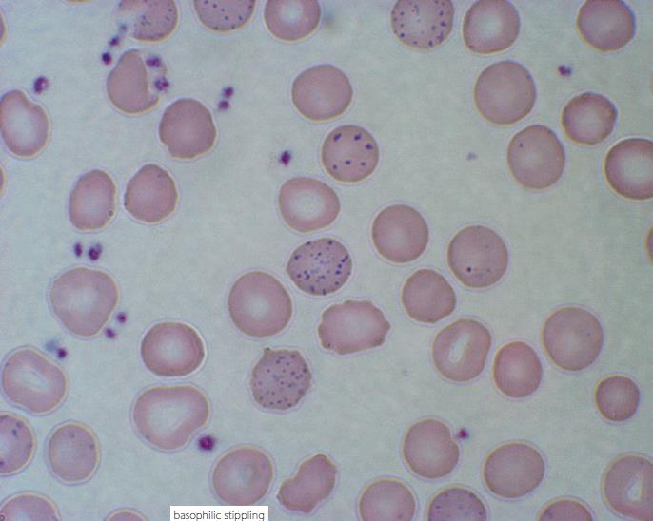
Other enzymopathies…
Pyrimidine 5’ Nucleotidase Deficiency ~ Lead Poisoning
  AR; Rare
  Presentation: Hemolysis; Neurologic Impairment
  DX: Screen for Pyrimidine Nucleotide in RBCs and molecular testing
  Treatment: Rare need of transfusions
Glucose Phosphate Isomerase Deficiency
  AR; Compound heterozygous or homozygous
  Presentation: Hemolysis; Neurologic Impairment
  Treatment: Splenectomy; Transfusions
Notes:
5P’N → accumulation of pyrimidine nucleotides in RBC; Extravascular.
Basophilic stippling: fragments of non degraded RNA precipitated in the cytoplasm
Lead is an inhibitor of the enzyme

Slide 28
RC Count
Normal/Decreased
Increased
MCV
Hemolysis
Blood Loss
Microcytic
Normocytic
Macrocytic
Intrinsic
Extrinsic
IDA
Thalassemia
ACD (late)
Sideroblastic
TEC
ACD (early)
Renal, Thyroid
BM Invasion
B12, Folate
Medications/ Substances
BM Aplasia
Membrane
Hemoglobinopathy
Enzyme
Immune
Non-Immune
Notes:
Transient Erythroblastopenia

Slide 29
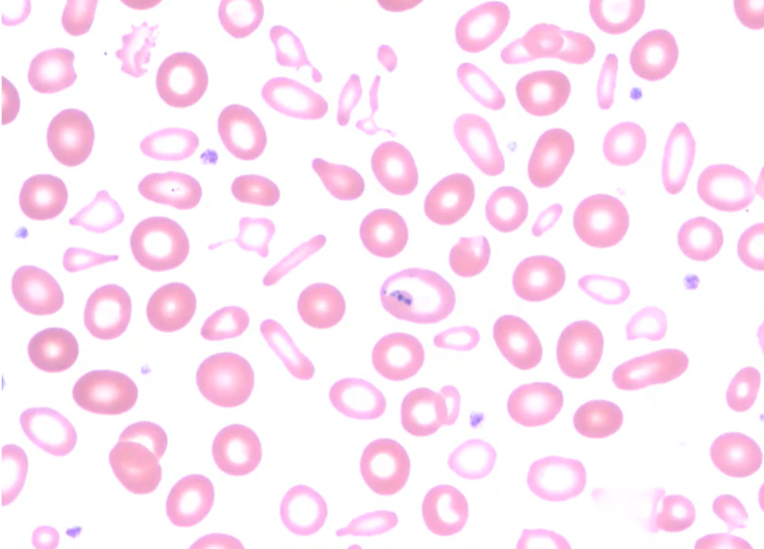
Case…
14 y.o male w/ non significant history presents with microcytic anemia. Hgb 7.5, MCV 65, RC 0.8%. His ferritin is 200.
Notes:
Dimorphic population of RBCs, Hypochromic, Microcytic, Prussian Blue Staining: Ringed sideroblasts; Pappenheimer bodies;

Slide 30
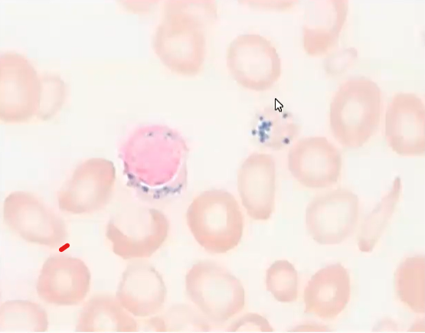
Case…
14 y.o male w/ non significant history presents with microcytic anemia. Hgb 7.5, MCV 65, RC 0.8%. His ferritin is 200.
Notes:
Pappenheimer bodies: Iron granules in RBC & Ringed Sideroblasts : iron stained ring (iron laden mitochondria) around RBC

Slide 31
Sideroblastic Anemia
Pathologic iron accumulation in mitochondria of RBC precursors
Inherited vs. Acquired
  X-linked most common; missense mutation in ALAS2 gene
  Men → first 2 decades; Microcytic; Women → Late adulthood; Normocytic/Macrocytic
Notes:
Abnormalities in heme synthesis and mitochondrial function
Several causes: ETOH most common acquired. Copper deficiency and Lead poisoning;
ALAS2 is an aminolevulinic acid synthase . an erythroid-specific mitochondrially located enzyme. The encoded protein catalyzes the first step in the heme biosynthetic pathway. Defects in this gene cause X-linked pyridoxine-responsive sideroblastic anemia.

Slide 32
Sideroblastic Anemia
  Congenital → Microcytic/Normocytic
  Acquired → Normocytic/Macrocytic
  Presentation: Fatigue, Dyspnea, Pallor, Hepatosplenomegaly
  DX: Anemia, Ring sideroblasts on bone marrow Elevated Iron studies
  TRT: Remove cause; Periodic Transfusions; B6
Notes:
Erythroblasts with iron loaded mitochondria; Isoniazid;

Slide 33
Iron Deficiency Anemia
CAUSES
Low Iron Diet: young children, vegetarian/vegan
External Blood Loss
Menstrual bleeding
GI bleeding
Blood donation
Malabsorption
GI conditions (Celiac) (H. Pylori)
IRIDIA
Most common hematologic condition globally
Prevalence: young children, adolescent girls, women
Notes:
Iron refractory Iron deficiency anemia

Slide 34
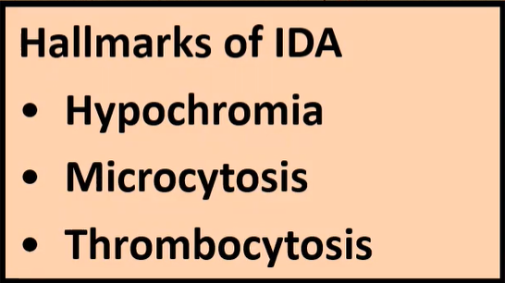
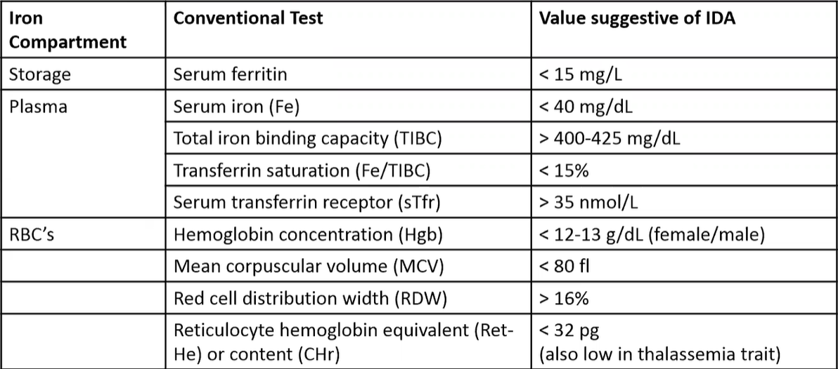
IDA

Slide 35
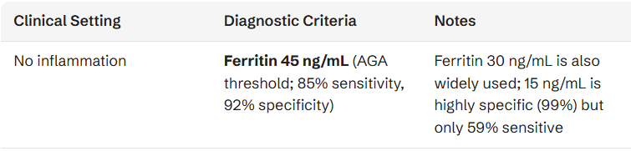
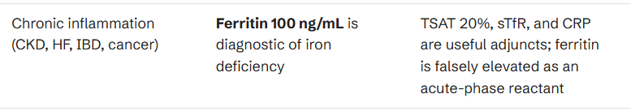
NEW GUIDELINES
Auerbach et al. Jama. 2025

Slide 36
IRIDIA
Mutations in the TMPRSS6 gene; AR
  Upregulation of hepcidin
  Poor Oral iron absorption
Persistent IDA
  Poor response to PO iron
  Better response to IV iron (higher doses needed)
Notes:
Iron Refractory Iron Deficiency Anemia; Rare
type II transmembrane serine proteinase that is found attached to the cell surface. The encoded protein may be involved in matrix remodeling processes in the liver.

Slide 37
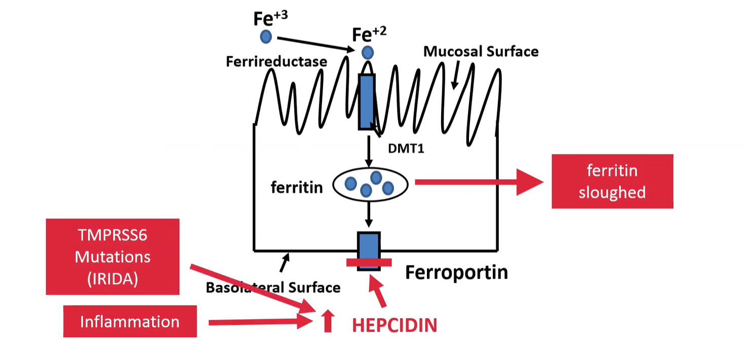
Notes:
Hepcidin increases w/ inflammation; Limits iron absorption

Slide 38
IDA Treatment
Increase iron intake (diet)
Control bleeding
AGA guidelines: Bi-derectional scopes +/- video capsule
Oral iron administration: Ferrous Sulfate every other day
Treat 3- 6 months of therapy with PO iron
Assess: 2-4 weeks; 3 months
Notes:
Anemia resolves prior to changes in iron parameters

Slide 39
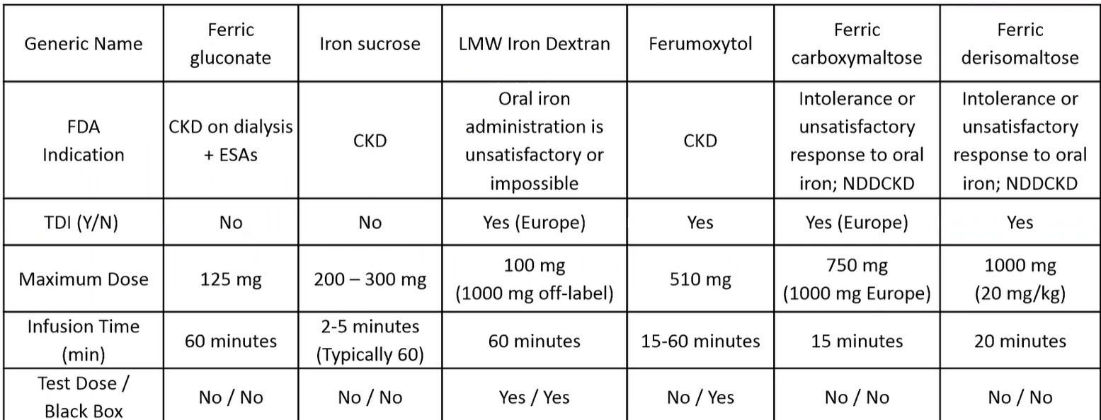
IDA Treatment – IV Iron
Ganzoni formula*: Subject weight in kg x (15 - current hemoglobin g/dL) x 2.4 + 500
Notes:
Calculated iron deficit based on the modified Ganzoni formula*: Subject weight in kg x (15 - current hemoglobin g/dL) x 2.4 + 500. If subject TSAT >20% and ferritin >50 ng/mL, the 500-mg constant is not needed.

Slide 40
IV Iron
Approved for use in patients
  CKD
  Intolerance to oral iron
  Persistent IDA despite oral iron
  IRIDIA
  Concomitant IDA + ACD
Notes:
Not considered standard of care

Slide 41
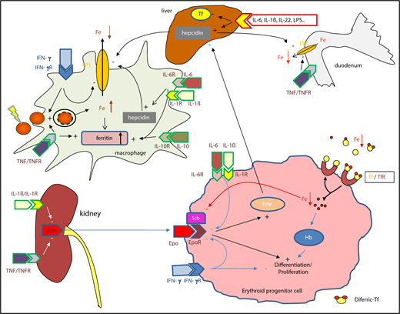
Anemia of Inflammation
Fe restricted erythropoiesis
Initially → Normocytic Anemia
Prolonged → Microcytic Anemia
  Assess for concomitant IDA
  Sol TfR elevated in IDA
Notes:
Systemic inflammation results in immune cell activation and numerous cytokines. Interleukin (IL-6) and IL-1β, as well as lipopolysaccharide (LPS), are potent inducers of hepcidin, in the liver, whereas expression of the iron-transport protein transferrin is reduced. Hepcidin causes iron retention in macrophages by degrading ferroportin (FP1); Interleukin-1β [IL-1β], IL-6, IL-10, and interferon-γ [IFN-γ]) promote iron uptake into macrophages, increase radical-mediated damage to erythrocytes and their ingestion by macrophages, and cause efficient iron storage by stimulating ferritin production and blocking iron export. IL-1 and TNF inhibit the formation of erythropoietin (Epo) by kidney epithelial cells. Moreover, cytokines can directly damage erythroid progenitors.

Slide 42
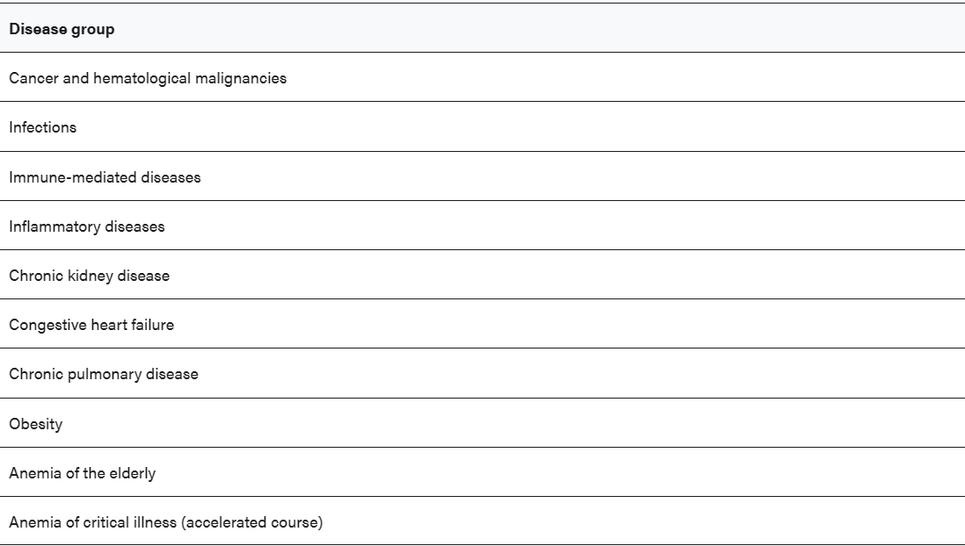

Slide 43
RC Count
Normal/Decreased
Increased
MCV
Hemolysis
Blood Loss
Microcytic
Normocytic
Macrocytic
Intrinsic
Extrinsic
IDA
Thalassemia
ACD (late)
Sideroblastic
TEC
ACD (early)
Renal, Thyroid
BM Invasion
B12, Folate
Medications/ Substances
BM Aplasia
Membrane
Hemoglobinopathy
Enzyme
Immune
Non-Immune

Slide 44
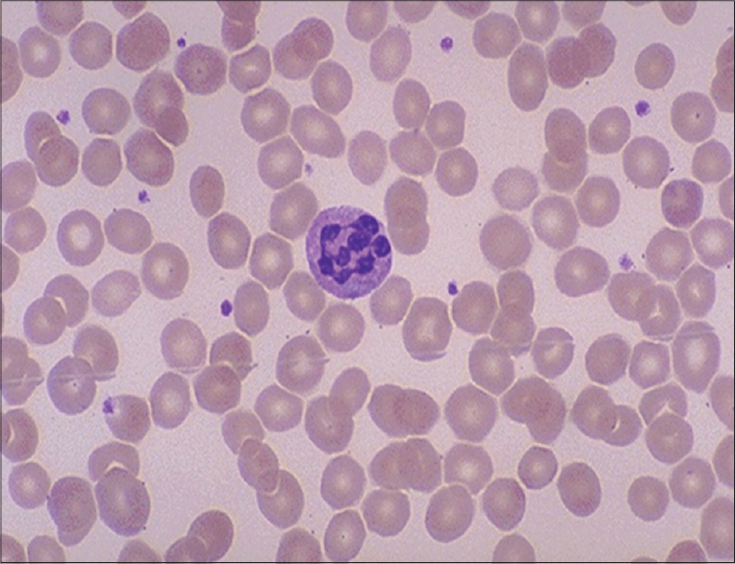
Macrocytosis Megaloblastic
Normal newborn infant
Trisomy 21
Marrow failure
Drugs (anti-epileptic)
Hypothyroidism
Liver Disease
MCV < 105
Folate Deficiency
B12 Deficiency
Defective DNA synthesis
Inherited Metabolic Disease
MCV > 110
Notes:
Large, abnormally developed red blood cell typical of certain forms of anemia, associated with a deficiency of folic acid or of vitamin B₁₂.

Slide 45
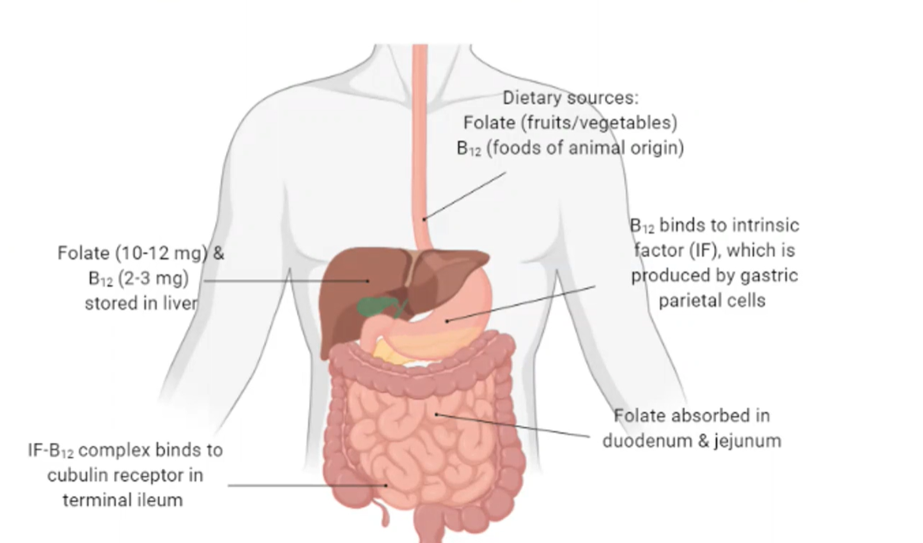
Megaloblastic Anemia
B12 and Folate required for DNA synthesis

Slide 46
Megaloblastic Anemia
Deficiency → reduced DNA synthesis → Bone marrow lysis → elevated LDH → increased heme catabolism → increased bilirubin
Notes:
Intramedullary Hemolysis

Slide 47
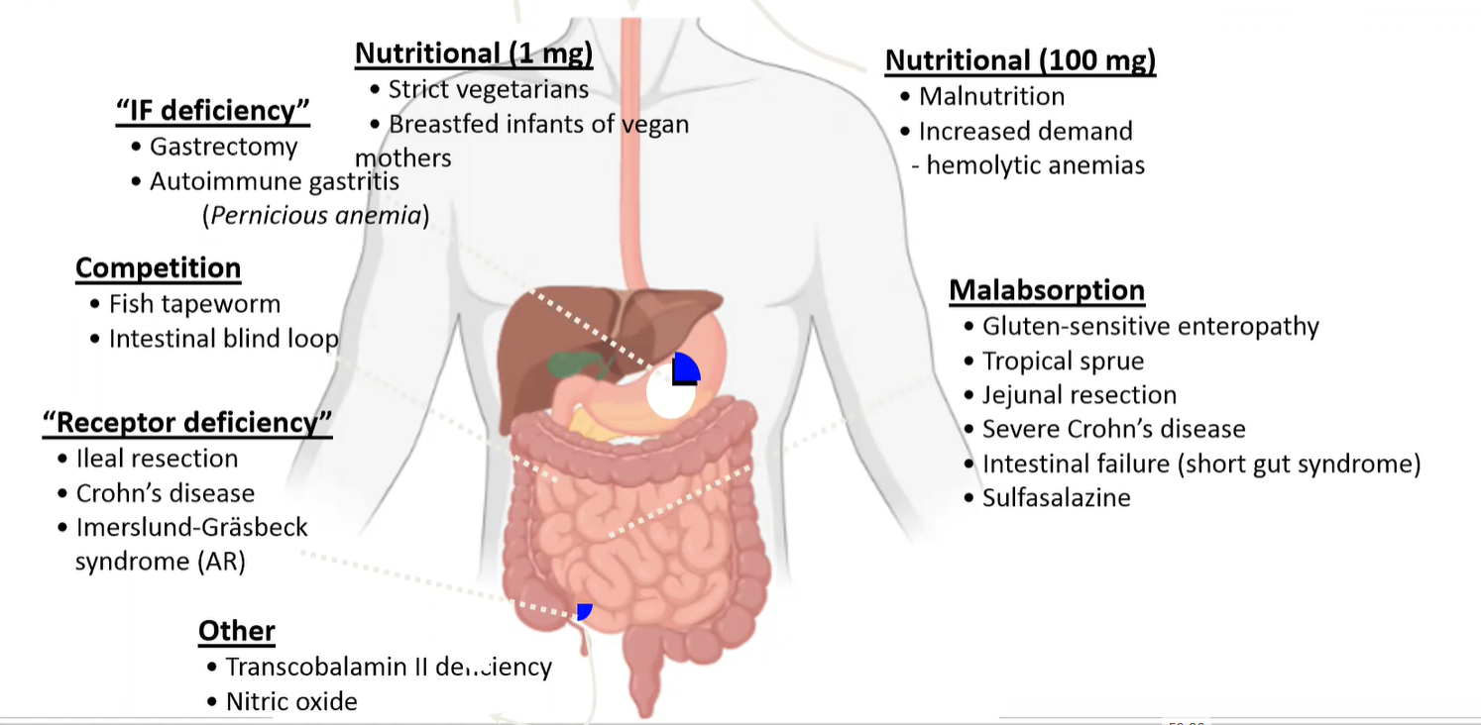
Notes:
CAUSES OF B12 deficiency

Slide 48
Clinical Findings/Diagnosis
Jaundice – Ineffective erythropoiesis
Diagnosis: B12 level, Homocysteine, Methylmalonic Acid
Neurological findings – B12
  Degeneration of the posterior columns
  Proprioception and fine motor deficits, seizures, depression, retardation, ataxia, psychosis
  Folate supplement treats hematological findings but not neurological
Notes:
Extensive stores; develops through a prolonged period of time; we completely depend on dietary B12

Slide 49
Pernicious Anemia
Inherited (AR) vs. acquired
Both rare
Mutation in the IF gene vs. autoantibodies
Treatment: IM B12

Slide 50
Folate Deficiency
Poor diet (child drinking goat’s milk)
Impaired absorption (Crohn’s, celiac)
Hematological findings same as B12
Diagnosis: Serum folate; Homocysteine, MMA
Treatment: Oral supplementation

Slide 51
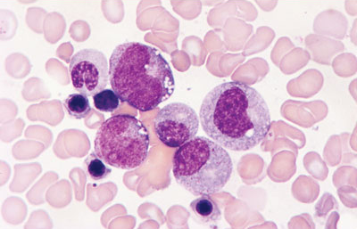
Copper Deficiency
Hematological + Neurological Findings
  Cytopenia: Anemia, Neutropenia; MDS like
  Myeloneuropathy
Hx of bariatric surgery
Menkes Syndrome
  Rare X-linked mutation in ATP7A
  copper transport protein
Treatment: Copper supplementation
Notes:
Iron containing plasma cells, hyposegmented neutrophils, dyserythropoiesis, ringed sideroblasts

Slide 52
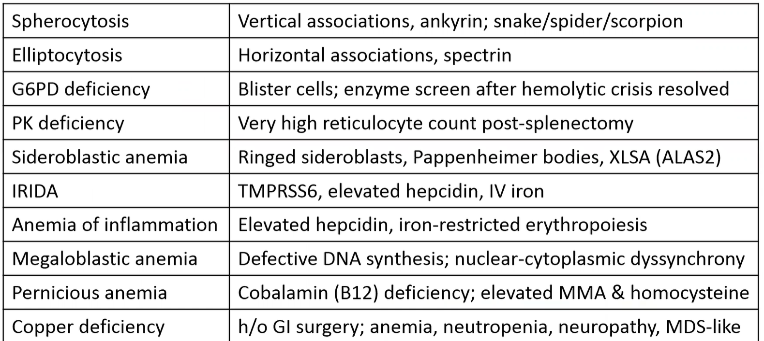

Slide 53
RC Count
Normal/Decreased
Increased
MCV
Hemolysis
Blood Loss
Microcytic
Normocytic
Macrocytic
Intrinsic
Extrinsic
IDA
Thalassemia
ACD (late)
Sideroblastic
TEC
ACD (early)
Renal, Thyroid
BM Invasion
B12, Folate
Medications/ Substances
BM Aplasia
Membrane
Hemoglobinopathy
Enzyme
Immune
Non-Immune

Slide 54
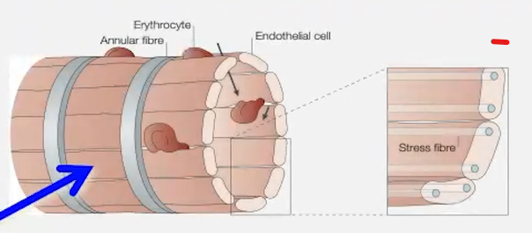
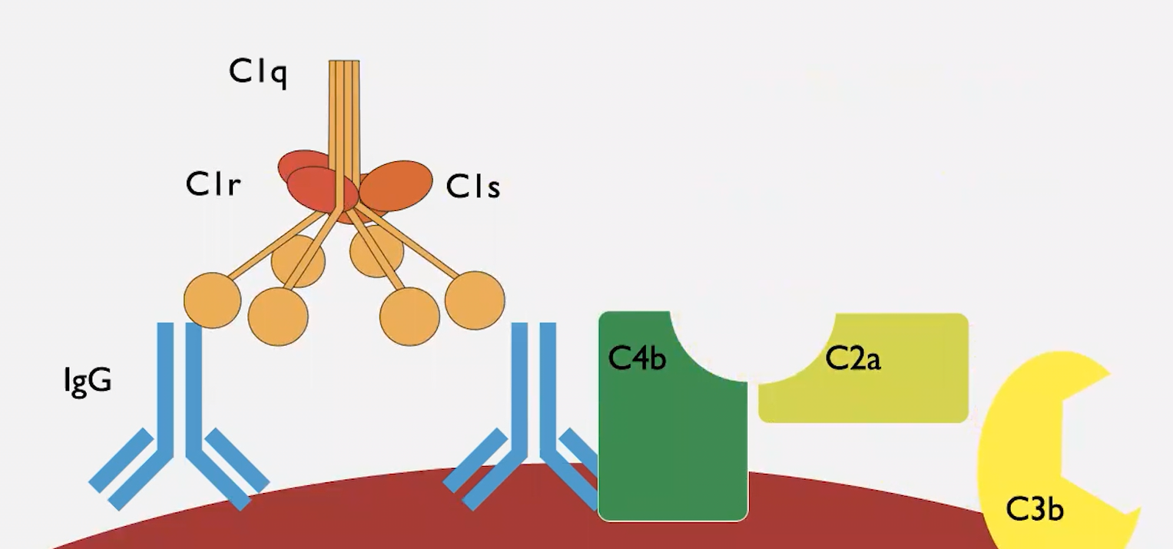
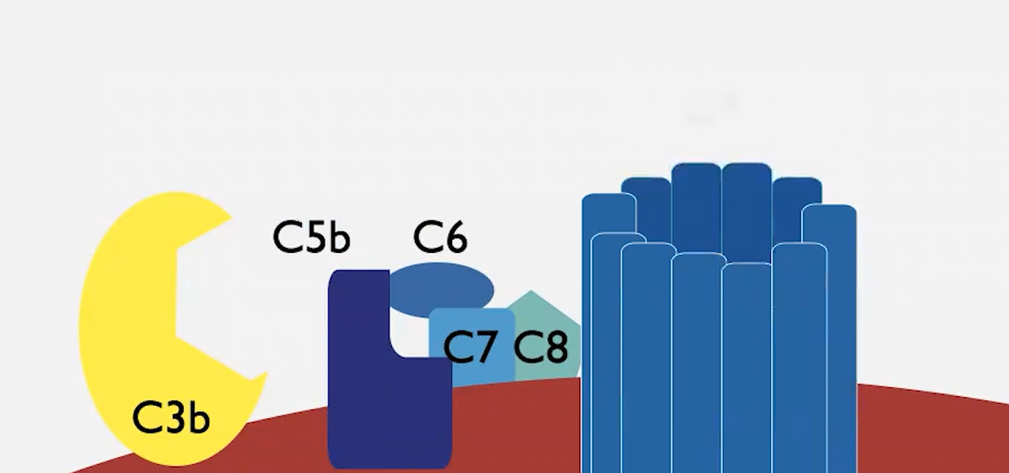
Hemolysis
Extravascular
Intravascular
Notes:
Extravascular: Liver, spleen and other parts of reticuloendothelial system; Spleen has the cords of bilroth; RBC become less deformable; This is a quality check; But they cannot fit through the fenestrations and not able to deform get engulfed by nearby macrophages.

Slide 55
Autoimmune Hemolytic Anemias
Warm AIHA (WAIHA)
Cold Agglutinin Syndrome (CAS)
Paroxysmal Cold Hemoglobinuria (PCH)
Other…
Mixed AIHA
Atypical (DAT-Negative) AIHA
Drug induced IHA
Allo- IHA

Slide 56
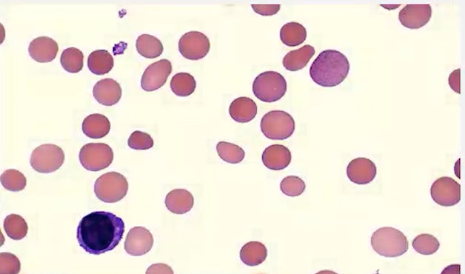
WAIHA
Females > males; Age ~ 70s; 1 in 80,000
Primary: Idiopathic
Secondary:
  CLL, Lymphomas, SLE
  Drugs, Ovarian Ca
Hgb
RC and MCV
LDH
Hapto
Bilirubin
Coombs: IgG + and C3d +/-
Notes:
Smear: Microspherocytes;

Slide 57
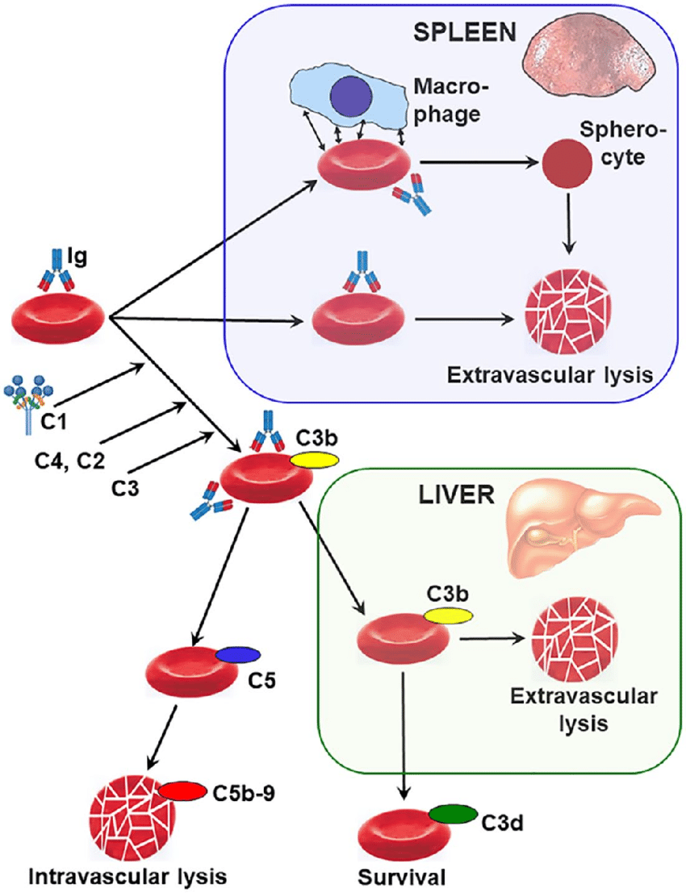
WAIHA
IgG → Optimally Binds at 37 degrees
Extravascular Hemolysis
Notes:
Pan reactive IgG; IgA is rare; Primarily in the spleen trap RBCs. Splenic macorophages phagocytose opsonized RBCs → partial loss of membrane → microspherocytes;

Slide 58
WAIHA - Treatment
Transfusions: Panagglutinin IgG → No perfect donor; Limit to symptomatic/cardiac
*Steroids → 80% OR → 50% relapse within 1 yr
- 1mg/kg → 3-4 weeks → slow taper at a a rate of 10 mg/week
Goal: Amelioration of symptoms/transfusion independence
Negative DAT → Not essential for successful treatment
Notes:
Prednisone > 20 mg/d → PCP ppx

Slide 59
2nd Line Treatment
Rituximab 375 mg/m2 weekly x 4 doses
  ORR 70 – 90%
  mDOR 20 months
  50% relapse
Splenectomy
  ORR 60-90%
  40-50% prolonged remissions
  Early relapse or late relapse
  Can respond to low dose steroids after

Slide 60
2nd Line Treatment
Immunomodulatory agents → Delayed Response ( 3- 4 months)
  Azathioprine
  Cyclophosphamide
  Cyclosporine
  MMF
  Danazol

Slide 61
Cold Agglutinin Disease
Primary Cold Agglutinin Disease
  Rare, 1 in 1 million; F> M; Age ~ 72
Secondary Cold Agglutinin Syndrome
  Mycoplasma pneumoniae
  Infectious mononucleosis
  Lymphoid Neoplasms
  SLE

Slide 62
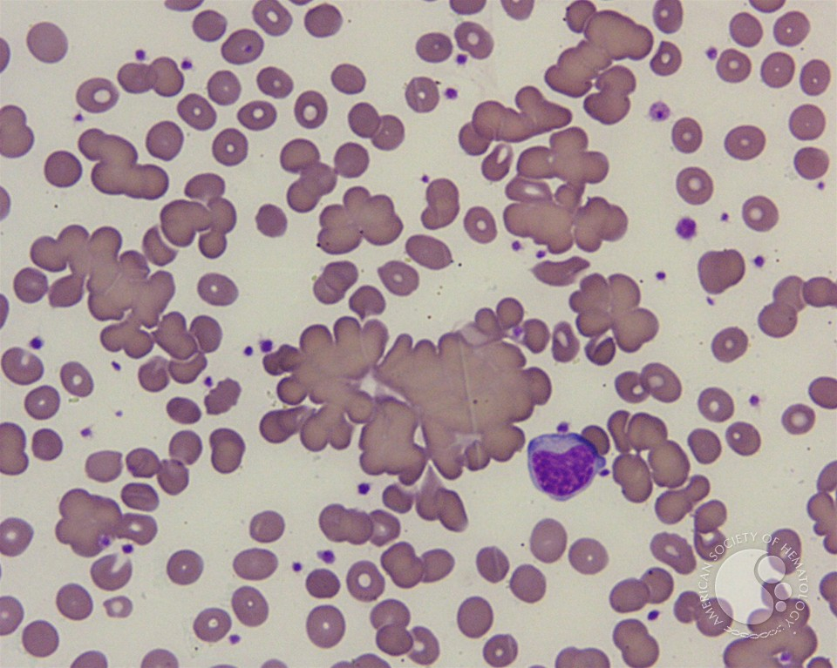
Primary CAD
Agglutination of RBC in microvasculature
Chronic Anemia vs. Episodic
Acrocyanosis, Livedo Reticularis, Raynaud’s
DAT IgG – and C3 + → Extravascular Hemolysis →Liver
IgM → cold antibodies
Notes:
Cold Agglutinin – IgM against carbohydrate antigen I inRBCs. Agglutination occurs at 0 – 5 degrees. Activation of complements at 20 – 25 and optimal at 37; Highest temp is thermal amplitude. The higher the more symptomatic.
C3 deposition on RBCs. Opsonization and then clearance in the liver. WAIHA – Spleen; CAD → liver;

Slide 63
Diagnosis
*Hemolysis features: High MCV; Reticulocytosis
*Cold agglutinin titer above 1:64 for DX
*Titer above 1: 512 → Clinically significant
Notes:
All should have BMBx and imaging studies to evaluate for lympho neoplasm.

Slide 64
Treatment for CAD
Cold avoidance; Treat primary disease in 2nd CAD
Transfusions : Warmed and Washed RBCs
Plasmapheresis – 90% of IgM circulates in the plasma
Rituximab 375 mg/m2 weekly x 4 dioses → In chronic hemolysis
- 50 % RR; May be repeated
Notes:
Splenectomy and Steroids → Rarely effective

Slide 65
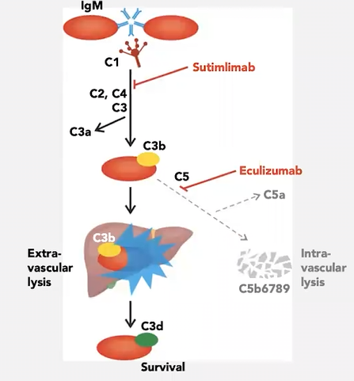
Complement Inhibitors
Notes:
Sutimlimab → C1s

Slide 66
Paroxysmal Cold Hemoglobinuria
Very rare: Children < 5 y.o
Severe/progressive Anemia
M > F
Primary (idiopathic)
Secondary
  Viral syndrome
  Syphilis ( in the past)
  Lymphoproliferative Disorder

Slide 67
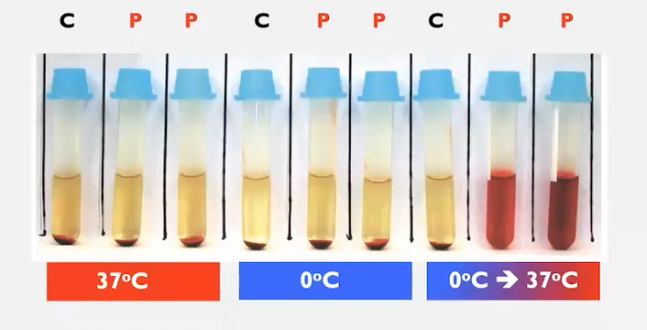
PCH
IgG → Anti – P (biphasic)
Bind RBCs at low temperatures
Intravascular hemolysis - brisk
Therapy
  Transfusions
  Steroids
Donath – Landsteiner Test
Notes:
Polyclonal IgG antibody; Complement mediated; Biphasic: binds at cold temp and remains bound in warm temps when activates complement too.
DLT: Pt serum is cooled at 4 degrees and incubated w/ P antigen RBCs.

Slide 68
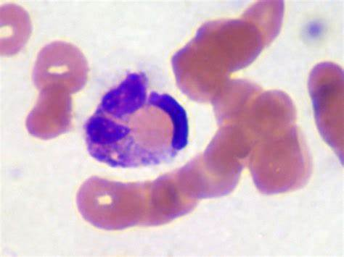
PCH
Signs of Intravascular hemolysis
  Hemoglobinuria
  Hemosiderinuria
Clinical: Transient hemolysis;, jaundice, AKI, splenomegaly, lymphadenopathy
DAT positive for C3/negative for IgG; No agglutination on smear
*Neutrophil erythrophagocytosis

Slide 69
PCH – Treatment
Hemolysis is self limiting
Supportive: Avoid Cold exposure
Blood Transfusion if anemia is severe; P + blood donor
Plasmapheresis in severe cases
Rituximab or Eculizumab for refractory cases

Slide 70
Hemolysis in transplantation
Hemolysis associated with transplantation
Major (Donor A, Recipient O) → Pure red cell aplasia
  - Plasmapheresis, EPO, Rituximab, Daratumumab

Slide 71
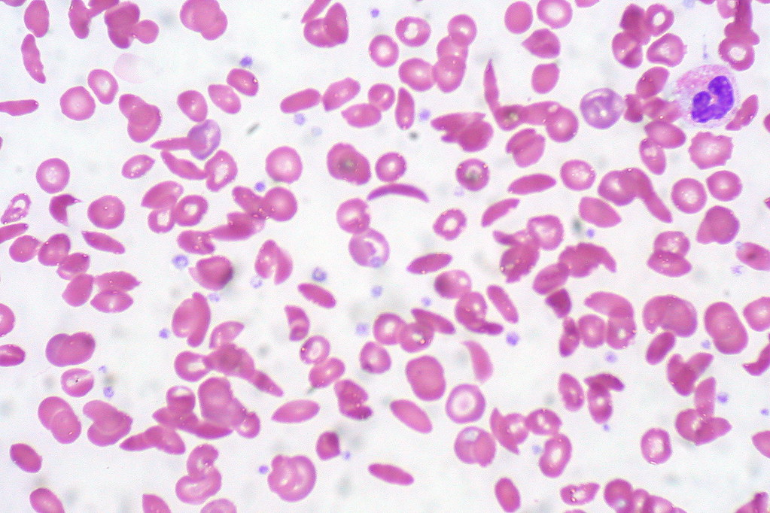
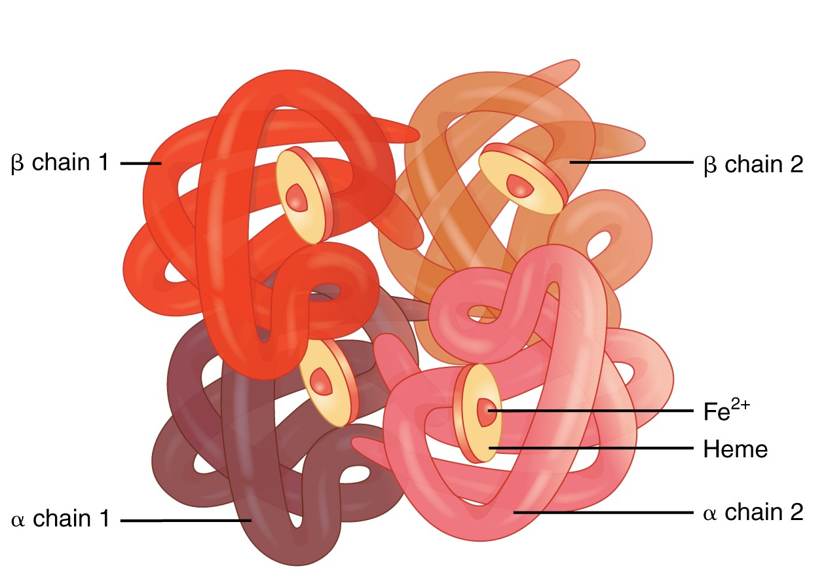
HEMOGLOBINOPATHIES
  Sickle Cell Disease
  Thalassemia

Slide 72
BONE MARROW DISORDERS
*Acquired Aplastic Anemia/Paroxysmal nocturnal hemoglobinuria (PNH)
*Hematologic Malignancies: Leukemias, Lymphomas, Multiple Myeloma, Myelodysplastic Syndrome, Eosinophilic myeloid/lymphoid neoplasms, myeloproliferative neoplasms
*Myelophthisic: Myelofibrosis, Solid cancers

Slide 73
INHERITED BONE MARROW FAILURE SYNDROMES
Fanconi anemia (FA) — DNA repair defect (FANC pathway genes, Pancytopenia, congenital anomalies (short stature, radial ray defects, café-au-lait spots), high risk of MDS/AML.
Dyskeratosis congenita/ Short telomere syndromes — Telomere maintenance defect (DKC1, TERC, TERT, TINF2, RTEL1). Classic triad: nail dystrophy, skin hyperpigmentation, oral leukoplakia. Also pulmonary fibrosis, liver fibrosis, bone marrow failure, MDS/AML (~10% lifetime risk).
Diamond-Blackfan anemia (DBA) — Ribosome biogenesis defect (ribosomal protein genes, RPS19, RPL5, RPL11). Pure red cell aplasia presenting in infancy, congenital malformations (~50%), short stature. ~5% risk of MDS/AML by age 45–50.
Shwachman-Diamond syndrome (SDS) — Ribosome biogenesis defect (SBDS, EFL1, DNAJC21). Neutropenia, exocrine pancreatic insufficiency, skeletal abnormalities, risk of MDS/AML.
*Congenital dyserythropoietic anemias (CDAs) – rare inherited anemias caused by defective erythropoiesis, characterized by anemia from ineffective erythropoiesis and secondary iron overload due to increased iron absorption.

Slide 74
REFERENCES
1. ASH SEP 2025
2. Al‑Samkari H, Galactéros F, Glenthoj A, et al. Mitapivat versus Placebo for Pyruvate Kinase Deficiency. N Engl J Med. 2022;386:1432‑1442. doi:10.1056/NEJMoa2116634.
3. Auerbach M, DeLoughery TG, Tirnauer JS. Iron Deficiency in Adults: A Review. JAMA. 2025;333(20):1813–1823. doi:10.1001/jama.2025.0452
4. UPTODATE

Slide 75
THANK YOU

