Slide 1

Medical Student Heme Review 2025
6/17/25
Kirk Cahill
Assistant Professor
Division of Hematology/Oncology
Loyola University Medical Center

Slide 2
Objectives
Highlight the CBC/differential
Review a practical approach to anemia
  Macrocytic
  Microcytic
  Normocytic
Review some specific anemia subtypes

Slide 3
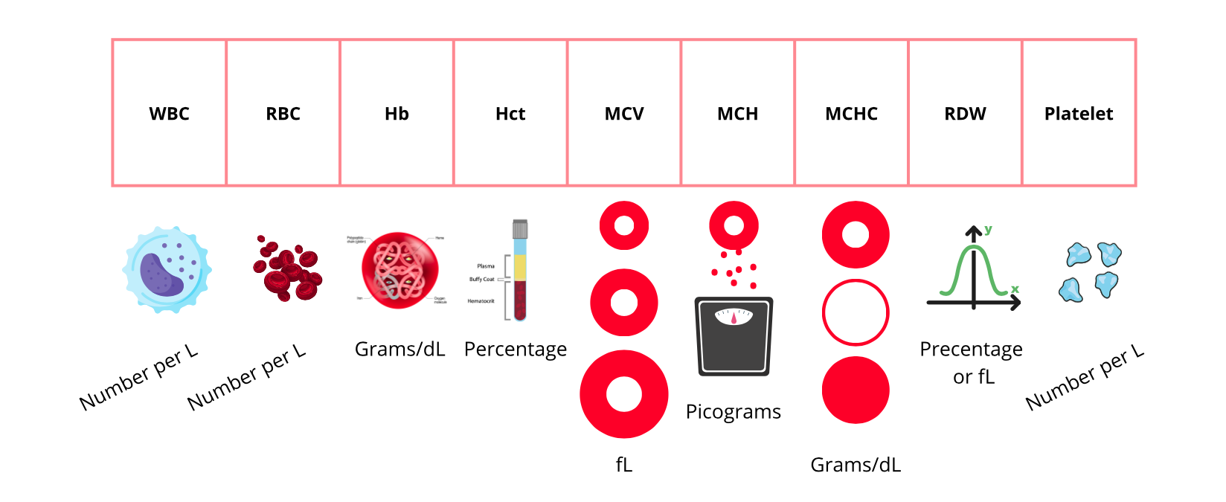
Complete Blood Count (CBC)
The Blood Project

Slide 4
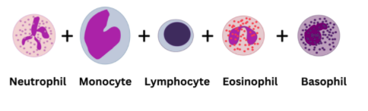
White blood cell differential
Normal WBC is approximately 4.4 - 11 x 10³ cells/uL
The absolute count of each cell type define a ‘cytopenia’ vs ‘cytosis’
Use the absolute count though percentages can be helpful if the total WBC is normal
Always look out for blasts (acute leukemia)!
Cell | Cytosis (x10³/uL) | Cytopenia (x10³/uL)
WBC | >11 | <4.4
Neutrophils | >7 | <1.5
Lymphocytes | >4.0 | <1.5
Monocytes | >0.8 | <0.2
Eosinophils | >0.35 | <0.04
Basophils | >0.1 | <0.01
Values vary by lab and reference
The Blood Project

Slide 5
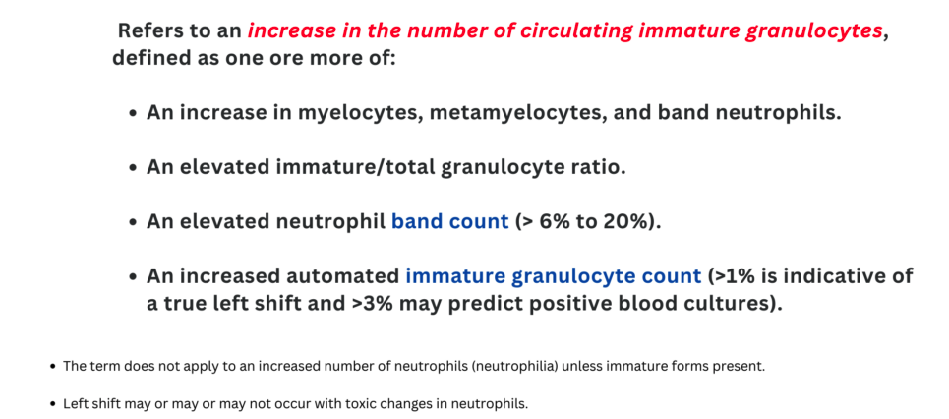
Left Shift
The Blood Project

Slide 6
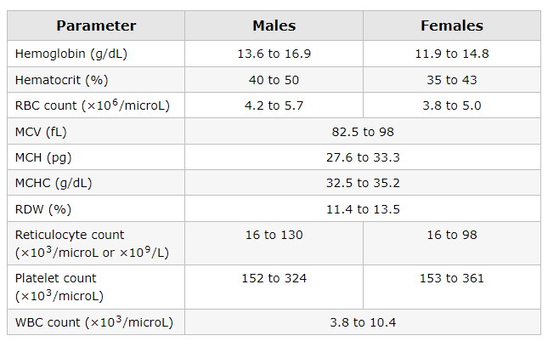
RBC Indices
Concentration of Hb in whole blood (directly measured)
Percentage of blood volume occupied by RBCs
Average size of RBC
Average Hb content in an RBC
Average Hb concentration per RBC
Red cell distribution width
UpToDate

Slide 7
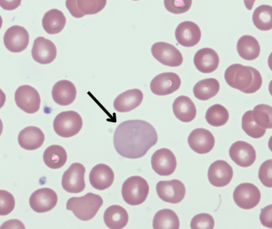
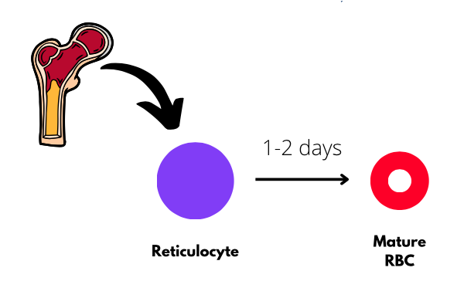
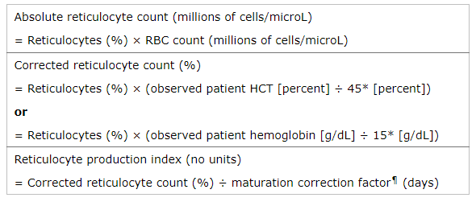
RBC Indices
Reticulocyte is a baby RBC
(1-2% of circulating RBCs)
Absolute Retic Count
(25,000 - 100,000/uL)
(0.25 - 1 x10¹¹/L)
Corrected Retic Count %
(0.5 – 2.0%)
RPI

Slide 8

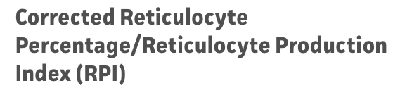
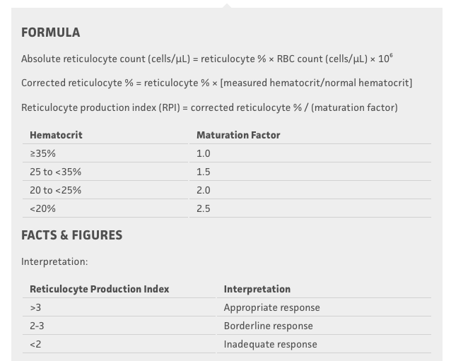
https://www.mdcalc.com/calc/1667/absolute-reticulocyte-count-reticulocyte-index#evidence

Slide 9
Reticulocyte Count Simplified
In general, an absolute retic count > 120,000/uL (1.2 x 10¹¹/L) is considered an appropriate response

Slide 10
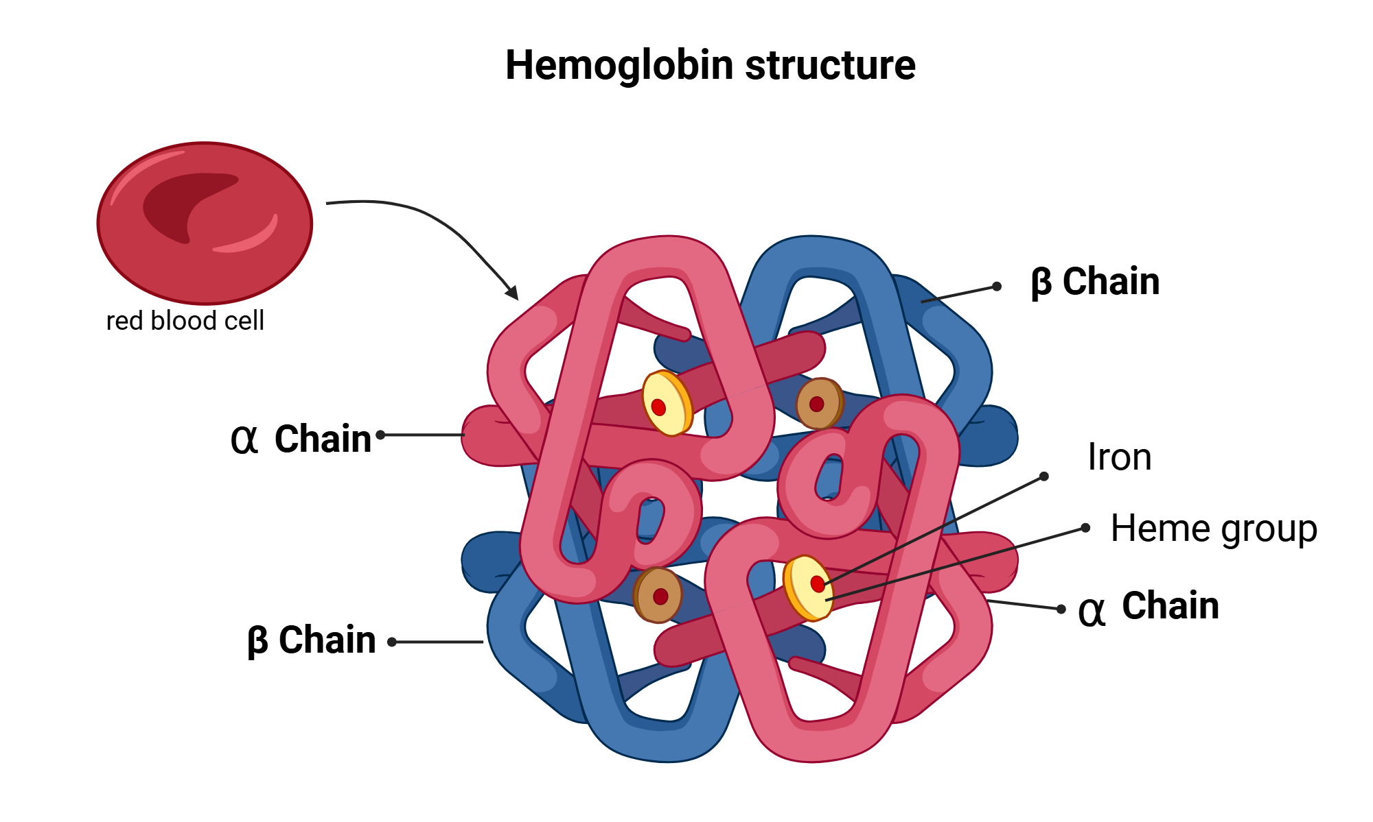
Anemia
Condition in which blood has reduced ability to carry oxygen owing to reduction in the amount of hemoglobin (Hb).
Hb cut-off varies in the literature and also by lab.
WHO Definition:
  Women: Hb < 12 g/dL
  Men: Hb <13 g/dL

Slide 11
Anemia
General principles
Anemia is a sign, not a disease
Anemias are often dynamic and trends are important
History is important (bleeding, medications, procedures, hospitalizations, family, social)
The diagnosis of iron deficiency requires further work-up
Tom DeLoughery

Slide 12
Anemia
Initial:
CBC/dif
Retic count
LDH and haptoglobin
Iron and ferritin
B12
Folate
CMP
Maybe:
PT/INR, PTT, D-dimer, Fibrinogen
TSH
Coombs test (DAT)
Copper
Zinc
Matthew Ho MD

Slide 13
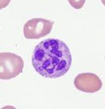
Macrocytic Anemia (MCV >100)
Megaloblastic
  Macrocytosis AND impaired DNA synthesis
  May also cause pancytopenia
    B12 deficiency
    Folate deficiency
Non-megaloblastic (no hypersegmentation)
  Liver disease
  Alcoholism
  Hypothyroidism
  COPD and CKD
  Drug induced
  Reticulocytosis
    Any hemolytic anemia!
    Recovering bone marrow
    Any high EPO state
Neutrophil with 6 or more lobes
Macrocyte = RBC ~ size of lymphocyte nucleus
Image: ASH image bank; Aslinia F. et al. Clin Med Res 2006

Slide 14
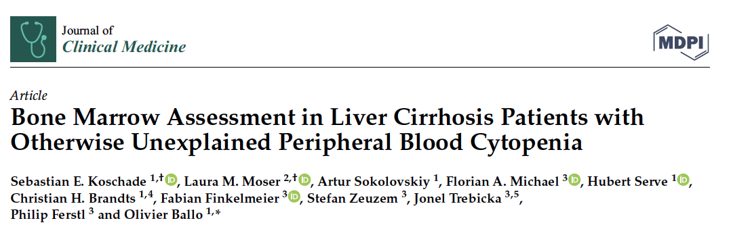
Cytopenias and Liver Disease
Retrospective single-center study on diagnostic yield of bone marrow biopsies in patients with cirrhosis and unexplained cytopenia. n=118
60% had pancytopenia.
Median spleen size: 14 cm (16-18cm)
Median INR 1.4 (1.2-1.7)
117/118 (99%) had normal and non-specific marrow. One patient had MDS.
Conclusion: Cytopenias with cirrhosis are rarely associated with heme malignancy.
Koschade S. et al. J Clin Med 2023

Slide 15
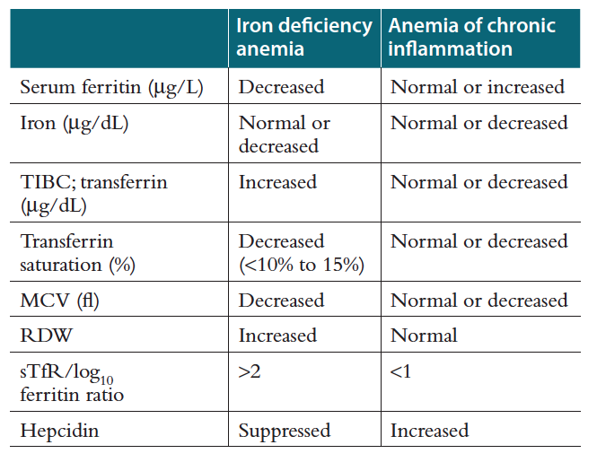
Microcytic Anemia (MCV < 80 fL)
Think:
Iron deficiency
Anemia of inflammation
Sometimes Thalassemia
  Check Hb electrophoresis
Rarely lead poisoning
  Check lead level
Rarely sideroblastic anemia
  May need bone marrow biopsy

Slide 16
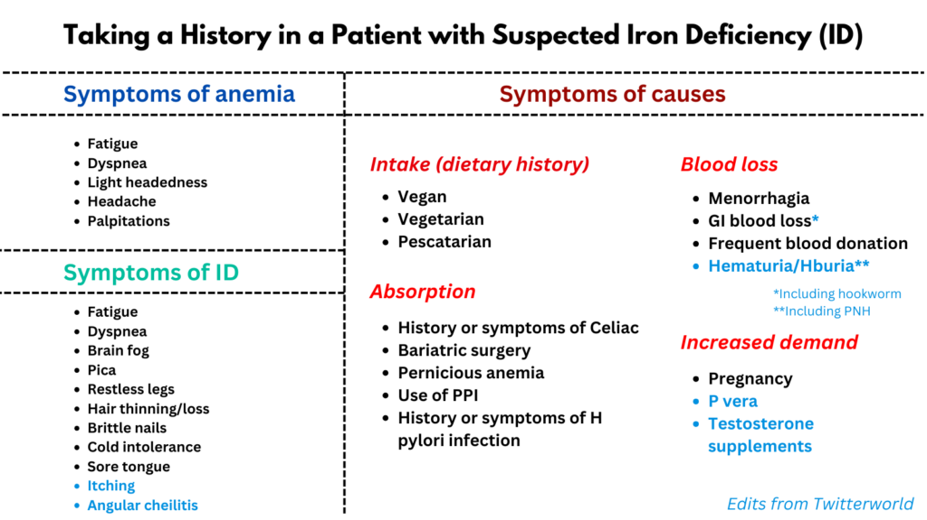
Iron Deficiency
thebloodproject.com

Slide 17
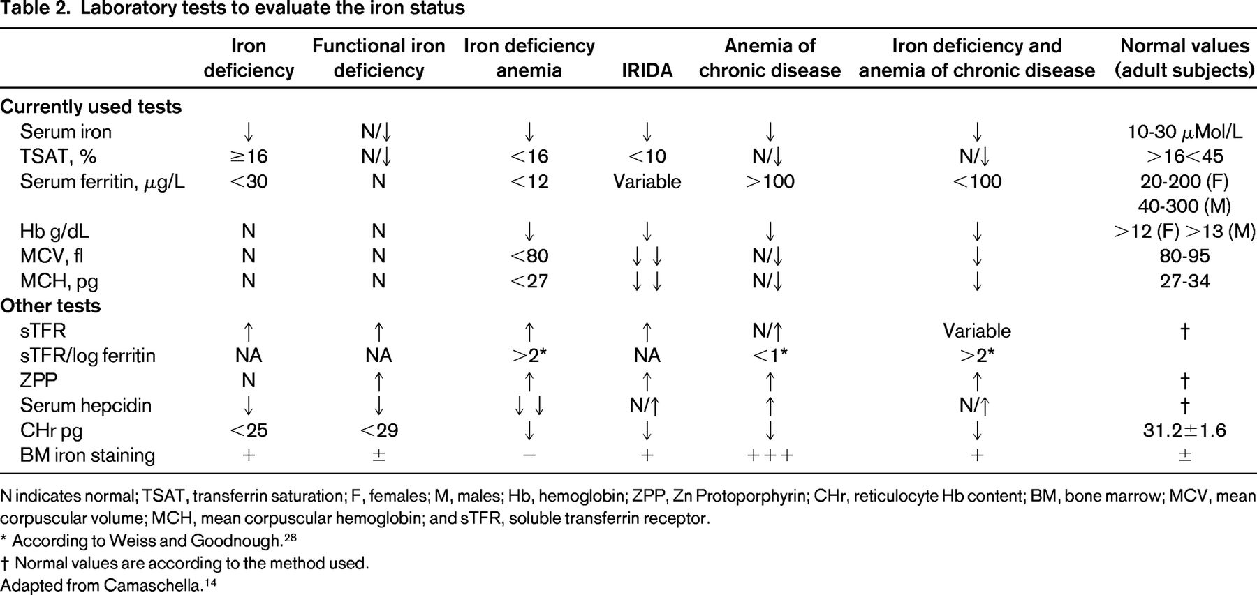
Iron Deficiency
Camaschella C. ASH Educ Program 2015

Slide 18
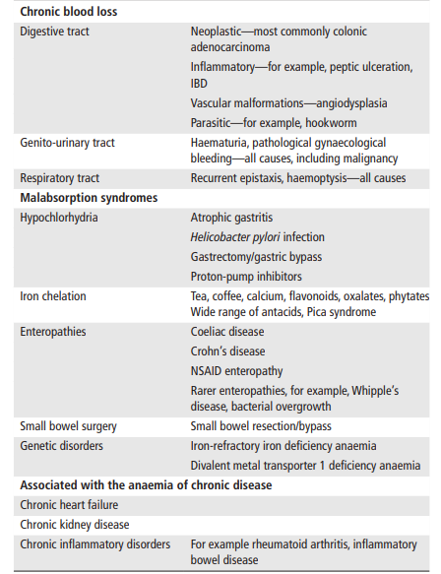
Iron Deficiency
Snook J. et al. Gut 2021

Slide 19
Iron Deficiency
Always figure out the cause
Treat with oral iron ferrous sulfate 325mg daily or every other day vs IV iron (~1000mg x1)
Only transfuse if severe symptomatic anemia (usually Hb <7)
For patients with anemia of CKD/ESRD
  EPO if Hb <10 and iron saturation >20% (non-dialysis) or >30% (dialysis)
  Avoid EPO if malignancy or previous stroke, heart attack, thrombosis

Slide 20
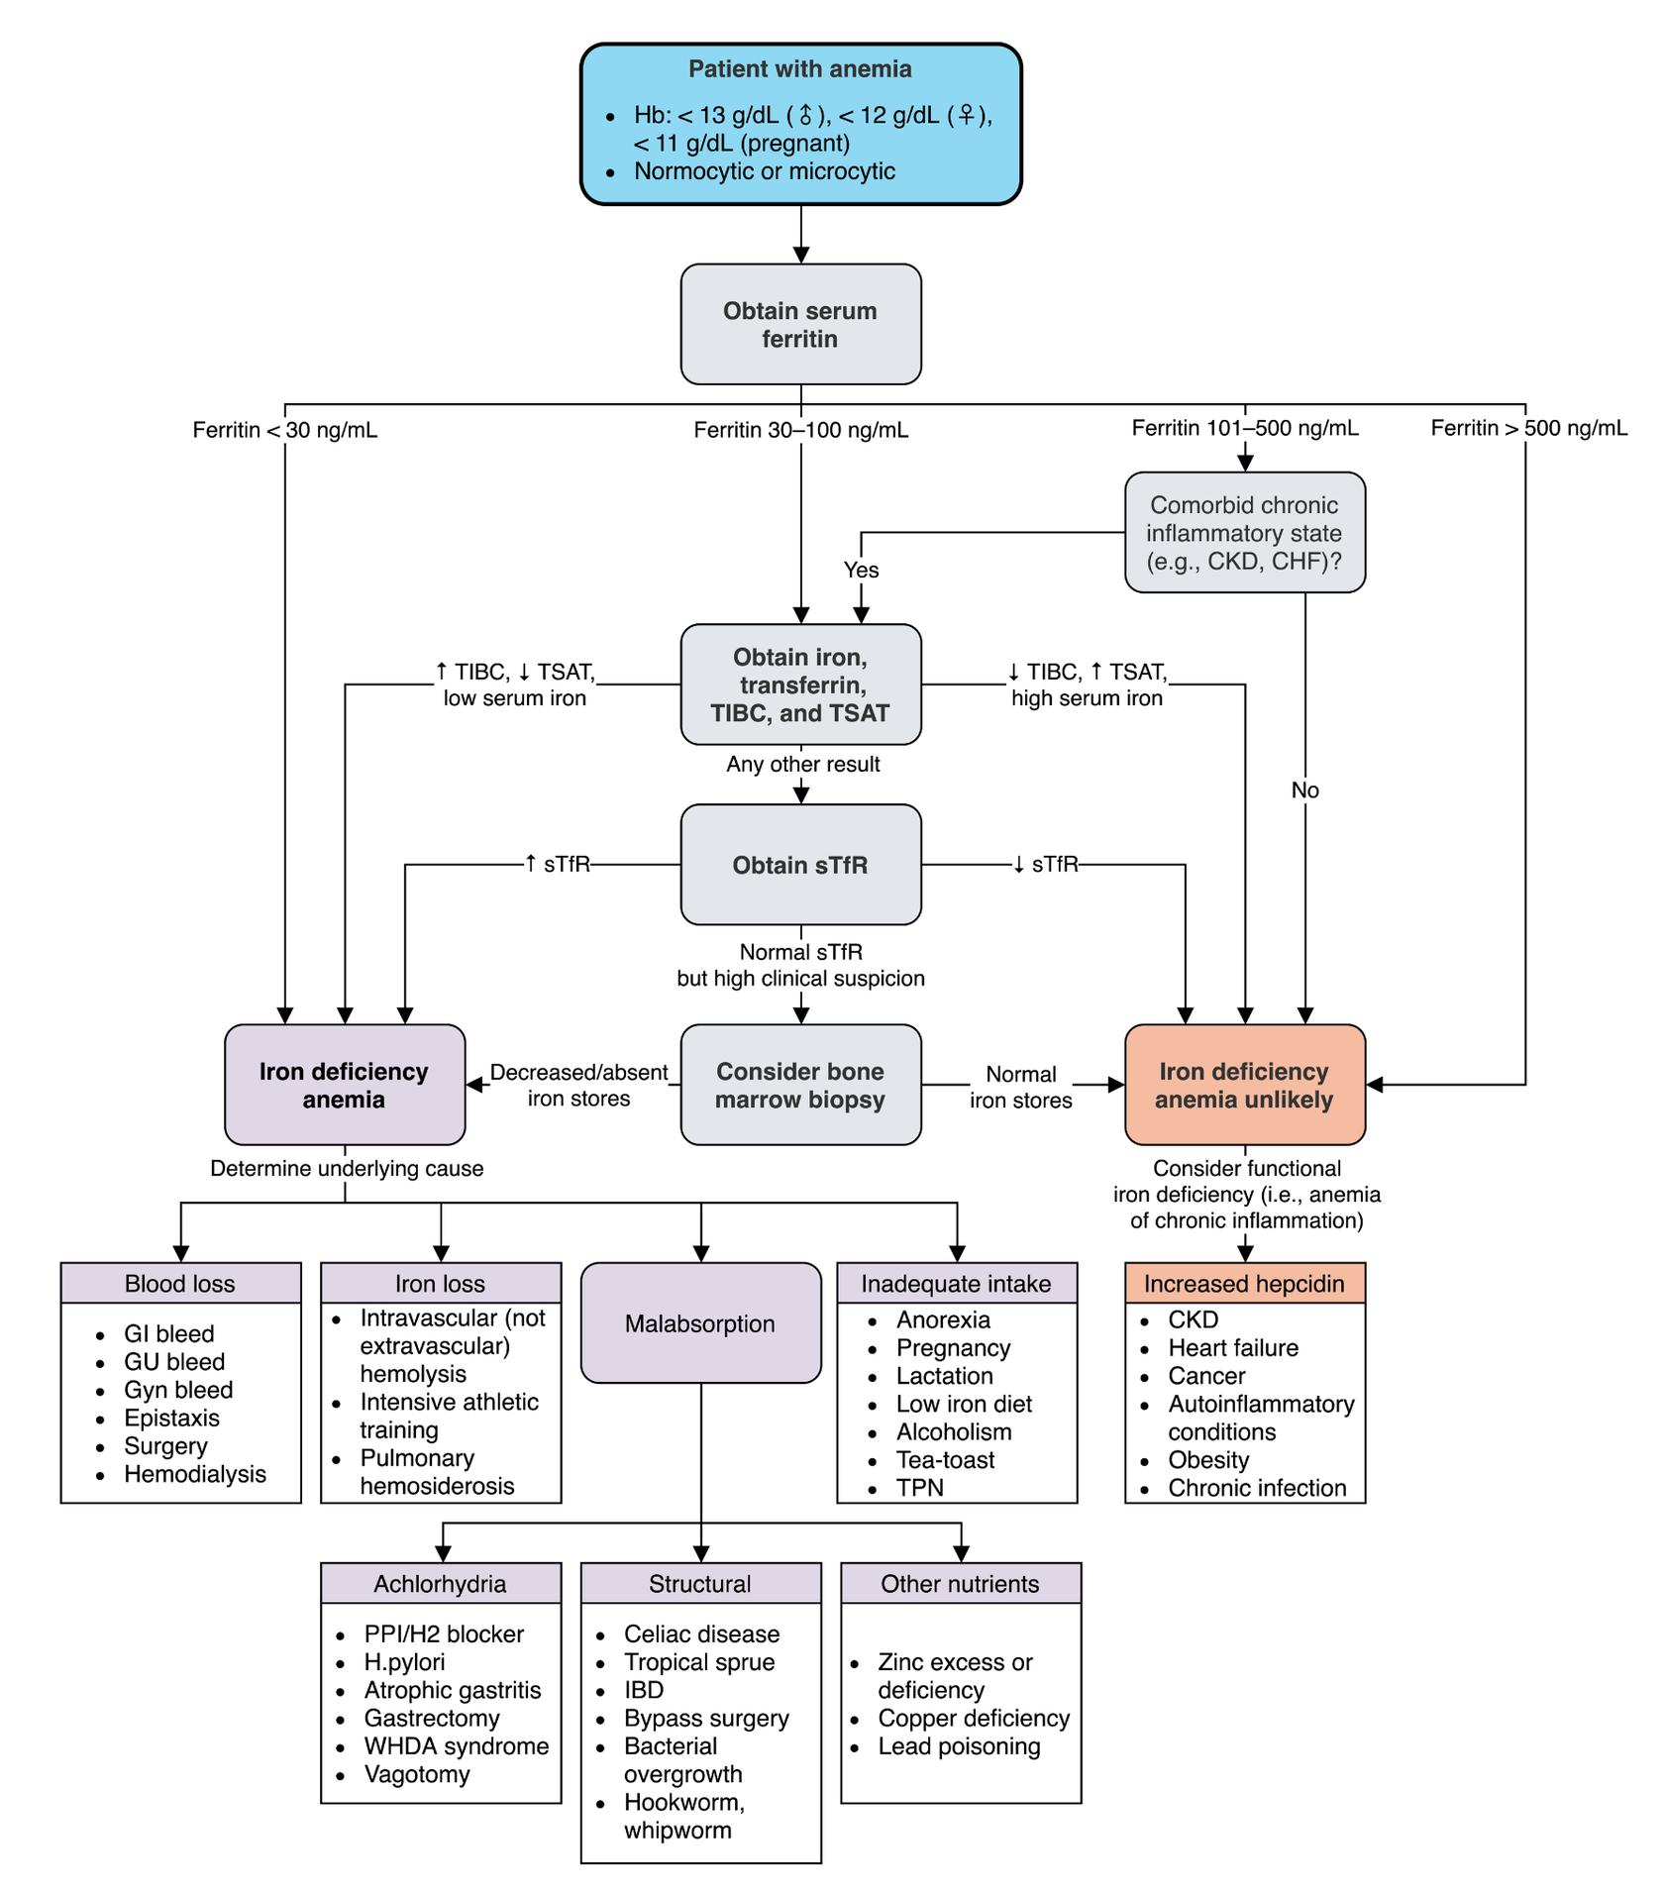
Iron Deficiency
Matthew Ho MD

Slide 21
Thalassemia – Hemoglobin Electrophoresis Patterns
Condition | Genes | HbA % (α2β2) | HbA2 % (α2δ2) | HbF % (α2γ2) | HbS % | HbC %
Normal | A / A | >95 | 2-3 | <1 | 0 | 0
Alpha Thal (0) | - - / - - | 0 | 0 | 0 | 0 | 0 | 4 alleles mutated. Hb-Barts; Hydrops fetalis
Alpha Thal Major | α - / - - | 60-90 | 2-3 | 0 | 0 | 0 | 3 alleles mutated. HbH; jaundice
Alpha Thal Trait | α α / - - α - / α - | 95 | 3-4 | <1 | 0 | 0 | 2 alleles mutated. Pattern looks normal, but microcytic anemia
Alpha Silent Carrier | α α / α - | >95 | 2-3 | <1 | 0 | 0 | 1 allele mutated. Pattern normal
Beta Thal Major | β⁰ / β⁰ | 0 | 5 | 95 | 0 | 0 | Transfusion dependent (Cooley anemia); jaundice.
Beta Thal Minor/Trait | β / β⁰ β / β⁺ | 90-95 | 3-10 | 2-3 | 0 | 0 | Microcytic anemia; RDW normal!
Sickle cell disease | S / S | 0 | <3.5 | 5-15 | 85-95 | 0 | Beta globin mutation Glu to Val
Sickle trait | A / S | 50-60 | <3.5 | <2 | 35-45 | 0
HbS-Beta Thal (0) | S / β⁰ | 0 | >3.5 | 2-15 | 80-92 | 0 | Identical to sickle cell disease. Except a little more A2.
HbS-Beta Thal (+) | S / β⁺ | 3-30 | >3.5 | 2-10 | 65-90 | 0 | Like sickle cell disease, but HbA present
HbSC | S / C | 0 | <3.5 | 1-5 | 45-50 | 45-50

Slide 22
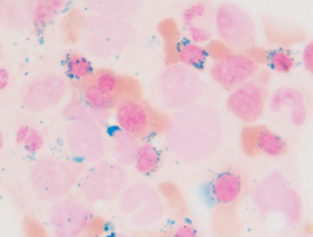
Sideroblastic Anemia
Defective protoporphyrin (heme) synthesis within the RBC
Reactions require B6
Low protoporphyrin so iron not added (trapped in mitochondria)
Causes:
  Isoniazid (microcytic): Causes B6 deficiency
  Alcoholism (macrocytic): Mitochondria poison. Clue = history and liver disease
  Copper deficiency (macrocytic): Clue = gastric bypass or chronic TPN or zinc intoxication (supplement) which causes copper deficiency
  Lead (microcytic or normocytic): anemia is mild, there may be some hemolysis, abdominal pain, joint pain, neuro symptoms
  Mutation in heme synthesis (ex: ALAS gene). Clue = family history
  Myelodysplastic syndrome (macrocytic!): Clue = dysplastic WBC, RBC, or megakaryocytes. Blasts present. Chromosomal deletions (5q or 7) or mutations (SF3B1).
Ringed sideroblasts (nucleated RBCs) shown with iron stain
Note: Basophilic stippling is not specific! It refers to ribosomal precipitates in RBCs and can be seen in thalassemia, alcohol abuse, Wilson’s disease, heavy metal poisoning.

Slide 23
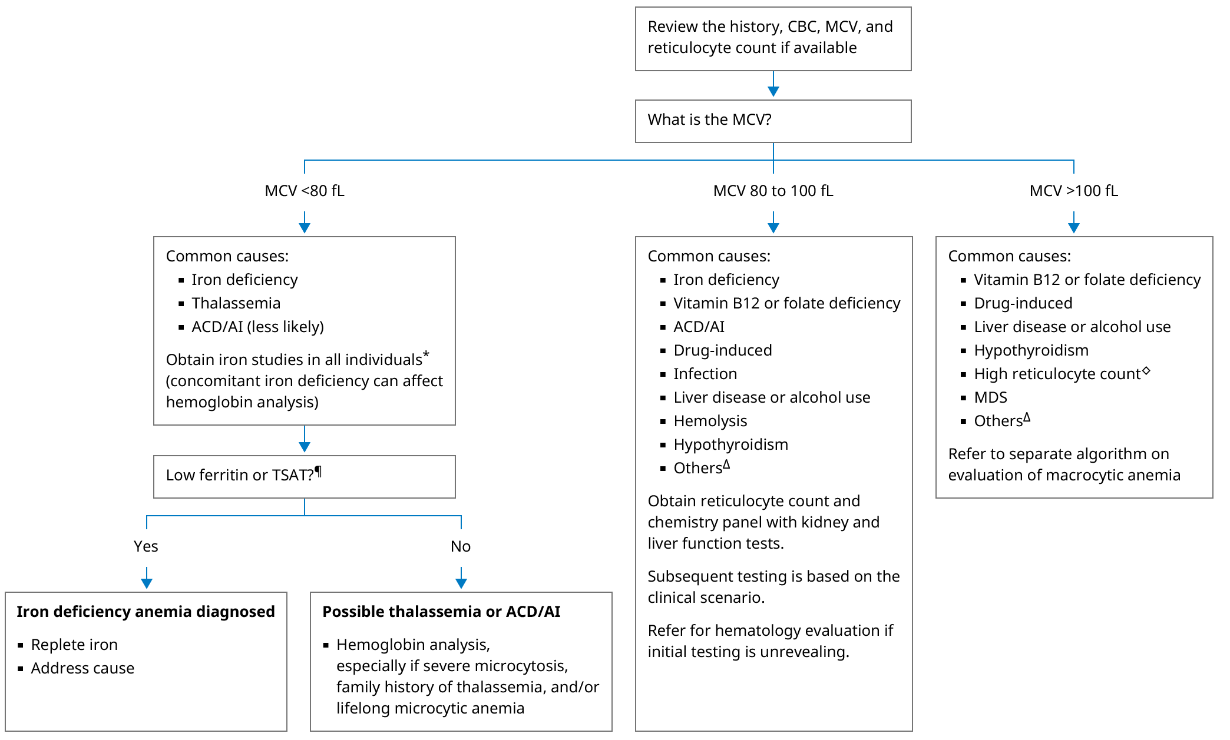
Back to the approach

Slide 24
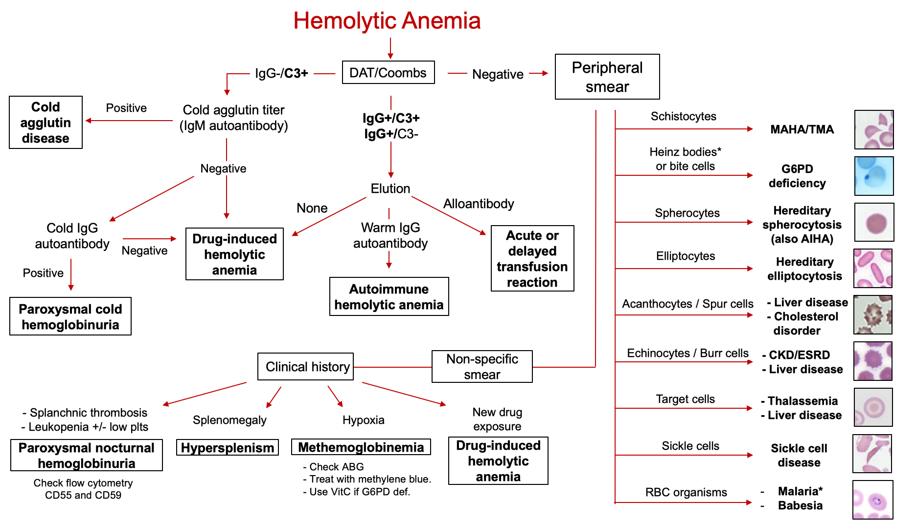

Slide 25
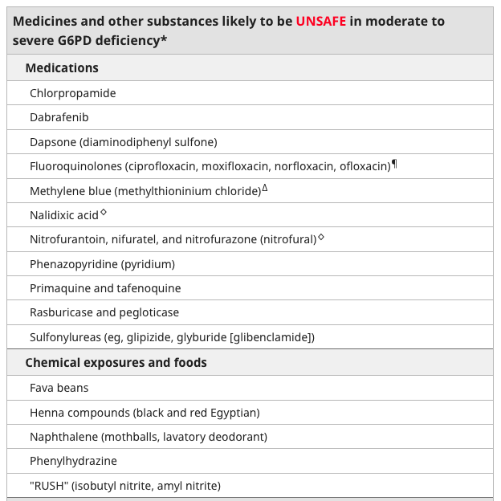
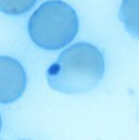
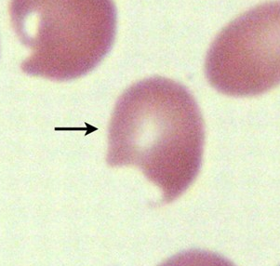
G6PD Deficiency
X-linked
Deficiency of G6PD results in decreased NADPH and reduced glutathione and RBCs become vulnerable to oxidative stress
Coomb’s negative hemolytic anemia
Heinz body: denatured hemoglobin. Only seen with supravital stain
Bite cell: RBC membrane removed by macrophage in spleen
ASH Image Bank

Slide 26
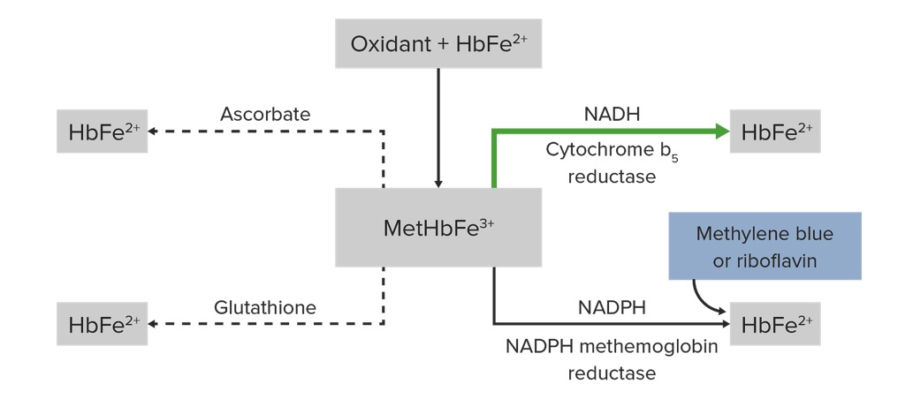
Methemoglobinemia
MetHbFe3+ does not bind O2 well.
Nitrates, sulfa drugs, dapsone, anti-malarial, lidocaine/benzocaine, rasburicase. There are also genetic causes (Cyb5R deficiency)
Avoid methylene blue in patients with G6PD deficiency!
Clinical: Cynaosis, neuro symptoms, respiratory depression, pulse ox inaccurate (may read ~85%), PaO2 normal.
CHECK BLOOD GAS for Met-Hb level!
MetHb >30% or 20-30% and sick:
Give methylene blue
Risk of serotonin syndrome if given with SSRIs or SNRIs or other serotonergic drugs
If G6PD deficiency then give Vitamin C

Slide 27
Microangiopathic hemolytic anemia (MAHA)
  Non-immune hemolysis with intravascular RBC fragmentation
  MAHA = Anemia + Coombs negative hemolysis + schistocytes
  Think about…
    Thrombotic microangiopathy (TTP, atypical HUS, HUS)
      If thrombocytopenia, calculate PLASMIC score. If int/high check ADAMTS13. PLEX.
    DIC
    Systemic infection
    Metastatic cancer
    HELLP
      Third trimester. Needs emergent delivery. Normal coags unlike DIC.
    HTN emergency
      Treating BP alone improves the MAHA.
    SLE or vasculitis flare
      Active clinical and serologic markers
    Antiphospholipid syndrome
      Catastrophic APLS can have DIC and needs anticoagulation and PLEX.
    Severe B12 deficiency
Bacteria | Cdif, Legionella, Mycobacteria, Rickettsia
Viruses | EBV, CMV, HBV, HCV, HIV, parvo, Dengue (hemorrhagic fever)
Fungi | Aspergillus, Blastomyces, Candida, Cryptococcus
Parasites | Babesia, malaria

Slide 28
Thrombotic microangiopathy (TMA)
  Pathologic lesion = microvascular thrombosis
  MAHA + thrombocytopenia/microvascular thrombosis
    Thrombotic thrombocytopenic purpura (TTP):
      Immune = autoantibody to ADAMTS13.
      ADAMTS13 activity <10%
      Fever, neuro symptom, purpura. Normal coags. Renal dysfunction less common.
      Treatment: PLEX, steroids, rituximab, caplacizumab (anti-vWF antibody)
    Shiga toxin-mediated hemolytic uremic syndrome (HUS):
      E.coli infection/Bloody diarrhea
      Treatment: Supportive care
    Complement-mediated TMA (Atypical HUS):
      Genetic mutation +/- autoantibody causes complement activation and endothelial injury.
      Renal injury is more common.
      No universally accepted diagnostic criteria!
      Treatment: Eculizumab or ravulizumab (anti-C5). PLEX is less effective.
    Drug-induced TMA
      Quinine (tonic water), cyclosporine, tacrolimus, gemcitabine, oral opioids abused intravenously, cocaine, MDMA
2 schistocytes per HPF (100x)
>1% schistocytes

