Slide 1

This is the way
Shaiba Ansari-Ali
Rheumatology
Stritch School of Medicine
Academic year 2026-2027

Slide 2



Housekeeping
Notes:
Disclosures: none
Goals:
Understand, patterns > memorize
Learn long term

Slide 3

Me.me
Notes:
Rheumatology is complex….
but so interesting

Slide 4
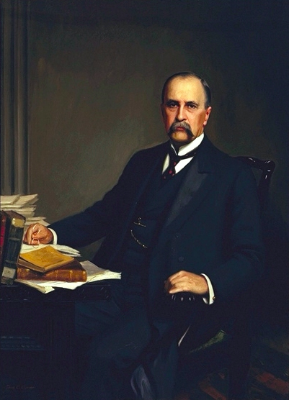
FUN FACTS ABOUT DR. OSLER
1845–1924
Wikimedia commons

Slide 5
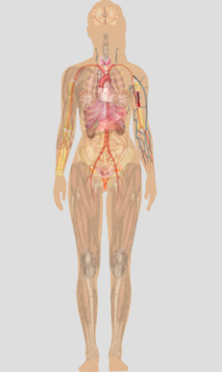
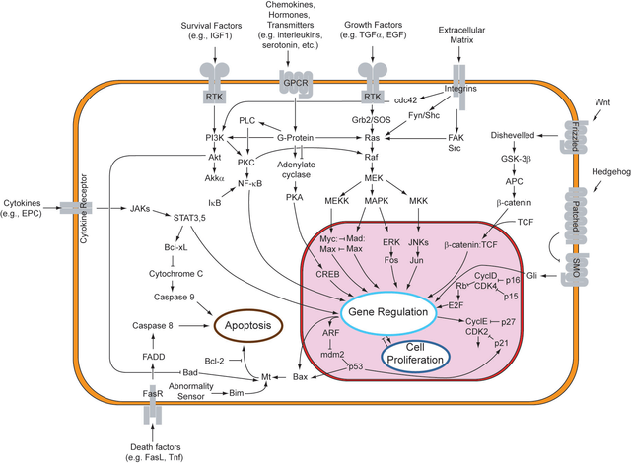

What is rheumatology?
  Wikimedia commons
Notes:
What we tell patients → EVERYONE HAS AN IMMUNE SYS THAT IS SUPPOSED TO PROTECT THEM FROM CANCER AND INFECTION
What we tell ourselves → much more complicated
You can’t handle the truth → in reality much much more complicated
Treatment risk of infection and cancer
Fibromyalgia is NOT a rheumatological disease
Very very RARE

Slide 6
“When I see an arthritis patient walk in the front door, my tendency is to walk out the back door”
- Dr Osler
Notes:
Probably hated rheumatology

Slide 7
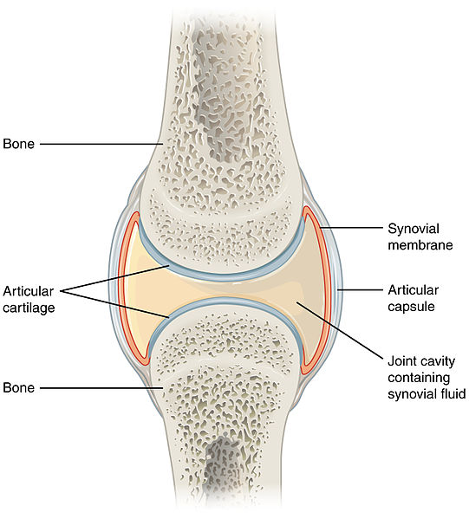
Wikimedia
Notes:
synovial lining inflamed in RA = inflammatory pannus → periarticular erosions & osteopenia
Middle of the joint → cartilage → thinning of this leads to degenerative joint disease aka osteoarthritis aka mother nature → joint space narrowing and bone on bone on x rays

Slide 8
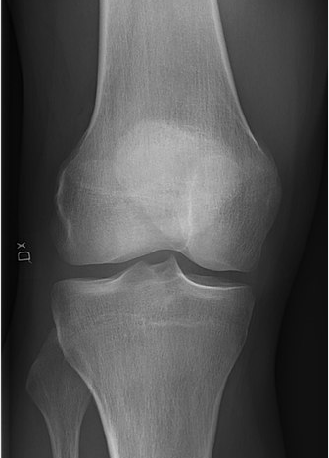
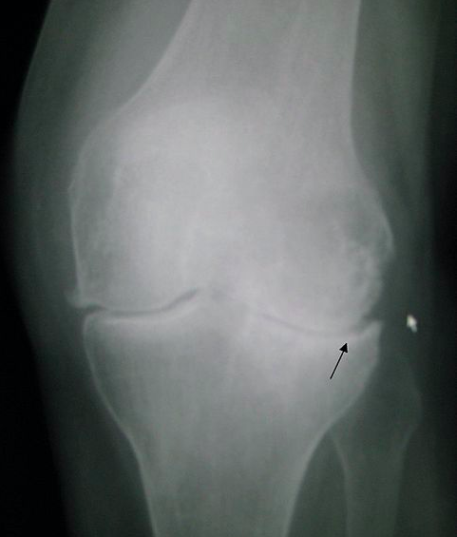
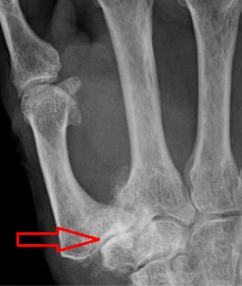
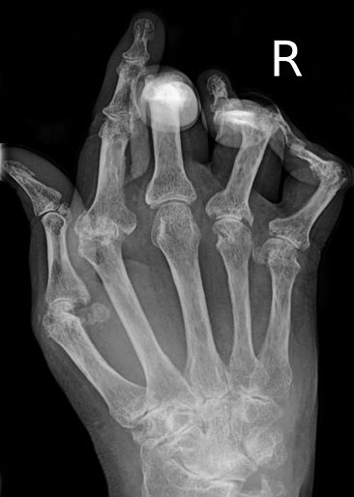
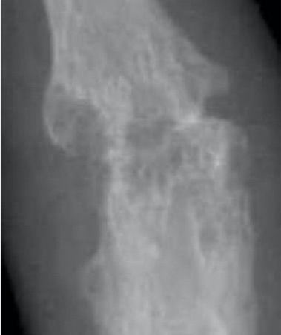
Wikimedia
Notes:
X rays
Normal knee
Knee w/ OA
Hand w/ OA
Hand w/ RA
Closeup of joint w/ RA

Slide 9
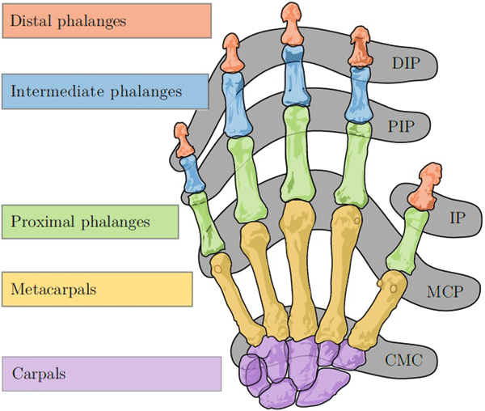
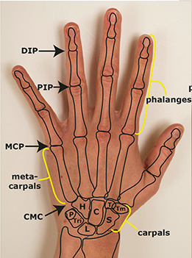
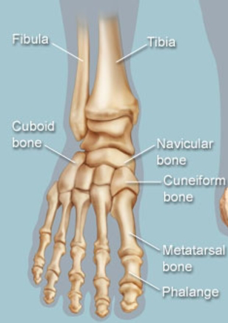
Research gate
Startradiology
Web md
Notes:
Important bc synovial lining of MCP and PIP is similar so gets attacked by same diseases
But DIP is different so usually unaffected by autoimmune arthritis pannus in RA

Slide 10

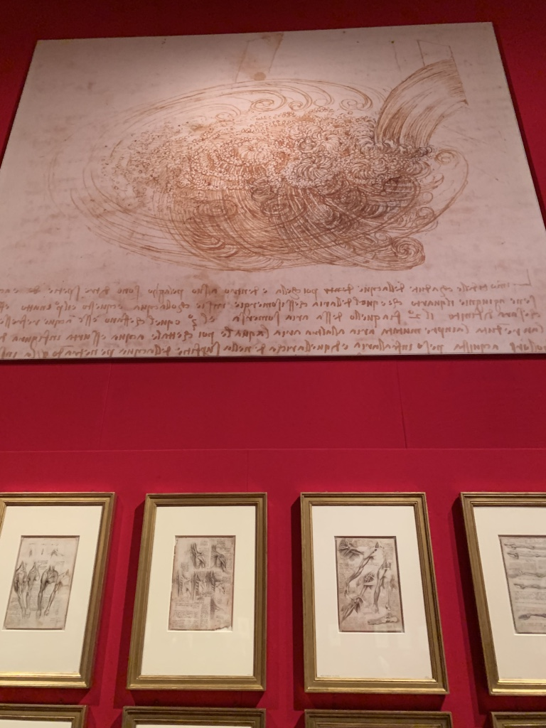
Joint inflammation
SYNOVITIS
Notes:
Synovitis = pain + swelling + warmth
Long-term studies have shown that patients with ill-defined rheumatic symptoms seldom progress to develop serious complications or disability so do not overtreat
Monoarticular = 1
Oligoarticular < 4
Polyarticular symmetric > 4
Polyarticular non symmetric > 4
Spine

Slide 11
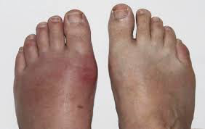
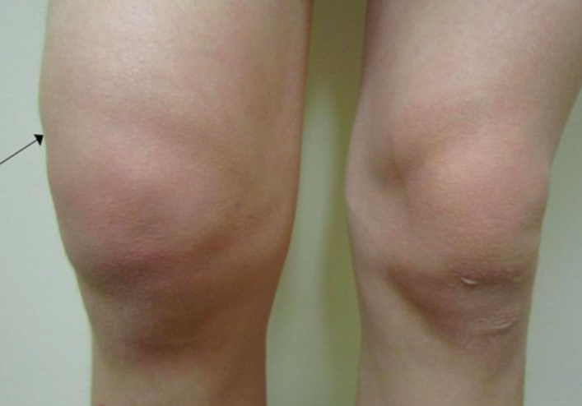
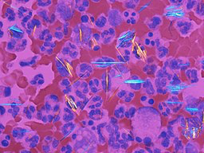
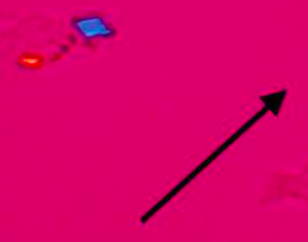
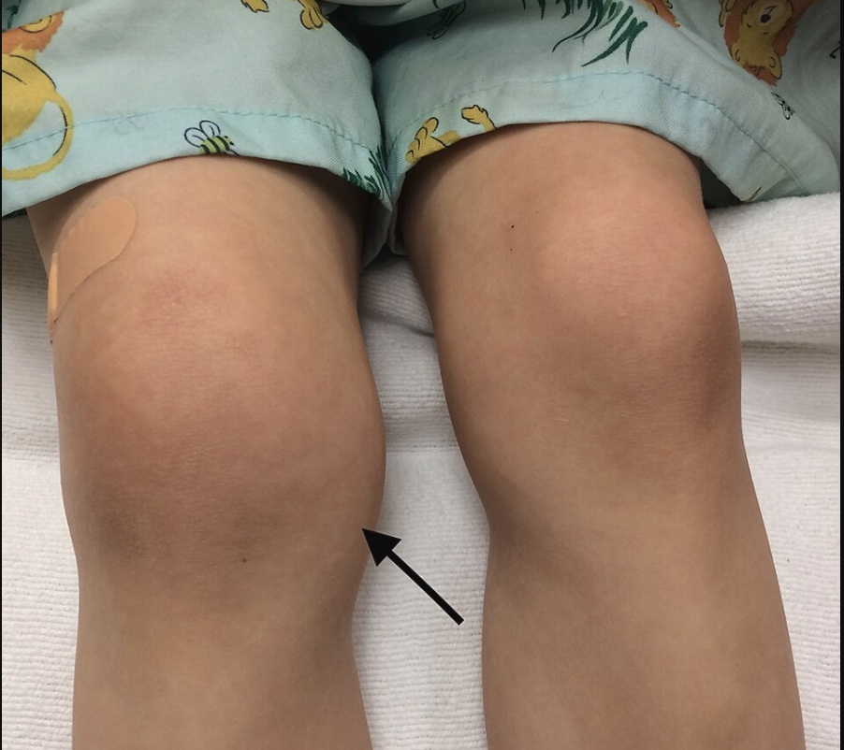
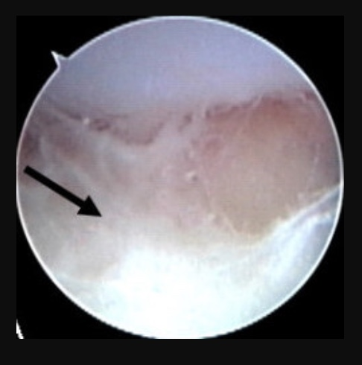
Monoarticular
Gout
CPPD
Septic
arthritis
Wikimedia commons
Notes:
MONOARTICULAR
Gout
In men and post menopausal women
Very intense; podagra of 1st MTP usually first presentation of gout
Negatively birefringent monosodium urate crystals
Allopurinol hypersensitivity syndrome (AHS) assoc with HLA-B*58:01 mostly in Han Chinese
CPPD
Older patient with metabolic issues or aging
Less intense; knee and wrist
positively birefringent, rhomboid shaped crystals
Crowned dens syndrome
Septic arthritis
Gonococcal arthritis, caused by Neisseria gonorrhoeae in young sexually active adults; knee
Septic arthritis with staphylococcus in knee, gonococcal in young women around menses
Mycobacterium marinum in people who clean fish tanks
Pseudomonas aeruginosa or Staphylococcus aureus with iv drug use
Can get permanent joint damage within 24 hours!
Lyme disease
Arthritis weeks to months after the initial infec
Knee
Diagnosis is important to facilitate early treatment to decrease morbidity and mortality and should often be initiated before a definitive diagnosis is made.
In summer in wooded areas
Before Lyme disease was described in literature, an aberrant number of children in Lyme, Connecticut, were diagnosed with JIA in 1975
Transmission with longer attachment periods of at least 48 to 72 hours
Stage I: occurs 7 to 10 d after tick bite; bull’s eye rash
Stage II: occurs days to weeks after the initial infection; rash of disseminated erythema migrans that spares the palms and sole; lethargy; radiculoneuritis or mononeuritis multiplex; conduction delay at AV node; monarticular arthritis with chronic knee effusions
Stage III: year or more after initial presentation with chronic persistent symptoms that involve multiple organ systems.
Removing ticks as soon as possible helps prevent disease

Slide 12
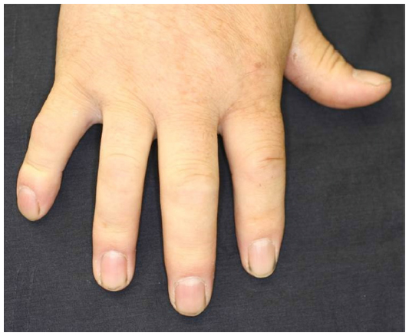
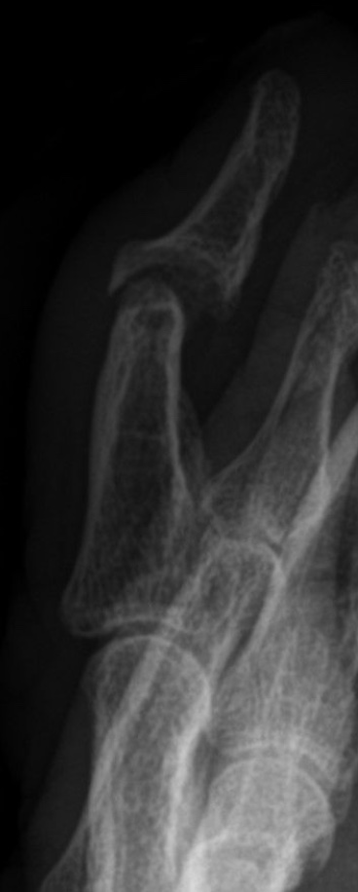
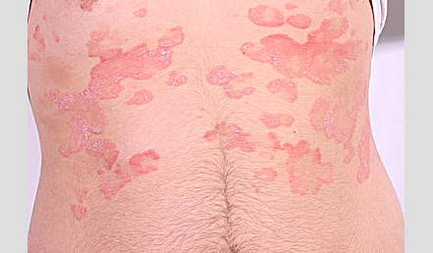
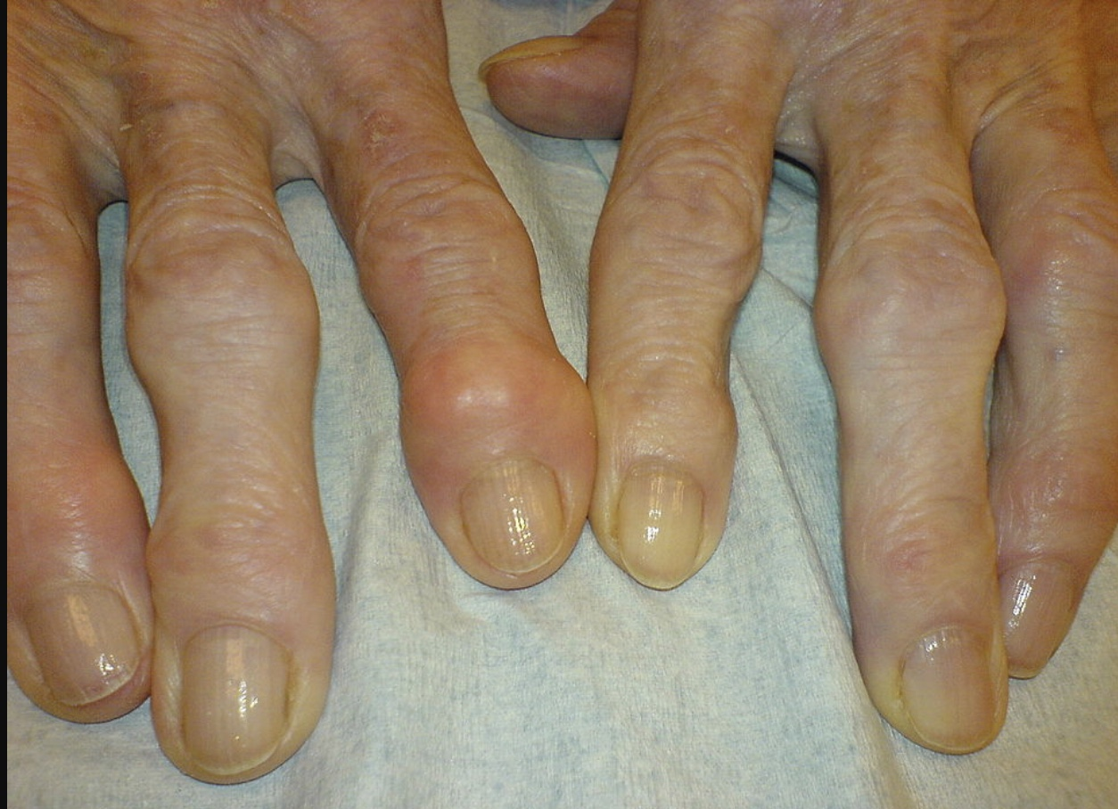
Oligoarticular
Psoriatic arthritis
Osteoarthtis
Yamamoto DMPL
Wikimedia commons
Notes:
OLIGOARTICULAR
Psoriatic arthritis PsA
Dactylitis = swelling of tendons of each finger and toes → sign that disease has been active for about 2 years already → so do not dismiss!
Includes enthesopathy, dactylitis, and abnormal bone remodeling
But dactylitis is characteristic symptom of PsA with a high specificity and associated with radiologically evident erosive damage to joints
Important to detect PsA early bc joint damage occurs and progresses in “early” stage of PsA (< 2 yrs)
Psoriasis is photoreceptive on extensor surfaces of body and usually precedes onset of joint manifestation in nearly 80% of cases
Nail pits means more chance of arthritis
Can get ”pencil in cup” deformities on x rays in PIPs and DIPs
Anywhere from 15-25 people w/ psoriasis get PsA
Higher cardiovascular risk
Significant benefit with tight control in terms of peripheral arthritis, skin disease and patient reported outcomes
Spondyloarthropathy
Includes PsA, IBD (Crohns, UC) assoc, ReA
ReA with circinate balaninitis, keratoderma blenorrhagicum , usu with Chlamydia
New studies show gut biome important in all these dz
Osteoarthritis
Mechanical
Due to older age; is natural
Problem is in the middle of the joint
Heberden’s and Bouchard’s nodes

Slide 13
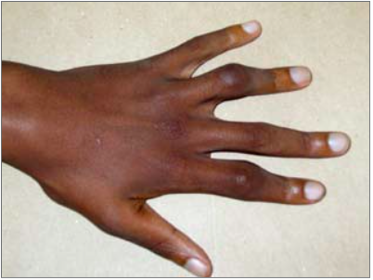
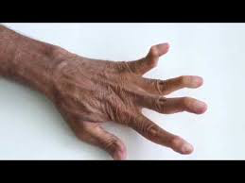
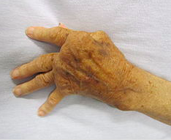
Polyarticular Symmetric
Rheumatoid arthritis
Lupus
Santiago NEJM
Tikly SAFP
Wikimedia commoms
Notes:
POLYARTICULAR SYMMETRIC
Rheumatoid arthritis
More in females ages 40
Significant morning stiffness > 1 hour
More in smokers; especially deforming disease; even if no family history!
Swan neck deformity = RA destroys joints but also tendons → imbalance of extensor tendons of fingers → hyperextension of PIP w/ flexion of DIP
Boutonniere deformity = RA destroys joint and tendon at PIP → flexion at PIP and hyperextension at DIP
Incidence 1/1000
Lupus
More in females of childbearing ages (15-44) Immune system becomes overactive → attacks many things in body → heme, renal, pulmonary, skin, joints etc → low everything (wbc, hb, plt, gfr, complements), sores in mouth, hair loss, photosensitive rashes, serositis (water around heart and lungs), fatigue, joint swelling/pain, nerve/brains suff
Jaccoud’s is reducible = the joints are fine but the tendons become lax → normal hand x rays
Jaccoud’s happens despite treatment bc soft-tissue abnormalities, like laxity of ligaments, fibrosis of capsule, and muscular imbalance
Incidence 1/10000

Slide 14
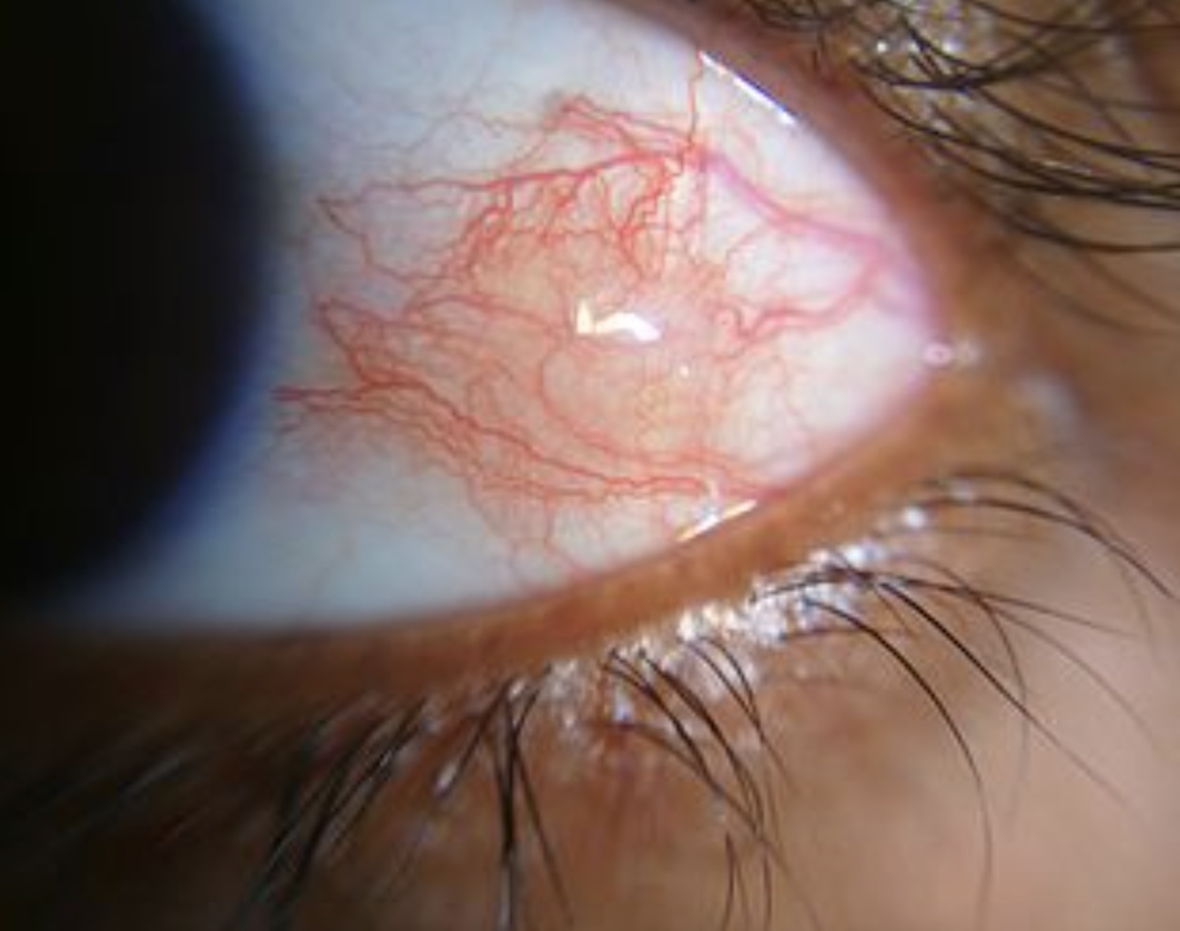
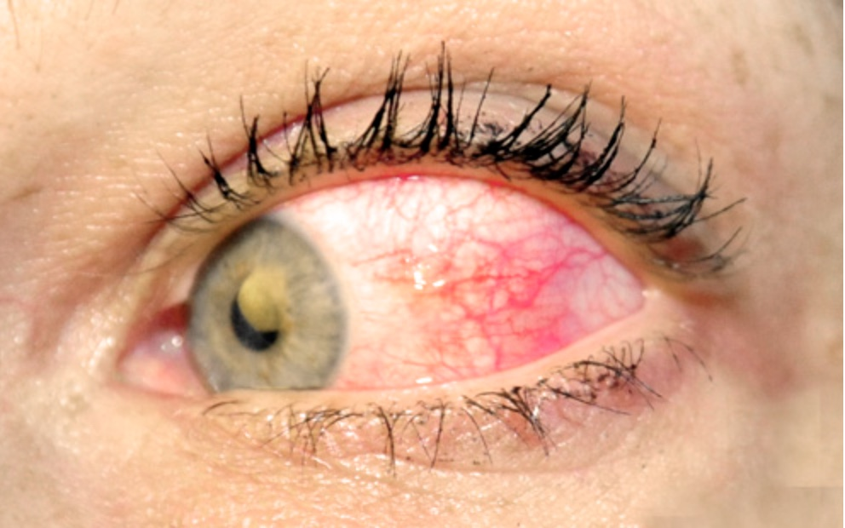
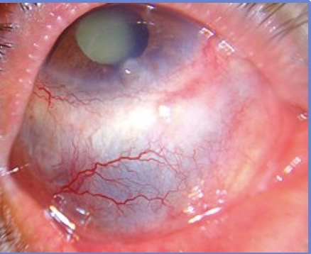
RA Ocular
Episcleritis
Scleritis
“S” for severe pain
Wikimedia commoms
Notes:
Episcleritis = Inflammation of the episclera, the tissue layer between the conjunctiva and the sclera → red eye, irritation but not too bad → self limiting usually
Scleritis = Inflammation of the sclera (the tough, white outer layer of the eye).→ Deep, boring eye pain, redness, swelling, light sensitivity, and potentially blurred vision → it’s serious → if recurrent can be scarring

Slide 15
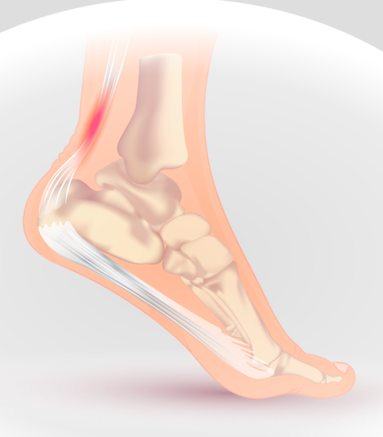
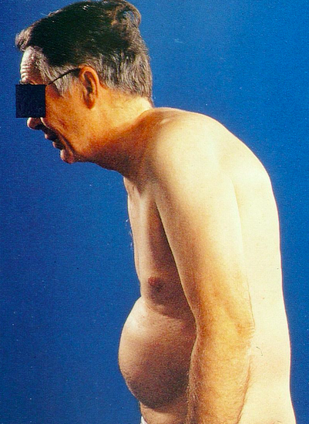

Spine
Ankylosing Spondylitis
Spondyloarthropathy
Wikimedia commons
Notes:
Inflammatory back pain in general
Worst at night and in mornings
Movement helps
Ankylosing spondylitis
= fusion of whole spine
Significant morning stiffness > 1hour
Usually begins in young men but FF now women getting it more too
Activity helps
So these are your very active young men
Fun fact = radiographs do not change but clinically patient looks normal
Incidence 1/1000 p
Enthesitis
= inflammation where tendon inserts into bone
Spondyloarthropathy
Includes PsA (psoriatic arthritis), IBD (Inflammatory Bowel disease Crohn’s, UC) associated, Reactive Arthritis (ReA)
ReA with circinate balaninitis, keratoderma blenorrhagicum , usually with Chlamydia
New studies show gut biome important in all these dz

Slide 16
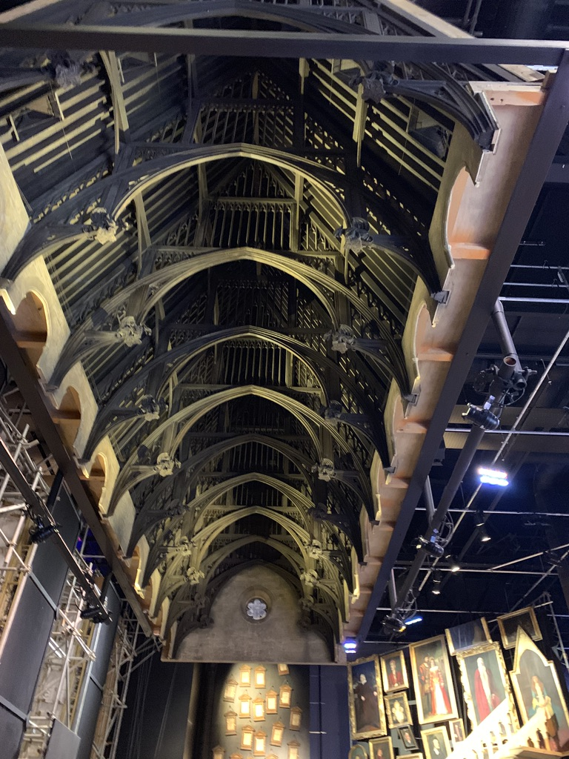
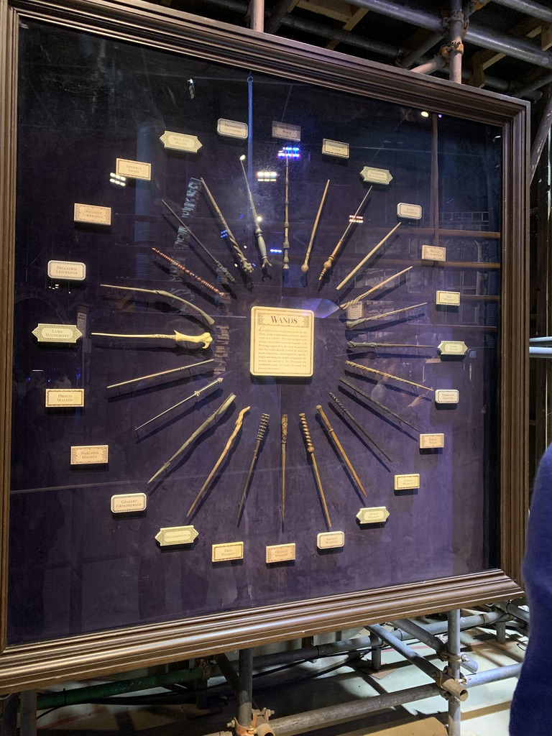
Notes:
Monoarticular (1)
Gout = Male, very intense, podagra
Pseudogout (CPP arthritis) = Older, knee, wrist, metabolic dz
Septic = Always aspirate, STD
Oligo (<4)/polyarthritis
Psoriatic = Dactylitis, psoriasis, nail pits
Osteoarthritis = Mechanical
Polyarticular symmetric (4)
Rheumatoid arthritis = Female, smokers, swan neck, boutonniere, am stiffness
Lupus = Jaccoud’s is reducible
Polyarticular non symmetric
Sarcoid ** = Non erosive, ankles, ocular → basically when the immune system can’t get rid of an infection it will wall it off with inflammatory cells that can technically happen anywhere → almost always a one hit wonder → but rarely becomes systemic and recurrent → seizures, skin stuff, heart conduction stuff, hilar lymphadenopathy, recurrent uveitis etc
Spine
Ankylosing spondylitis = Night time back pain, activity helps, enthesitis
Spondyloarthropathies (IBD, psoriatic, reactive) = GI sx, rash, infection

Slide 17
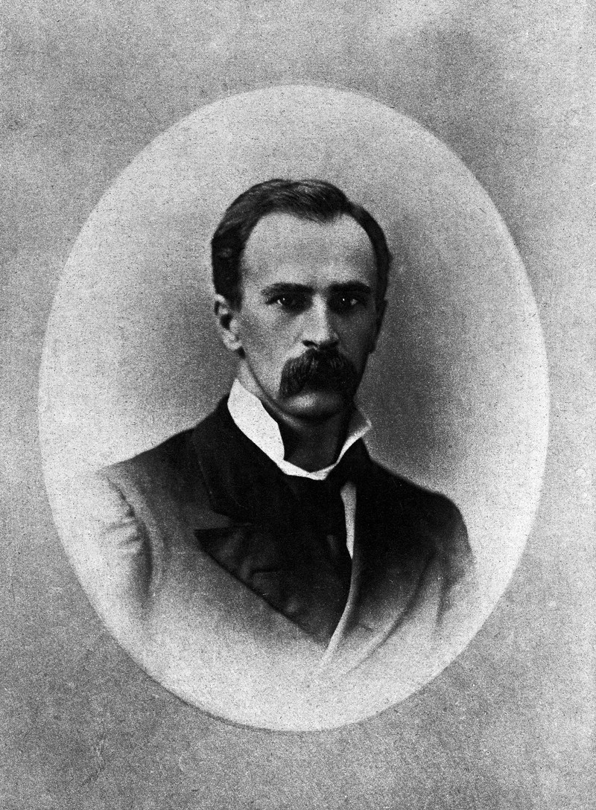
Became a minister but then studied medicine in Europe
Wellcomecollection.org

Slide 18
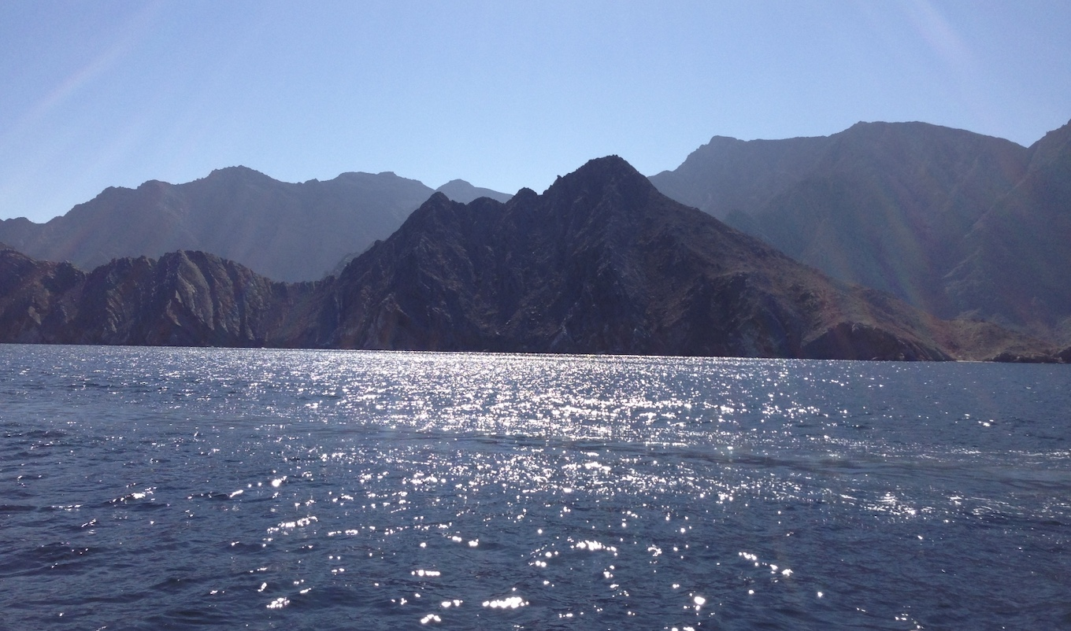
Weakness and/or Pain
Notes:
Now focus on weakness
Myositis and vascular inflammation leading to bursitis
Pay attention to clinical pattern
Proximal weakness
Proximal and distal weakness
Shoulder and hip girdle pain rather than true weakness

Slide 19
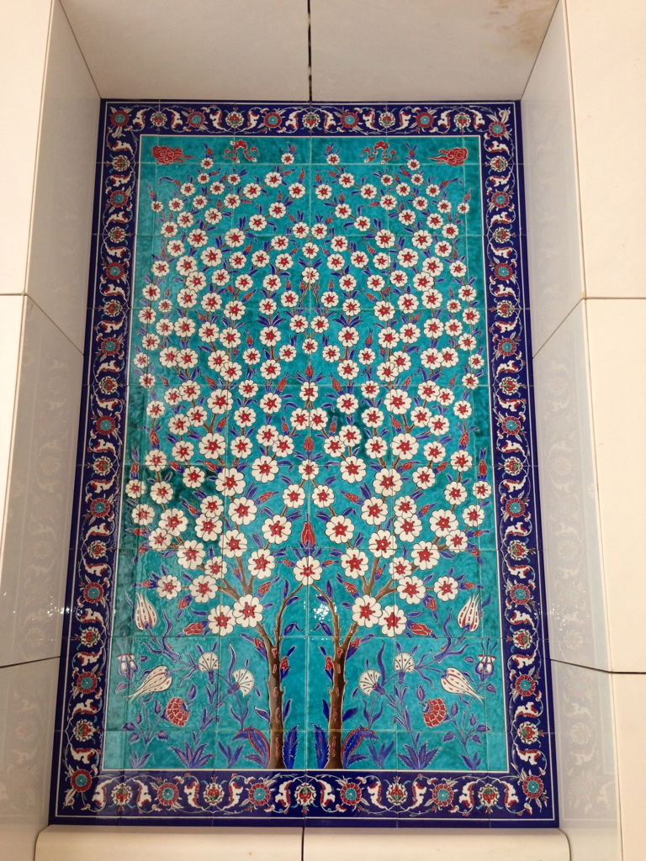
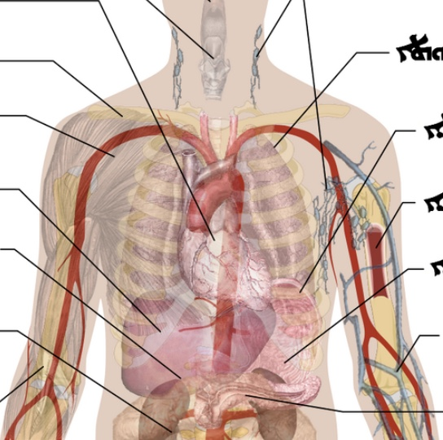
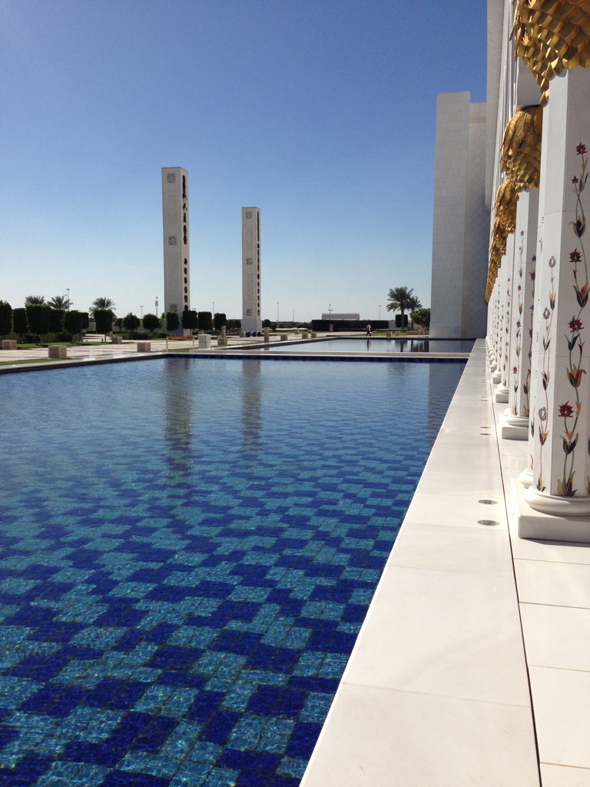
Proximal weakness
Wikimedia commons
Notes:
Proximal weakness from myositis all have:
Esophageal dysmotility
ILD
Raynaud’s
Super rare
Then they are divided up into
With a rash → dermatomyositis w/ photosensitive rashes
With no rash → Polymyositis (now an umbrella term for Necrotizing immune mediated myopathy, antisynthetase syndrome, blah blah blah)

Slide 20

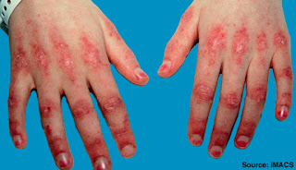
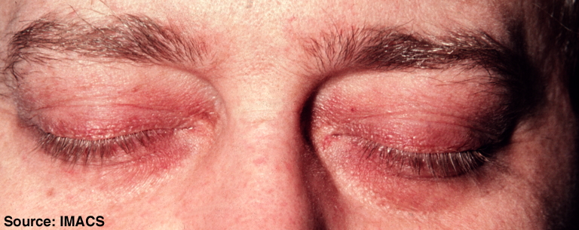
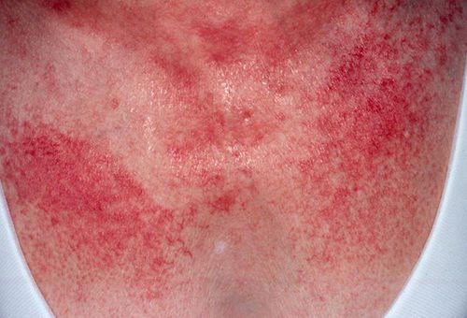
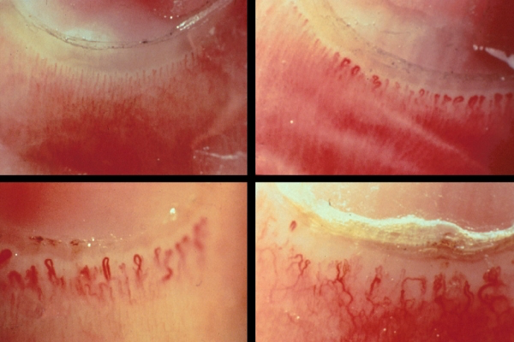
Dermatomyositis
ACR
Medscape
Wikimedia commons
Notes:
Gottron papules and heliotrope rash are pathognomonic
20% to 30% also have interstitial lung disease
Increased risk of malignancy
Autoimmune Myopathies
Very rare
Few per million but immune mediated necrotizing may be one per 10,000
Dermatomyositis
Gottron papules and heliotrope rash are pathognomonic
20% to 30% also have interstitial lung disease
Increased risk of malignancy
Should undergo age-appropriate screening + pelvic ultrasound (in women) + contrast-enhanced CT scan of the chest, abdomen, and pelvis
Heliotrope rash
Over eyelids
Photosensitive
V-sign rash
Over front of chest
Photosensitive
Shawl-sign rash
Over back of neck etc
Photosensitive
Gottron’s papules
Raised redness over joints (MCPs, PIPs, DIPs and IP)
Nailfold abnormalities
Changes mimic dz
Poor mans test of dz progression
Extensively studied in JDM at Children’s NW

Slide 21
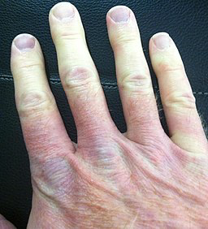
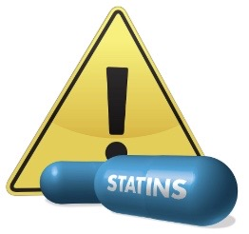
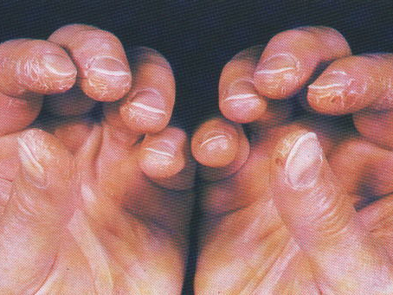

Polymyositis
MSU
Wikimedia commons
Notes:
Polymyositis
Basically anything that does not have a rash
Now it’s a dx of exclusion
Immune mediated necrotizing myopathies
Rare but may be one per 10,000
Severe proximal muscle weakness, dysphagia, and muscle atrophy
Anti-HMG-CoA reductase autoantibodies in 40% and statin use
But develop a progressive myopathic process that requires immunosuppressive therapy to control in addition to NEVER USING STATINS AGAIN
Antisynthetase syndrome
Multisystem disease
Myositis, interstitial lung disease, arthritis, Raynaud phenomenon, fevers, mechanic’s hands
Attacking anti signal recognition peptide that is EVERYWHERE
Raynaud’s
Vasospastic dz
Raynaud’s : pallor, cyanosis then erythema (white, blue then red) → at least the white and blue
Occurs in 4/1000 but only 1 has connective tissue disease associated w/ them
Others that’s how God made them
Mechanic’s hands
Very severe dz
Multisystem disease
ILD

Slide 22
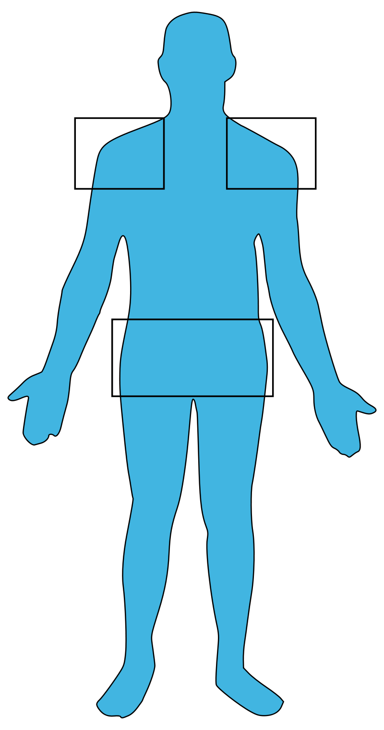
Polymyalgia rheumatica
Wikimedia commons
Notes:
PAIN, NOT WEAKNESS
Polymyalgia Rheumatica: Common Disease, Elusive Diagnosis
Mostly older (>50 yo) white women
Proximal muscle pain and weakness in the arms and hips suddenly
CRP tends to be a more sensitive
15% of patients with PMR will also develop giant cell arteritis
May be paraneoplastic
Incidence 52/ 100,000 so more common

Slide 23
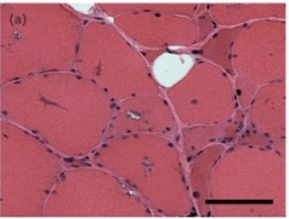
Inclusion body myositis
MSU
Wikimedia commons
Notes:
INCLUSION BODY MYOSITIS IN WHITE MALES ABOVE 50 YO, HITS PROXIMAL & DISTAL MUSCLES; MAY TAKE YEARS TO DX; NO REAL TX
Autoimmune Myopathies
Very rare
Few per million but immune mediated necrotizing may be one per 10,000
Dermatomyositis
Gottron papules and heliotrope rash are pathognomonic
20% to 30% also have interstitial lung disease
Increased risk of malignancy
Should undergo age-appropriate screening + pelvic ultrasound (in women) + contrast-enhanced CT scan of the chest, abdomen, and pelvis
Polymositis
Now dx of exclusion
Immune mediated necrotizing myopathies
Severe proximal muscle weakness, dysphagia, and muscle atrophy
Anti-HMG-CoA reductase autoantibodies in 40% and statin use
But develop a progressive myopathic process that requires immunosuppressive therapy to control
Antisynthetase syndrome
Multisystem disease bc targeting signal recognition peptide that is EVERYWHERE
Myositis, interstitial lung disease, arthritis, Raynaud phenomenon, fevers, mechanic’s hands;
Inclusion body myositis
White males over age 50
Slow painless weakness
Asymetric, proximal and distal muscles affected
Dysphasia end stage
Associated with Sjogren’s, have neuropathy
Red rimmed vacuoles on histopathology
Polymyalgia Rheumatica: Common Disease, Elusive Diagnosis
Mostly older (>50 yo) white women
Proximal muscle pain and weakness in the arms and hips suddenly
CRP tends to be a more sensitive
15% of patients with PMR will also develop giant cell arteritis
May be paraneoplastic
Incidence 52/ 100,000 so more common

Slide 24
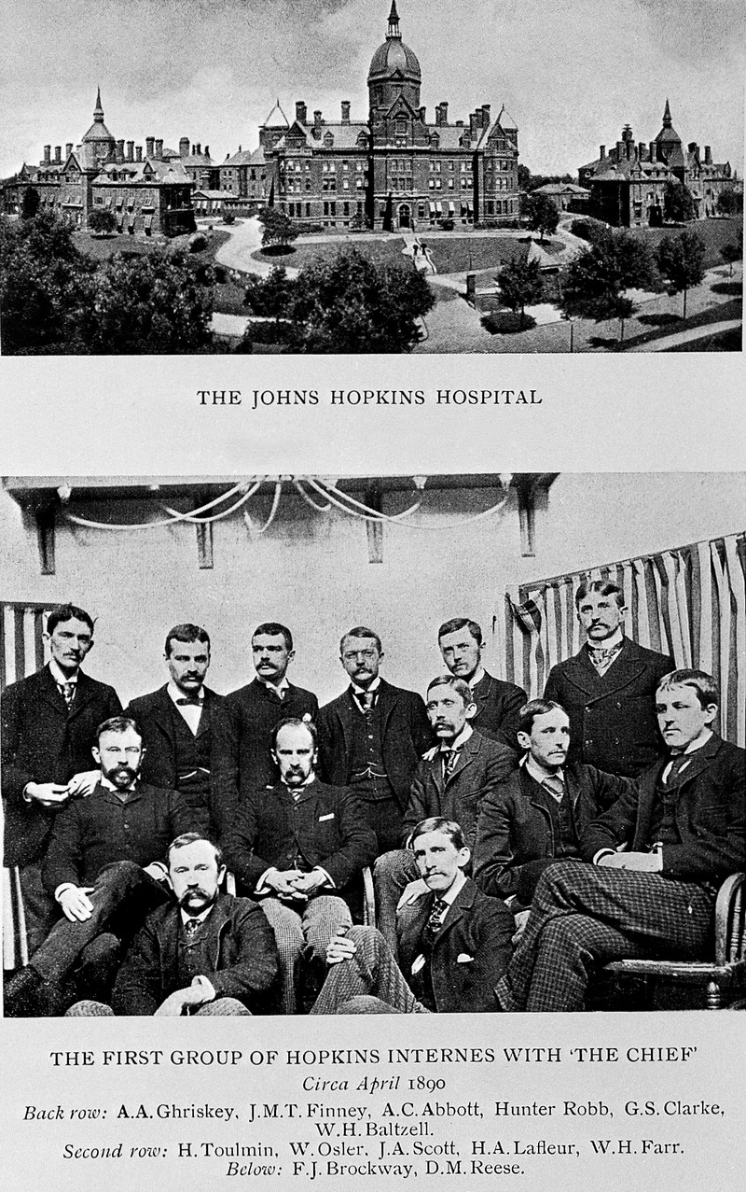
One of the founders of John Hopkins in Baltimore (even though he was from Canada)
Wellcomecollection.org

Slide 25


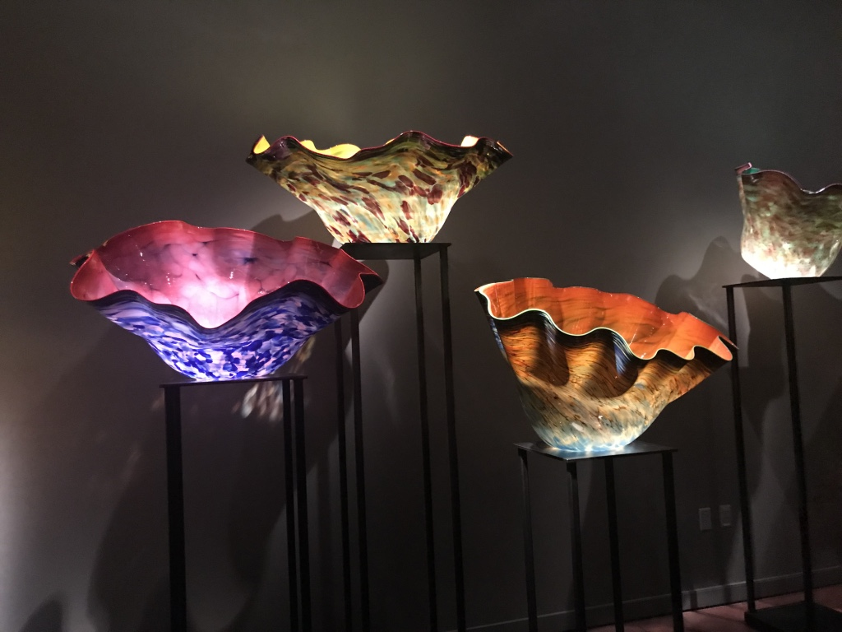
Skin lesions
Wikimedia commons
Notes:
Now switch to skin lesions
Divide into 5 categories
Photosensitive
Photoreceptive
Ulcers
Skin thickening
Nodules & purpura
Most noticeable part of physical exam
Have patient take pictures bc most are transient
Focus on clinical pattern
Macular (flat) vs papular (raised)
Clear border vs not
Vesicle (raised < 1 cm) vs nodule (raised > 1 cm)
Blanch vs not (purpura do not)

Slide 26
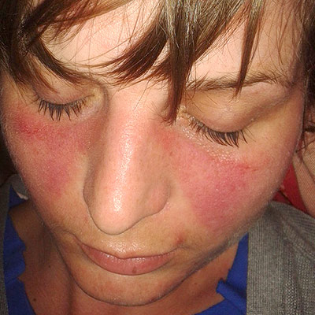


Photosensitive
Dermatomyositis
Lupus
Medscape
Notes:
Lupus and dermatomyositis are the big photosensitive rashes in rheum
Malar rash
Spares nasolabial fold
Photosensitive
Usually raised
Do not confuse with rosacea
Discoid lesions
D for deforming bc leaves scars
SLE
Frequency of cutaneous manifestations high as 70%
CLE
Almost 16% progress to SLE (but converse is much higher; almost 85+% of those w/ SLE have skin stuff)
Unclear how CLE relates to SLE pathogenesis
Challenge is definition of what constitutes SLE with cutaneous features versus CLE as an independent disease
UV exposure common trigger for CLE, with photosensitivity rates 81%
Divided into acute, subacute, and chronic;
incidence of CLE is 4/100,000
Acute is malar rash and eruption with erythema and edema of the hands, with prominent sparing of the joint and lasts days to weeks
Subacute is annular or psoriasiform plaques in a photodistribution and lasts months and can be seasonal
Chronic is discoid vs tumid (juicy papules ) vs panniculitis (painful subcutaneous nodules that heal with depression and atrophy) and lasts weeks to years
Discoid with erythematous scaly plaques with prominent follicular plugging that results in scarring and atrophy
Remember: discoid is for deforming
Lupus ulcers
Painless oral lesions usually on top of mouth

Slide 27

Photoreceptive
Psoriatic arthritis
Medscape
Wikimedia commons
Notes:
Psoriasis
Gets better with sunlight (vs SCLE rashes get worse in sunlight)
Psoriasis precedes arthritis in 80%
Scaly plaques on extensor areas
About 14-25% get psoriatic arthritis (PsA)
PsA
Remember dactylitis should be treated bc joint damage starts in early stage
Get more metabolic syndrome stuff so monitor the cholesterol and heart disease risk factors
Nail pits
In PsA
Predicts more erosive and peripheral dz early on (<2yr)

Slide 28



Ulcers
Lupus
Behcet’s
Pyoderma
gangrenosum
Healthtap.com
Physio-pedia.com
Wikimedia commons
Notes:
Lupus ulcers
Painless oral lesions on roof of mouth
Behcet’s
Oral and genital ulcers that are painful and usually scarring
Very painful
In usa get more ulcerative form of dz vs Turkey (Yazici father in Turkey and son in NY)
Oral and GU ulcers
RA again but also in IBD
Pyoderma gangrenosum
Punched out ulcer on lower extremities
Looks more painful than it is bc nerves are damaged through inflammation
Balance of treatment vs conservative therapy

Slide 29




Skin thickening
Diffuse
sclerosis
CREST
Mayo clinic Thefreedictionary.com
Wikimedia commons
Notes:
SSc vs CREST
PULM HTN IN CREST
Systemic (diffuse) scleroderma (SSc)
Women between ages 35-64
Raynaud’s : pallor, cyanosis then erythema (white then blue then red)
Skin thickening over more parts of the body: fingers to wrists, legs, neck, etc
More lung stuff = interstitial lung disease → so if short of breath check lungs
Renal crisis risk = renal artery becomes vasospastic (like internal Raynaud’s) → get renal crisis → die very quickly so AVOID HIGH DOSE STEROIDS in them so do not precipitate this
Those that get fast skin stuff get more renal crisis and then have less survival rates
Incidence about 50 per million
CREST
= Calcinosis, Raynaud’s, esophageal dysmotility, sclerodactyly, telangiectasias
Skin thickening on fingers to knuckles only, around mouth → small oral aperture
Get more pulmonary hypertension → so if short of breath check heart
Incidence about 27 per million
Raynaud’s
Vasospastic dz
Raynaud’s : pallor, cyanosis then erythema (white, blue then red)
Occurs in 4/1000 but only 1 has ctd
Others that’s how God made them
Telangiecasia
Blanch with pressure bc pushing out blood from abnormal blood vessel
Vs purpura DOES NOT blanch

Slide 30



Nodules & purpura
Rheumatoid
arthritis
Vasculitis
Panniculitis
WikEM
Wikimedia commons
Notes:
Rheumatoid nodules
On extensor surfaces like elbows and back of fingers
Can get removed but they usually come back
Some meds can increase this
Some ethnicities (middle eastern) have more of this
Not cancerous
Vasculitis
Palpable purpura ( DOES NOT BLANCH) bc of inflammation of blood vessels in skin
Dependent portions of body
Cryoglobulinemia (discuss further later) can also get Raynaud's
Important to treat bc can minimize effect of systemic disease
Cutaneous vasculitis is idiopathic in 50% cases
Panniculitis with sarcoid and IBD
Erythema nodosum
Very small blood vessel inflammation going to fat layer right below skin so will also see in small vessel vasculitis (like GPA, will discuss further later)

Slide 31


Erythema migrans
Wikimedia commons
Notes:
SLE
Frequency of cutaneous manifestations high as 70%
CLE
Unclear how CLE relates to SLE pathogenesis
Challenge is definition of what constitutes SLE with cutaneous features versus CLE as an independent disease
UV exposure common trigger for CLE, with photosensitivity rates 81%
Divided into acute, subacute, and chronic;
incidence of CLE is 4/100,000
Acute is malar rash and eruption with erythema and edema of the hands, with prominent sparing of the joint
Subacute is annular or psoriasiform plaques in a photodistribution
Chronic is discoid vs tumid (juicy papules ) vs panniculitis (painful subcutaneous nodules that heal with depression and atrophy)
Disoid with erythematous scaly plaques with prominent follicular plugging that results in scarring and atrophy
Remember: discoid is for deforming
Psoriatic arthritis
Almost 50% of cases of PsA in primary care and secondary care clinics are unrecognised
Skin lesions precede onset of joint manifestation in nearly 80% of cases;
Scaly plaques on extensor areas
Gets better with sunlight
Can be hidden behind ears, in scalp, in umbilicus, gluteal fold
Nail involvement is almost always seen in cases of distal type PsA
Important to detect PsA early bc joint damage occurs and progresses in “early” stage (<2yrs)
ScL
Sclerosis rapid worsening of cutaneous sclerosis has been associated with renal crisis and reduced survival
Women between ages 35-64
Raynaud’s : pallor, cyanosis then erythema (white then blue then red)
RA
Nodules on elbows
Sometimes with meds like methotrexate
Vasculitis
Palpable purpura
Dependent portions of body
Cryoglobulinemia (discuss further later) can also get Raynaud's
Important to treat bc can minimize effect of systemic disease
Cutaneous vasculitis is idiopathic in 50% cases
Panniculitis with sarcoid and IBD
Erythema nodosum
Very small blood vessel inflammation so will also see in small vessel vasculitis (like GPA, will discuss further later)
Behcet’s
Oral and genital ulcers that are painful and usually scarring
More cutaneous in usa
Lupus again
Painless oral lesions
RA again
Pyoderma gangrenosum
Punched out ulcer on lower extremities
Looks more painful than it is bc nerves are damaged through inflammation
Balance of treatment vs conservative treatment
Lyme
Bulls eye
Central clearing
Aka erythema migrans
Appears in Stage I: occurs 7 to 10 d after tick bite
Children and middle-aged adults
Remember: 99% of patients diagnosed during early localized infection period and 90% of patients with Lyme arthritis respond to therapy.
-------------------------------------------
BY CATEGORY
Photosensitive
SLE, Cutaneous lupus → Malar, Subacute cutaneous, Discoid
Dermatomyositis → heliotropic and gottrons papules
Photoresponsive & nails
Psoriatic arthritis = Psoriasis, Nail pits (more arthritis)
Skin thickening
Systemic sclerosis w/ Raynaud’s, Sclerosis, renal crisis
CREST w/ Pulm HTN, telangiectasias
Nodules & purpura
Rheumatoid nodules
Palpable purpura
Panniculitis, Sarcoid, IBD aka Erythema nodosum
Ulcerations
Behcet’s → Oral and GU ulcers
Lupus → painless Oral ulcers
Rheumatoid, IBD →painful to look at but no feeling for patient, Pyoderma gangrenosum
Bulls eye with central clearing
Lyme → Erythema chronicum migrans

Slide 32

Created residency, clinical rotations starting in medical school and IN HOUSE CALL
Collectionscanada.gc.ca

Slide 33



Vasculitis
Wikimedia commons
Notes:
Best to do by size bc then don’t have to memorize where occurs and symptoms
Large →
Headaches
Pulses missing
Discordant blood pressures
Medium →
Foot drop
Renal failure
Small →
Epistaxis
Hemoptysis
Hematuria
Purpura
Variable →
Disease itself can affect any size vessel
Other →
Don’t really fit a pattern based on size but already have another underlying disease
Ex rheumatoid vasculitis, lupus vasculitis, etc
Most vasculitis share:
Constitutional symptoms
Aspirin → decreases thrombotic stuff
General points
In vasculitis Inflammation can shift balance promoting a prothrombotic state; arterial or venous → can get more clots in general
Usually with active dz
High prevalence of cardiovascular events soon after diagnosis suggests that active disease may play a role in triggering arterial thrombosis
4 granulomatous vasculitis: GCA, TA, GPA, EGPA
3 anca associated vasculitis: GPA, EGPA, MPA
Mortality in first year is due to active vasculitis or infection, late mortality due to infection, cardiovascular disease and malignancy

Slide 34

Large vessel vasculitis
Temporal arteritis
Wikimedia commons
Notes:
Giant cell arteritis (GCA) aka temporal arteritis
PMR and GCA occur together more frequently
New headache, jaw claudication. visual loss, fevers, weight loss
Vision loss permanent so treat quickly → do not delay for diagnostic biopsy bc it’s still ok to get done even after started steroids x 2 weeks
Transmural large vessel inflammation with skip lesions and multinucleated giant cells
About 2/3 have headache
Total or partial visual loss affects up to 20% of GCA, mostly at disease onset
Can get arm claudication and arterial bruits after 3-4 years
Can get lung involvement
Anticardiolipin antibodies can be increased in active GCA
Aspirin may prevent GCA-related ischemic complications.
Usually lasts 2 years from disease onset
Takayasu’s arteritis (TA)
Large vessel vasculitis of unknown etiology
Can be seen in all ethnicities around world (not just Asians)
Young women
Affects aorta and its major branches
Thoracic aorta and its branches was more common among females vs males have a tendency toward limited involvement of abdominal aorta and its branches
Pregnancy seems to cause serious risks for both maternal and fetal health
IBD frequently
Cardiac echo bc aortic aneurysms and pulmonary hypertension later on
Assessment of disease activity in Takayasu arteritis is difficult.
Restenosis or occlusion risks are still high with vascular interventions.
Just like GCA can use Asa to prevent ischemic events
Mortality seems to be decreasing in recent years but still 3-20%

Slide 35
Artery size | Disease | Abbreviation
Large | Giant cell arteritis | GCA
 | Takayasu’s arteritis | TA
Medium | Polyartertitis nodosa | PAN
Small | Granulomatosis with polyangiitis | GPA
 | Eosinophilic granulomatosis with polyangiitis | EGPA
 | Microscopic polyangiitis | MPA
 | Cryoglobulinemia | Cryo
Variable | Behcet’s
Notes:
General points
In vasculitis Inflammation can shift balance promoting a prothrombotic state; arterial or venous → can get more clots in general
Usually with active dz
High prevalence of cardiovascular events soon after diagnosis suggests that active disease may play a role in triggering arterial thrombosis
4 granulomatous vasculitis: GCA, TA, GPA, EGPA
3 anca associated vasculitis: GPA, EGPA, MPA
3 pulmonary renal syndromes = GPA, SLE, Goodpasture’s
GCA
PMR and GCA occur together more frequently
New headache, jaw claudication. visual loss, fevers, weight loss
Transmural large vessel inflammation with skip lesions and multinucleated giant cells
About 2/3 have headache
Total or partial visual loss affects up to 20% of GCA, mostly at disease onset
Can get arm claudication and arterial bruits after 3-4 years
Can get lung involvement
Anticardiolipin antibodies can be increased in active GCA
Asa may prevent GCA-related ischemic complications.
Usually lasts 2 years from disease onset
TA
Large vessel vasculitis of unknown etiology
Can be seen in all ethnicities around world (not just Asians)
Young women
Affects aorta and its major branches
Thoracic aorta and its branches was more common among females vs males have a tendency toward limited involvement of abdominal aorta and its branches
Pregnancy seems to cause serious risks for both maternal and fetal health
IBD frequently
Cardiac echo bc aortic aneurysms and pulmonary hypertension later on
Assessment of disease activity in Takayasu arteritis is difficult.
Restenosis or occlusion risks are still high with vascular interventions.
Just like GCA can use Asa to prevent ischemic events
Mortality seems to be decreasing in recent years but still 3-20%
PAN
40 yo male w/ abdominal pain, testicular pain, foot drop, and aneurysms of medium sized blood vessels especially in kidney
Diagnosis usually via renal angiogram where see “beads on a string” sign
Associated w/ hepatitis B
GPA
Avoid diagnostic delay to prevent end organ damage, particularly renal disease
GPA higher in northern Europe in older men
Presents with prodromal “flu-like” symptoms
Have lung dz in 50%
5-10% of patients do not develop ANCA
Clots in AAV especially when dz active; VTE in GPA was seven times the risk of VTE in SLE
More than 90% of patients died within two years due to rapidly progressive renal failure, and second most common cause was respiratory failure without treatment
Relapse can occur after many years in remission; remain on indefinite follow-up
Risk of death for patients treated with current treatments is still 2.6 times higher due to infections and active vasculitis early on and infections, cardiovascular disease, and cancer later on (includes lung)
EGPA
GPA + asthma/allergies in older men
Clots in AAV especially when dz active
Eosinophils contain preformed protein-containing granules that are released when activated; some of these proteins have known prothrombotic effects
MI and CHF bc granulomatous myocarditis
MPA
MPA higher in southern Europe and Japan in older men
Profoundly lung and renal
Abnormal CT in 97% suggesting subclinical lung (more at risk for lung ca)
Prognosis of ILD is better than those with DAH in short term, but may be worse long-term
Clots in AAV especially when dz active
Cryo
Small vessel vasculitis induced by immune complex deposits
Palpable purpura begins lower limbs
Pure sensory polyneuropathy to mononeuritis multiplex; very painful, asymmetric paresthesia, which later becomes symmetric,
Proteinuria with microscopic hematuria
Mesenteric vasculitis
Pulmonary hemorrhage
Type I cryoglobulins: Waldenström’s macroglobulinemia
Type II cryoglobulins: chronic hepatitis C virus
Type III cryoglobulins: Sjögren’s syndrome and systemic lupus
Definitive dx: cryoglobulinemia in serum
Protein that precipitates in the patient's serum maintained at 4°C during at least 7 days, and dissolved when heated at 37°C (why do Wintrobe & Buell hate us??)
Prognosis 63% at 10 years usually die from liver dz or infection
Behcet’s
Can involve any size vessel
Uveitis, hypopyon, erythema nodosum, oral and genital ulcers
Can involve entire pulmonary artery tree → pulmonary artery aneurysms and pulmonary artery thrombotic occlusions
Increasing immune med decreases thrombosis but watch for hemorrhage
DVT in the extremities and superficial thrombophlebitis in asymptomatic patient
Low rate of embolic phenomenon to lungs because of tight adhesions of peripheral thrombosis to venous walls
Young men after 5 years of dz leading cause of death is pulmonary artery aneurysms and bleeds
Can get strokes bc higher incidence of anti cardiolipin ab

Slide 36



Odds & Ends
Notes:
Pulmonary renal syndromes
Strokes in young folks (<50)
Skinnylicious

Slide 37



Livedo reticularis
Lymphoma in salivary gland
Southern medical journal
Wikipedia
Notes:
3 pulmonary renal syndromes we care about → hemoptysis + hematuria
GPA = older male
SLE class IV nephritis = younger female
Goodpasture’s = younger male
Antiphospholipid antibody syndrome
Strokes in young folks (<50)
Mult miscarriages
Pregnancy loss later on
Sjogren’s
Dry eyes, dry mouth
“diet” version of lupus
Primary or secondary
r/o NHL especially w/ salivary gland swollen

Slide 38

Never too old to learn in medicine
(Also never too old to get burned in medicine…)
McGill Univ Library

Slide 39

Testing should ONLY CONFIRM diagnosis, not make it
Wikipedia
Notes:
Labs testing for
Inflammation
Autoantibodies
Fluid cell counts
Crystals
Imaging for everything
X rays
MRI
CT
Ultrasound
Angiogram
Pet scan

Slide 40



Acute phase reactants
ESR
CRP
www.medicine.mcgill.ca
Notes:
ESR higher when rbcs fall faster bc electrostatic forces between them disrupted extra molecules and they stick together in roleaux formation
So CRP more accurate !!
The ESR is governed by the balance between pro-sedimentation factors, mainly fibrinogen, and those factors resisting sedimentation, namely the negative charge of the erythrocytes (zeta potential). When an inflammatory process is present, the high proportion of fibrinogen in the blood causes red blood cells to stick to each other. The red cells form stacks called rouleaux which settle faster, due to their increased density
Sedimentation rate
= measurement of how fast RBCs fall
Increased in: Older age, Anemia, Renal dz, Diabetes, Obesity, Inflammation, Cancers, Low albumin, Trauma Decreased in: Abnormal RBC, High WBC, CHF, Cachexia , Low fibrinogen
Calculation needed to adjust for age and gender
M = age/2
W = (age + 10)/2
C reactive protein
= opsonin made by liver
Increased in obesity
Calculation needed to adjust for age and gender
M = age/5
W = (age + 30)/5

Slide 41

Don’t be a hater; order a REGULAR CRP!
Flickr.com
Notes:
High sensitivity for heart attacks only!! Vs regular crp for EVERYTHING else

Slide 42


RA antibodies
Cyclic
citrullinated
peptide
Rheumatoid factor
Wikipedia
Notes:
RF = antibody against Fc portion of IgG → generic marker for RA
also increased in older age, Sjogren’s, Cryoglobulinemia, Chronic lung and liver infections (Tb, hepatitis)
Anti CCP ab = antibodies against citrullinated peptides that only happens with inflammation → specific marker for RA
Almost exclusively found in RA especially if a smoker
Get more joint deformities

Slide 43



Anti nuclear antigens
(America’s sweetheart)
Wikipedia
Notes:
ANA = autoantibodies that bind to contents of cell nucleus
Different patterns can mean different things
Peripheral = Rim = SLE
Homogeneous = Diffuse = RA, SLE, drug-induced lupus
Speckled = Scleroderma, Sjogren’s SLE
Nucleolar = Scleroderma, Raynaud’s
Anti-centromere = CREST, Raynaud’s
ANA= Anti nuclear antigen antibody
Increased with Age, Infections, Drugs, Thyroid dz , White women
Used as a screening tool in SYMPTOMATIC pt
Dilution > 1:160, centromere most significant
99% of lupus have + ANA BUT only 15% of those w/ + ANA have lupus
ENA = Extractable nuclear antigen antibody
Subtypes assoc with specific CTD
Smith (Lupus); only in lupus but low sensitivity
RNP (MCTD)
SSA (skin)
SSA/SSB (Sjo, neonatal, CHB)
Check in ALL pregnant patients with rheum autoimmune dz
ScL 70 (Systemic scleroderma w/ ILD)
Anti RNA polymerase III w/ renal crisis & more skin dz & cancer risk
Anti-Centromere (lim scleroderma w/ pHTN)
These antibodies also can be seen in breast cancer
dsDNA (renal) it CAN correlate with nephritis
Dx of SLE
SOAP BRAIN MD
Serositis
Oral ulcers
Arthritis
Photosensitivity
Blood disorders
Renal involvement
Antinuclear antibodies
Immunologic phenomena (eg, dsDNA; anti-Smith [Sm] antibodies; also anti-phospholipid antibodies)
Neurologic disorder
Malar rash
Discoid rash

Slide 44

Anti phospholipids (aPL)
Wikipedia
Notes:
WHY DO YOU HATE ME??
Intrinsic pathway measured by PTT = PIT
Extrinsic pathway measures by PT = ET
Antiphospholipid antibody syndrome
Hypercoagulable autoimmune dz due to antiphospholipid antibodies
aPL
Attack inhibitors of coagulation OR activates coagulation
Diagnosis
Thrombosis AND positive labs at least 12 weeks apart
Antibody tests
aCL IgG, IgM (anticardiolipin antibodies)
B2GP IgG, IgM (anti-B2 glycoprotein antibodies)
Mixing studies
LAC (lupus anticoagulant)
Treatment
Anticoagulation

Slide 45

Anti neutrophilic cytoplasmic antibodies (ANCA)
Wiki www.oocities.org
Notes:
ANCA target things that leads to neutrophil activation, vessel wall destruction downstream
Specific target → vasculitis
“Atypical pattern” → non rheumatological dz
Confirmed by ELISA
https://youtu.be/alQT_soh_V0?si=5HKYKYyi8DKJBr9F

Slide 46


Cocaine turns everything positive
Wikimedia commons
Notes:
c-ANCA
Ab to neutrophils’ cytoplasm usually targeting PR-3 found in:
GPA (vasculitis)
p-ANCA
Ab to material around neutrophils’ nucleus usually targeting MPO found in:
EGPA & MPA (vasculitis)
IBD
Liver dz
Drugs
Infection
Cocaine turns EVERYTHING positive

Slide 47

HLA B27
Likesuccess.com
Notes:
Associated with certain types of autoimmune diseases (AS, IBD, PsA, ReA)
In 90% of Ankylosing spondylitis
BUT also in 6-10% of normal population
Helpful in atypical presentations
(like more people w red hair get asthma)

Slide 48





Synovial fluid analysis
Foamcast.org
usmlepathslides:
Notes:
Even a drop is helpful
Send fluid for cell count with differential, gram stain, culture, crystals
Look at fluid YOURSELF

Slide 49



Gout
Pseudogout (CPPD)
Ann Rheum Dis
Wikimedia commons
Notes:
Gout
Yellow monosodium urate
Negative birefringent
Needle shaped
Pseudogout (CPPD)
Blue calcium pyrophosphate
Positive birefringent
Rhomboid shape

Slide 50

How we treat EVERYTHING in rheumatology
Notes:
FIRST
Rule out common stuff like thyroid, infections, cancer
SECOND
Divide disease into mild – moderate – severe
Rash, arthralgias vs 1-2 organ system dz vs more than 3 organs dz
Nsaids, low dose steroids vs steroids then steroid sparing agent vs iv steroids then expensive iv meds
THIRD
Buy time with steroids
FOURTH
Pick a steroid sparing agent
Basic 4 approaches to treatment
Intracellular = mtx
Block cellular activation/differentiation = rituximab
Intercellular = anti tnf
Back end approach = warfarin in aplas

Slide 51

BUT Monoarticular arthritis is different
Notes:
Gout
Aspirate & inject with intra-articular steroids
+/- Meds
NSAIDS
Colchicine
Steroids
Uricosurics (probenecid)
Xanthine oxidase inhibitors (allopurinol, febuxostat)
Pseudogout
Aspirate & inject with intra-articular steroids
NSAIDS
Colchicine
Steroids
Septic
Serial aspirations
Surgery
Prolonged antibiotics

Slide 52
Cases
Clinical
Labs/tests
Drug rep vs the truck driver
Volleyball player vs every old person in Elgin
Ron’s twin from Harry Potter vs the man whose now ex wife (yay) hates me
Every old person in Elgin vs the retired engineer
Labs in v anxious tree hugger vs Max’s mom
Gold lid implant vs an extra in Lord of the Rings
Crystals and treatment in the retired nurse with the crazy aunt vs Italian seamstress
Notes:
RA vs AS (jen vs Jon)
PM/DM vs PMR (kay vs old p)
SLE vs PsA (drew vs jon)
PMR vs GCA (old p vs tom)
RF, CCP vs ANA (veronica vs missy)
GPA vs EGPA (harshad vs gordeys pt)
Gout vs CPPD (Jean vs franchesca)

Slide 53
That’s what Lee said
History | Physical
Synovitis | Joint 2x size of normal, warm, tender
Morning stiffness | At least 1 hour; set morning alarms earlier
Inflammatory back pain | Wake up at night and get better with exercise
Photosensitive rashes | Worse with sun exposure
Raynaud’s | Color changes
Constitutional sx | Look ill (pay attention to grooming)
Notes:
“A good H&P is the most accurate and cheapest test you can do”

Slide 54
Know where to send the patient…
Problem | Rheum | Ortho
Infected joint |  | Aspirate, surgery, iv antibiotics
Mechanical issue |  | Image, phys tx, surgery
Polyarticular synovitis | RA
Morning stiffness | RA
Photosensitive rashes with synovitis | Lupus
Recurrent symptoms | Arthritis
Muscle weakness/atrophy | Myositis
Constitutional symptoms | Vasculitis

Slide 55

Donated his brain to science
The Wistar Institute

Slide 56
Questions, concerns, deep thoughts?
Shaiba.ansariali@gmail.com

Slide 57
Bonus material
(you’re welcome)

Slide 58
What I wish my superiors had taught me about rashes…(sigh)
Macular (flat) vs plaque (raised)
Nodule (big bump) vs papule (tiny bumps)
Fluid vs non fluid filled
Color
Clear borders vs unclear borders
Photosensitive vs photoreceptive vs nothing

Slide 59
Pediatric rheumatology
Juvenile idiopathic arthritis
Juvenile systemic connective tissue disease
Kawasaki disease
Systemic JIA just like Adult Onset Still’s Disease with the quotidian fevers, rash, arthritis

Slide 60
Kids are just like little adults except…
JIA girl named ANA who can’t see u bc uveitis
SLE in kids is worse and in kidneys
Don’t get cancers with dermatomyositis
Henoch Schonlein Purpura most common small vessel vasculitis in small Henry
Localized scleroderma more common and responds to meds in little people
Get a unique vasculitis (Kawasaki’s disease) that give anuerysms around the Koronaries

Slide 61



3 rashes in kids v specific in rheum
Erythema marginatum in ARF
Salmon macules
in systemic JIA
Purpura in HSP
Dermatology advisor Science direct Wiki commons

Slide 62

RAPID3
Routine assessment of patient index data
Quick way to monitor if patient’s response to treatment
Add up
MDHAQ
+ patient pain + PtGA
Lower the score the better (max is 30)
RheumGuide.ca
Notes:
MDHAQ = Multidimensional Health Assessment Questionnaire
PtGA = Patient Global Assessment
https://www.rheumguide.ca/rapid3.html

