Slide 1
Addiction
Sree Katragadda M.D.
Edward Hines VA Medical Center
Mental Health Service Line

Slide 2
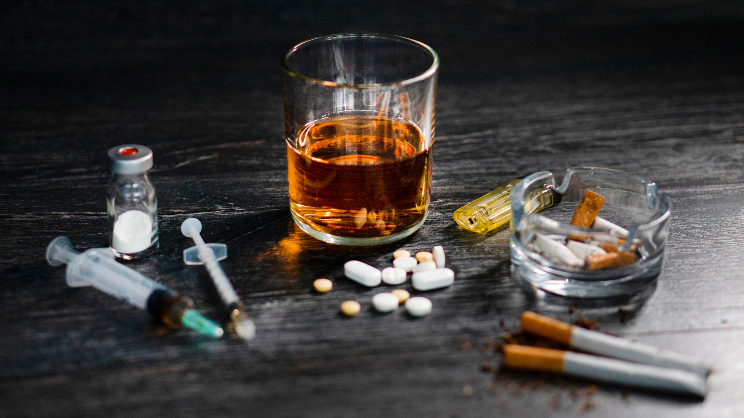
AddICTION
https://atriumhealth.org/dailydose/the-aftermath-of-pandemic-addiction

Slide 3
“One is too many,
A thousand is never enough…”
Unknown

Slide 4
What is it?
Addiction is a disorder characterized by persistent and intense urge to use a substance or engage in a behavior that produces a natural reward, despite potential harm and negative consequences
It is a dysregulation of motivation leading to, initially impulsive, and later on compulsive urges.
Repetitions of the compulsive behavior, i.e. gambling or substance use, lead to physiologic changes in brain function that perpetuate that behavior and weaken efforts to control the behavior.
Repeated engagement of this behavior → dysfunction in various spheres of life
This is where the ‘disorder’ in substance use disorder comes from.

Slide 5
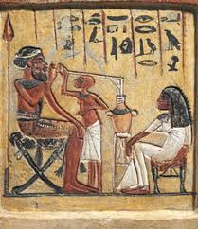
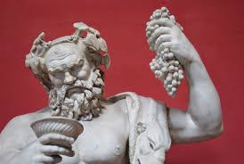
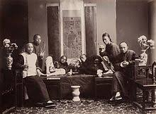
Brief History
> 10,000 BC - Alcoholic beverages consumed in China
~6000 BC – Evidence found of Peruvian foraging societies chewing coca leaves
~4000 BC – Egyptian pictographs of wine; beer commonly drank throughout Egypt
~4000 BC – Europe, North America – findings of cave paintings of mushrooms/psilocybin
~2100 BC – Opium (potentially) listed as Sumerian medical prescription
Peyote part of First People’s religious ceremonies for 1000’s of years
300’s BC – Aristotle speaks indirectly of addictive behaviors in Nicomacheian Ethics
~1500 – First description of coca leaf use by Amerigo Vespucci
1700’s – Addictive qualities of opium observed in Chinese populations
~1784 – Dr. Benjamin Rush medicalized the term alcohol use disorder as a ‘disease of the will.’

Slide 6
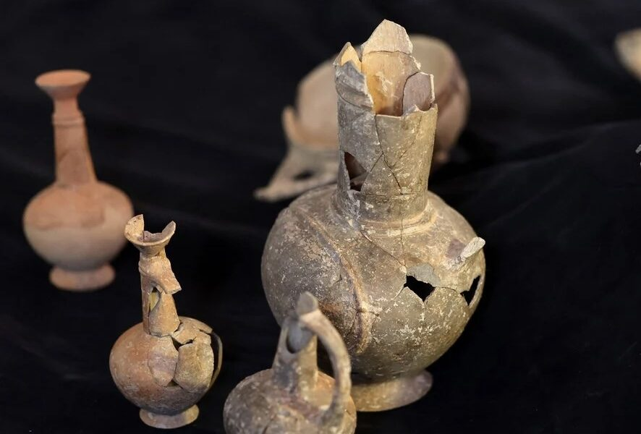
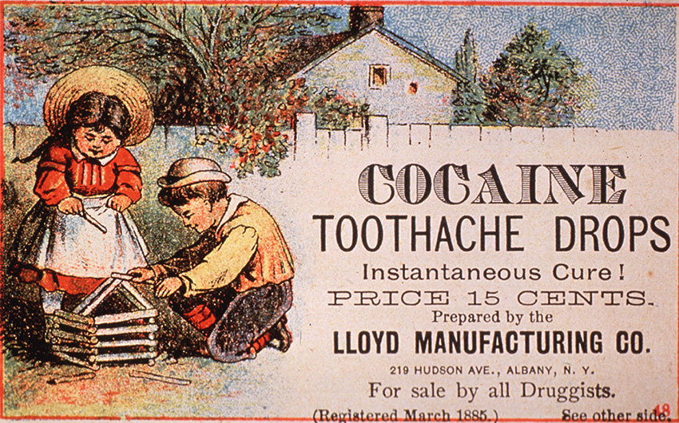
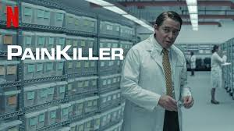
Brief History (cont.)
Early 1800’s – morphine first isolated from opium for clinical use
1860 – Cocaine first isolated from coca leaves; used initially for anesthesia
Gradually used in more settings until eventually spread enough for euphorigenic aspect to become more wide-spread in early 1900’s; became ‘feared’ by 1920 in most states
Late 1800’s: heroin developed for pain relief and as cough suppressant
Produced by Bayer; dependence/addiction soon describe in years after
Early 1900’s: US bans opium importation
1914 – Congress passed Harrison Act, which tightly regulated sale & distribution of cocaine
1916 – Oxycodone produced in Germany; more widely avail. in US after FDA approval
2000’s – Purdue Pharma aggressively marketed slow-release oxycodone as safe for chronic pain

Slide 7
Terms
Addiction: disorder characterized by persistent and intense urge to use a drug or engage in a behavior that produces an endogenous reward, despite potential harm or other negative consequences
Addict: A person who is addicted to a particular substance or activity
Stigmatizing vs. Empowering
Substance Use Disorder
Persistent use of drugs despite substantial harm and adverse consequences
DSM-V Clinically appropriate term (‘Patient has a…’)
Recovery
A process of change through which individuals improve their lives and wellness, live in a self-directed life, and strive to reach their full potential
Per SAMHSA (Substance Abuse and Mental Health Service Administration)

Slide 8

Recovery: 10 Guiding Principles
Hope
Person-driven
Many Pathways
Holistic
Peer Support
Relational
Culture
Addresses Trauma
Strengths/Responsibility
Respect
https://store.samhsa.gov/sites/default/files/pep12-recdef.pdf

Slide 9
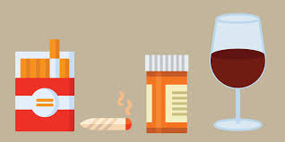
Demographics
National Survey on Drug Use and Health (NSDUH)
Yearly comprehensive survey on ~70,000 people age 12 years or older
Seeks to track statistics related to substance use, treatment, co-morbid mental health difficulties, and use of mental health services
Most recent based on 2022 data (Released in Fall ‘23)
Key Findings
59.8% of people 12+ used nicotine, alcohol, or cannabis/illicit substance within the month prior to the survey (‘Current use’)
48.7% drank alcohol
18.1% used tobacco products
8.3% used nicotine vaporized products
16.5% used cannabis/illicit substance use

Slide 10
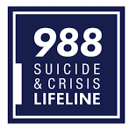
NSDUH (Cont.)
Regarding illicit drugs, cannabis was most common used (24.9%)
Caveat: considered ‘illicit’ on national level; likely skewed by increased accessibility in states where it was legalized.
17.3% considered to meet criteria for Substance Use Disorder (SUD) within year prior
10.47% with alcohol use disorder
9.66% with other substance use disorder
2.8% with combined alcohol/other substance use disorder
5.2% adults 18+ had serious thoughts of suicide in the year prior.
1.5 % with a plan and 0.5% with an attempt in the past year
12.3% adolescents 12-17 years had thoughts of suicide
6.5% made plans and 3.7% with an attempt in the past year

Slide 11

World Health Organization
Per the World Health Organization (WHO), ~5.5% of the world’s population between 15-64 years have used psychoactive substances in the last year, and of this, about ~0.7% struggle with active substance use disorder
~0.5 million deaths (350k male & 150k female)
Opioid related deaths have pushed up death rates in more developed countries, primarily from synthetic opioids
Worldwide, ~11 million people use needles for administration of drugs
1.4 million live with HIV
5.6 million live with Hepatitis C
42 million years of disability adjusted life years (DALY) lost due to drug use (2017)
~1.5% of total disease burden
For comparison, depression contributes 3.7%

Slide 12
Assessment & Diagnosis
“First you take a drink, then the drink takes a drink, then
the drink takes you.”
F. Scott Fitzgerald

Slide 13
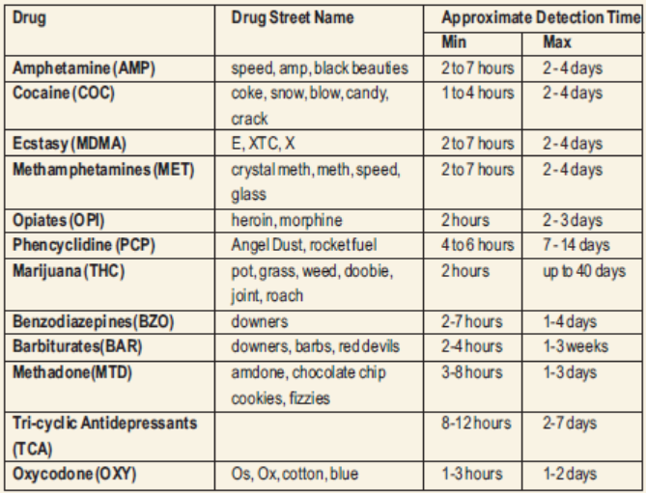
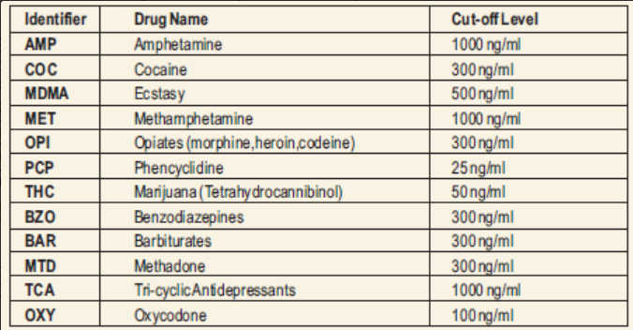
Screening
Urine drug screen is MORE sensitive than serum study
Remember, kidneys concentrate
Synthetic opioids (i.e. buprenorphine, oxycodone, fentanyl) need a SEPARATE order placed
Lipophilic substances (i.e. THC, fentanyl) can have extended duration of detection based on quantity and chronicity of use
In this case, if needed, it can be helpful to track quantitative levels in specimens to show they are decreasing
Remember, standard screen is a QUALITATIVE test
https://www.lalpathlabs.com/blog/screening-tests-for-drug-abuse-dr-lal-pathlabs/

Slide 14
DSM-V - Substance Use disorder
IMPAIRED CONTROL
1. The substance is often taken in larger amounts or over a longer period than was intended.
2. There is a persistent desire or unsuccessful effort to cut down or control use of the substance.
3. A great deal of time is spent to obtain, consume and recover from a substance.
4. Craving, or a strong desire or urge to use the substance, occurs.
SOCIAL FAILURE
5. Continued use of the substance results in a failure to fulfill major role responsibilities at work, school or home.
6. Use of the substance is contributing to relationship problems.
7. Important social, occupational or recreational activities are given up or reduced because of use of the substance.
RISKY USE
8. Use of the substance is recurrent in situations in which it is physically hazardous (e.g., driving while intoxicated).
9. Continuing to use the substance despite knowing that it has an impact on physical or psychological problems likely caused by the substance (e.g., drinking with a liver condition or using opioids when depressed or anxious).
PHYSIOLOGIC
10. Tolerance, which means that the person needs more of a substance to get a desired effect, or the same amount of a substance doesn’t produce the desired effect any longer.
11. Withdrawal, such that when the substance is not taken, a person experiences substance-specific withdrawal symptoms.

Slide 15
Substance Use Disorder Specifiers
Severity
Mild – 2-3 symptoms
Moderate – 4-5 symptoms
Severe – 6+
Remission – all criteria of the SUD no longer apply
Early – for more than 3 months, but less than 12 months
Sustained – for 12 months and more
In a controlled environment
To be used if individual is in an environment where access to the substance is restricted

Slide 16
Substance Use disorder - Nuanced
IMPAIRED CONTROL
1. The substance is often taken in larger amounts or over a longer period than was intended.
2. There is a persistent desire or unsuccessful effort to cut down or control use of the substance.
3. A great deal of time is spent to obtain, consume and recover from a substance.
4. Craving, or a strong desire or urge to use the substance, occurs.
SOCIAL FAILURE
5. Continued use of the substance results in a failure to fulfill major role responsibilities at work, school or home.
6. Use of the substance is contributing to relationship problems.
7. Important social, occupational or recreational activities are given up or reduced because of use of the substance.
RISKY USE
8. Use of the substance is recurrent in situations in which it is physically hazardous (e.g., driving while intoxicated).
9. Continuing to use the substance despite knowing that it has an impact on physical or psychological problems likely caused by the substance (e.g., drinking with a liver condition or using opioids when depressed or anxious).
PHYSIOLOGIC
10. Tolerance, which means that the person needs more of a substance to get a desired effect, or the same amount of a substance doesn’t produce the desired effect any longer.
11. Withdrawal, such that when the substance is not taken, a person experiences substance-specific withdrawal symptoms.

Slide 17
Assessment – ASAM Criteria
American Society of Addiction Medicine Assessment Criteria
Most widely used systematized and comprehensive set of standards for evaluation, placement, continued treatment, and transfer of patients with addiction and co-occurring disorders.
Assessment forces a comprehensive evaluation of the patient’s current state, factors critical to their substance use, and understanding nuanced elements of their history that affect the ability to treat that patient
6-Dimensions
1. Acute Intoxication and/or withdrawal
2. Biomedical conditions and complications
3. Emotional, behavioral, or cognitive conditions and complications
4. Readiness to change
5. Relapse, continued use, or continued problem potential
6. Recovery/living environment

Slide 18
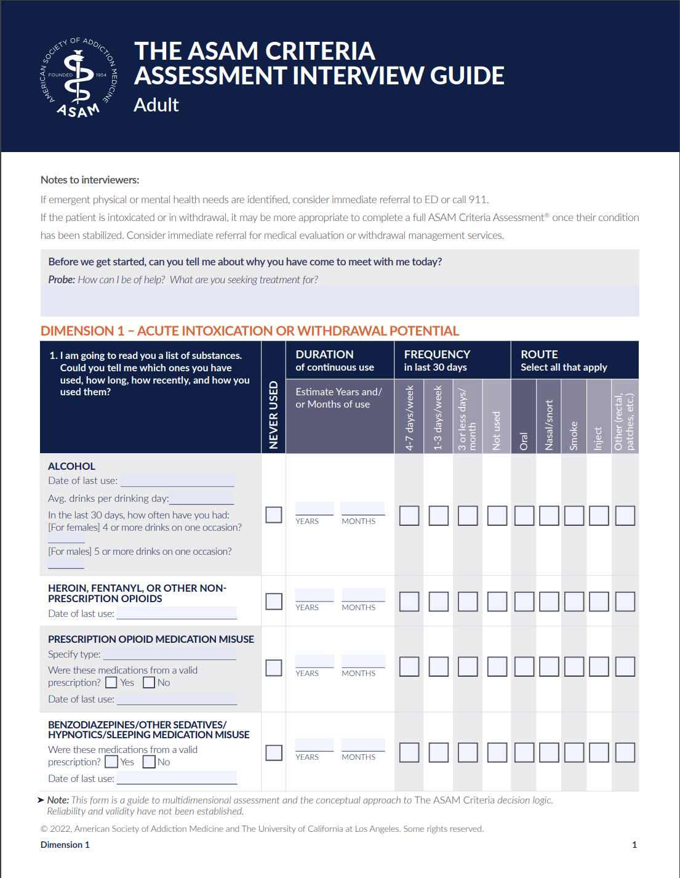
ASAM – Interview Guide
Comprehensive 30 page form
Provides straightforward & structured guide for assessing a patient for substance use disorder
Aligned along the 6-dimensions in ASAM Criteria
Free to download
https://www.asam.org/asam-criteria/implementation-tools/criteria-intake-assessment-form

Slide 19
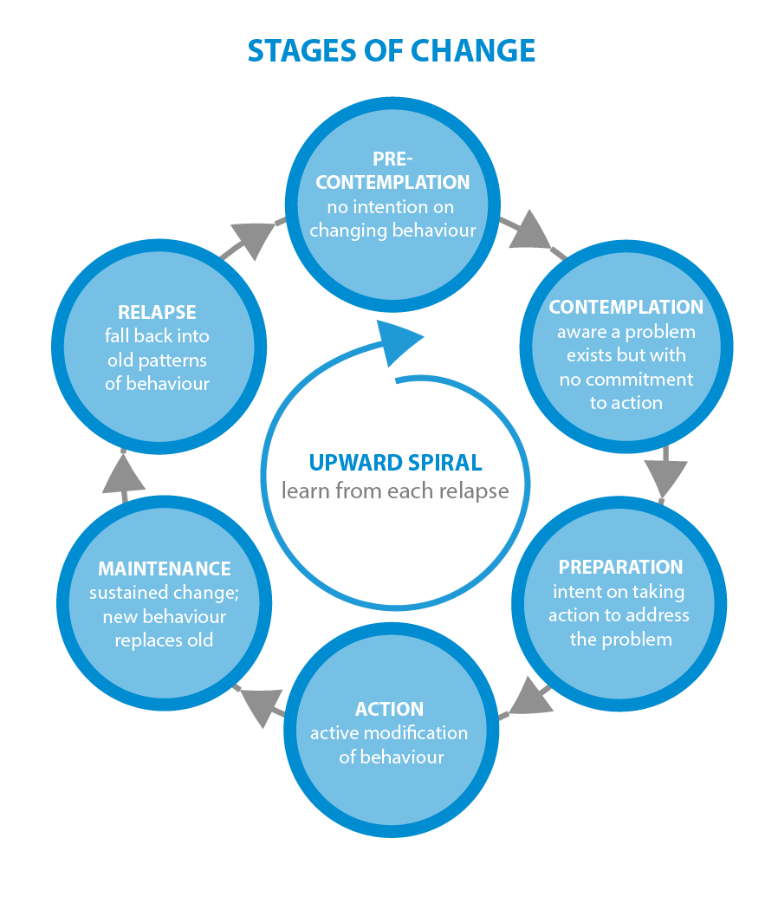
Stages of & Readiness to Change
Motivation to change lies on a spectrum
‘Precontemplation” → Maintenance
“Relapse” can serve as a bridge linking the two ends
2019 Study of US adults (N: 39,809) found population of people resolving a significant SUD (n: 2002) and looked at attempts before establishing recovery (Kelly et al.)
Average 5.35 Median: 2
Kelly JF, Greene MC, Bergman BG, White WL, Hoeppner BB. How Many Recovery Attempts Does it Take to Successfully Resolve an Alcohol or Drug Problem? Estimates and Correlates From a National Study of Recovering U.S. Adults. Alcohol Clin Exp Res. 2019 Jul;43(7):1533-1544. doi: 10.1111/acer.14067. Epub 2019 May 15.

Slide 20
SBIRT
Screening, Brief Intervention & Referral to Treatment (SBIRT)
Used to identify individuals who use alcohol and other drugs at risky levels
Pre-screening – brief screen, meant to be a rapid evaluation to proactively ID those at risk of a substance use disorder
For Alcohol: AUDIT-C or NIAAA Single Question Alcohol Screening
DAST-1 (single question pre-screen for DAST-10)
Positive findings on the pre-screen measure → Full Screen
AUDIT (Alcohol Use Disorder Identification Test)
ASSIST (Alcohol, Smoking, and Substance Abuse Involvement Screen Test)
TAPS (Tobacco, Alcohol, Prescription Medication and Other Substance Use Tool)
DAST-10 (Drug Abuse Screening Test)
Training – online options for training in administration available through:
University of Missouri Kansas City
(https://sbirt.care/training.aspx)
4 hour training (3.5 hour Course for Health Care Professionals + 0.5 hour Putting it Together Course)

Slide 21
Neurobiology
“Where attention goes, neural firing flows, and neural
connection grows.”
Daniel Siegel

Slide 22
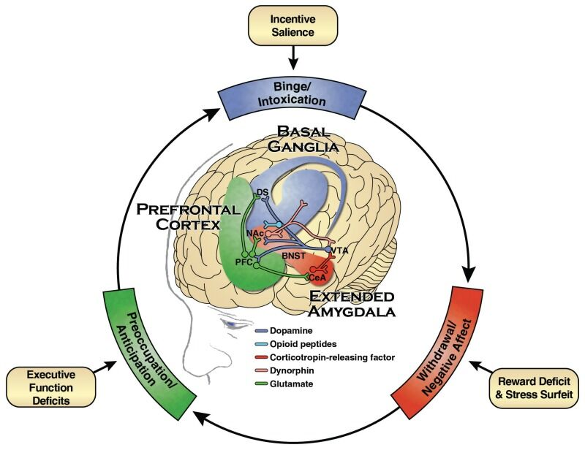
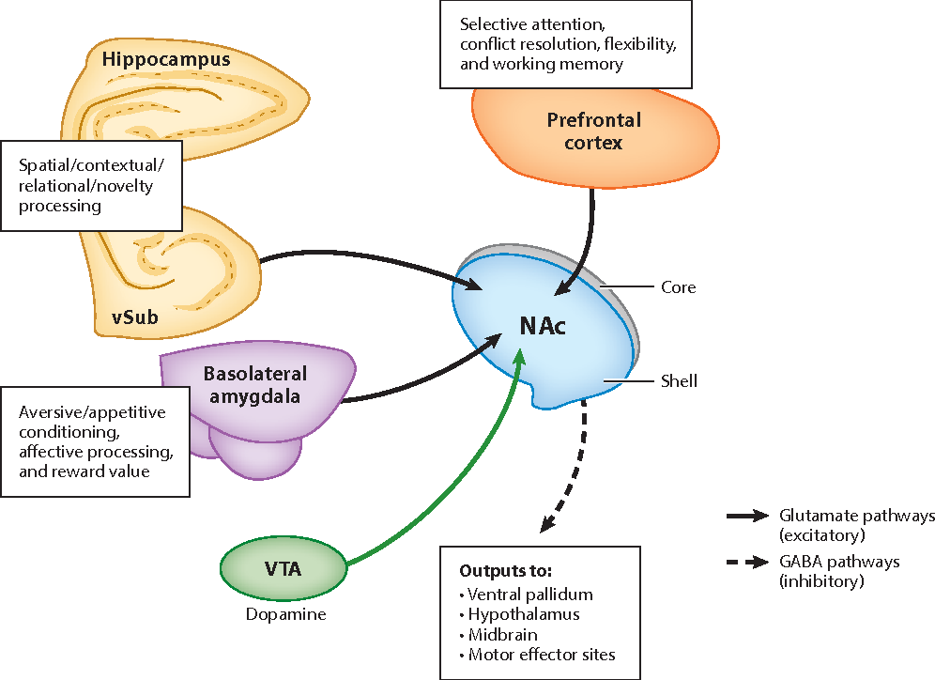
Neurobiology
Addiction is a dysregulation of motivation and reward.
Motivation and reward mediated by complex series of circuits of neurons whose activity is mediated by neurotransmitters.
Mesocorticolimbic dopamine (DA) system is most significant for mediation of addiction development
DA release at the nucleus accumbens (NA) reinforces reward predictive cues
Repeated stimulation of NA leads to strengthening of cognitive and behavioral connections.
Repetition leads to downregulation of response → needing larger quantities at increased frequency for same response
Can also ‘blunt’ the reward of other behaviors
Notes:
Parsons LH, Hurd YL. Endocannabinoid signalling in reward and addiction. Nat Rev Neurosci. 2015 Oct;16(10):579-94. doi: 10.1038/nrn4004. Epub 2015 Sep 16. PMID: 26373473
Floresco SB. The nucleus accumbens: an interface between cognition, emotion, and action. Annu Rev Psychol. 2015 Jan 3;66:25-52. doi: 10.1146/annurev-psych-010213-115159. Epub 2014 Sep 17.
https://delamere.com/blog/the-neurobiology-of-addiction

Slide 23
Behavioral Intervention
“The program works.
If you work it…”
Unknown, about 12-Step Recovery

Slide 24
Behavioral Intervention Individual therapy
Individual psychotherapy (i.e. CBT, psychodynamic psychotherapy, ACT)
Can directly address elements of how substance use affects the patient’s life, and develop tools to aid in decreasing and avoiding substance use
Can also address other psychosocial difficulties that are affecting the patient and interrupting ability to establish and maintain sobriety
MET (Motivational Enhancement Therapy)
Form of therapy targeting ambivalence to enacting behaviors supportive of stability and sobriety
Contingency Management
Uses system of rewards if a patient meets a treatment goal (i.e. selecting a prize for making meetings or negative drug screens)
Occasionally, uses a negative consequence if unable to meet a goal (i.e. removal of a privilege while in a controlled setting)
Based on operant conditioning (B.F. Skinner)
12-Step Facilitation
Aimed at linking people to, and supporting engagement in, 12-step mutual support meetings
Primarily Supplemental

Slide 25
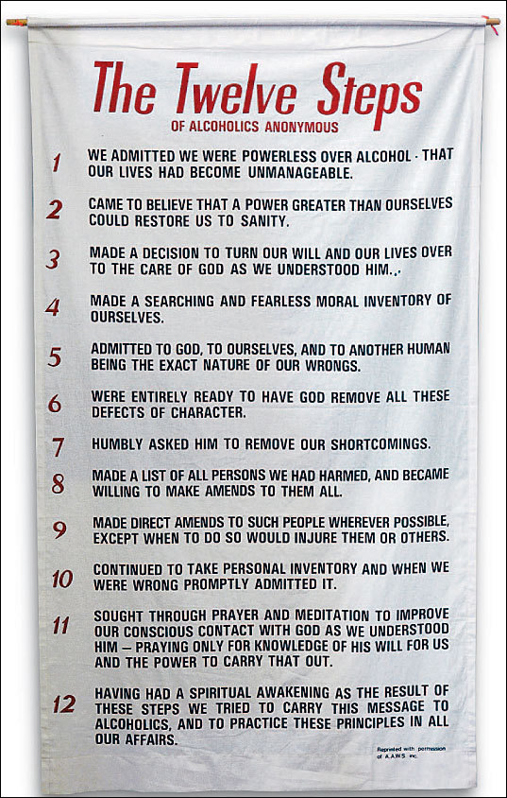
Behavioral Intervention Mutual Support
12-Step Recovery
Most wide-spread and while AA & NA are most common, there also are other focuses, i.e. CA (cocaine anonymous) and SAA (Sex Addicts Anonymous)
Though group based, encourages 1:1 engagement with a ‘sponsor’ for working through the steps
Secular – Non-12-step
SMART Recovery
Refuge Recovery
Uses tenets of Buddhism and the 4-Fold path to support recovery from substance use
Celebrate Recovery (12-Step)
Stronger Religious/Christian focus
Notes:
https://www.tidewaterintergroup.org/sample-page/aa_12_steps_on_banner/

Slide 26
Tobacco/Nicotine
“It’s more profitable for your congressman to
support the tobacco industry than your life.”
Jackie Mason

Slide 27
Tobacco/Nicotine – A brief History
~100 B.C. – first estimated regular use by Maya people of Central America and disseminated gradually across the Americas
1500’s – used for trade by Spanish, Portuguese, British
British started investigating ‘medicinal’ uses relatively early on
1600’s – primary cash crop for colonies and eventually for USA.
Early 20th century: beginning recognition of associated health problems
1965 – Cigarette Labeling & Advertising Act passed
By this point, >40% of adults in the USA smoked
By 2000’s, 1.2 billion smokers world wide (80% in developing/underdeveloped countries).
Per WHO report in 2007, accounted for 5.4 million deaths (9% of deaths globally)

Slide 28
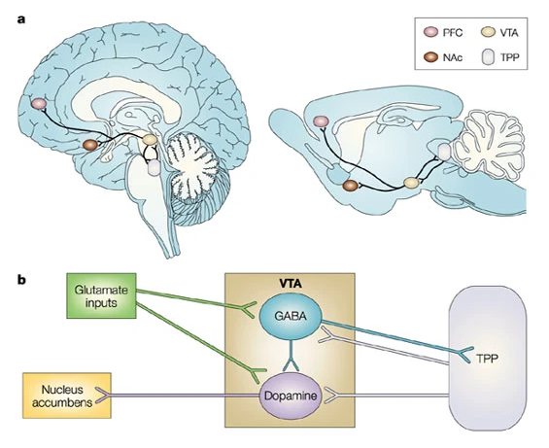
Tobacco/Nicotine
Nicotine – direct stimulator of specific nicotinic acetylcholinergic (ACh) neurons
Stimulates pre-synaptic nACh receptors → increased ACh release
These receptors found in specific areas
Striatum, Midbrain Tegmentum, Nucleus Accumbens, Ventral Tegmentum, Hypothalamus, Hippocampus,
Reminiscence, alertness, attentiveness, autonomic control
Muscles, Adrenal Glands, Cardiovascular system, Other peripheral tissues
Respiration, heart rate, muscle contraction
Directly stimulates dopamine release at nucleus accumbens
Laviolette, S., van der Kooy, D. The neurobiology of nicotine addiction: bridging the gap from molecules to behaviour. Nat Rev Neurosci 5, 55–65 (2004). https://doi.org/10.1038/nrn1298

Slide 29
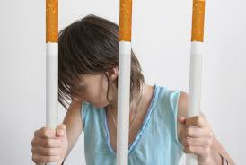
Tobacco/Nicotine
Withdrawal
Half-life: ~20 hours; acute withdrawal peaks within about 1x week and subsides over 3-4 weeks.
Symptoms: irritability, frustration, depression, increased appetite, insomnia, restlessness
Full recovery can be prolonged based on duration/severity of use (importance of understanding ‘pack-year’ history

Slide 30


Slide 31
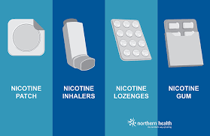
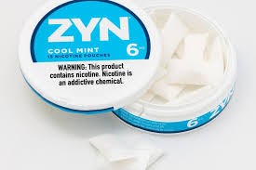
Tobacco/Nicotine - medications

Slide 32
Tobacco/Nicotine - Medications
Bupropion – dopamine/norepinephrine/serotonin reuptake inhibitor → increased DA/NA levels in synaptic cleft.
Can mitigate fatigue, increased appetite, depression associated with withdrawal
Adverse effects: irritability, sleep disturbance (if taken too late), lowered seizure threshold
Varenecline – Nicotinic receptor partial agonist with tight binding affinity. Essentially ‘blocks off’ receptor from direct stimulation by nicotine → blunts (+) reinforcing effect of using tobacco.
Partial agonism helps with mitigating withdrawal symptoms when ‘quitting’
Adverse effects: abnormal dreams, insomnia, headache, nausea, increased appetite
Less common: panic, dysphoria, decreased libido, suicidality

Slide 33
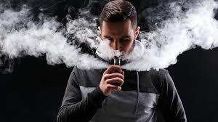
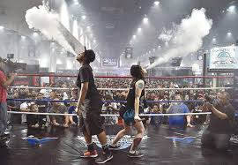
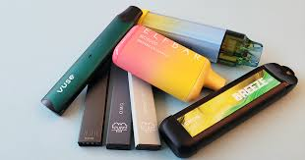
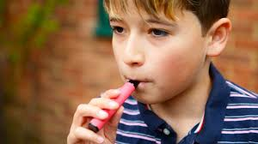

Slide 34
Cannabis
The good thing about weed is that it makes it so that your
problems don’t bother you.
The bad thing about weed is that it makes it so that your problems don’t bother you.
Anon

Slide 35
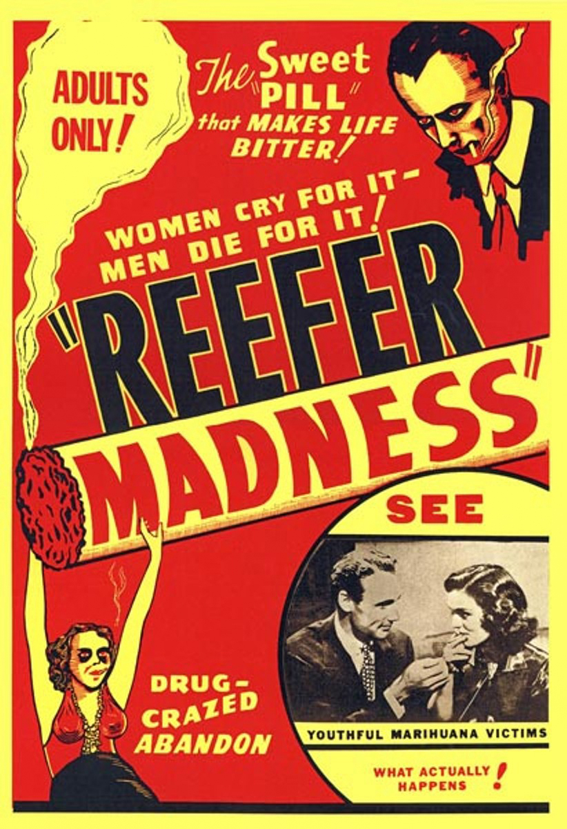
Brief history
Cannabis being used in medicinal fashion since 2800 BC in what is now western China. Use spread to central Asia and into Europe
Therapeutic indications noted in records from India, Greece, Rome
1841 – Cannabis introduced to western medicine
1898 – cannabinol isolated from plant
1930s – release of ‘Reefer Madness’ and Marijauna Tax Act in USA
1940’s – cannabidiol isolated
1964 – THC isolated
1970 – Controlled Substance Act – listed as having no accepted medical use and high potential for abuse
1988-1995 – CB1/2 receptors & 2-arachidonylglycerol discovered
1996 → today, gradual legalization in states and discovery of different clinical uses, but also increased granular understanding of dysfunctions related to cannabis (i.e. effect on development of psychotic disorder), and commercialization of sales

Slide 36
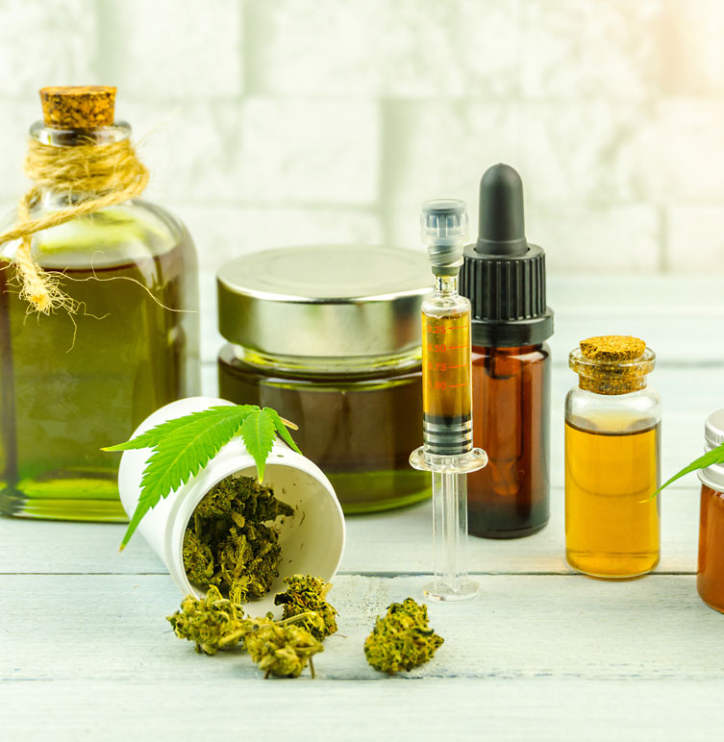
Cannabis
Primary Effects
Psychologically: relaxation, euphoria, paranoia, impaired memory formation, decreased motivation
Physiologically: increased appetite, conjunctival injection
Withdrawal
Anxiety, irritability, nausea, insomnia, anorexia
No generally considered dangerous
Biology
Binds endocannabinoid receptors – modulate appetite, pain sensation, memory, mood
THC has high binding affinity to receptor vs. endogenous cannabinoids
Utility
Some potential benefit with management of pain & PTSD symptoms; extensive study varied
May exacerbate symptoms of psychosis in patients with history of psychotic disorder (personal or family)

Slide 37
Demographics & Statistics
Most widely cultivated, trafficked and abused substance
147 million people worldwide use cannabis (~2.5% population)
Per CDC, 48.2 million (~18%) of Americans have used it
~3 in 10 people who have used met criteria for a substance use disorder at some point in their lives – per CDC
Risk increased if use started before age 18 years
In 2022, 23% adults in US used in the last year; 15.9% in the past month
2021 study from JAMA
~10 % of adults surveyed used cannabis regularly/irregularly

Slide 38
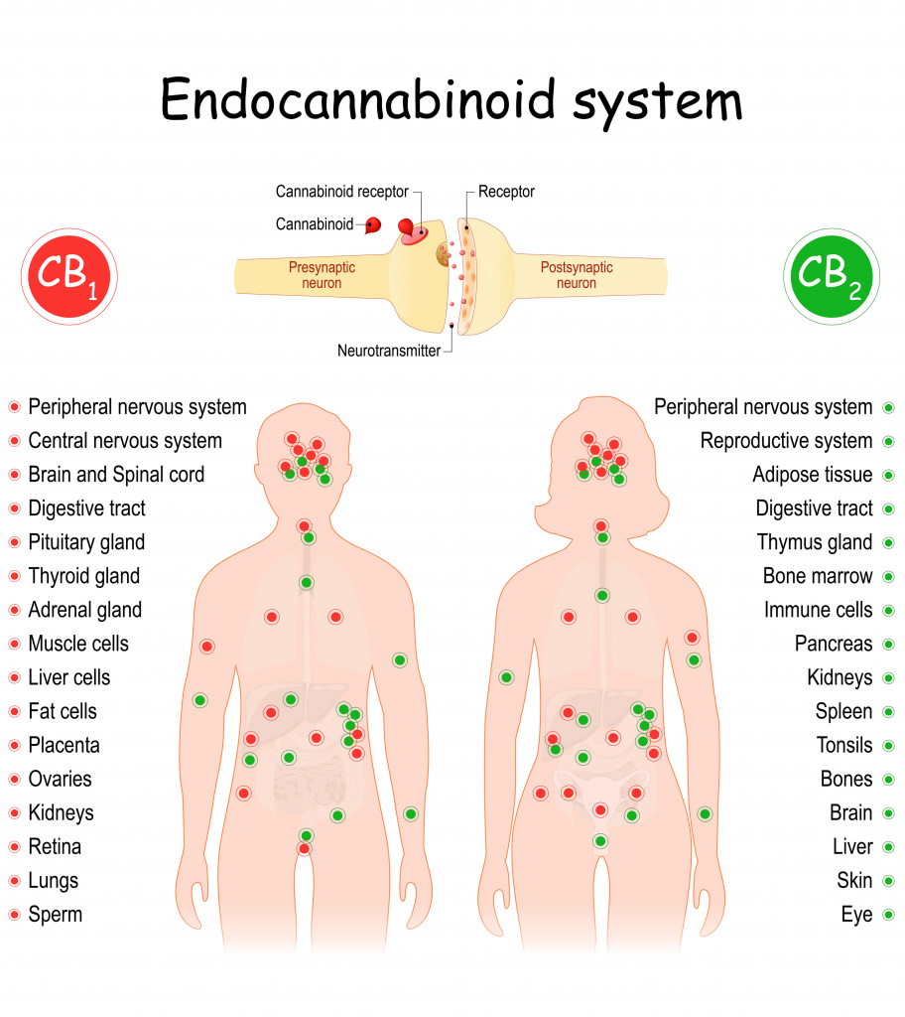
Neurobiology: Endocannabinoid System
Neurotransmitter system in central nervous system (CNS)
Andandamide – first identified endogenous cannabinoid
2-arachidonylglycerol (2AG) – 2nd major identified endogenous cannabinoid
Receptors: CB1 & CB2
Processes
CB1 – concentrated principally in CNS
Basal ganglia & cerebellum (movement, coordination)
Hippocampus and cerebral cortex (memory formation, cognition, processing)
Nucleus accumbens (reward)
CB2 – mainly associated with immune system and associated with inflammatory and chronic pain processes
Cannabis sativa – 100+ substances that interact with endogenous cannabinoid system.
Most commonly studied: Tetrahydrocannabinol (THC) & Cannabidiol (CBD)
THC: partial CB1 agonist with strong binding affinity
CBD: low binding affinity for CB1, but fair antagonism at low concentrations

Slide 39
Endocannbinoid System (Cont)
Cognition & Brain Development
Involved in neurogenesis and synaptic pruning
THC disrupts long-term memory potentiation and long-term depression and to directly alter brain structure and function
CBD may oppose this to some extent
Decreases in IQ have been associated with THC use, but not consistent
Acute effects
Decrease in working & episodic memory
Decrease in executive function (response inhibition, planning, decision making)
Some reduction in processing speed, but inconsistent
Visuospatial effect less consistent/clear
Acute effects may become more progressively prolonged with frequency of use
Some studies show reversal of dysfunction w/I 4 weeks abstinence

Slide 40
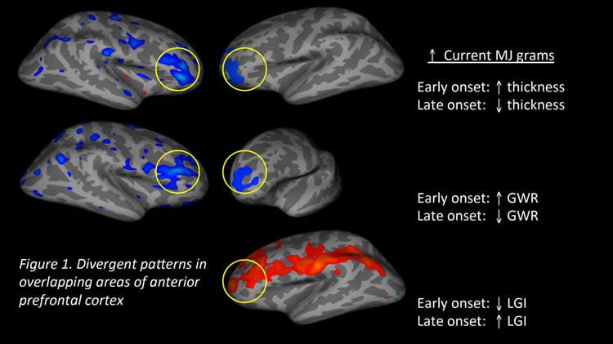
Endocannabinoid System (Cont)
Brain imaging does show altered activation in frontal cortex (anterior cingulate & dorsolateral prefrontal cortex)
Impulse control, problem solving, judgement
fMRI studies → similar performance on measures with increased neural activation (inefficient processes?)
Sensitization of reward pathway
Cannabis use associated with hyperactivation of striatum during monetary incentive delay tasks
‘Gateway’?
Adult & adolescent
Reduced white fiber tract integrity in prefrontal, limbic, parietal, and cerebellar tracts
https://neurosciencenews.com/prefrontal-lobe-marijuana-use-3632/

Slide 41
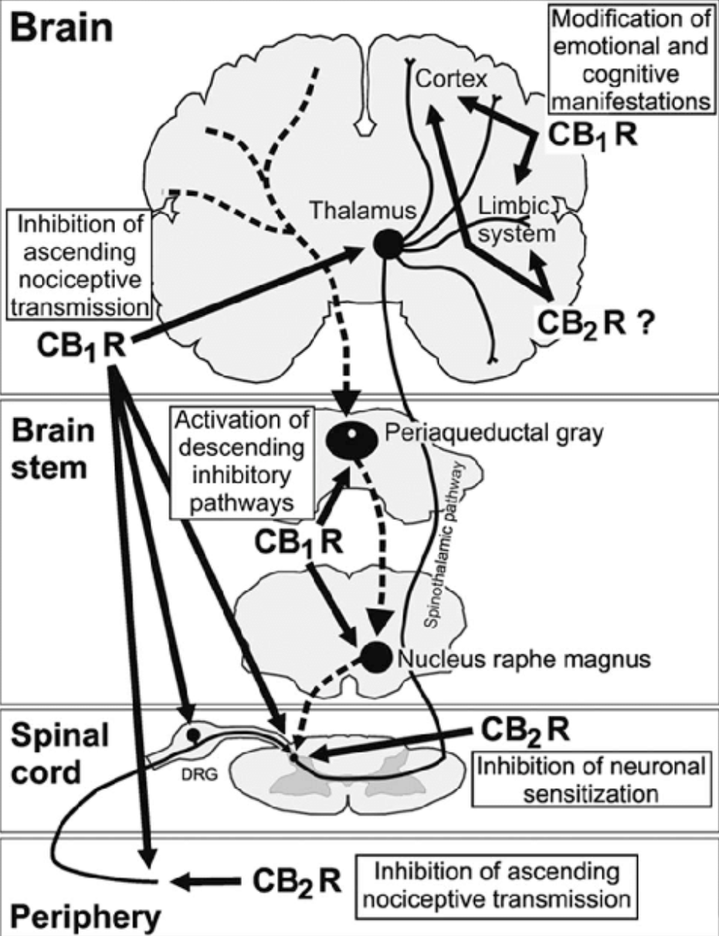
Pain
CB1/2 receptors throughout central and peripheral nervous system
High density found in peripheral pain pathways (i.e. ascending pathways of spinal cord and medial prefrontal cortex)
Maldonado, Rafael & Banos, Josep-E & Cabañero, David. (2015). The endocannabinoid system and neuropathic pain. PAIN. 157 Suppl 1. 1. 10.1097/j.pain.0000000000000428.

Slide 42
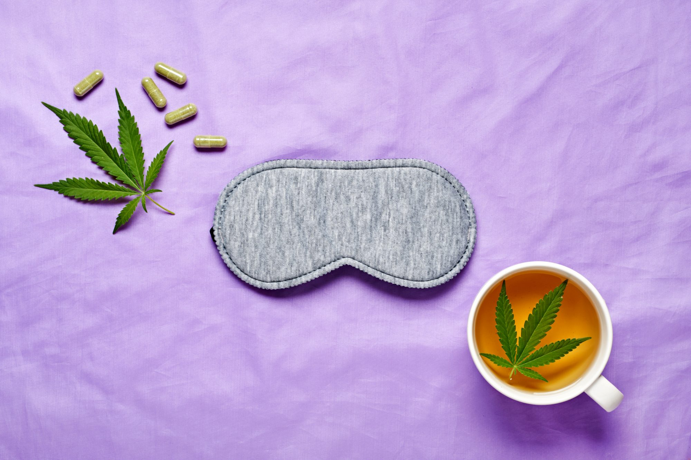
Sleep
10-15% of general population report regularly disrupted sleep
CB1 receptors found in suprachiasmatic nucleus
Activation associated with alteration of sleep-wake system, suppressing arousal
Increase adenosine (associated with fatigue/sleep onset)
Some studies show subjective improvement in sleep with cannabis use.
Measured disruption of sleep architecture demonstrated with chronic users

Slide 43
Treatment
Primarily psychotherapeutic & supportive
Inhibition and response prevention
Will be growing challenge with increased accessibility of cannabis and increased prevalence of dispensaries and advertisements
Therapies
Motivational Enhancement Therapy (MET)
Cognitive Behavioral Therapy (CBT)
Contingency Management (CT)
Medications:
Adjunctive use at best (i.e. trazodone or mirtazapine for sleep, SSRI for mood)

Slide 44
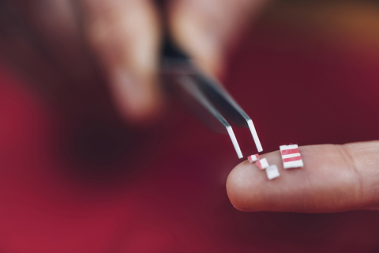
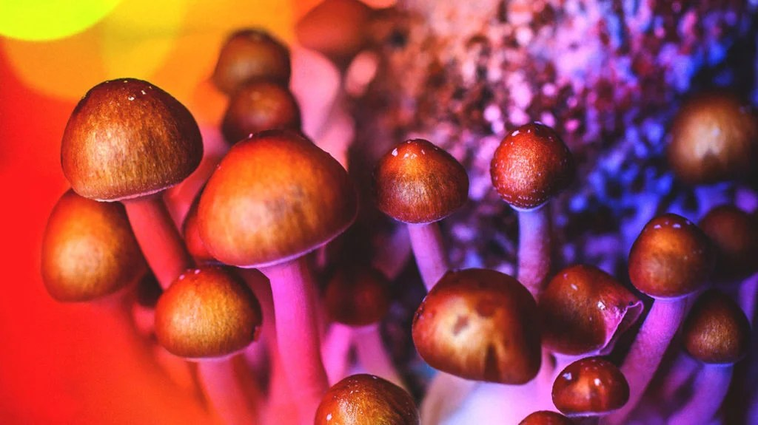
Hallucinogens: Serotonergic
Serotonin (5HT) – plays role in synthesizing senses into understood representation of reality. Associated with front cortex.
LSD – prominent in 1960’s counter culture movement
Associated with sensory irregularities and visual disturbances, along with sensation of openness/oneness with the world
Mescaline/Peyote – derived from peyote cactus plant
Strong cultural ties/association with Native American tribes and used in cultural traditions
Mushrooms/Psilocybin – similar to LSD and peyote in mechanism of effect
Effects
Intoxication/High:
Mainly sensory distortion and depersonalization, occasionally anxiety/paranoia (aka ‘bad trip’)
Physical: secondary effects of catecholamine release (pupillary dilation, diaphoresis, tachycardia)
Withdrawal – not generally a major issue
Chronic use → hallucinogen persisting disorder. Visual/sensory abnormalities that do not recede. Halos, visual snow, changes in dimension
Notes:
https://www.healthline.com/health-news/benefits-of-medical-mushroom
https://www.mcgill.ca/newsroom/channels/news/lsd-may-offer-viable-treatment-certain-mental-disorders-328008s

Slide 45
Hallucinogens: Dissociative
Main effect: dissociation (feeling disconnected from body or self)
Primarily mitigated by antagonism of NMDA receptors (a glutamate receptor subtype).
PCP
Effect: aggression, impulsiveness, agitation, psychosis, delirium, fever, nystagmus
(vertical nystagmus)
Intoxication
Muscle rigidity can lead to rhabdomyolysis
Ketamine
Medical Use
Anesthesia
Psychiatry – use for treatment resistant depression
Effects: amnesia, anesthesia, depersonalizations, hallucinations, epiphanies, disorientation, euphoria, spiritual revelations

Slide 46
Stimulants
“Cocaine is a hell of a drug.”
Rick James

Slide 47
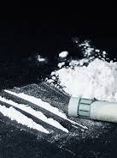
Stimulant – Cocaine
Cocaine – tropane alkaloid salt isolated from coca leaf (found in South America)
First isolated as cocaine hydrochloride salt
By processing with ammonia or sodium bicarbonate, can isolate the ‘base’ form of cocaine, which has much lower melting point → easier to inhale; more potent
Duration of effect
Insufflation – 45-60 minutes
Inhalation (crack) or injection – 10-20 minutes
Acute: euphoria, increased libido, alertness, impulsivity, talkativeness, elevated heart rate/blood pressure, numbness, anorexia, dilated pupils
Also: nausea, seizures, psychosis, coronary infarction, anxiety/paranoia
Long-term
Hallucinations, septal perforation/atrophy, psychosis, depression, anxiety, weight loss, respiratory problems
Withdrawal
Irritability, fatigue/sleepiness, increased appetite, depression, paranoia, body aches, cravings

Slide 48
Amphetamines
Discovered in 1887, but used as drug/medication in 1920’s.
First amphetamine, benzadrine, used OTC for nasal congestion
By 1937, used for treatment of narcolepsy and ADHD, mild depression, and post-encephalitic Parkinsonism
By 1940’s, used in widespread manner by allied forces during WWII.
By 1950’s, surpluses of amphetamines from war funneled into ‘black market’ and became more aware of negative effects/abuse. Stimulant induced psychosis and drug diversion more readily appreciated.
While traditionally a salt/racemic mixture of salt-enantiomers, methamphetamine is the ‘free-base’ form. Lowered melting point makes it easier to inhale

Slide 49
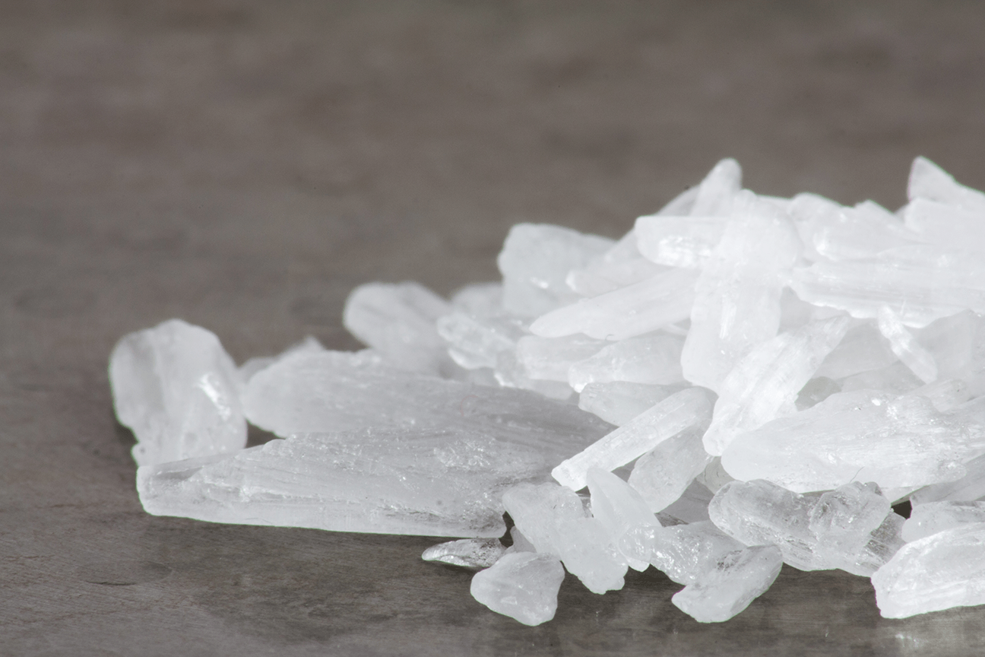
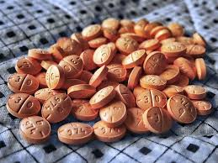
Amphetamine (cont)
Effect duration: up to 12 hours
Amphetamine: up to 12 hours
Methamphetamine: 6-12 hours
Acute effects
Euphoria, increased libido, alertness, increased concentration, decreased fatigue, confidence, anorexia
Dysphoria, decreased concentration/impulsivity, grandiosity, obsessive behaviors, picking behaviors, dehydration, rhabdomyolysis
Chronic
Irritability, mood swings, depression, anxiety, paranoia, hallucinations
Withdrawal
Irritability, dysphoria, depression, anxiety, fatigue/increased sleeping, overeating,
Notes:
https://pharmaservices.com.au/services/amphetamines/

Slide 50
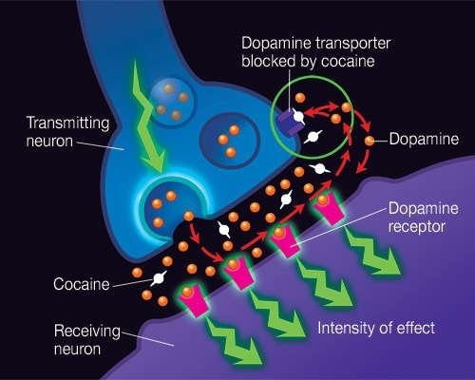
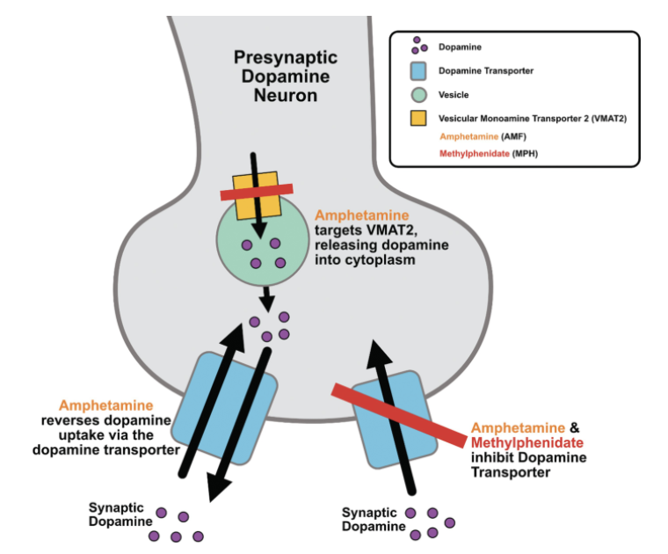
Stimulant - Mechanisms
Cocaine
Binds to dopamine transporter at pre-synaptic terminal and prevents reuptake.
Amphetamine
Binds to pre-synaptic transport proteins for monoamine neurotransmitters (serotonin [5HT], dopamine [DA], norepinephrine[NE]) → taken into the neuron and disrupts storage of monoamines, leading to extended release into synaptic cleft
Notes:
https://www.tldrpharmacy.com/content/the-art-of-adhd
https://storymd.com/journal/qj358a7tam-cocaine/page/8a9vphqvl8-how-does-cocaine-produce-its-effects

Slide 51
Stimulant Treatment
Medications
No FDA approved medications
Primarily adjunctive
Behavioral
Group/Individual therapies
Mutual Support Meetings
Individual CBT
Contingency Management

Slide 52
Alcohol
“As an alcoholic, you will violate your standards quicker
than you can lower them.”
Robin Williams

Slide 53
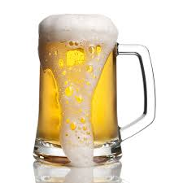


Alcohol
Binge: pattern that brings blood alcohol content (BAC) to 0.08 %
For typical male – 5+ drinks in a 2-hour sitting
For typical female and all people 65+ - 4+ drinks in a 2-hour sitting
Heavy Use/’At Risk’ Use
For typical male: 15+ drinks/week
For typical female: 8+ drinks/week
Binging on 5+ days/month
Particular Risk
Younger adults
Males: 2-3x more likely vs. Females
Native American/First People’s
Significant disability, other SUD, or existing mood disorder
What’s a standard ‘Drink’
1x standard drink contains 14 grams alcohol
12 oz of ‘regular beer’ (~5% abv)
5 oz of wine (~12%)
1.5 oz distilled spirits (40%)
NOTE: Can widely vary, hence may need to ask about the specific brand
i.e. Sam Adams Utopias is 28% alcohol → 12 oz is 5.6 drink equivalents
i.e. Barcardi 151 ~75% alcohol →1x ‘shot’ is about 2 drink equivalents
https://www.niaaa.nih.gov/alcohol-health/overview-alcohol-consumption/moderate-binge-drinking

Slide 54
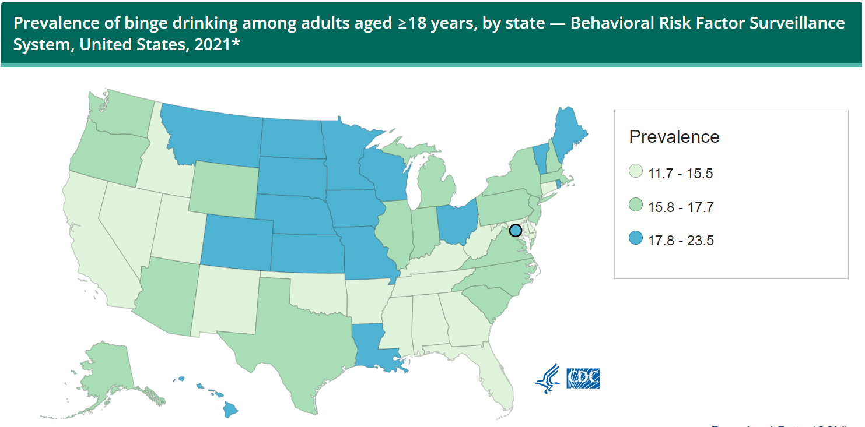
Per 2022 NSDUH, 215.6 million adults 18+ reported alcohol use at some point in their lifetime (84.1%)
In people 12+, 62.8% of all people drank within the last year.
21.7% reported binge drinking in last month prior
Per Alcohol Related Disease Impact (ARDI), during 2020-2021, excessive alcohol use responsible for 178,000 deaths and 4.3 million potential life-years lost
1/3 of deaths and > ½ of lives lost due to binge drinking
https://www.cdc.gov/alcohol/data-stats.htm

Slide 55
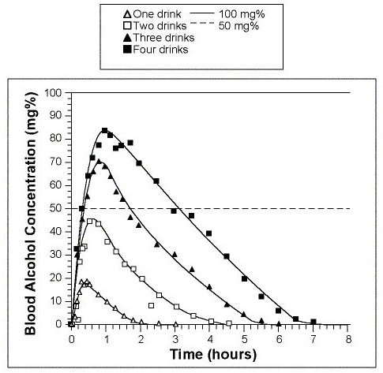
Alcohol Intoxication
Alcohol metabolism follows Zero-order elimination kinetics
Decreases by ~0.015% per hour in average person
Legal limit – 0.8 BAC (0.08% blood by volume)
0.15-0.3% → high risk of decrease in airway protection and voluntary control of motor functions
>0.3% → increased risk of coma/death
Wilkinson, Paul K., et al. "Pharmacokinetics of ethanol after oral administration in the fasting state." Journal of pharmacokinetics and biopharmaceutics 5.3 (1977): 207-224

Slide 56
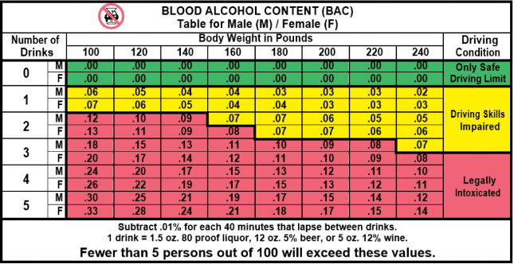
https://www.washingtonalcoholtraining.com/resources/bac/

Slide 57
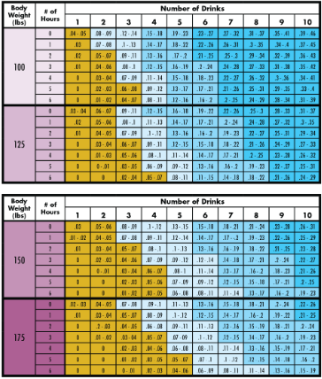
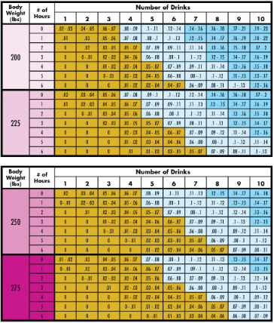
Intoxication
https://www3.uwsp.edu/safepoint/Pages/bac.aspx

Slide 58
Alcohol Risks
Short Term
Injuries
Alcohol poisoning
Risky behaviors (sexual, substance, etc)
Miscarriage, stillbirth, or fetal alcohol syndrome
Acute hepatic injuries, pancreatitis, respiratory depression,
Long Term
Cardiovascular – dilated cardiomyopathy/CHF, arrhythmia, elevated blood pressure, stroke
GI – pancreatic insufficiency, hepatic steatosis, hepatitis, cirrhosis; malnutrition, GI-bleeds
Malignancy: mouth, throat, lung, gastric, hepatic
Neuro: peripheral neuropathies, cognitive problems, Wernicke-Korsakoff, withdrawal seizures

Slide 59
Alcohol Use disorder Screening
CAGE
Have you ever:
felt the need to Cut down?
been Annoyed by people criticizing your drinking?
felt Guilty about drinking?
felt you needed a drink/Eye-opener upon waking to steady your nerves
‘Yes’ to any is considered positive screen
NIAAA Single Question Alcohol Screening Tool
In the last year, have you ever drank more than 4 drinks in a single sitting

Slide 60
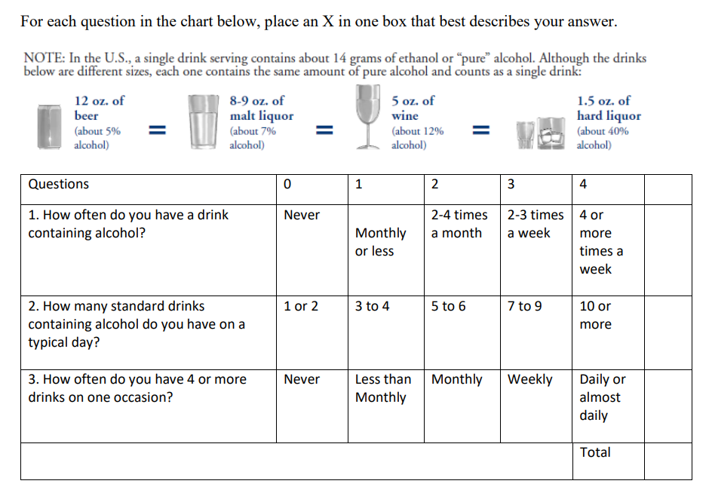
Alcohol Screening: Audit-C
Positive: Score of 3+
Opens conversation for more involved discussion about use
May consider doing formal AUDIT evaluation
https://oasas.ny.gov/system/files/documents/2022/08/audit-c-eng.pdf
https://nida.nih.gov/sites/default/files/files/AUDIT.pdf

Slide 61
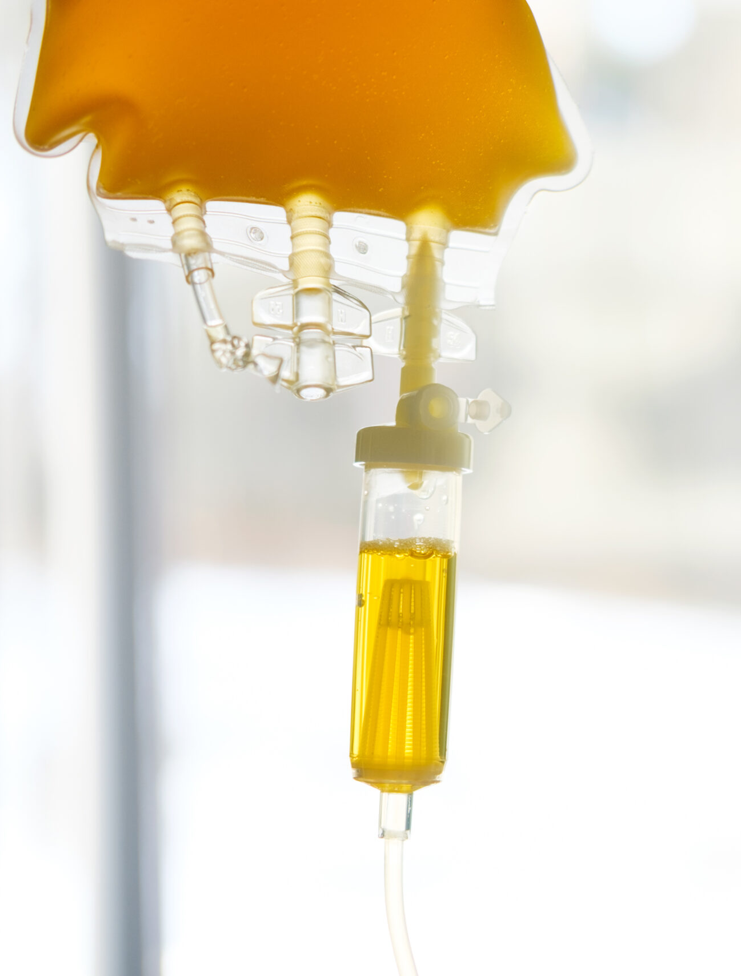
Alcohol Intoxication Management
Acute
A-B-C’s - Airway protection, breathing stably, circulation
Primarily supplemental
Ranges from observation to hydration to intubation to hemodialysis
Assess orientation and alertness
Neurological Exam
Evaluate for physical injuries
Labs
BAC – breathalyzer vs. UDS vs. serum drug screen
Drug screen
CBC/CMP – can give indication of acute hepatic injury as well as indirect evidence of chronic alcohol use
Thiamine, vitamins, electrolytes, IV Fluids (Banana bag!)
Make sure thiamine is given BEFORE/ALONG WITH dextrose
Address need for withdrawal management

Slide 62
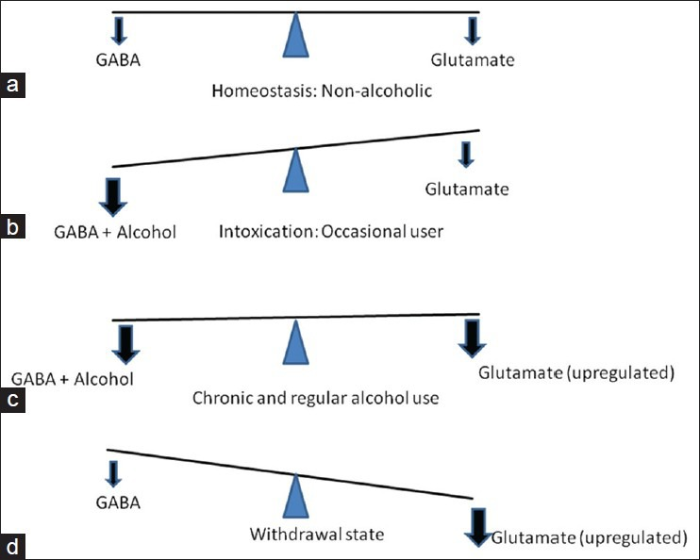
https://www.researchgate.net/figure/Neurochemistry-of-alcohol-withdrawal_fig1_263860038

Slide 63
Alcohol Withdrawal
Risk based on duration of alcohol use
1-2 episodes of increased alcohol use
Fatigue, sleep disturbance, dehydration
Excessive use for 5-7 days
Mild withdrawal: Sleep disturbance, dehydration, agitation, GI-upset, sweats, tremor
Autonomic hyperactivity
Excessive use for > 30 days
Increased risk for significant withdrawal
Severe nausea, vomiting, diaphoresis, tachycardia,
Hallucinations, withdrawal seizures
Delirium Tremens

Slide 64

Kindling effect: Repeated episodes of alcohol withdrawal lead to increasingly severe alcohol withdrawal symptoms.

Slide 65
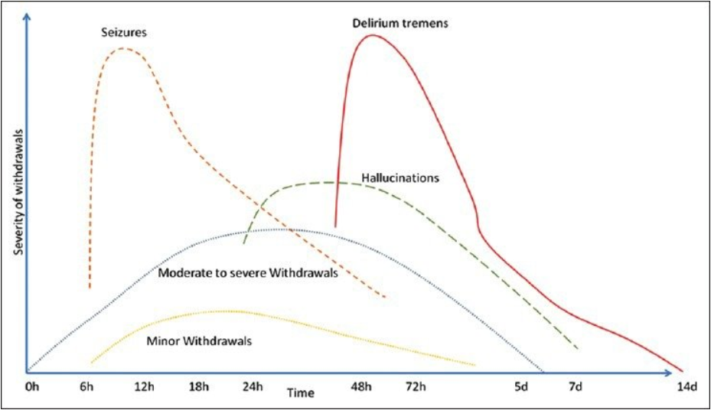
Anxiety, insomnia, nausea, abdominal pain
Elevated blood pressure, tachycardia, diaphoresis, elevated temperature
Agitation, hallucinations, fever, seizures, delirium
Kattimani, Shivanand & Bharadwaj, Balaji. (2013). Clinical management of alcohol withdrawal: A systematic review. Industrial psychiatry journal. 22. 100-8. 10.4103/0972-6748.132914.

Slide 66
Autonomic HyperReactivity
Generally, about 6 hours after last drink
Seen with moderate to severe withdrawal
Peaks ~24-48 hours
Tremors
Diaphoresis
Anxiety
Agitation
Nausea/Vomiting
Insomnia
Headache
Palpitation/Tachycardia

Slide 67
Complicated Withdrawal
Neuronal Excitation from uncompensated glutamatergic tone
Between 12-48 hours after last drink (can be variable)
Most commonly, generalized tonic-clonic seizures
Status epilepticus not usual
Hallucinations
Between 24-72 hours
Delrium Tremens
48-96 hours after last drink; Can last days
Characterized by disorientation, autonomic/hemodynamic instability (fever, tachycardia, hypertension), hyperventilation, electrolyte abnormalities
Incredibly fatal in the past (35-50%), but with treatment mortality decreased; up to 5 %

Slide 68
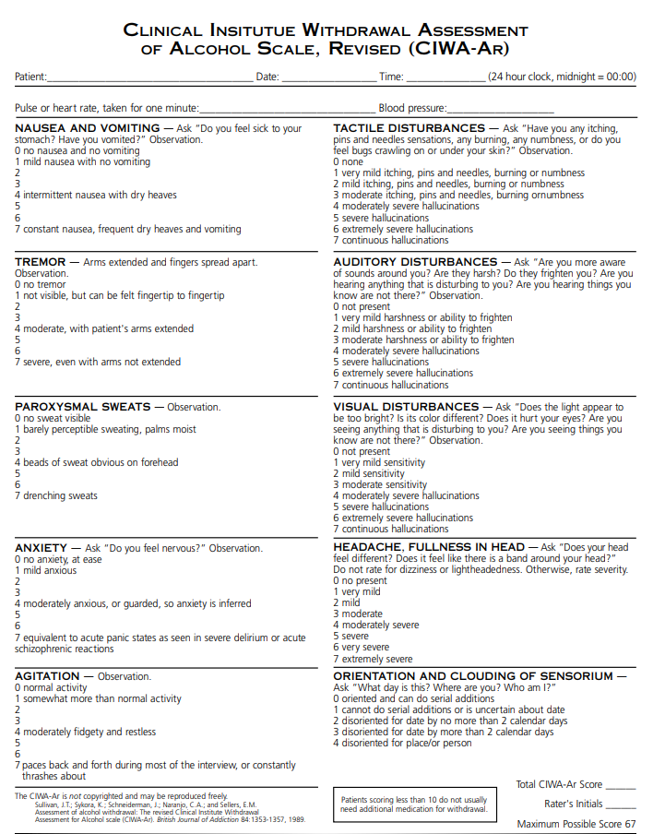
Treating Withdrawal
Understanding use – how much/how frequent/what type/previous withdrawal history
CIWA-Ar scale score
Metric for guiding clinical intervention
Administer medication (i.e. lorazepam) based on score
Correct serum abnormalities
Address medical coborbidities

Slide 69
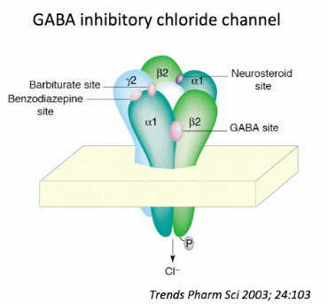
Medication for Alcohol Withdrawal
Benzodiazepines: 1st line agents
Improves GABA-ergic tone, offsetting glutamatergic overdrive
Timely use can prevent progression of withdrawal
Lorazepam, oxazepam, temazepam: undergo glucuronidation phase-II metabolism, instead of p450 phase I. Phase-II better preserved in advanced liver disease
Other agents
Barbiturates
Anticonvulsants
Gabapentin
Notes:
Benzodiazepines increase FREQUENCY of opening, barbiturates and alcohol keep it open LONGER

Slide 70
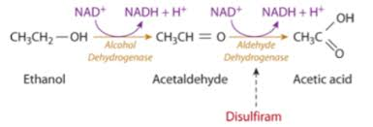
FDA Approved medications for Alcohol Use Disorder
Disulfiram (Antabuse)
Acetaldehyde dehydrogenase inhibitor. Prevents conversion of acetaldehyde to acetate → diaphoresis, palpitations, flushing, nausea, vertigo, hypotension, tachycardia
Negative reinforcement; most effective with family support/observed dosing
Hepatic clearance; can cause hepatitis

Slide 71
FDA approved medications for alcohol use disorder: Acamprosate
Mechanism
Partial co-agonist at NMDA receptor; serves to modulate glutamate activity
Can help in part with cravings and elements of prolonged abstinence.
Most effective in patients with several weeks abstinence
Avoid starting in patients actively drinking
Renally cleared (better choice in setting of reduced hepatic function)
Limited use in renal failure

Slide 72
FDA Approved medications for Alcohol use disorder: Naltrexone
Naltrexone
Central μ-Opioid antagonist
Stimulation at nucleus accumbens mediated by μ-receptor
Prevents euphoria from alcohol
Inhibits positive reinforcement
Hepatic clearance; can cause hepatitis
Be careful starting in patient with alcoholic hepatitis
Need to re-check liver enzymes in 3-6 months
Available as daily oral tablet and 4-week long acting injectable
Long-acting injectable allows bypass of first pass metabolism
Increased serum levels with decreased potential side-effects

Slide 73
Opioid
Heroin – A drug that helps you to escape reality,
while making it much harder to cope when you are recaptured.
Nikki Sixx

Slide 74
Opioid
Opioids – all compounds that bind to opioid receptors and exert morphine like effect
Opiates – subcategory of NATURAL opioids, drugs derived from opium (i.e. morphine)
Interacts with μ, κ, and δ receptor systems (principally concerned with effect at μ-receptors)
Opioid receptors ALL over the body and with multitude of effects
CNS – sedation, analgesia, euphoria, miosis, seizures (both in overdose and in acute withdrawal), respiratory depression, psychiatric depression, increased prolactin release
Urinary: urinary retention
Cardiovascular: vasodilation, prolonged QT/QTc with methadone
Respiratory: respiratory depression, pulmonary edema, cough suppression
GI: constipation, nausea, weight gain, slowed GI transit
Other: histamine release/itching, dizziness, sweating, hypogonadism
Chronic use → Tolerance and eventual withdrawal
Needing to use progressively larger quantities for same effect
Needing to use more to stave off symptoms of withdrawal

Slide 75
Opioid oVerdose
Stupor/Altered Mental Status
Respiratory depression
Pinpoint pupils/Miosis
Pulmonary edema
Seizures (opioids block release of GABA)
Consider Opioid Overdose in all patients found unconscious with decrease respiratory rate and/or pinpoint pupils (miosis)
Classic Triad

Slide 76

Naloxone
Narcan, Kloxxado, Evzio, RiVive, Zimhi
μ-Opioid receptor antagonist
Available in 4 mg and 8 mg; often comes in 2x doses per kit
Can be administered IM or intranasal
Available OTC in all 50 states, D.C., and Puerto Rico
THIS IS A STOP GAP
Goal is to get patient connected to higher levels of emergency care ASAP
https://www.walmart.com/ip/NARCAN-Nasal-Spray-4-mg-Emergency-Treatment-of-Opioid-Overdose-2-Single-Dose-Devices/1319667929

Slide 77
Opioid intoxication treatment
A-B-C’s - Airway protection, breathing stably, circulation
Naloxone (Intranasal, intramuscular, IV) – administer ASAP
Readminister if needed (longer acting opiates may cause re-intoxication if naloxone wears off)
Can potentially buy enough time to prevent need for more invasive treatments
Be ready to intubate, and if response to naloxone not sufficient, proceed with it
IV Fluids
Labwork and treat abnormalities as required
Re-evaluate frequently.

Slide 78

Opioid Withdrawal
GI distress – cramps, nausea, vomiting, diarrhea
Pilorection (goosebumps)
Runny nose/watery eyes
Yawning
Diaphoresis
Mydriasis
Tachycardia/Hypertension
Muscle cramps
Insomnia
Anxiety/Agitation

Slide 79
Opioid Withdrawal: Deadly?
In the past, opioid withdrawal viewed as very uncomfortable, but not necessarily deadly in the way of alcohol withdrawal
Often, felt could be managed outpatient
Hospitalizations often declined by insurance
Exceptions
Dehydration
Potential for precipitated heart attacks/strokes in patient with pre-existing comorbidities
Increased potential for aspiration
Potential for unintentional overdose

Slide 80

Opioid Withdrawal: Locus COeruleus
Located in pons at base of brain
Primary site for norepinephrine (NE) synthesis
NE projections to mid brain, frontal cortex, parietal cortex. Involved in reticular activating system and activating sympathetic nervous system
Stimulates arousal, anxiety, muscle tone, blood pressure, heart rate, respiration.
Inhibited by exogenous opioids
Sudden loss of chronic inhibition → increased noradrenergic tone
Anxiety, sweats, tachycardia, GI distress, insomnia, agitation, etc
Part of why clonidine is used to help with withdrawal
Does NOT help with withdrawal dysphoria (DA mediated)
Morris, Laurel & McCall, Jordan & Charney, Dennis & Murrough, James. (2020). The role of the locus coeruleus in the generation of pathological anxiety. Brain and Neuroscience Advances. 4. 239821282093032. 10.1177/2398212820930321.

Slide 81

Opioid withdrawal management
Longer acting opioid agonists
Methadone
Buprenorphine/naloxone
Adjunctive
Alpha-2 agonists – to decrease noradrenergic tone
Clonidine – most commonly used
Lofexidine – FDA approved for opioid withdrawal management; less hypotension
Hydroxyzine – for anxiety, insomnia, anxiety; some benefit with GI hyperactivity
Ondansetron – nausea/vomiting
Trazodone – insomnia
Loperamide – diarrhea; opioid agonist with low systemic bioavailability; works on GI opioid receptors
NOTE: abuse potential if used in very high doses
https://nida.nih.gov/sites/default/files/ClinicalOpiateWithdrawalScale.pdf

Slide 82
Challenges with Opioid Detox
Direct medical challenges
Respiratory depression/intubation, management of withdrawal, withdrawal of other susbtances (i.e. heroin often contaminated with benzodiazepines)
Blood-born infections, gangrene, wound care
Outpatient challenges
Connection with treatment, both outpatient provider and providing very fast connection
Engaging in harm reduction practices (i.e. safe-injection supplies)

Slide 83
FDA approved medications for Opioid Use disorder
Full Agonist Opioid
Methadone (PO) – long ½ life and with tight binding affinity for μ-opioid receptor
Requires acquisition through program with strict (though loosening) requirements
Naltrexone (PO, IM)
μ-Opioid receptor full antagonist
Have to wait 2x weeks after stopping opiates to begin
Longer, if using opioids with long half-life
For motivated patients
Partial agonist
Buprenorphine (SL,SQ)– μ-opioid partial agonist/κ-full antagonist with very tight binding affinity for receptor and long ½ life.
κ-Opioid receptors – stimulation produces analgesia, but also can stimulate dysphoria, hallucinations, and dysphoria. Antagonism can help with symptoms of depression, particularly after establishing sobriety from full μ-opioid agonists
Month long subcutaneous long-acting injectable available
Typically combined with naloxone to reduce abuse potential (naloxone has poor transmucosal/oral bioavailability

