Slide 1

PCM3 2023-24 End of Life Session 1

Slide 2
Today’s Agenda
9:45-10:00 Introduction; Theresa Kristopaitis, MD
10:00-11:00 Palliative Care and Hospice; Aziz Ansari, DO
11:00-11:10 Break
11:10-12:10 Delivering Serious News; Kelly Henry, MD, Donna Quinones
12:10-12:15 Break
12:15-1:00 Pain Palliation; T. Kristopaitis, MD

Slide 3
EOL Session 2 – January 10, 2024
End of Life Ethics
Developing a Care Plan for a Dying Patient
Faculty Panel – How We Cope

Slide 4
Assessment
PCM3 Exam
TCM3 multiple choice exam- June 2024
Includes End of Life VIC content from Years 1,2,3
Third year End of Life Clinical Skills Exercise
Pain Assessment
Deliver Serious News
Discuss Advance Directives (POA for Healthcare)
Discuss Hospice

Slide 5
A 67-year old man is diagnosed with widely metastatic pancreatic adenocarcinoma
A 33-year old woman suffers multiple severe life-threatening injuries, including severe head injury, in an MVA.
An 81 year old man with systolic heart failure (LVEF 45%), severe aortic stenosis, COPD, diabetes mellitus type 2, and mild dementia falls and sustains a complex pelvic fracture; the medical and orthopedics teams are discussing nonoperative vs operative management with the patient and his family
An 11-year old with metastatic rhabdomyosarcoma has disease progression while on treatment
A 27-year old man is declared brain dead after a skiing accident
An 85-year old woman with severe dementia is hospitalized with aspiration pneumonia
A 14-year old is shot while walking into his home and is moribound when paramedics arrive at the scene
A 66-year old man with metastatic lung cancer is visited in his home by the hospice chaplain
A 56-year old woman is hospitalized x 4 weeks with severe pancreatitis and has progressive ongoing multi-organ system failure
A 33- year old woman is diagnosed with glioblastoma multiforme
A 74-year old man has progressive ALS
A full-term infant is still-born

Slide 6
Thoughts?

Slide 7
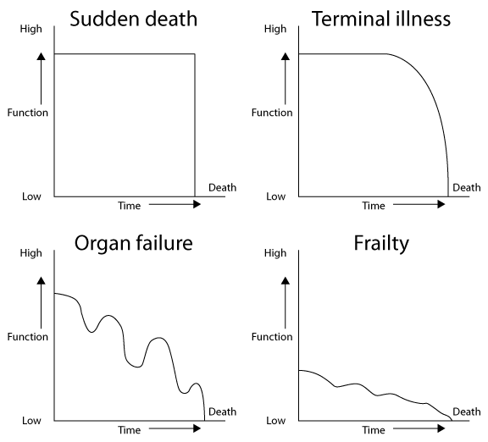

Slide 8
Physician’s Responsibilities Caring for Patients with Life Limiting Illness & Dying Patients
Communicate effectively, honestly
Understand physiologic changes
Manage symptoms
Address Advance Directives
Non‐abandonment
Educate patient, family, healthcare team
Work as a team member
Recognize, address ethical issues
Complete responsibilities after a patient dies

Slide 9
Are “we” good at taking care of seriously ill and dying patients?”

Slide 10

https://www.youtube.com/watch?v=VRkr09ZMI3w

Slide 11
Challenges…
Discomfort discussing issues related to death and dying
Death → medical “failure”
Aligning plan of care with patient goals
Advanced therapies
Decision-making
Many patients unable to make decisions as diseases progress
Communication with healthcare proxies or surrogate decision makers
Ethical issues
Patient, and family, distress
Physical, Social, Emotional, Spiritual

Slide 12

For Today
What is “Palliative Care”
What is “Hospice”
How can palliative care and hospice help my patients, and their families?
How do I deliver Serious News to a patient and/or their family?
How can I palliate pain?

